Slide 1
Keyword-based Search and Exploration on Databases
Yi Chen
Wei Wang
Ziyang Liu
Arizona State University, USA
University of New South Wales, Australia
Arizona State University, USA

Slide 2


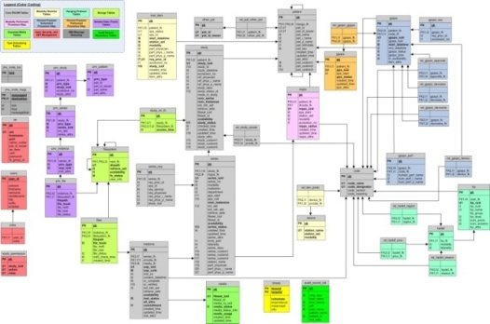
Traditional Access Methods for Databases
Relational/XML Databases are structured or semi-structured, with rich meta-data
Typically accessed by structured
query languages: SQL/XQuery
Advantages: high-quality results
Disadvantages:
Query languages: long learning curves
Schemas: Complex, evolving, or even unavailable.
select paper.title from conference c, paper p, author a1, author a2, write w1, write w2 where c.cid = p.cid AND p.pid = w1.pid AND p.pid = w2.pid AND w1.aid = a1.aid AND w2.aid = a2.aid AND a1.name = “John” AND a2.name = “John” AND c.name = SIGMOD
Small user population
“The usability of a database is as important as its capability” ^{[Jagadish, SIGMOD 07]}.

Slide 3
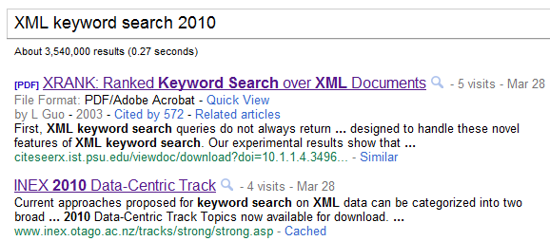
Popular Access Methods for Text
Text documents have little structure
They are typically accessed by keyword-based unstructured queries
Advantages: Large user population
Disadvantages: Limited search quality
Due to the lack of structure of both data and queries

Slide 4
Grand Challenge: Supporting Keyword Search on Databases
Can we support keyword based search and exploration on databases and achieve the best of both worlds?
Opportunities
Challenges
State of the art
Future directions

Slide 5


Opportunities /1
Easy to use, thus large user population
Share the same advantage of keyword search on text documents

Slide 6
Opportunities /2
High-quality search results
Exploit the merits of querying structured data by leveraging structural information
Query: “John, cloud”
Structured Document
Text Document
Such a result will have a low rank.
“John is a computer scientist.......... One of John’ colleagues, Mary, recently published a paper about cloud computing.”
scientist
scientist
name
publications
name
publications
John
paper
Mary
paper
title
title
XML
cloud

Slide 7
Opportunities /3
Enabling interesting/unexpected discoveries
Relevant data pieces that are scattered but are collectively relevant to the query should be automatically assembled in the results
A unique opportunity for searching DB
Text search restricts a result as a document
DB querying requires users to specify relationships between data pieces
University
Student
uid | uname
12 | UC Berkeley
sid | sname | uid
6055 | Margo Seltzer | 12
Project
Participation
Q: “Seltzer, Berkeley”
pid | pname
5 | Berkeley DB
pid | sid
5 | 6055
Is Seltzer a student at UC Berkeley?
Expected
Surprise

Slide 8



Keyword Search on DB – Summary of Opportunities
Increasing the DB usability and hence user population
Increasing the coverage and quality of keyword search

Slide 9
Keyword Search on DB- Challenges
Keyword queries are ambiguous or exploratory
Structural ambiguity
Keyword ambiguity
Result analysis difficulty
Evaluation difficulty
Efficiency

Slide 10
Challenge: Structural Ambiguity (I)
No structure specified in keyword queries
e.g. an SQL query: find titles of SIGMOD papers by John
select paper.title
from author a, write w, paper p, conference c
where a.aid = w.aid AND w.pid = p.pid AND p.cid=c.cid
AND a.name = ‘John’ AND c.name = ‘SIGMOD’
keyword query: --- no structure
Structured data: how to generate “structured queries” from keyword queries?
Infer keyword connection
e.g. “John, SIGMOD”
Find John and his paper published in SIGMOD?
Find John and his role taken in a SIGMOD conference?
Find John and the workshops organized by him associated with SIGMOD?
Return info
(projection)
Predicates
(selection, joins)
“John, SIGMOD”

Slide 11
Challenge: Structural Ambiguity (II)
Query: “John, SIGMOD”
Infer return information
e.g. Assume the user wants to find John and his SIGMOD papers
What to be returned? Paper title, abstract, author, conference year, location?
Infer structures from existing structured query templates (query forms)
suppose there are query forms designed for popular/allowed queries
which forms can be used to resolve keyword query ambiguity?
Semi-structured data: the absence of schema may prevent generating structured queries
select * from author a, write w, paper p, conference c where a.aid = w.aid AND w.pid = p.pid AND p.cid=c.cid AND a.name = $1 AND c.name = $2
Person Name
Op
Expr
Author Name
Op
Expr
Journal Name
Op
Expr
Conf Name
Op
Expr
Conf Name
Op
Expr
Workshop
Name
Op
Expr
Journal Year
Op
Expr

Slide 12
Challenge: Keyword Ambiguity
A user may not know which keywords to use for their search needs
Syntactically misspelled/unfinished words
E.g. datbase
database conf
Under-specified words
Polysemy: e.g. “Java”
Too general: e.g. “database query” --- thousands of papers
Over-specified words
Synonyms: e.g. IBM -> Lenovo
Too specific: e.g. “Honda civic car in 2006 with price $2-2.2k”
Non-quantitative queries
e.g. “small laptop” vs “laptop with weight <5lb”
Query cleaning/
auto-completion
Query refinement
Query rewriting

Slide 13
Challenge – Efficiency
Complexity of data and its schema
Millions of nodes/tuples
Cyclic / complex schema
Inherent complexity of the problem
NP-hard sub-problems
Large search space
Working with potentially complex scoring functions
Optimize for Top-k answers

Slide 14
Challenge: Result Analysis /1
How to find relevant individual results?
How to rank results based on relevance?
However, ranking functions are never perfect.
How to help users judge result relevance w/o reading (big) results?
--- Snippet generation
scientist
scientist
scientist
name
publications
name
publications
name
publications
John
paper
John
paper
Mary
paper
title
title
title
cloud
Cloud
XML
High Rank
Low Rank

Slide 15
Challenge: Result Analysis /2
In an information exploratory search, there are many relevant results
What insights can be obtained by analyzing multiple results?
How to classify and cluster results?
How to help users to compare multiple results
Eg.. Query “ICDE conferences”
Feature Type | value
conf: year | 2000
paper: title | OLAP, Data mining
Feature Type | value
conf: year | 2010
paper: title | clouds, scalability, search
ICDE 2000
ICDE 2010

Slide 16
Challenge: Result Analysis /3
Aggregate multiple results
Find tuples with the same interesting attributes that cover all keywords
Query: Motorcycle, Pool, American Food
Month | State | City | Event | Description
Dec | TX | Houston | US Open Pool | Best of 19, ranking
Dec | TX | Dallas | Cowboy’s dream run | Motorcycle, beer
Dec | TX | Austin | SPAM Museum party | Classical American food
Oct | MI | Detroit | Motorcycle Rallies | Tournament, round robin
Oct | MI | Flint | Michigan Pool Exhibition | Non-ranking, 2 days
Sep | MI | Lansing | American Food history | The best food from USA
December Texas
*
Michigan

Slide 17
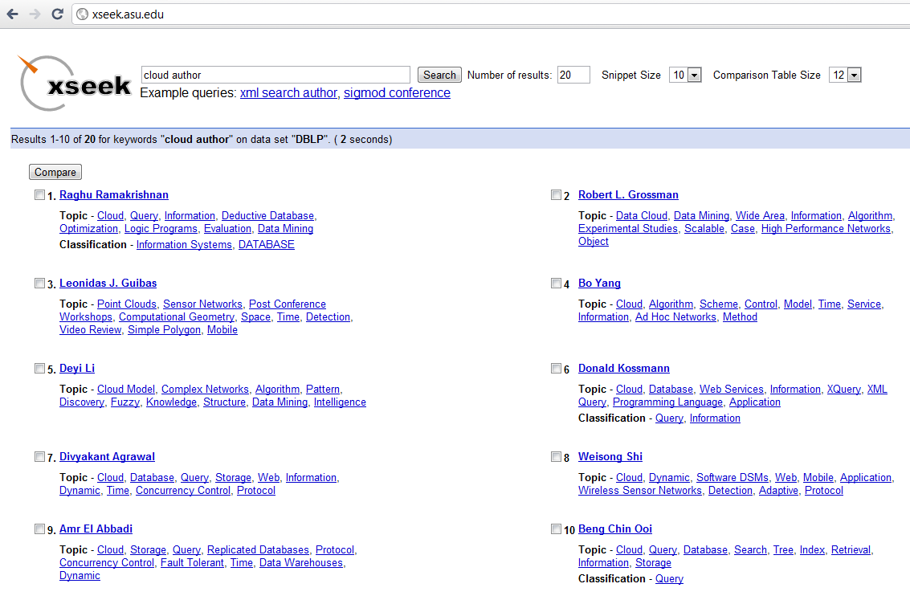
XSeek /1

Slide 18
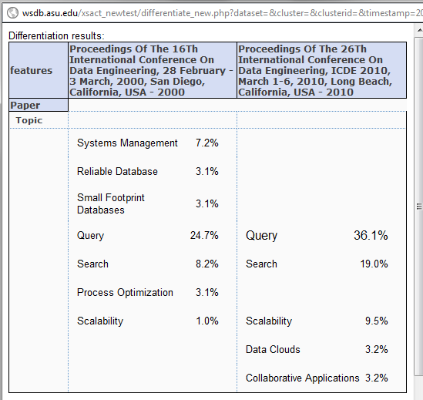
XSeek /2

Slide 19
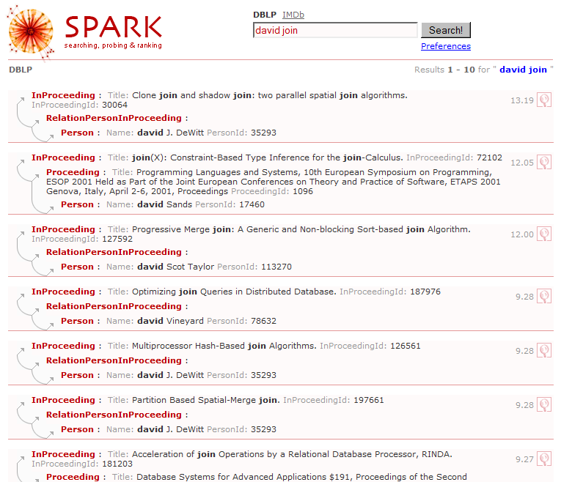
SPARK Demo /1
http://www.cse.unsw.edu.au/~weiw/project/SPARKdemo.html
After seeing the query results, the user identifies that ‘david’ should be ‘david J. Dewitt’.

Slide 20
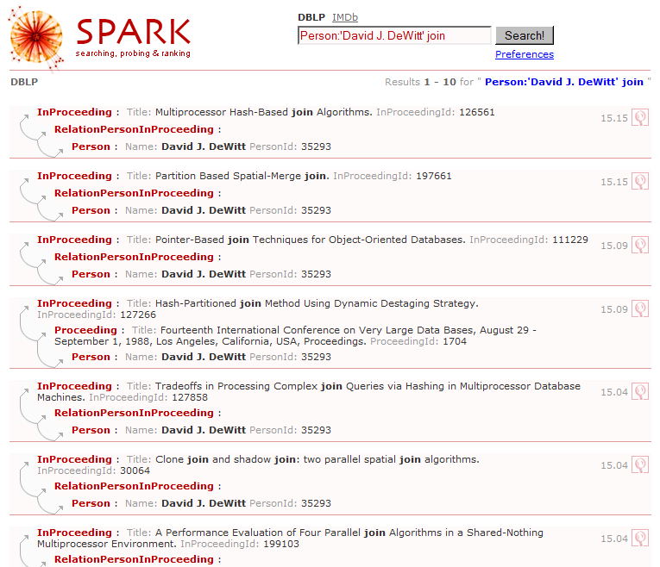
SPARK Demo /2
The user is only interested in finding all join papers written by David J. Dewitt (i.e., not the 4th result)

Slide 21
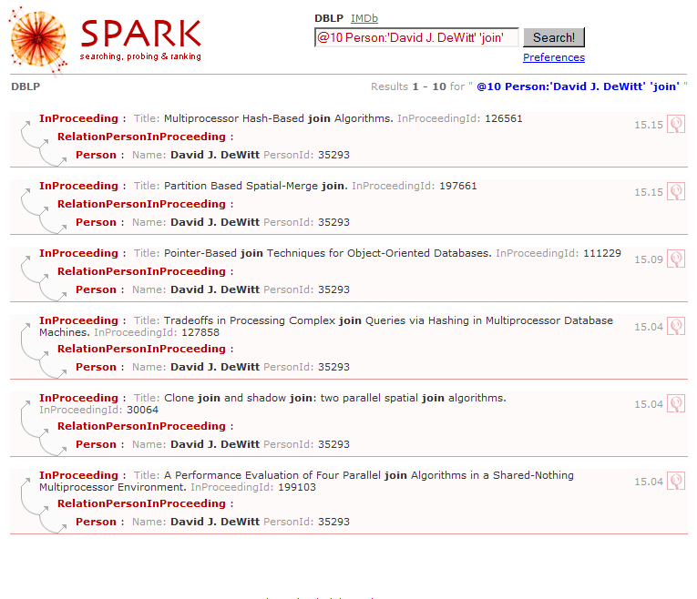
SPARK Demo /3

Slide 22
Roadmap
Related tutorials
SIGMOD’09 by Chen, Wang, Liu, Lin
VLDB’09 by Chaudhuri, Das
Motivation
Structural ambiguity
structure inference
return information inference
leverage query forms
Keyword ambiguity
query cleaning and auto-completion
query refinement
query rewriting
Covered by this tutorial only.
Evaluation
Query processing
Focus on work after 2009.
Result analysis
ranking
snippet
comparison
clustering
correlation

Slide 23
Roadmap
Motivation
Structural ambiguity
Node Connection Inference
Return information inference
Leverage query forms
Keyword ambiguity
Evaluation
Query processing
Result analysis
Future directions

Slide 24
Problem Description
Data
Relational Databases (graph), or XML Databases (tree)
Input
Query Q = <k₁, k₂, ..., k_{l}>
Output
A collection of nodes collectively relevant to Q
Predefined
Searched based on schema graph
Searched based on data graph

Slide 25
Option 1: Pre-defined Structure
Ancestor of modern KWS:
RDBMS
SELECT * FROM Movie WHERE contains(plot, “meaning of life”)
Content-and-Structure Query (CAS)
//movie[year=1999][plot ~ “meaning of life”]
Early KWS
Proximity search
Find “movies” NEAR “meaing of life”
Q: Can we remove the burden off the user?

Slide 26
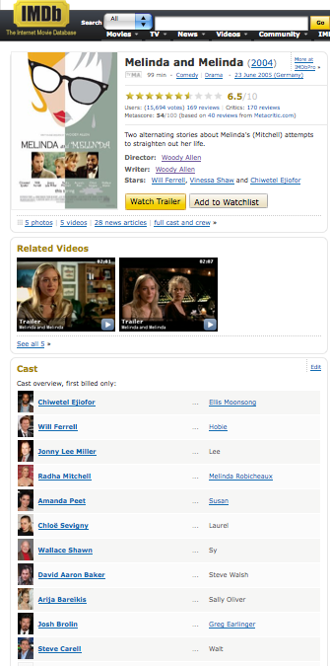
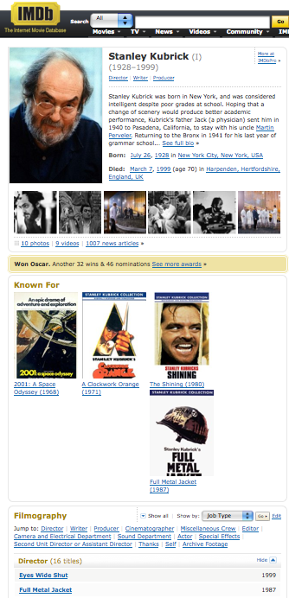

Option 1: Pre-defined Structure
QUnit ^{[Nandi & Jagadish, CIDR 09]}
“A basic, independent semantic unit of information in the DB”, usually defined by domain experts.
e.g., define a QUnit as “director(name, DOB)+ all movies(title, year) he/she directed”
Woody Allen
name
title
D_101
1935-12-01
DOB
Director
Movie
year
Match Point
B_Loc
Melinda and Melinda
Anything Else
Q: Can we remove the burden off the domain experts?
… … …

Slide 27
Option 2: Search Candidate Structures on the Schema Graph
E.g., XML ➔ All the label paths
/imdb/movie
/imdb/movie/year
/imdb/movie/name
…
/imdb/director
…
Q: Shining 1980
imdb
TV
TV
movie
movie
director
Simpsons
Friends
name
year
plot
…
name
year
plot
name
DOB
shining
1980
… …
scoop
2006
… …
W Allen
1935-12-1

Slide 28
Candidate Networks
E.g., RDBMS ➔ All the valid candidate networks (CN)
Schema Graph: A ⬅ W ➔ P
Q: Widom XML
interpretations
ID | CN
1 | A^{Q}
2 | P^{Q}
3 | A^{Q} ← W → P^{Q}
4 | A^{Q} ← W → P^{Q} ← W → A^{Q}
5 | P^{Q} ← W → A^{Q} ← W → P^{Q}
… | …
an author
an author wrote a paper
two authors wrote a single paper
an authors wrote two papers

Slide 29
Option 3: Search Candidate Structures on the Data Graph
Data modeled as a graph G
Each k_{i} in Q matches a set of nodes in G
Find small structures in G that connects keyword instances
Group Steiner Tree (GST)
Approximate Group Steiner Tree
Distinct root semantics
Subgraph-based
Community (Distinct core semantics)
EASE (r-Radius Steiner subgraph)
Graph
LCA
Tree

Slide 30
Results as Trees
k1
a
10
e
5
6
7
b
Group Steiner Tree ^{[Li et al, WWW01]}
The smallest tree that connects an instance of each keyword
top-1 GST = top-1 ST
☒NP-hard ☑Tractable for fixed l
11
k2
2
3
c
d
k3
k1
a
6
7
k2
k3
c
d
a
10
ST
GST
a (c, d): 13
5
7
k1
6
a
1M
b
11
5
2
3
b
c
d
e
k2
k3
1M
1M
1M
2
3
c
d
k1
k2
k3
a (b(c, d)): 10
30

Slide 31
Other Candidate Structures
Distinct root semantics [Kacholia et al, VLDB05] [He et al, SIGMOD 07]
Find trees rooted at r
cost(T_{r}) = ∑_{i} cost(r, match_{i})
Distinct Core Semantics ^{[Qin et al, ICDE09]}
Certain subgraphs induced by a distinct combination of keyword matches
r-Radius Steiner graph ^{[Li et al, SIGMOD08]}
Subgraph of radius ≤r that matches each k_{i} in Q less unnecessary nodes

Slide 32
Candidate Structures for XML
Any subtree that contains all keywords ➔
subtrees rooted at LCA (Lowest common ancestor) nodes
|LCA(S₁, S₂, …, S_{n})| = min(N, ∏_{I} |S_{i}|)
Many are still irrelevant or redundant ➔ needs further pruning
conf
Q = {Keyword, Mark}
name
year
paper
…
SIGMOD
2007
title
author
author
…
keyword
Mark
Chen

Slide 33
SLCA ^{[Xu et al, SIGMOD 05]}
SLCA ^{[Xu et al. SIGMOD 05]}
Min redundancy: do not allow Ancestor-Descendant relationship among SLCA results
conf
Q = {Keyword, Mark}
name
year
paper
…
paper
…
SIGMOD
2007
title
author
author
…
title
author
author
…
keyword
Mark
Chen
RDF
Mark
Zhang

Slide 34
Other ?LCAs
ELCA ^{[Guo et al, SIGMOD 03]}
Interconnection Semantics ^{[Cohen et al. VLDB 03]}
Many more ?LCAs

Slide 35
Search the Best Structure
Given Q
Many structures (based on schema)
For each structure, many results
We want to select “good” structures
Select the best interpretation
Can be thought of as bias or priors
How?
Ask user? Encode domain knowledge?
⬅ Ranking structures
⬅ Ranking results
XML
Graph
Exploit data statistics !!

Slide 36
XML
What’s the most likely interpretation
Why?
E.g., XML ➔ All the label paths
/imdb/movie
Imdb/movie/year
/imdb/movie/plot
…
/imdb/director
…
Q: Shining 1980
imdb
TV
TV
movie
movie
director
Simpsons
Friends
name
year
plot
…
name
year
plot
name
DOB
shining
1980
… …
scoop
2006
… …
W Allen
1935-12-1

Slide 37
XReal ^{[Bao et al, ICDE 09]} /1
Infer the best structured query ⋍ information need
Q = “Widom XML”
/conf/paper[author ~ “Widom”][title ~ “XML”]
Find the best return node type (search-for node type) with the highest score
/conf/paper ➔ 1.9
/journal/paper ➔ 1.2
/phdthesis/paper ➔ 0
Ensures T has the potential to match all query keywords

Slide 38
XReal ^{[Bao et al, ICDE 09]} /2
Score each instance of type T ➔ score each node
Leaf node: based on the content
Internal node: aggregates the score of child nodes
XBridge ^{[Li et al, EDBT 10]} builds a structure + value sketch to estimate the most promising return type
See later part of the tutorial

Slide 39
Entire Structure
Two candidate structures under /conf/paper
/conf/paper[title ~ “XML”][editor ~ “Widom”]
/conf/paper[title ~ “XML”][author ~ “Widom”]
Need to score the entire structure (query template)
/conf/paper[title ~ ?][editor ~ ?]
/conf/paper[title ~ ?][author ~ ?]
conf
paper
…
paper
paper
paper
title
author
editor
…
title
author
editor
title
editor
title
author
XML
Mark
Widom
XML
Widom
Whang

Slide 40
Related Entity Types ^{[Jayapandian & Jagadish, VLDB} ^{08]}
Background
Automatically design forms for a Relational/XML database instance
Relatedness of E₁ – ☁ – E₂
= [ P(E₁ → E₂) + P(E₂ → E₁) ] / 2
P(E₁ → E₂) = generalized participation ratio of E₁ into E₂
i.e., fraction of E₁ instances that are connected to some instance in E₂
What about (E₁, E₂, E₃)?
Author
Paper
Editor
P(A → P) = 5/6
P(P → A) = 1
P(E → P) = 1
P(P → E) = 0.5
P(A → P → E)
≅ P(A → P) * P(P → E)
(1/3!) *
P(E → P → A)
≅ P(E → P) * P(P → A)
4/6 != 1 * 0.5

Slide 41
NTC [Termehchy & Winslett, CIKM 09]
Specifically designed to capture correlation, i.e., how close “they” are related
Unweighted schema graph is only a crude approximation
Manual assigning weights is viable but costly (e.g., Précis ^{[Koutrika et al, ICDE06]})
Ideas
1 / degree(v) ^{[Bhalotia et al, ICDE 02]} ?
1-1, 1-n, total participation ^{[Jayapandian & Jagadish, VLDB} ^{08]}?

Slide 42
NTC [Termehchy & Winslett, CIKM 09]
Idea:
Total correlation measures the amount of cohesion/relatedness
I(P) = ∑H(P_{i}) – H(P₁, P₂, …, P_{n})
Author
Paper
Editor
 | P1 | P2 | P3 | P4
A1 |  | 1/6 | 1/6
A2
A3 | 1/6
A4 | 1/6
A5 |  |  | 1/6
A6 |  |  |  | 1/6
2/6
0
1/6
1/6
1/6
1/6
I(P) ≅ 0 ➔ statistically completely unrelated
i.e., knowing the value of one variable does not provide any clue as to the values of the other variables
2/6 | 1/6 | 2/6 | 1/6
H(A) = 2.25
H(P) = 1.92
H(A, P) = 2.58
I(A, P) = 2.25 + 1.92 – 2.58 = 1.59

Slide 43
NTC [Termehchy & Winslett, CIKM 09]
Idea:
Total correlation measures the amount of cohesion/relatedness
I(P) = ∑H(P_{i}) – H(P₁, P₂, …, P_{n})
I*(P) = f(n) * I(P) / H(P₁, P₂, …, P_{n})
f(n) = n²/(n-1)²
Rank answers based on I*(P) of their structure
i.e., independent of Q
Author
Paper
Editor
 | P1 | P2 | P3 | P4
E1 | 1/2
E2 |  |  | 1/2
1/2
1/2
1/2 | 0 | 1/2 | 0
H(E) = 1.0
H(P) = 1.0
H(A, P) = 1.0
I(E, P) = 1.0 + 1.0 – 1.0 = 1.0

Slide 44
Relational Data Graph
E.g., RDBMS ➔ All the valid candidate networks (CN)
Method | Idea
SUITS ^{[Zhou et al, 07]} | Heuristic ranking or ask users
IQ^{P [Demidova et al, TKDE 11]} | Auto score keyword binding + heuristic score structure
Probabilistic scoring ^{[Petkova et al, ECIR 09]} | Auto score keyword binding + structure
Schema Graph: A ⬅ W ➔ P
Q: Widom XML
ID | CN
3 | A^{Q} ← W → P^{Q}
4 | A^{Q} ← W → P^{Q} ← W → A^{Q}
5 | P^{Q} ← W → A^{Q} ← W → P^{Q}
… | …
an author wrote a paper
two authors wrote a single paper

Slide 45
SUITS ^{[Zhou et al, 2007]}
Rank candidate structured queries by heuristics
The (normalized) (expected) results should be small
Keywords should cover a majority part of value of a binding attribute
Most query keywords should be matched
GUI to help user interactively select the right structural query
Also c.f., ExQueX [Kimelfeld et al, SIGMOD 09]
Interactively formulate query via reduced trees and filters

Slide 46
IQ^{P} ^{[Demidova et al, TKDE11]}
Structural query = keyword bindings + query template
Pr[A, T | Q] ∝ Pr[A | T] * Pr[T] = ∏_{I} Pr[Ai | T] * Pr[T]
Query template
Author ← Write → Paper
Keyword
Binding 1 (A₁)
Keyword
Binding 2 (A₂)
“Widom”
“XML”
Probability of keyword bindings
Estimated from Query Log
Q: What if no query log?

Slide 47
Probabilistic Scoring ^{[Petkova et al, ECIR 09]} /1
List and score all possible bindings of (content/structural) keywords
Pr(path[~“w”]) = Pr[~“w” | path] = p_{LM}[“w” | doc(path)]
Generate high-probability combinations from them
Reduce each combination into a valid XPath Query by applying operators and updating the probabilities
Aggregation
Specialization
//a[~“x”] + //a[~“y”] ➔ //a[~ “x y”]
Pr = Pr(A) * Pr(B)
//a[~“x”] ➔ //b//a[~ “x”]
Pr = Pr[//a is a descendant of //b] * Pr(A)

Slide 48
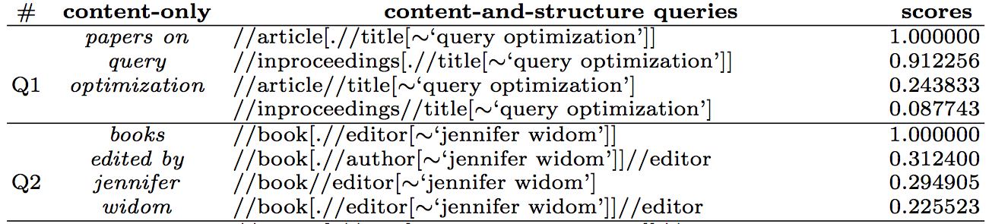
Probabilistic Scoring ^{[Petkova et al, ECIR 09]} /2
Reduce each combination into a valid XPath Query by applying operators and updating the probabilities
Nesting
Keep the top-k valid queries (via A* search)
//a + //b[~“y”] ➔ //a//b[~ “y”], //a[//b[~“y”]]
Pr’s = IG(A) * Pr[A] * Pr(B), IG(B) * Pr[A] * Pr[B]

Slide 49
Summary
Traditional methods: list and explore all possibilities
New trend: focus on the most promising one
Exploit data statistics!
Alternatives
Method based on ranking/scoring data subgraph (i.e., result instances)

Slide 50
Roadmap
Motivation
Structural ambiguity
Node connection inference
Return information inference
Leverage query forms
Keyword ambiguity
Evaluation
Query processing
Result analysis
Future directions

Slide 51
Identifying Return Nodes ^{[Liu and Chen SIGMOD 07]}
Similar as SQL/XQuery, query keywords can specify
predicates (e.g. selections and joins)
return nodes (e.g. projections)
Q1: “John, institution”
Return nodes may also be implicit
Q2: “John, Univ of Toronto” → return node = “author”
Implicit return nodes: Entities involved in results
XSeek infers return nodes by analyzing
Patterns of query keyword matches: predicates, explicit return nodes
Data semantics: entity, attributes

Slide 52
Fine Grained Return Nodes Using Constraints ^{[Koutrika et al. 06]}
E.g. Q3: “John, SIGMOD”
multiple entities with many attributes are involved
which attributes should be returned?
Returned attributes are determined based on two user/admin-specified constraints:
Maximum number of attributes in a result
Minimum weight of paths in result schema.
If minimum weight = 0.4 and table person is returned, then attribute sponsor will not be returned since path: person->review->conference->sponsorhas a weight of 0.8*0.9*0.5 = 0.36.
pname
…
name
year
…
sponsor
1
1
0.5
1
0.8
0.9
person
review
conference

Slide 53
Roadmap
Motivation
Structural ambiguity
Node connection inference
Return information inference
Leverage query forms
Keyword ambiguity
Evaluation
Query processing
Result analysis
Future directions

Slide 54
Combining Query Forms and Keyword Search ^{[Chu et al. SIGMOD 09]}
Inferring structures for keyword queries are challenging
Suppose we have a set of Query Forms, can we leverage them to obtain the structure of a keyword query accurately?
What is a Query Form?
An incomplete SQL query (with joins)
selections to be completed by users
which author publishes which paper
SELECT *
FROM author A, paper P, write W
WHERE W.aid = A.id AND W.pid = P.id AND A.name op expr AND P.title op expr
Author Name
Op
Expr
Paper Title
Op
Expr

Slide 55
Challenges and Problem Definition
Challenges
How to obtain query forms?
How many query forms to be generated?
Fewer Forms - Only a limited set of queries can be posed.
More Forms – Which one is relevant?
Problem definition
OFFLINE
Input: Database Schema
Output: A set of Forms
Goal: cover a majority of potential queries
ONLINE
Input: Keyword Query
Output: a ranked List of Relevant Forms, to be filled by the user

Slide 56
Offline: Generating Forms
Step 1: Select a subset of “skeleton templates”, i.e., SQL with only table names and join conditions.
Step 2: Add predicate attributes to each skeleton template to get query forms; leave operator and expression unfilled.
SELECT * FROM author A, paper P, write W WHERE W.aid = A.id AND W.pid = P.id
AND A.name op expr AND P.title op expr
semantics: which person writes which paper

Slide 57
Online: Selecting Relevant Forms
Generate all queries by replacing some keywords with schema terms (i.e. table name).
Then evaluate all queries on forms using AND semantics, and return the union.
e.g., “John, XML” will generate 3 other queries:
“Author, XML”
“John, paper”
“Author, paper”

Slide 58
Online: Form Ranking and Grouping
Forms are ranked based on typical IR ranking metrics for documents (Lucene Index)
Since many forms are similar, similar forms are grouped. Two level form grouping:
First, group forms with the same skeleton templates.
e.g., group 1: author-paper; group 2: co-author, etc.
Second, further split each group based on query classes (SELECT, AGGR, GROUP, UNION-INTERSECT)
e.g., group 1.1: author-paper-AVG; group 1.2: author-paper-INTERSECT, etc.

Slide 59
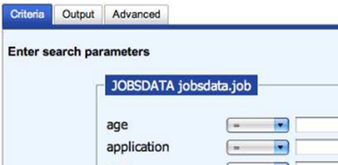
Generating Query Forms [Jayapandian and Jagadish PVLDB08]
Motivation:
How to generate “good” forms?
i.e. forms that cover many queries
What if query log is unavailable?
How to generate “expressive” forms?
i.e. beyond joins and selections
Problem definition
Input: database, schema/ER diagram
Output: query forms that maximally cover queries with size constraints
Challenge:
How to select entities in the schema to compose a query form?
How to select attributes?
How to determine input (predicates) and output (return nodes)?

Slide 60
Queriability of an Entity Type
Intuition
If an entity node is likely to be visited through data browsing/navigation, then it’s likely to appear in a query
Queriability estimated by accessibility in navigation
Adapt the PageRank model for data navigation
PageRank measures the “accessibility” of a data node (i.e. a page)
A node spreads its score to its outlinks equally
Here we need to measure the score of an entity type
Spread weight from n to its outlinks m is defined as:
normalized by weights of all outlinks of n
e.g. suppose: inproceedings , articles → authors
if in average an author writes more conference papers than articles
then inproceedings has a higher weight for score spread to author (than artilcle)

Slide 61
Queriability of Related Entity Types
Intuition: related entities may be asked together
Queriability of two related entities depends on:
Their respective queriabilities
The fraction of one entity’s instances that are connected to the other entity’s instances, and vice versa.
e.g., if paper is always connected with author but not necessarily editor, then queriability (paper, author) > queriability (paper, editor)

Slide 62
Queriability of Attributes
Intuition: frequently appeared attributes of an entity are important
Queriability of an attribute depends on its number of (non-null) occurrences in the data with respect to its parent entity instances.
e.g., if every paper has a title, but not all papers have indexterm, then queriability(title) > queriability (indexterm).

Slide 63
Operator-Specific Queriability of Attributes
Expressive forms with many operators
Operator-specific queryability of an attribute: how likely the attribute will be used for this operator
Highly selective attributes → Selection
Intuition: they are effective in identifying entity instances
e.g., author name
Text field attributes → Projections
Intuition: they are informative to the users
e.g., paper abstract
Single-valued and mandatory attributes → Order By:
e.g., paper year
Repeatable and numeric attributes → Aggregation.
e.g., person age
Selected entity, related entities, their attributes with suitable operators query forms

Slide 64
QUnit ^{[Nandi & Jagadish, CIDR 09]}
Define a basic, independent semantic unit of information in the DB as a QUnit.
Similar to forms as structural templates.
Materialize QUnit instances in the data.
Use keyword queries to retrieve relevant instances.
Compared with query forms
QUnit has a simpler interface.
Query forms allows users to specify binding of keywords and attribute names.

Slide 65
Roadmap
Motivation
Structural ambiguity
Keyword ambiguity
Query cleaning and auto-completion
Query refinement
Query rewriting
Evaluation
Query processing
Result analysis
Future directions

Slide 66
Spelling Correction
Noisy Channel Model
Intended Query (C)
Noisy channel
Observed Query (Q)
C₁ = ipad
Q = ipd
Variants(k₁)
C₂ = ipod
Error model
Query generation
(prior)

Slide 67
Keyword Query Cleaning ^{[Pu & Yu, VLDB 08]}
Hypotheses = Cartesian product of variants(k_{i})
Error model:
Prior:
k_{i} | Confusion Set (k_{i})
Appl | {Appl, Apple}
ipd | {ipd, ipad, ipod}
nan | {nan, nano}
2*3*2 hypotheses:
{Appl ipd nan,
Apple ipad nano,
Apple ipod nano,
… … }
att | {att, at&t}
Prevent
fragmentation
= 0 due to DB normalization
What if “at&t” in another table ?

Slide 68
Segmentation
Both Q and Ci consists of multiple segments (each backed up by tuples in the DB)
Q = { Appl ipd } { att }
C₁ = { Apple ipad } { at&t }
How to obtain the segmentation?
Pr₁
Pr₂
Maximize Pr₁*Pr₂
Why not Pr_{1’}*Pr_{2’} *Pr_{3’} ?
Efficient computation using (bottom-up) dynamic programming
?
?
?
?
?
?
?
?
?
?
?
… … …
?
?
?
?

Slide 69
XClean ^{[Lu et al, ICDE 11]} /1
Noisy Channel Model for XML data T
Error model:
Query generation model:
Error model
Query generation model
Lang. model
Prior

Slide 70
XClean ^{[Lu et al, ICDE 11]} /2
Advantages:
Guarantees the cleaned query has non-empty results
Not biased towards rare tokens
Query | adventurecome ravel diiry
XClean | adventuresome travel diary
Google | adventure come travel diary
[PY08] | adventuresome rävel dairy

Slide 71
Auto-completion
Auto-completion in search engines
traditionally, prefix matching
now, allowing errors in the prefix
c.f., Auto-completion allowing errors [Chaudhuri & Kaushik, SIGMOD 09]
Auto-completion for relational keyword search
TASTIER ^{[Li et al, SIGMOD 09]}: 2 kinds of prefix matching semantics

Slide 72
TASTIER ^{[Li et al, SIGMOD 09]}
Q = {srivasta, sig}
Treat each keyword as a prefix
E.g., matches papers by srivastava published in sigmod
Idea
Index every token in a trie ➔ each prefix corresponds to a range of tokens
Candidate = tokens for the smallest prefix
Use the ranges of remaining keywords (prefix) to filter the candidates
With the help of δ-step forward index

Slide 73
Example
…
sig
srivasta
…
v
r
k74
a
sigact
Q = {srivasta, sig}
Candidates = I(srivasta) = {11,12, 78}
Range(sig) = [k23, k27]
After pruning, Candidates = {12} ➔ grow a Steiner tree around it
Also uses a hyper-graph-based graph partitioning method
k23
…
k27
k73
sigweb
{11, 12}
Node | Keywords Reachable within δ Steps
… | …
11 | k2, k14, k22, k31
12 | k5, k25, k75
… | …
78 | k101, k237
{78}

Slide 74
Roadmap
Motivation
Structural ambiguity
Keyword ambiguity
Query cleaning and auto-completion
Query refinement
Query rewriting
Evaluation
Query processing
Result analysis
Future directions

Slide 75
Query Refinement: Motivation and Solutions
Motivation:
Sometimes lots of results may be returned
With the imperfection of ranking function, finding relevant results is overwhelming to users
Question: How to refine a query by summarizing the results of the original query?
Current approaches
Identify important terms in results
Cluster results
Classify results by categories – Faceted Search

Slide 76
Data Clouds ^{[Koutrika et al. EDBT 09]}
Goal: Find and suggest important terms from query results as expanded queries.
Input: Database, admin-specified entities and attributes, query
Attributes of an entity may appear in different tables
E.g., the attributes of a paper may include the information of its authors.
Output: Top-K ranked terms in the results, each of which is an entity and its attributes.
E.g., query = “XML”
Each result is a paper with attributes title, abstract, year, author name, etc.
Top terms returned: “keyword”, “XPath”, “IBM”, etc.
Gives users insight about papers about XML.

Slide 77
Ranking Terms in Results
Popularity based:
in all results.
However, it may select very general terms, e.g., “data”
Relevance based:
for all results E
Result weighted
for all results E
How to rank results Score(E)?
Traditional TF*IDF does not take into account the attribute weights.
e.g., course title is more important than course description.
Improved TF: weighted sum of TF of attribute.

Slide 78
Frequent Co-occurring Terms^{[Tao et al. EDBT 09]}
Can we avoid generating all results first?
Input: Query
Output: Top-k ranked non-keyword terms in the results.
Capable of computing top-k terms efficiently without even generating results.
Terms in results are ranked by frequency.
Tradeoff of quality and efficiency.

Slide 79
Query Refinement: Motivation and Solutions
Motivation:
Sometimes lots of results may be returned
With the imperfection of ranking function, finding relevant results is overwhelming to users
Question: How to refine a query by summarizing the results of the original query?
Current approaches
Identify important terms in results
Cluster results
Classify results by categories – Faceted Search

Slide 80
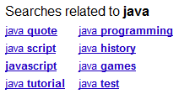

Summarizing Results for Ambiguous Queries
Query words may be polysemy
It is desirable to refine an ambiguous query by its distinct meanings
All suggested queries are about “Java” programming language

Slide 81
Motivation Contd.
Goal: the set of expanded queries should provide a categorization of the original query results.
“Java”
Java band
Ideally: Result(Qi) = Ci
Java language
Java island
c3
c1
c2
Java band formed in Paris.…..
….OO Language
...
….is an island of Indonesia…..
….Java software platform…..
….there are three languages…
...
…active from 1972 to 1983…..
….developed at Sun
…
….has four provinces….
….Java applet…..
Result (Q1)
Q1 does not retrieve all results in C1, and retrieves results in C2.
How to measure the quality of expanded queries?

Slide 82
Query Expansion Using Clusters
Input: Clustered query results
Output: One expanded query for each cluster, such that each expanded query
Maximally retrieve the results in its cluster (recall)
Minimally retrieve the results not in its cluster (precision)
Hence each query should aim at maximizing F-measure.
This problem is APX-hard
Efficient heuristics algorithms have been developed.

Slide 83
Query Refinement: Motivation and Solutions
Motivation:
Sometimes lots of results may be returned
With the imperfection of ranking function, finding relevant results is overwhelming to users
Question: How to refine a query by summarizing the results of the original query?
Current approaches
Identify important terms in results
Cluster results
Classify results by categories – Faceted Search

Slide 84
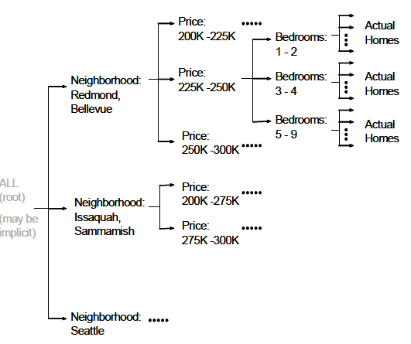
Faceted Search ^{[Chakrabarti et al. 04]}
facet
facet condition
Allows user to explore the classification of results
Facets: attribute names
Facet conditions: attribute values
By selecting a facet condition, a refined query is generated
Challenges:
How to determine the nodes?
How to build the navigation tree?

Slide 85
How to Determine Nodes -- Facet Conditions
Categorical attributes:
A value → a facet condition
Ordered based on how many queries hit each value.
Numerical attributes:
A value partition →a facet condition
Partition is based on historical queries
If many queries has predicates that starts or ends at x, it is good to partition at x

Slide 86
How to Construct Navigation Tree
Input: Query results, query log.
Output: a navigational tree, one facet at each level, Minimizing user’s expected navigation cost for finding the relevant results.
Challenge:
How to define cost model?
How to estimate the likelihood of user actions?

Slide 87
User Actions
proc(N): Explore the current node N
showRes(N): show all tuples that satisfy N
expand(N): show the child facet of N
readNext(N): read all values of child facet of N
Ignore(N)
apt 1, apt2, apt3…
showRes
neighborhood: Redmond, Bellevue
expand
price: 200-225K
price: 225-250K
price: 250-300K

Slide 88
Navigation Cost Model
How to estimate the involved probabilities?
ICDE 2011Tutorial
88

Slide 89
Estimating Probabilities /1
p(expand(N)): high if many historical queries involve the child facet of N
p(showRes (N)): 1 – p(expand(N))

Slide 90
Estimating Probabilities/2
p(proc(N)): User will process N if and only if user processes and chooses to expand N’s parent facet, and thinks N is relevant.
P(N is relevant) = the percentage of queries in query log that has a selection condition overlapping N.

Slide 91
Algorithm
Enumerating all possible navigation trees to find the one with minimal cost is prohibitively expensive.
Greedy approach:
Build the tree from top-down. At each level, a candidate attribute is the attribute that doesn’t appear in previous levels.
Choose the candidate attribute with the smallest navigation cost.

Slide 92
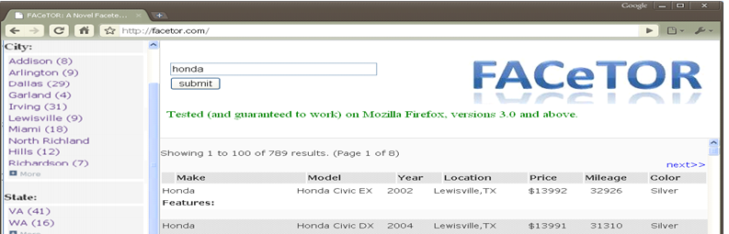
Facetor ^{[Kashyap et al. 2010]}
Input: query results, user input on facet interestingness
Output: a navigation tree, with set of facet conditions (possibly from multiple facets) at each level,
minimizing the navigation cost
EXPAND
SHOWRESULT
SHOWMORE

Slide 93
Facetor ^{[Kashyap et al. 2010]} /2
Different ways to infer probabilities:
p(showRes): depends on the size of results and value spread
p(expand): depends on the interestingness of the facet, and popularity of facet condition
p(showMore): if a facet is interesting and no facet condition is selected.
Different cost models

Slide 94
Roadmap
Motivation
Structural ambiguity
Keyword ambiguity
Query cleaning and auto-completion
Query refinement
Query rewriting
Evaluation
Query processing
Result analysis
Future directions

Slide 95
Effective Keyword-Predicate Mapping ^{[Xin et al. VLDB 10]}
Keyword queries
are non-quantitative
may contain synonyms
E.g. small IBM laptop
Handling such queries directly may result in low precision and recall
Low Precision
Low Recall
ID | Product Name | BrandName | Screen Size | Description
1 | ThinkPad T60 | Lenovo | 14 | The IBM laptop...small business…
2 | ThinkPad X40 | Lenovo | 12 | This notebook...

Slide 96
Problem Definition
Input: Keyword query Q, an entity table E
Output: CNF (Conjunctive Normal Form) SQL query Tσ(Q) for a keyword query Q
E..g
Input: Q = small IBM laptop
Output: Tσ(Q) =
SELECT *
FROM Table
WHERE BrandName = ‘Lenovo’ AND ProductDescription LIKE ‘%laptop%’ ORDER BY ScreenSize ASC

Slide 97
Key Idea
To “understand” a query keyword, compare two queries that differ on this keyword, and analyze the differences of the attribute value distribution of their results
e.g., to understand keyword “IBM”, we can compare the results of
q1: “IBM laptop”
q2: “laptop”

Slide 98

Differential Query Pair (DQP)
For reliability and efficiency for interpreting keyword k, it uses all query pairs in the query log that differ by k.
DQP with respect to k:
foreground query Qf
background query Qb
Qf = Qb U {k}

Slide 99
Analyzing Differences of Results of DQP
To analyze the differences of the results of Q_{f} and Q_{b} on each attribute value, use well-known correlation metrics on distributions
Categorical values: KL-divergence
Numerical values: Earth Mover’s Distance
E.g. Consider attribute Brand: Lenovo
Qb = [IBM laptop] Returns 50 results, 30 of them have “Brand:Lenovo”
Qf = [laptop] Returns 500 results, only 50 of them have “Brand:Lenovo”
The difference on “Brand: Lenovo” is significant, thus reflecting the “meaning” of “IBM”
For keywords mapped to numerical predicates, use order by clauses
e.g., “small” can be mapped to “Order by size ASC”
Compute the average score of all DQPs for each keyword k

Slide 100
Query Translation
Step 1: compute the best mapping for each keyword k in the query log.
Step 2: compute the best segmentation of the query.
Linear-time Dynamic programming.
Suppose we consider 1-gram and 2-gram
To compute best segmentation of t₁,…t_{n-2}, t_{n-1}, t_{n}:
t₁,…t_{n-2}, t_{n-1}, t_{n}
Option 1
Option 2
(t₁,…t_{n-2}, t_{n-1}), {t_{n}}
(t₁,…t_{n-2}), {t_{n-1}, t_{n}}
Recursively computed.

Slide 101
Query Rewriting Using Click Logs ^{[Cheng et al. ICDE 10]}
Motivation: the availability of query logs can be used to assess “ground truth”
Problem definition
Input: query Q, query log, click log
Output: the set of synonyms, hypernyms and hyponyms for Q.
E.g. “Indiana Jones IV” vs “Indian Jones 4”
Key idea: find historical queries whose “ground truth” significantly overlap the top k results of Q, and use them as suggested queries

Slide 102
Query Rewriting using Data Only ^{[Nambiar and} ^{Kambhampati ICDE 06]}
Motivation:
A user that searches for low-price used “Honda civic” cars might be interested in “Toyota corolla” cars
How to find that “Honda civic” and “Toyota corolla” cars are “similar” using data only?
Key idea
Find the sets of tuples on “Honda” and “Toyota”, respectively
Measure the similarities between this two sets

Slide 103
Roadmap
Motivation
Structural ambiguity
Keyword ambiguity
Evaluation
Query processing
Result analysis
Future directions

Slide 104
INEX - INitiative for the Evaluation of XML Retrieval
Benchmarks for DB: TPC, for IR: TREC
A large-scale campaign for the evaluation of XML retrieval systems
Participating groups submit benchmark queries, and provide ground truths
Assessor highlight relevant data fragments as ground truth results
http://inex.is.informatik.uni-duisburg.de/

Slide 105
INEX
Data set: IEEE, Wikipeida, IMDB, etc.
Measure:
Assume user stops reading when there are too many consecutive non-relevant result fragments.
Score of a single result: precision, recall, F-measure
Precision: % of relevant characters in result
Recall: % of relevant characters retrieved.
F-measure: harmonic mean of precision and recall
Result
Read by user (D)
Tolerance
Ground truth
D
P1
P2
P3

Slide 106
INEX
Measure:
Score of a ranked list of results: average generalized precision (AgP)
Generalized precision (gP) at rank k: the average score of the first r results returned.
Average gP(AgP): average gP for all values of k.

Slide 107
Axiomatic Framework for Evaluation
Formalize broad intuitions as a collection of simple axioms and evaluate strategies based on the axioms.
It has been successful in many areas, e.g. mathematical economics, clustering, location theory, collaborative filtering, etc
Compared with benchmark evaluation
Cost-effective
General, independent of any query, data set

Slide 108
Axioms ^{[Liu et al. VLDB 08]}
Axioms for XML keyword search have been proposed for identifying relevant keyword matches
Challenge: It is hard or impossible to “describe” desirable results for any query on any data
Proposal: Some abnormal behaviors can be identified when examining results of two similar queries or one query on two similar documents produced by the same search engine.
Assuming “AND” semantics
Four axioms
Data Monotonicity
Query Monotonicity
Data Consistency
Query Consistency

Slide 109
Violation of Query Consistency
Q1: paper, Mark
conf
Q2: SIGMOD, paper, Mark
name
year
paper
paper
demo
SIGMOD
2007
title
author
author
…
title
author
author
title
author
keyword
name
name
XML
name
name
Top-k
name
Mark
Yang
Liu
Chen
Soliman
An XML keyword search engine that considers this subtree as irrelevant for Q1, but relevant for Q2 violates query consistency .
Query Consistency: the new result subtree contains the new query keyword.

Slide 110
Roadmap
Motivation
Structural ambiguity
Keyword ambiguity
Evaluation
Query processing
Result analysis
Future directions

Slide 111
Efficiency in Query Processing
Query processing is another challenging issue for keyword search systems
Inherent complexity
Large search space
Work with scoring functions
Performance improving ideas
Query processing methods for XML KWS

Slide 112
1. Inherent Complexity
RDMBS / Graph
Computing GST-1: NP-complete & NP-hard to find (1+ε)-approximation for any fixed ε > 0
XML / Tree
# of ?LCA nodes = O(min(N, Π_{i} n_{i}))

Slide 113
Specialized Algorithms
Top-1 Group Steiner Tree
Dynamic programming for top-1 (group) Steiner Tree ^{[Ding et al, ICDE07]}
MIP ^{[Talukdar et al, VLDB08]} use Mixed Linear Programming to find the min Steiner Tree (rooted at a node r)
Approximate Methods
STAR ^{[Kasneci et al, ICDE 09]}
4(log n + 1) approximation
Empirically outperforms other methods

Slide 114
Specialized Algorithms
Approximate Methods
BANKS I ^{[Bhalotia et al, ICDE02]}
Equi-distance expansion from each keyword instances
Found one candidate solution when a node is found to be reachable from all query keyword sources
Buffer enough candidate solution to output top-k
BANKS II ^{[Kacholia et al, VLDB05]}
Use bi-directional search + activation spreading mechanism
BANKS III ^{[Dalvi et al, VLDB08]}
Handles graphs in the external memory

Slide 115
2. Large Search Space
ID | CN
1 | P^{Q}
2 | C^{Q}
3 | P^{Q} ← C^{Q}
4 | C^{Q} → P^{Q} ← C^{Q}
5 | C^{Q} → U ← C^{Q}
6 | C^{Q} → P ← C^{Q}
7 | C^{Q} → U ← C^{Q} ← P^{Q}
… | …
Typically thousands of CNs
SG: Author, Write, Paper, Cite
➔ ≅0.2M CNs, >0.5M Joins
Solutions
Efficient generation of CNs
Breadth-first enumeration on the schema graph [Hristidis et al, VLDB 02] [Hristidis et al, VLDB 03]
Duplicate-free CN generation [Markowetz et al, SIGMOD 07] [Luo 2009]
Other means (e.g., combined with forms, pruning CNs with indexes, top-k processing)
Will be discussed later

Slide 116
3. Work with Scoring Functions
top-2
Top-k query processing
Discover 2 ^{[Hristidis et al, VLDB 03]}
Naive
Retrieve top-k results from all CNs
Sparse
Retrieve top-k results from each CN in turn.
Stop ASAP
Single Pipeline
Perform a slice of the CN each time
Stop ASAP
Global pipeline
ID | CN
1 | P^{Q} ← W → A^{Q}
2 | P^{Q} ← W → A^{Q} ← W → P^{Q}
Result (CN1) | Score
P1-W1-A2 | 3.0
P2-W5-A3 | 2.3
... | ...
Result (CN2) | Score
P2-W2-A1-W3-P7 | 1.0
P2-W9-A5-W6-P8 | 0.6
... | ...
Requiring monotonic scoring function

Slide 117
Working with Non-monotonic Scoring Function
Result (CN1) | Score
P1 – W – A1 | 3.0
P2 – W – A3 | 2.3
... | ...
?
SPARK ^{[Luo et al, SIGMOD 07]}
Why non-monotonic function
P₁^{k1} – W – A₁^{k1}
P₂^{k1} – W – A₃^{k2}
Solution
sort P_{i} and A_{j} in a salient order
watf(tuple) works for SPARK’s scoring function
Skyline sweeping algorithm
Block pipeline algorithm
10.0
Score(P1) > Score(P2) > …

Slide 118
Efficiency in Query Processing
Query processing is another challenging issue for keyword search systems
Inherent complexity
Large search space
Work with scoring functions
Performance improving ideas
Query processing methods for XML KWS

Slide 119
Performance Improvement Ideas
Keyword Search + Form Search ^{[Baid et al, ICDE 10]}
idea: leave hard queries to users
Build specialized indexes
idea: precompute reachability info for pruning
Leverage RDBMS ^{[Qin et al, SIGMOD 09]}
Idea: utilizing semi-join, join, and set operations
Explore parallelism / Share computaiton
Idea: exploit the fact that many CNs are overlapping substantially with each other

Slide 120
Selecting Relevant Query Forms ^{[Chu et al. SIGMOD 09]}
Idea
Run keyword search for a preset amount of time
Summarize the rest of unexplored & incompletely explored search space with forms
easy queries
hard queries

Slide 121
Specialized Indexes for KWS
Graph reachability index
Proximity search ^{[Goldman et al, VLDB98]}
Special reachability indexes
BLINKS ^{[He et al, SIGMOD 07]}
Reachability indexes ^{[Markowetz et al, ICDE 09]}
TASTIER ^{[Li et al, SIGMOD 09]}
Leveraging RDBMS ^{[Qin et al,} ^{SIGMOD09]}
Index for Trees
Dewey, JDewey [Chen & Papakonstantinou, ICDE 10]
Over the
entire graph
Local neighbor-
hood

Slide 122
Proximity Search ^{[Goldman et al, VLDB98]}
H
Index node-to-node min distance
O(|V|²) space is impractical
Select hub nodes (H_{i}) – ideally balanced separators
d*(u, v) records min distance between u and v without crossing any H_{i}
Using the Hub Index
y
x
d(x, y) = min( d*(x, y), d*(x, A) + d^{H}(A, B) + d*(B, y), ∀A, B ∈H )

Slide 123
BLINKS ^{[He et al, SIGMOD 07]}
r_{i}
d1=5
d2=6
d1’=3
r_{j}
d2’ =9
SLINKS ^{[He et al, SIGMOD 07]} indexes node-to-keyword distances
Thus O(K*|V|) space ≈ O(|V|²) in practice
Then apply Fagin’s TA algorithm
BLINKS
Partition the graph into blocks
Portal nodes shared by blocks
Build intra-block, inter-block, and keyword-to-block indexes
r | d1 | d2
r_{i} | 5 | 6
r_{j} | 3 | 9

Slide 124
D-Reachability Indexes ^{[Markowetz et al, ICDE 09]}
Precompute various reachability information
with a size/range threshold (D) to cap their index sizes
Node ➔ Set(Term) (N2T)
(Node, Relation) ➔ Set(Term) (N2R)
(Node, Relation) ➔ Set(Node) (N2N)
(Relation1, Term, Relation2) ➔ Set(Term) (R2R)
Prune partial solutions
Prune CNs
Proximity Search | Node ➔ (Hub, dist)
SLINKS | Node ➔ (Keyword, dist)

Slide 125
TASTIER ^{[Li} ^{et al, SIGMOD 09]}
Precompute various reachability information
with a size/range threshold to cap their index sizes
Node ➔ Set(Term) (N2T)
(Node, dist) ➔ Set(Term) (δ-Step Forward Index)
Also employ trie-based indexes to
Support prefix-match semantics
Support query auto-completion (via 2-tier trie)
Prune partial solutions

Slide 126
Leveraging RDBMS ^{[Qin et al,} ^{SIGMOD09]}
Goal:
Perform all the operations via SQL
Semi-join, Join, Union, Set difference
Steiner Tree Semantics
Semi-joins
Distinct core semantics
Pairs(n1, n2, dist), dist ≤ D_{max}
S = Pairs_{k1}(x, a, i) ⋈_{x} Pairs_{k2}(x, b, j)
Ans = S GROUP BY (a, b)
x
a
b
…

Slide 127
Leveraging RDBMS ^{[Qin et al,} ^{SIGMOD09]}
How to compute Pairs(n1, n2, dist) within RDBMS?
Can use semi-join idea to further prune the core nodes, center nodes, and path nodes
T
R
S
x
s
r
Pairs_{S}(s, x, i) ⋈ R ➔ Pairs_{R}(r, x, i+1)
Min_{dist} Pairs_{R}(r, x, 0) U
Pairs_{R}(r, x, 1) U
…
Pairs_{R}(r, x, D_{max})
Pairs_{T}(t, y, i) ⋈ R ➔ Pairs_{R}(r’, y, i+1)
Also propose more efficient alternatives

Slide 128
Other Kinds of Index
EASE ^{[Li et al, SIGMOD 08]}
(Term1, Term2) ➔ (maximal r-Radius Graph, sim)
Summary
Index | Mapping
Proximity Search | Node ➔ (Hub, dist)
SLINKS | Node ➔ (Keyword, dist)
N2T | Node ➔ (Keyword, Y/N) | D
N2R | (Node, R) ➔ (Keyword, Y/N) |D
N2N | (Node, R) ➔ (Node, Y/N) | D
R2R | (R1, Keyword, R2) ➔ (Keyword, Y/N) |D
^{[Qin et al, SIGMOD09]} | Node ➔ (Node, dist) | D_{max}
EASE | (K1, K2) ➔ (maximal r-SG, sim) |r

Slide 129
Multi-query Optimization
Issues: A keyword query generates too many SQL queries
Solution 1: Guess the most likely SQL/CN
Solution 2: Parallelize the computation
^{[Qin et al, VLDB 10]}
Solution 3: Share computation
Operator Mesh [^{[Markowetz et al, SIGMOD 07]}]
SPARK2 ^{[Luo et al, TKDE]}

Slide 130
Parallel Query Processing ^{[Qin et al, VLDB 10]}
Many CNs share common sub-expressions
Capture such sharing in a shared execution graph
Each node annotated with its estimated cost
ID | CN
1 | P^{Q}
2 | C^{Q}
3 | P^{Q} ← C^{Q}
4 | C^{Q} → P^{Q} ← C^{Q}
5 | C^{Q} → U ← C^{Q}
6 | C^{Q} → P ← C^{Q}
7 | C^{Q} → U ← C^{Q} ← P^{Q}
7
4
5
6
⋈
3
⋈
⋈
⋈
2
⋈
⋈
⋈
1
C^{Q}
P^{Q}
U
P
C^{Q}
P^{Q}

Slide 131
Parallel Query Processing ^{[Qin et al, VLDB 10]}
7
CN Partitioning
Assign the largest job to the core with the lightest load
4
5
6
⋈
3
⋈
⋈
⋈
2
⋈
⋈
⋈
1
ID | CN
1 | P^{Q}
2 | C^{Q}
3 | P^{Q} ← C^{Q}
4 | C^{Q} → P^{Q} ← C^{Q}
5 | C^{Q} → U ← C^{Q}
6 | C^{Q} → P ← C^{Q}
7 | C^{Q} → U ← C^{Q} ← P^{Q}
C^{Q}
P^{Q}
U
P
C^{Q}
P^{Q}
Core | Job | Job | Job
1 | ⑦ | ②
2 | ⑥ | ③ | ①
3 | ⑤ | ④

Slide 132
Parallel Query Processing ^{[Qin et al, VLDB 10]}
7
Sharing-aware CN Partitioning
Assign the largest job to the core that has the lightest resulting load
Update the cost of the rest of the jobs
4
5
6
⋈
3
⋈
⋈
⋈
2
⋈
⋈
⋈
1
C^{Q}
P^{Q}
U
P
C^{Q}
P^{Q}
Core | Job | Job | Job
1 | ⑦ | ⑤ | ①
2 | ⑥
3 | ④ | ③ | ②

Slide 133
Parallel Query Processing ^{[Qin et al, VLDB 10]}
Operator-level Partitioning
Consider each level
Perform cost (re-)estimation
Allocate operators to cores
Also has Data level parallelism for extremely skewed scenarios
⋈
⋈
⋈
⋈
⋈
⋈
⋈
C^{Q}
P^{Q}
U
P
C^{Q}
P^{Q}
Core | Jobs
1 | C^{Q} ⋈ ⋈ ⋈
2 | P^{Q} ⋈ ⋈
3 | P^{Q} ⋈ ⋈

Slide 134
Operator Mesh ^{[Markowetz et al, SIGMOD 07]}
Background
Keyword search over relational data streams
No CNs can be pruned !
Leaves of the mesh: |SR| * 2^{k} source nodes
CNs are generated in a canonical form in a depth-first manner ➔ Cluster these CNs to build the mesh
The actual mesh is even more complicated
Need to have buffers associated with each node
Need to store timestamp of last sleep

Slide 135
SPARK2 ^{[Luo et al, TKDE]}
4
7
⋈
⋈
⋈
Capture CN dependency (& sharing) via the partition graph
Features
Only CNs are allowed as nodes ➔ no open-ended joins
Models all the ways a CN can be obtained by joining two other CNs (and possibly some free tuplesets) ➔ allow pruning if one sub-CN produce empty result
3
5
6
⋈
⋈
⋈
P
U
1
2
ID | CN
1 | P^{Q}
2 | C^{Q}
3 | P^{Q} ← C^{Q}
4 | C^{Q} → P^{Q} ← C^{Q}
5 | C^{Q} → U ← C^{Q}
6 | C^{Q} → P ← C^{Q}
7 | C^{Q} → U ← C^{Q} ← P^{Q}

Slide 136
Efficiency in Query Processing
Query processing is another challenging issue for keyword search systems
Inherent complexity
Large search space
Work with scoring functions
Performance improving ideas
Query processing methods for XML KWS

Slide 137
XML KWS Query Processing
SLCA
Index Stack [Xu & Papakonstantinou, SIGMOD 05]
Multiway SLCA ^{[Sun et al, WWW 07]}
ELCA
XRank ^{[Guo et al, SIGMOD 03]}
JDewey Join [Chen & Papakonstantinou, ICDE 10]
Also supports SLCA & top-k keyword search
[Xu & Papakonstantinou, EDBT 08]

Slide 138
XKSearch [Xu & Papakonstantinou, SIGMOD 05]
Indexed-Lookup-Eager (ILE) when k_{i} is selective
O( k * d * |S_{min}| * log(|S_{max}|) )
z
y
x
Q: x ∈ SLCA ?
w
A: No. But we can decide if the previous candidate SLCA node (w) ∈ SLCA or not
lm_{S}(v)
v
rm_{S}(v)
Document
order

Slide 139
Multiway SLCA ^{[Sun et al, WWW 07]}
Basic & Incremental Multiway SLCA
O( k * d * |S_{min}| * log(|S_{max}|) )
Q: Who will be the anchor node next?
z
y
1) skip_after(S_{i}, anchor)
x
2) skip_out_of(z)
w
… …
anchor

Slide 140
Index Stack [Xu & Papakonstantinou, EDBT 08]
Idea:
ELCA(S₁, S₂, … S_{k}) ⊆ ELCA_candidates(S₁, S₂, … S_{k})
ELCA_candidates(S₁, S₂, … S_{k}) =∪_{v ∈S1} SLCA({v}, S₂, … S_{k})
O(k * d * log(|S_{max}|)), d is the depth of the XML data tree
Sophisticated stack-based algorithm to find true ELCA nodes from ELCA_candidates
Overall complexity: O(k * d * |S_{min}| * log(|S_{max}|))
DIL ^{[Guo et al, SIGMOD 03]}: O(k * d * |S_{max}|)
RDIL^{[Guo et al, SIGMOD 03]}: O(k²* d * p * |S_{max}| log(|S_{max}|) + k² * d + |S_{max}|²)

Slide 141
Computing ELCA
JDewey Join [Chen & Papakonstantinou, ICDE 10]
Compute ELCA bottom-up
1
1
1
1
1
1
1
2
3
1
1
1
1
3
1
2
2
3
1
2
3
⋈
1
2
1
2
1.1.2.2

Slide 142
Summary
Query processing for KWS is a challenging task
Avenues explored:
Alternative result definitions
Better exact & approximate algorithms
Top-k optimization
Indexing (pre-computation, skipping)
Sharing/parallelize computation

Slide 143
Roadmap
Motivation
Structural ambiguity
Keyword ambiguity
Evaluation
Query processing
Result analysis
Ranking
Snippet
Comparison
Clustering
Correlation
Summarization
Future directions

Slide 144
Result Ranking /1
Types of ranking factors
Term Frequency (TF), Inverse Document Frequency (IDF)
TF: the importance of a term in a document
IDF: the general importance of a term
Adaptation: a document → a node (in a graph or tree) or a result.
Vector Space Model
Represents queries and results using vectors.
Each component is a term, the value is its weight (e.g., TFIDF)
Score of a result: the similarity between query vector and result vector.

Slide 145
Result Ranking /2
Proximity based ranking
Proximity of keyword matches in a document can boost its ranking.
Adaptation: weighted tree/graph size, total distance from root to each leaf, etc.
Authority based ranking
PageRank: Nodes linked by many other important nodes are important.
Adaptation:
Authority may flow in both directions of an edge
Different types of edges in the data (e.g., entity-entity edge, entity-attribute edge) may be treated differently.

Slide 146
Roadmap
Motivation
Structural ambiguity
Keyword ambiguity
Evaluation
Query processing
Result analysis
Ranking
Snippet
Comparison
Clustering
Correlation
Summarization
Future directions

Slide 147

Result Snippets
Although ranking is developed, no ranking scheme can be perfect in all cases.
Web search engines provide snippets.
Structured search results have tree/graph structure and traditional techniques do not apply.
Notes:
icde

Slide 148
Result Snippets on XML ^{[Huang et al. SIGMOD 08]}
Input: keyword query, a query result
Output: self-contained, informative and concise snippet.
Snippet components:
Keywords
Key of result
Entities in result
Dominant features
The problem is proved NP-hard
Heuristic algorithms were proposed
Q: “ICDE”
conf
name
year
paper
paper
ICDE
2010
title
author
title
data
country
query
USA

Slide 149
Result Differentiation ^{[Liu et al. VLDB 09]}
Techniques like snippet and ranking helps user find relevant results.
50% of keyword searches are information exploration queries, which inherently have multiple relevant results
Users intend to investigate and compare multiple relevant results.
How to help user compare relevant results?
Web Search
50% Navigation
50% Information Exploration
Broder, SIGIR 02

Slide 150
Result Differentiation
Query: “ICDE”
conf
name
year
paper
paper
paper
Snippets are not designed to compare results:
both results have many papers about “data” and “query”.
- both results have many papers from authors from USA
ICDE
2000
title
author
title
title
data
country
information
query
USA
conf
name
year
paper
paper
ICDE
2010
title
author
author
title
data
country
aff.
query
USA
Waterloo

Slide 151
Result Differentiation
conf
Query: “ICDE”
name
year
paper
paper
paper
Feature Type | Result 1 | Result 2
conf: year | 2000 | 2010
paper: title | OLAP data mining | cloud scalability search
ICDE
2000
title
author
title
title
data
country
information
query
USA
conf
name
year
paper
paper
Bank websites usually allow users to compare selected credit cards.
however, only with a pre-defined feature set.
ICDE
2010
title
author
author
title
data
country
aff.
query
USA
Waterloo
How to automatically generate good comparison tables efficiently?

Slide 152
Desiderata of Selected Feature Set
Concise: user-specified upper bound
Good Summary: features that do not summarize the results show useless & misleading differences.
Feature sets should maximize the Degree of Differentiation (DoD).
Feature Type | Result 1 | Result 2
paper: title | network | query
This conference has only a few “network” papers
Feature Type | Result 1 | Result 2
conf: year | 2000 | 2010
paper: title | OLAP data mining | Cloud, scalability, search
DoD = 2

Slide 153
Result Differentiation Problem
Input: set of results
Output: selected features of results, maximizing the differences.
The problem of generating the optimal comparison table is NP-hard.
Weak local optimality: can’t improve by replacing one feature in one result
Strong local optimality: can’t improve by replacing any number of features in one result.
Efficient algorithms were developed to achieve these

Slide 154
Roadmap
Motivation
Structural ambiguity
Keyword ambiguity
Evaluation
Query processing
Result analysis
Ranking
Snippet
Comparison
Clustering
Correlation
Summarization
Future directions

Slide 155
Result Clustering
Results of a query may have several “types”.
Clustering these results helps the user quickly see all result types.
Related to Group By in SQL, however, in keyword search,
the user may not be able to specify the Group By attributes.
different results may have completely different attributes.

Slide 156
XBridge [Li et al. EDBT 10]
To help user see result types, XBridge groups results based on context of result roots
E.g., for query “keyword query processing”, different types of papers can be distinguished by the path from data root to result root.
Input: query results
Output: Ranked result clusters
bib
bib
bib
conference
journal
workshop
paper
paper
paper

Slide 157
Ranking of Clusters
Ranking score of a cluster:
Score (G, Q) = total score of top-R results in G, where
R = min(avg, |G|)
This formula avoids too much benefit to large clusters
avg number of
results in all
clusters

Slide 158
Scoring Individual Results /1
Not all matches are equal in terms of content
TF(x) = 1
Inverse element frequency (ief(x)) = N / # nodes containing the token x
Weight(n_{i} contains x) = log(ief(x))
keyword
query
processing

Slide 159
Scoring Individual Results /2
Not all matches are equal in terms of structure
Result proximity measured by sum of paths from result root to each keyword node
Length of a path longer than average XML depth is discounted to avoid too much penalty to long paths.
dist=3
query
processing
keyword

Slide 160
Scoring Individual Results /3
Favor tightly-coupled results
When calculating dist(), discount the shared path segments
Loosely coupled
Tightly coupled
Computing rank using actual results are expensive
Efficient algorithm was proposed utilizes offline computed data statistics.

Slide 161
Describable Result Clustering ^{[Liu and Chen, TODS 10]} -- Query Ambiguity
Goal
Query aware: Each cluster corresponds to one possible semantics of the query
Describable: Each cluster has a describable semantics.
Semantics interpretation of ambiguous queries are inferred from different roles of query keywords (predicates, return nodes) in different results.
auctions
Q: “auction, seller, buyer, Tom”
closed auction
closed auction
…
…
…
open auction
seller
buyer
auctioneer
price
seller
buyer
auctioneer
price
seller
buyer
auctioneer
price
Bob
Mary
Tom
149.24
Frank
Tom
Louis
750.30
Tom
Peter
Mark
350.00
Find the seller, buyer of auctions whose auctioneer is Tom.
Find the seller of auctions whose buyer is Tom.
Find the buyer of auctions whose seller is Tom.
Therefore, it first clusters the results according to roles of keywords.

Slide 162
Describable Result Clustering ^{[Liu and Chen, TODS 10]} -- Controlling Granularity
How to further split the clusters if the user wants finer granularity?
Keywords in results in the same cluster have the same role.
but they may still have different “context” (i.e., ancestor nodes)
Further clusters results based on the context of query keywords, subject to # of clusters and balance of clusters
“auction, seller, buyer, Tom”
closed auction
open auction
seller
buyer
auctioneer
price
seller
buyer
auctioneer
price
Tom
Mary
Louis
149.24
Tom
Peter
Mark
350.00
This problem is NP-hard.
Solved by dynamic programming algorithms.

Slide 163
Roadmap
Motivation
Structural ambiguity
Keyword ambiguity
Evaluation
Query processing
Result analysis
Ranking
Snippet
Comparison
Clustering
Correlation
Summarization
Future directions

Slide 164
Table Analysis^{[Zhou et al. EDBT 09]}
In some application scenarios, a user may be interested in a group of tuples jointly matching a set of query keywords.
E.g., which conferences have both keyword search, cloud computing and data privacy papers?
When and where can I go to experience pool, motor cycle and American food together?
Given a keyword query with a set of specified attributes,
Cluster tuples based on (subsets) of specified attributes so that each cluster has all keywords covered
Output results by clusters, along with the shared specified attribute values

Slide 165
Table Analysis ^{[Zhou et al. EDBT 09]}
Input:
Keywords: “pool, motorcycle, American food”
Interesting attributes specified by the user: month state
Goal: cluster tuples so that each cluster has the same value of month and/or state and contains query keywords
Output
Month | State | City | Event | Description
Dec | TX | Houston | US Open Pool | Best of 19, ranking
Dec | TX | Dallas | Cowboy’s dream run | Motorcycle, beer
Dec | TX | Austin | SPAM Museum party | Classical American food
Oct | MI | Detroit | Motorcycle Rallies | Tournament, round robin
Oct | MI | Flint | Michigan Pool Exhibition | Non-ranking, 2 days
Sep | MI | Lansing | American Food history | The best food from USA
December Texas
*
Michigan

Slide 166
Keyword Search in Text Cube ^{[Ding et al. 10]} -- Motivation
Shopping scenario: a user may be interested in the common “features” in products to a query, besides individual products
E.g. query “powerful laptop”
Desirable output:
{Brand:Acer, Model:AOA110, CPU:*, OS:*} (first two laptops)
{Brand:*, Model:*, CPU:1.7GHz, OS: *} (last two laptops)
Brand | Model | CPU | OS | Description
Acer | AOA110 | 1.6GHz | Win 7 | lightweight…powerful…
Acer | AOA110 | 1.7GHz | Win 7 | powerful processor…
ASUS | EEE PC | 1.7GHz | Win Vista | large disk…

Slide 167
Keyword Search in Text Cube – Problem definition
Text Cube: an extension of data cube to include unstructured data
Each row of DB is a set of attributes + a text document
Each cell of a text cube is a set of aggregated documents based on certain attributes and values.
Keyword search on text cube problem:
Input: DB, keyword query, minimum support
Output: top-k cells satisfying minimum support,
Ranked by the average relevance of documents satisfying the cell
Support of a cell: # of documents that satisfy the cell.
{Brand:Acer, Model:AOA110, CPU:*, OS:*} (first two laptops): SUPPORT = 2

Slide 168
Other Types of KWS Systems
Distributed database, e.g., Kite ^{[Sayyadian et al, ICDE 07]}, Database selection [Yu et al. SIGMOD 07] [Vu et al, SIGMOD 08]
Cloud: e.g., Key-value Stores ^{[Termehchy & Winslett, WWW 10]}
Data streams, e.g., ^{[Markowetz et al, SIGMOD 07]}
Spatial DB, e.g., ^{[Zhang et al, ICDE 09]}
Workflow, e.g., ^{[Liu et al. PVLDB 10]}
Probabilistic DB, e.g., ^{[Li et al, ICDE 11]}
RDF, e.g., ^{[Tran et al. ICDE 09]}
Personalized keyword query, e.g., ^{[Stefanidis et al, EDBT 10]}

Slide 169
Future Research: Efficiency
Observations
Efficiency is critical, however, it is very costly to process keyword search on graphs.
results are dynamically generated
many NP-hard problems.
Questions
Cloud computing for keyword search on graphs?
Utilizing materialized views / caches?
Adaptive query processing?

Slide 170
Future Research: Searching Extracted Structured Data
Observations
The majority of data on the Web is still unstructured.
Structured data has many advantages in automatic processing.
Efforts in information extraction
Question: searching extracted structured data
Handling uncertainty in data?
Handling noise in data?

Slide 171



Future Research: Combining Web and Structured Search
Observations
Web search engines have a lot of data and user logs, which provide opportunities for good search quality.
Question: leverage Web search engines for improving search quality?
Resolving keyword ambiguity
Inferring search intentions
Ranking results

Slide 172
Future Research: Searching Heterogeneous Data
Observations
Vast amount of structured, semi-structured and unstructured data co-exist.
Question: searching heterogeneous data
Identify potential relationships across different types of data?
Build an effective and efficient system?

Slide 173

Thank You !

Slide 174
References /1
Baid, A., Rae, I., Doan, A., and Naughton, J. F. (2010). Toward industrial-strength keyword search systems over relational data. In ICDE 2010, pages 717-720.
Bao, Z., Ling, T. W., Chen, B., and Lu, J. (2009). Effective xml keyword search with relevance oriented ranking. In ICDE, pages 517-528.
Bhalotia, G., Nakhe, C., Hulgeri, A., Chakrabarti, S., and Sudarshan, S. (2002). Keyword Searching and Browsing in Databases using BANKS. In ICDE, pages 431-440.
Chakrabarti, K., Chaudhuri, S., and Hwang, S.-W. (2004). Automatic Categorization of Query Results. In SIGMOD, pages 755-766
Chaudhuri, S. and Das, G. (2009). Keyword querying and Ranking in Databases. PVLDB 2(2): 1658-1659.
Chaudhuri, S. and Kaushik, R. (2009). Extending autocompletion to tolerate errors. In SIGMOD, pages 707-718.
Chen, L. J. and Papakonstantinou, Y. (2010). Supporting top-K keyword search in XML databases. In ICDE, pages 689-700.

Slide 175
References /2
Chen, Y., Wang, W., Liu, Z., and Lin, X. (2009). Keyword search on structured and semi-structured data. In SIGMOD, pages 1005-1010.
Cheng, T., Lauw, H. W., and Paparizos, S. (2010). Fuzzy matching of Web queries to structured data. In ICDE, pages 713-716.
Chu, E., Baid, A., Chai, X., Doan, A., and Naughton, J. F. (2009). Combining keyword search and forms for ad hoc querying of databases. In SIGMOD, pages 349-360.
Cohen, S., Mamou, J., Kanza, Y., and Sagiv, Y. (2003). XSEarch: A semantic search engine for XML. In VLDB, pages 45-56.
Dalvi, B. B., Kshirsagar, M., and Sudarshan, S. (2008). Keyword search on external memory data graphs. PVLDB, 1(1):1189-1204.
Demidova, E., Zhou, X., and Nejdl, W. (2011). A Probabilistic Scheme for Keyword-Based Incremental Query Construction. TKDE, 2011.
Ding, B., Yu, J. X., Wang, S., Qin, L., Zhang, X., and Lin, X. (2007). Finding top-k min-cost connected trees in databases. In ICDE, pages 836-845.
Ding, B., Zhao, B., Lin, C. X., Han, J., and Zhai, C. (2010). TopCells: Keyword-based search of top-k aggregated documents in text cube. In ICDE, pages 381-384.

Slide 176
References /3
Goldman, R., Shivakumar, N., Venkatasubramanian, S., and Garcia-Molina, H. (1998). Proximity search in databases. In VLDB, pages 26-37.
Guo, L., Shao, F., Botev, C., and Shanmugasundaram, J. (2003). XRANK: Ranked keyword search over XML documents. In SIGMOD.
Guo, L., Shao, F., Botev, C., and Shanmugasundaram, J. (2003). XRANK: Ranked keyword search over XML documents. In SIGMOD.
He, H., Wang, H., Yang, J., and Yu, P. S. (2007). BLINKS: Ranked keyword searches on graphs. In SIGMOD, pages 305-316.
Hristidis, V. and Papakonstantinou, Y. (2002). Discover: Keyword search in relational databases. In VLDB.
Hristidis, V., Papakonstantinou, Y., and Balmin, A. (2003). Keyword proximity search on xml graphs. In ICDE, pages 367-378.
Huang, Yu., Liu, Z. and Chen, Y. (2008). Query Biased Snippet Generation in XML Search. In SIGMOD.
Jayapandian, M. and Jagadish, H. V. (2008). Automated creation of a forms-based database query interface. PVLDB, 1(1):695-709.
Kacholia, V., Pandit, S., Chakrabarti, S., Sudarshan, S., Desai, R., and Karambelkar, H. (2005). Bidirectional expansion for keyword search on graph databases. In VLDB, pages 505-516.

Slide 177
References /4
Kashyap, A., Hristidis, V., and Petropoulos, M. (2010). FACeTOR: cost-driven exploration of faceted query results. In CIKM, pages 719-728.
Kasneci, G., Ramanath, M., Sozio, M., Suchanek, F. M., and Weikum, G. (2009). STAR: Steiner-Tree Approximation in Relationship Graphs. In ICDE, pages 868-879.
Kimelfeld, B., Sagiv, Y., and Weber, G. (2009). ExQueX: exploring and querying XML documents. In SIGMOD, pages 1103-1106.
Koutrika, G., Simitsis, A., and Ioannidis, Y. E. (2006). Précis: The Essence of a Query Answer. In ICDE, pages 69-78.
Koutrika, G., Zadeh, Z.M., and Garcia-Molina, H. (2009). Data Clouds: Summarizing Keyword Search Results over Structured Data. In EDBT.
Li, G., Ji, S., Li, C., and Feng, J. (2009). Efficient type-ahead search on relational data: a TASTIER approach. In SIGMOD, pages 695-706.
Li, G., Ooi, B. C., Feng, J., Wang, J., and Zhou, L. (2008). EASE: an effective 3-in-1 keyword search method for unstructured, semi-structured and structured data. In SIGMOD.
Li, J., Liu, C., Zhou, R., and Wang, W. (2010) Suggestion of promising result types for XML keyword search. In EDBT, pages 561-572.

Slide 178
References /5
Li, J., Liu, C., Zhou, R., and Wang, W. (2011). Top-k Keyword Search over Probabilistic XML Data. In ICDE.
Li, W.-S., Candan, K. S., Vu, Q., and Agrawal, D. (2001). Retrieving and organizing web pages by "information unit". In WWW, pages 230-244.
Liu, Z. and Chen, Y. (2007). Identifying meaningful return information for XML keyword search. In SIGMOD, pages 329-340.
Liu, Z. and Chen, Y. (2008). Reasoning and identifying relevant matches for xml keyword search. PVLDB, 1(1):921-932.
Liu, Z. and Chen, Y. (2010). Return specification inference and result clustering for keyword search on XML. TODS 35(2).
Liu, Z., Shao, Q., and Chen, Y. (2010). Searching Workflows with Hierarchical Views. PVLDB 3(1): 918-927.
Liu, Z., Sun, P., and Chen, Y. (2009). Structured Search Result Differentiation. PVLDB 2(1): 313-324.
Lu, Y., Wang, W., Li, J., and Liu, C. (2011). XClean: Providing Valid Spelling Suggestions for XML Keyword Queries. In ICDE.
Luo, Y., Lin, X., Wang, W., and Zhou, X. (2007). SPARK: Top-k keyword query in relational databases. In SIGMOD, pages 115-126.

Slide 179
References /6
Luo, Y., Wang, W., Lin, X., Zhou, X., Wang, J., and Li, K. (2011). SPARK2: Top-k Keyword Query in Relational Databases. TKDE.
Markowetz, A., Yang, Y., and Papadias, D. (2007). Keyword search on relational data streams. In SIGMOD, pages 605-616.
Markowetz, A., Yang, Y., and Papadias, D. (2009). Reachability Indexes for Relational Keyword Search. In ICDE, pages 1163-1166.
Nambiar, U. and Kambhampati, S. (2006). Answering Imprecise Queries over Autonomous Web Databases. In ICDE, pages 45.
Nandi, A. and Jagadish, H. V. (2009). Qunits: queried units in database search. In CIDR.
Petkova, D., Croft, W. B., and Diao, Y. (2009). Refining Keyword Queries for XML Retrieval by Combining Content and Structure. In ECIR, pages 662-669.
Pu, K. Q. and Yu, X. (2008). Keyword query cleaning. PVLDB, 1(1):909-920.
Qin, L., Yu, J. X., and Chang, L. (2009). Keyword search in databases: the power of RDBMS. In SIGMOD, pages 681-694.
Qin, L., Yu, J. X., and Chang, L. (2010). Ten Thousand SQLs: Parallel Keyword Queries Computing. PVLDB 3(1):58-69.

Slide 180
References /7
Qin, L., Yu, J. X., Chang, L., and Tao, Y. (2009). Querying Communities in Relational Databases. In ICDE, pages 724-735.
Sayyadian, M., LeKhac, H., Doan, A., and Gravano, L. (2007). Efficient keyword search across heterogeneous relational databases. In ICDE, pages 346-355.
Stefanidis, K., Drosou, M., and Pitoura, E. (2010). PerK: personalized keyword search in relational databases through preferences. In EDBT, pages 585-596.
Sun, C., Chan, C.-Y., and Goenka, A. (2007). Multiway SLCA-based keyword search in XML data. In WWW.
Talukdar, P. P., Jacob, M., Mehmood, M. S., Crammer, K., Ives, Z. G., Pereira, F., and Guha, S. (2008). Learning to create data-integrating queries. PVLDB, 1(1):785-796.
Tao, Y., and Yu, J.X. (2009). Finding Frequent Co-occurring Terms in Relational Keyword Search. In EDBT.
Termehchy, A. and Winslett, M. (2009). Effective, design-independent XML keyword search. In CIKM, pages 107-116.
Termehchy, A. and Winslett, M. (2010). Keyword search over key-value stores. In WWW, pages 1193-1194.

Slide 181
References /8
Tran, T., Wang, H., Rudolph, S., and Cimiano, P. (2009). Top-k Exploration of Query Candidates for Efficient Keyword Search on Graph-Shaped (RDF) Data. In ICDE, pages 405-416.
Xin, D., He, Y., and Ganti, V. (2010). Keyword++: A Framework to Improve Keyword Search Over Entity Databases. PVLDB, 3(1): 711-722.
Xu, Y. and Papakonstantinou, Y. (2005). Efficient keyword search for smallest LCAs in XML databases. In SIGMOD.
Xu, Y. and Papakonstantinou, Y. (2008). Efficient lca based keyword search in xml data. In EDBT '08: Proceedings of the 11th international conference on Extending database technology, pages 535-546, New York, NY, USA. ACM.
Yu, B., Li, G., Sollins, K., Tung, A.T.K. (2007). Effective Keyword-based Selection of Relational Databases. In SIGMOD.
Zhang, D., Chee, Y. M., Mondal, A., Tung, A. K. H., and Kitsuregawa, M. (2009). Keyword Search in Spatial Databases: Towards Searching by Document. In ICDE, pages 688-699.
Zhou, B. and Pei, J. (2009). Answering aggregate keyword queries on relational databases using minimal group-bys. In EDBT, pages 108-119.
Zhou, X., Zenz, G., Demidova, E., and Nejdl, W. (2007). SUITS: Constructing structured data from keywords. Technical report, L3S Research Center.

