Slide 1
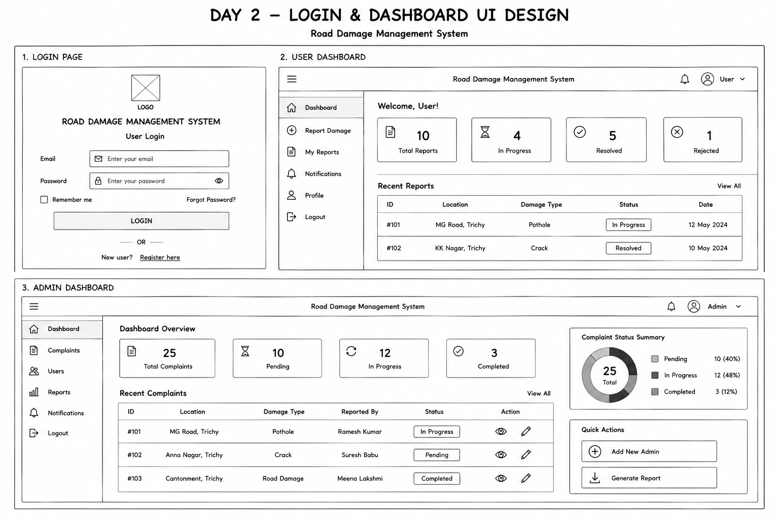
Login & Dashboard UI design
l

