Slide 1
3-DAY INTENSIVE
Agentic Systems
Bootcamp
From Tool-Caller to Multi-Agent Architect
Build agents from the bare metal up — the loop, design patterns, LangGraph orchestration, the MCP and A2A protocols, and a working multi-agent system you can demo.
LangChain + LangGraph
MCP + A2A
Python
3 days
Stack: Python · LangChain · LangGraph · MCP

Slide 2



THE PROGRAM · 3 DAYS
From a raw loop to a multi-agent system
DAY 01
DAY 02
DAY 03
Foundations
Orchestration
Systems
What an agent is, the Reason–Act–Observe loop, and the design patterns. Build a bare-metal agent.
Why the raw loop breaks. LangChain vs LangGraph: state, graphs, checkpoints, human-in-the-loop.
MCP and A2A protocols, multi-agent architectures, and a supervisor system you can demo.
STACK: PYTHON · LANGCHAIN · LANGGRAPH · MCP · A2A
02 / 21

Slide 3
BEFORE YOU START · SETUP
Run this once
INSTALL
PROJECT STRUCTURE
mkdir agentic-bootcamp && cd agentic-bootcamp
python -m venv venv
source venv/bin/activate
pip install langchain langchain-openai \
langgraph langgraph-supervisor \
"mcp[cli]" python-dotenv
# .env -> OPENAI_API_KEY=your_key_here
agentic-bootcamp/
├── .env
├── day1_agent.py
├── day2_graph.py
├── day3_mcp_server.py
└── day3_multiagent.py
PREREQUISITE
Comfortable calling an LLM API and have seen tool calling once. Did the RAG bootcamp? You're set.
SETUP
03 / 21

Slide 4
01
DAY 01
Foundations
What an agent is, and why they exist
The Reason → Act → Observe loop
Workflow vs agentic design patterns
Build: a bare-metal agent, no framework
04 / 21

Slide 5
DAY 01 · 1.1 · WHAT IS AN AGENT
An LLM that can act, observe, and retry
The model alone
MENTAL MODEL
An LLM is text-in, text-out. It can't act, fetch fresh data, or notice its own mistakes. It predicts tokens and stops.
A workflow is a recipe — fixed steps in a fixed order.
The augmented LLM
Wrap it in a loop and give it tools. Now it can decide on an action, see the result, and decide what to do next.
An agent is a cook who tastes the dish and decides what to do next.
Workflow vs agent
A workflow runs predefined code paths you wrote. An agent dynamically directs its own process and tool use.
Write a recipe when you can. Hire a cook when you can't.
AGENT = LLM + TOOLS + LOOP
05 / 21

Slide 6



DAY 01 · 1.2 · THE AGENT LOOP
Every agent is the same loop underneath
1
2
3
→
→
REASON
ACT
OBSERVE
The model thinks: what do I need to do next?
It emits a tool call to take an action.
The tool runs; the result returns to the model.
not done? loop back to REASON. This is the ReAct pattern (Reason + Act, 2022) — nearly every framework wraps it.
REASON · ACT · OBSERVE · REPEAT
06 / 21

Slide 7





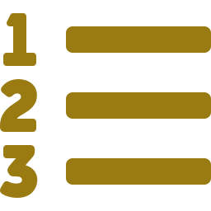


DAY 01 · 1.3 · DESIGN PATTERNS
Two pattern families
WORKFLOW PATTERNS
AGENTIC PATTERNS
you own the control flow
the model owns the control flow
Prompt chaining output of one call feeds the next
Reflection critique its own output and revise
Routing classify, send to a specialized path
Tool use call functions to act on the world
Parallelization run subtasks at once, aggregate
Planning break a goal into sequenced steps
Orchestrator–workers lead splits work, then synthesizes
Multi-agent specialized agents divide the labor
Evaluator–optimizer generate, critique, loop till good
RULE: THE SIMPLEST THING THAT WORKS
07 / 21

Slide 8

DAY 01 · 1.4 · BUILD
day1_agent.py — the loop by hand
# a tool is just a python function
def get_weather(city): ...
def run_agent(user_input):
msgs = [{"role":"user","content":user_input}]
while True:
resp = client.chat.completions.create(
model="gpt-4o-mini",
messages=msgs, tools=tools)
msg = resp.choices[0].message
msgs.append(msg)
if not msg.tool_calls: # done
return msg.content
for call in msg.tool_calls: # act + observe
result = get_weather(**args)
msgs.append({"role":"tool",
"tool_call_id": call.id,
"content": result})
WHAT TO OBSERVE
The model decides to call get_weather — you never told it to.
The loop ends when the model stops emitting tool calls.
That while-True with a "no tool calls" exit IS the agent.
Days 2–3 make this loop stateful, controllable, connectable.
THE LOOP IS THE AGENT
08 / 21

Slide 9
02
DAY 02
Orchestration
Why the bare-metal loop breaks at scale
LangChain the toolkit vs LangGraph the engine
State, nodes, edges — the graph model
Build: a stateful agent that remembers
09 / 21

Slide 10
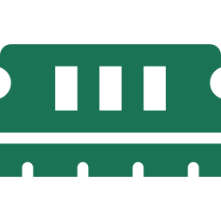



DAY 02 · 2.1 · LIMITS OF THE RAW LOOP
Four things the hand-rolled loop can't do
No persistent state
No human in the loop
Every run starts from zero. Nothing is remembered across turns, calls, or sessions without you wiring it by hand.
It acts on every decision immediately. There's no clean place to pause for approval before a risky action.
Rigid control flow
No resume or recovery
One hard-coded while-loop. Branching, routing, and retries all collapse into tangled if-statements.
Crash mid-task and there's no checkpoint to restart from. You re-run the entire job from the beginning.
FRAMEWORKS EXIST TO SOLVE EXACTLY THESE
10 / 21

Slide 11

DAY 02 · 2.2 · TWO LAYERS
LangChain is the parts. LangGraph is the engine.
LangChain
LangGraph
THE TOOLKIT
THE ORCHESTRATION LAYER
Model wrappers — one interface for every provider
A stateful graph of nodes and edges
Tools, retrievers, output parsers
Cycles, branching, and conditional routing
LCEL chains: linear, composable pipelines
Checkpointing → memory, resume, human-in-loop
Great for a single pass: prompt → model → parse
Built for agents and multi-agent systems
USE LANGCHAIN'S PARTS INSIDE LANGGRAPH'S ENGINE
11 / 21

Slide 12
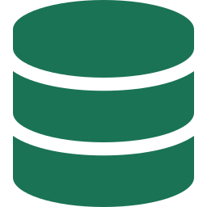



DAY 02 · 2.3 · THE GRAPH MODEL
Four ideas and you can read any LangGraph
State
Nodes
A shared object — usually a TypedDict — that flows through the graph. Every node reads it and writes back to it.
Plain Python functions that do the work: call a model, run a tool, transform the state, and return an update.
Edges
Checkpointing
Wire nodes together. Conditional edges route on the current state, so the graph can branch — and cycle back.
Persist state after every step. This is what unlocks memory, human-in-the-loop, and crash recovery.
CREATE_REACT_AGENT GIVES YOU ALL FOUR FOR FREE
12 / 21

Slide 13
DAY 02 · 2.4 · BUILD
day2_graph.py — an agent that remembers
from langgraph.prebuilt import create_react_agent
from langgraph.checkpoint.memory import InMemorySaver
agent = create_react_agent(
model="openai:gpt-4o-mini",
tools=[get_weather],
checkpointer=InMemorySaver(), # memory
)
cfg = {"configurable": {"thread_id": "1"}}
# first turn
agent.invoke({"messages":[{"role":"user",
"content":"Weather in Paris?"}]}, cfg)
# same thread_id -> it remembers "Paris"
agent.invoke({"messages":[{"role":"user",
"content":"And tomorrow?"}]}, cfg)
WHAT TO OBSERVE
The agent loop is now one function call, not a while-True.
thread_id is the memory key — reuse it to continue a conversation.
The checkpointer persists state between invokes.
Swap InMemorySaver for SQLite/Postgres to survive restarts.
STATE + CHECKPOINTER = MEMORY
13 / 21

Slide 14
03
DAY 03
Systems
The interoperability problem: tools and peers
MCP — one protocol to connect agents to tools
A2A — agents discovering and calling agents
Build: a supervisor over two specialist agents
14 / 21

Slide 15
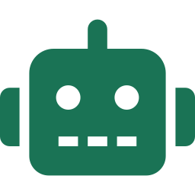

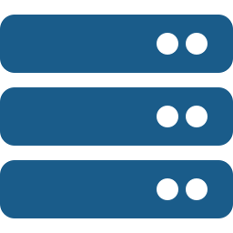
DAY 03 · 3.2 · MODEL CONTEXT PROTOCOL
MCP: the USB-C port for tools & data
Host
Client
Server
→
→
The AI app (Claude, an IDE, your agent) the user talks to.
Lives inside the host; holds one dedicated connection per server.
A program exposing tools, data, and prompts over the protocol.
SERVER EXPOSES
CLIENT OFFERS
Tools model-callable actions
Resources readable data / context
Prompts reusable templates
Sampling server asks host's LLM
Roots scoped filesystem access
Elicitation server asks the user input
STDIO FOR LOCAL · STREAMABLE HTTP FOR REMOTE
15 / 21

Slide 16
DAY 03 · 3.3 · AGENT-TO-AGENT PROTOCOL
A2A: how agents find and call each other
Each agent publishes an Agent Card — a signed JSON manifest at /.well-known/agent.json declaring its identity and skills. Others discover it, then exchange tasks over JSON-RPC.
 | MCP | A2A
Connects | agent → tools & data | agent → agent
Answers | “what can I use?” | “who can help?”
Discovery unit | tools / resources | signed Agent Card
Wire format | JSON-RPC | JSON-RPC
Governance | Linux Foundation (AAIF) | Linux Foundation
Complementary, not competing — production stacks run both.
MCP = TOOLS · A2A = TEAMMATES
16 / 21

Slide 17
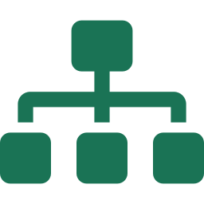


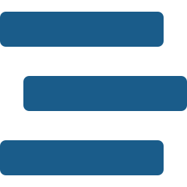
DAY 03 · 3.4 · MULTI-AGENT ARCHITECTURES
Four shapes for wiring agents together
Supervisor
Swarm
A lead agent routes each task to the right specialist and synthesizes results. Centralized, easy to reason about.
Agents hand off directly to one another as peers. Decentralized, flexible, no single coordinator.
Hierarchical
Pipeline
Supervisors of supervisors. Teams of agents nested into a tree when one layer isn't enough.
A fixed sequence of agents, each transforming the work. Predictable, assembly-line flow.
START WITH SUPERVISOR — ADD STRUCTURE ONLY WHEN NEEDED
17 / 21

Slide 18

DAY 03 · 3.5 · BUILD
day3_multiagent.py — a supervisor team
from langgraph_supervisor import create_supervisor
from langgraph.prebuilt import create_react_agent
math = create_react_agent(model, tools=[add, multiply],
name="math_expert",
prompt="You are a math expert.")
research = create_react_agent(model, tools=[web_search],
name="research_expert",
prompt="You look up facts.")
app = create_supervisor(
[math, research], model=model,
prompt="Route to the right expert.",
).compile()
app.invoke({"messages":[{"role":"user",
"content":"France GDP times two?"}]})
WATCH IT ROUTE
The supervisor reads the task and hands off to research first.
research_expert returns France's GDP as a fact.
Control returns to the supervisor, which routes to math_expert.
Two specialists, one coordinator — that's the whole system.
A MULTI-AGENT SYSTEM IN ~20 LINES
18 / 21

Slide 19
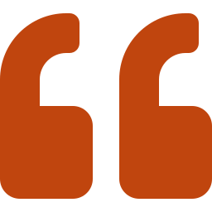
INTERVIEW PREP
Say these out loud before the interview
Workflow vs agent?
Why LangGraph over a raw loop?
You hard-code a workflow's path. An agent decides its own path at runtime. Prefer workflows; reach for agents only when the steps can't be predicted.
State, persistence, conditional and cyclic flow, human-in-the-loop, and resume are all first-class. The hand-rolled loop has none of them.
MCP vs A2A?
When is multi-agent worth it?
MCP connects an agent to tools and data. A2A connects agents to each other. They're complementary — real systems run both.
When the task splits into separable specialties or needs parallel work. Otherwise one good agent with the right tools wins on cost and latency.
CRISP DEFINITIONS BEAT BUZZWORDS
19 / 21

Slide 20
QUICK REFERENCE
The whole bootcamp on one slide
Raw loop
→
LangGraph
→
MCP / A2A
→
Multi-agent
Design patterns
LangGraph core
Workflows: chaining, routing, parallelization, orchestrator–workers, evaluator–optimizer. Agentic: reflection, tool use, planning, multi-agent.
State (TypedDict) · Nodes (functions) · Edges (conditional/cyclic) · Checkpointer (memory). Shortcut: create_react_agent.
MCP
Multi-agent
Host → Client → Server. Server: tools, resources, prompts. Client: sampling, roots, elicitation. stdio + Streamable HTTP.
Supervisor (centralized) · Swarm (handoffs) · Hierarchical (nested) · Pipeline (sequential). create_supervisor for the common case.
TOOL-CALLER → MULTI-AGENT ARCHITECT
20 / 21

Slide 21
YOU SHIPPED
A working multi-agent
system, end to end.
From a raw while-loop to a supervisor routing specialist agents over MCP and A2A — you built every layer yourself.
PYTHON · LANGCHAIN · LANGGRAPH · MCP · A2A
21 / 21

