Slide 1
Swapping and Page Replacement in OS-using FIFO and LRU ALGORITHMS

Slide 2
Submitted by :
BATCH -06
241FA04918 – P.GAYATHRI
241FA04947 – O.ALEKHYA
241FA04985 – T.SADASIVA RAO
241FA04F28 – B. JOHN RONALD

Slide 3
QUESTIONS
8. (a). Summarize the process of swapping in memory management. What conditions typically lead to swapping, and what impact can it have on system performance?
8 (b). Apply a page swapping algorithm to manage memory in a system with 3-page frames. Given the memory access sequence X, Y, Z, X, W, Y, Z, calculate the number of page faults using the FIFO and LRU algorithms. Apply the swapping technique to optimize disk I/O and reduce the page fault rate. Then, evaluate the effect of different page replacement strategies on system performance and memory utilization. Finally, determine how the system's performance is impacted when the number of frames is increased to 4.

Slide 4
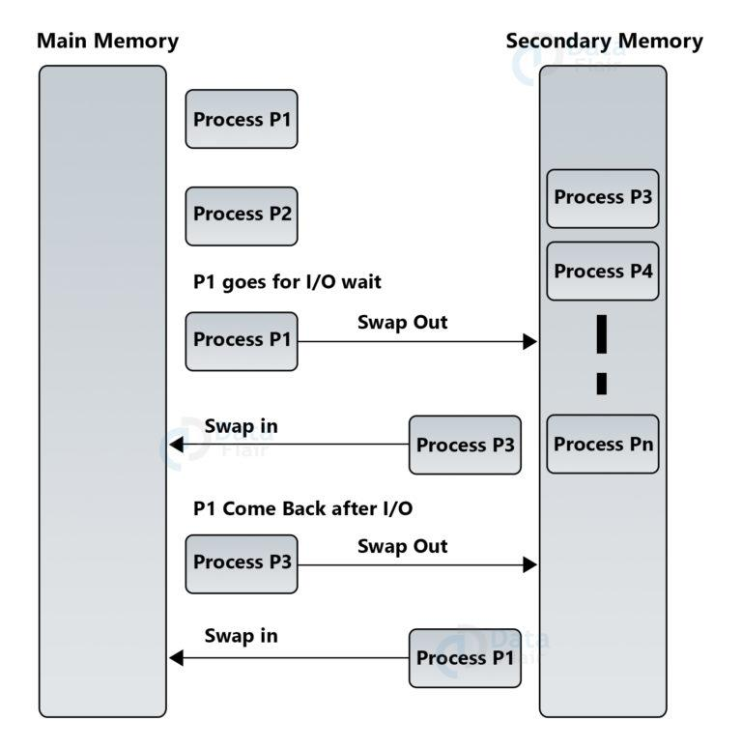
Process of Swapping
A)
Swapping is a memory management technique where processes are temporarily
moved from main memory (RAM) to secondary storage (disk) and later
brought back when needed.
Two operations:
1.Swap-out
2.Swap-in
Swapping Process
Process moved from main memory → disk
New process loaded into RAM
Swapped process returns when needed
Managed by OS scheduler
.

Slide 5
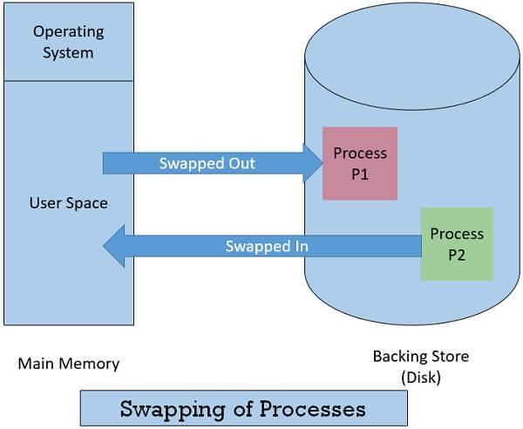
Conditions for Swapping
Memory is full
Too many processes (multiprogramming)
Process waiting for I/O
Low priority process removed
Memory overloading
Impact on Performance
Advantages:
Better memory utilization
Supports more processes
Disadvantages:
High disk I/O
Slower execution
May cause thrashing
Reduced CPU efficiency

Slide 6
B)
FIFO (First-In First-Out) Page Replacement
📌 Definition
FIFO (First-In First-Out) is a page replacement algorithm in operating systems where the oldest page in memory is replaced first when a new page needs to be loaded.
⚙️ Working Principle
Pages are stored in a queue (line) structure
The page that enters first will leave first
When a page fault occurs:
Remove the oldest page
Insert the new page into memory

Slide 7
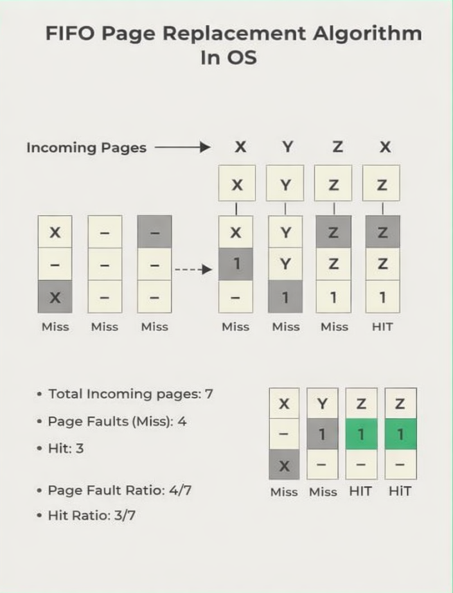
Step | Page | Frames (3) | Fault
1 | X | X - - | Yes
2 | Y | X Y - | Yes
3 | Z | X Y Z | Yes
4 | X | X Y Z | No
5 | W | W Y Z (X out) | Yes
6 | Y | W Y Z | No
7 | Z | W Y Z | No

Slide 8
LRU (Least Recently Used) Page Replacement
📌 Definition
LRU (Least Recently Used) is a page replacement algorithm that replaces the page which has not been used for the longest period of time when a new page needs to be loaded.
⚙️ Working Principle
The OS keeps track of recent page usage
When a page fault occurs:
Find the page least recently accessed
Replace it with the new page
Based on past usage history
LRU = Least Recently Used
Replaces the page not used for longest time
Uses past usage history
👉 More efficient than FIFO

Slide 9
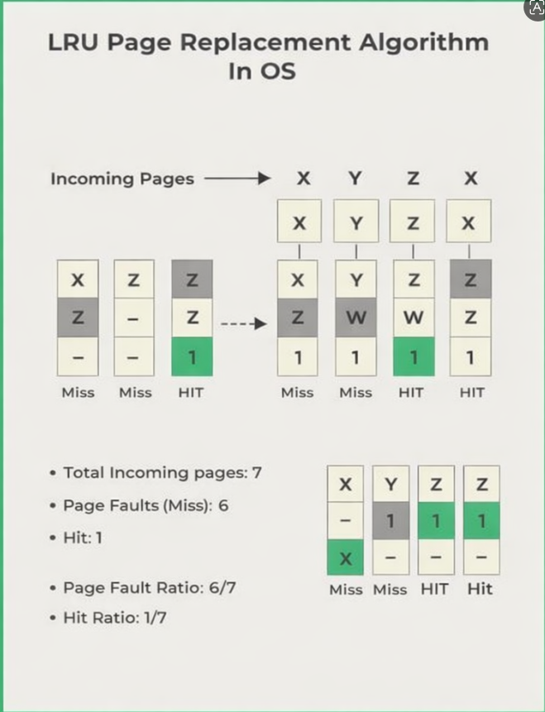
Step | Page | Frames (3) | Fault
1 | X | X - - | Yes
2 | Y | X Y - | Yes
3 | Z | X Y Z | Yes
4 | X | X Y Z | No
5 | W | X W Z (Y out) | Yes
6 | Y | X W Y (Z out) | Yes
7 | Z | Z W Y (X out) | Yes

