Slide 1
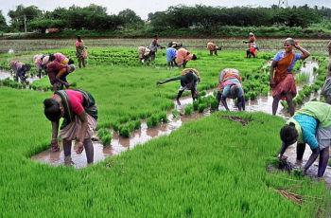
Uzhavan

Slide 2
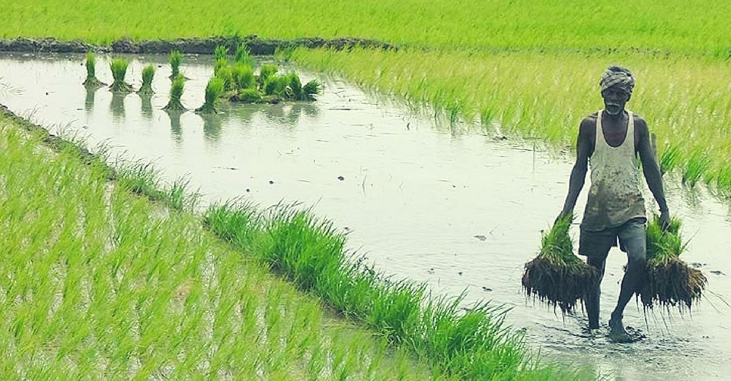
Farming is one of the major sectors that influences a country’s economic growth.
In country like India, majority of the population is dependent on agriculture for their livelihood. Many new technologies, such as Machine Learning and Deep Learning, are being implemented into agriculture so that it is easier for farmers to grow and maximize their yield.

Slide 3
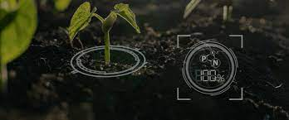
Crop recommendation
Crop recommendation is determined by NPK's value the soil. 'N' is nitrogen content in soil, 'P' is the content of phosphorus and "K" is the content of potassium the soil, ph. level and location of the state, city.

Slide 4
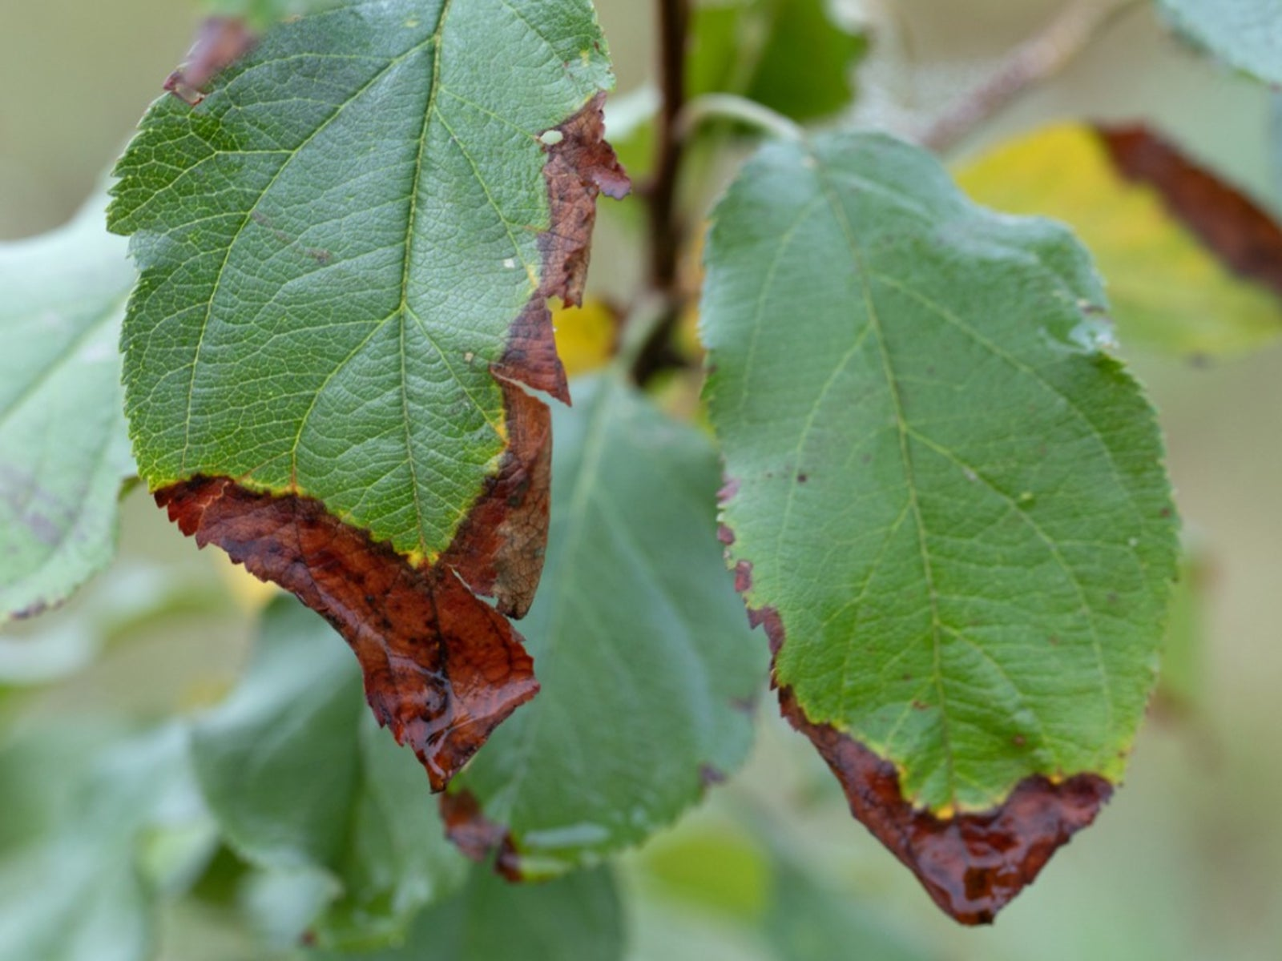
Disease detection
The disease detection method includes image acquisition, image pre-processing, image segmentation, feature extraction, and classification. To prevent crops at the initial stage from diseases, it is essential to develop an automatic system to diagnose plant diseases and identify its category.

Slide 5
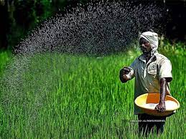
Fertilizer recommendation
For maintaining of soil quality and attainable crop yield, it is required to add proper amount of fertilizers and minimize the misuse of soil resources which is possible by knowing actual situation of soil physical, chemical and biological condition through observation, investigation and soil testing. So recommending proper fertilizers to use plays a vital role for increased yield.

Slide 6
THANK YOU

