Slide 1

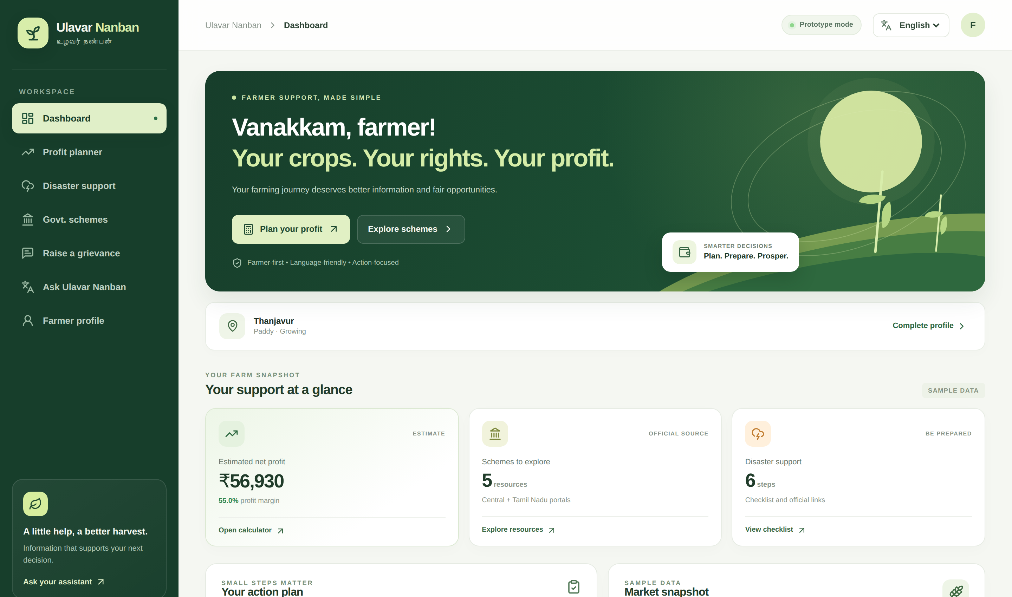
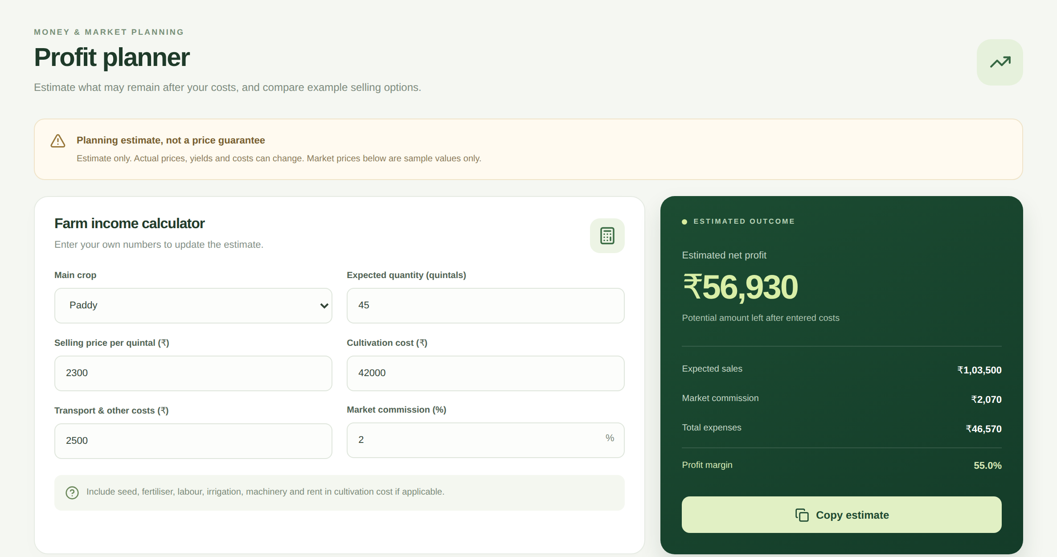
HACKATHON PROJECT · AGRI-TECH FOR SOCIAL GOOD
ULAVAR NANBAN
உழவர் நண்பன்
One Digital Companion for Smarter Farming Decisions
Profit planning, disaster readiness, scheme guidance and complaint drafting — in English, Tamil and Hindi, in one simple website.
Actual screenshots
TEAM [Team Name]
[Member 1] · [Member 2] · [Member 3] · [Member 4]
From the working React prototype
Notes:
Namaste everyone. We are Team [Team Name], and this is Ulavar Nanban — which means "the farmer's friend". Our idea is simple: a farmer should not have to open five different websites to plan profit, prepare for a disaster, find a scheme or write a complaint. Ulavar Nanban brings these into one friendly website, in English, Tamil and Hindi. What you see on the right are real screenshots from our working prototype, not mock-ups.

Slide 2






THE PROBLEM
Farmers juggle too many scattered sources
Scattered information
Disaster readiness
Prices, alerts and schemes sit on different sites
Preparedness steps are hard to navigate
THE FARMER
needs one simple place to start
Unclear profit
Scheme confusion
Hard to see net profit after every cost
Eligibility and documents feel complicated
Language & access barriers
Digital tools are not always in the farmer’s language
Notes:
Think about a farmer making a decision today. Market information is on one site, weather warnings on another, scheme details on a third, and complaint portals somewhere else. Working out real profit after all costs is hard. Disaster guidance can be difficult to find when you need it. And many digital tools do not speak the farmer's language. We are not claiming statistics here — this is the everyday friction we set out to reduce.

Slide 3
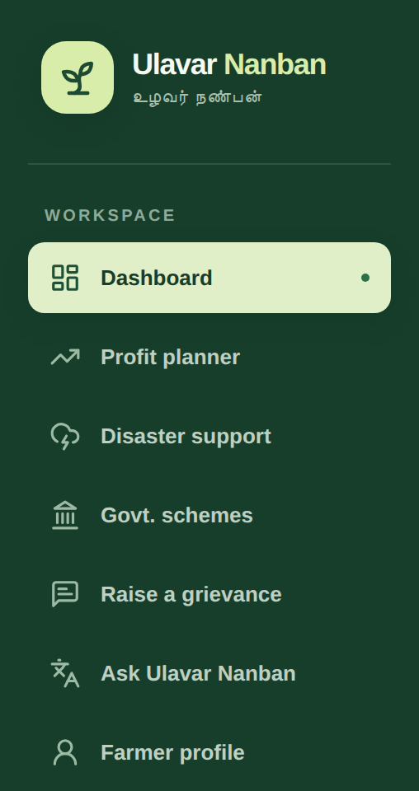


OUR SOLUTION
One platform. Six farmer-support tools
Personalized dashboard
Profit planning
Disaster support
Crop- and district-aware home with an action plan
Net profit and margin from your own numbers
Checklist, damage steps and official links
Scheme guidance
Grievance drafting
Multilingual help
Searchable official resources and documents
Editable complaint draft that you submit
English, Tamil and Hindi guided assistant
Actual navigation menu
Notes:
Ulavar Nanban is one website with a single menu. A farmer gets a personalised dashboard, a profit planner, disaster support, government scheme guidance, a grievance drafting tool and a multilingual assistant. The picture on the left is the real navigation menu from our prototype. There is also a farmer profile page where district, crop and language are saved on the farmer's own device.

Slide 4
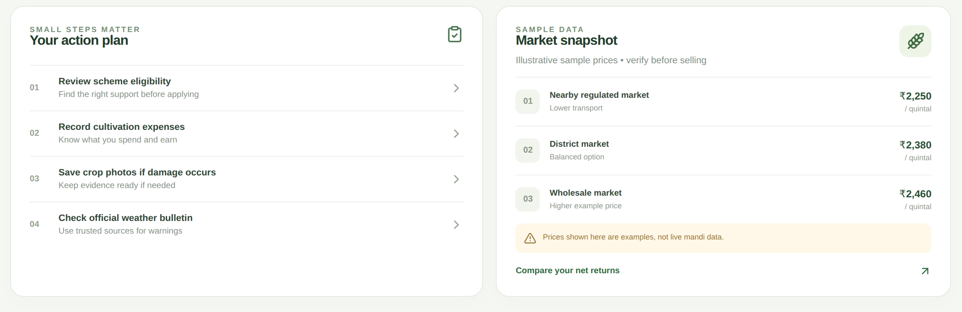
PRODUCT SHOWCASE
Dashboard: every next step in one place
1
One menu, seven tools
1
4
Switch between planner, support, schemes and help
2
Quick actions
Plan your profit or explore schemes in one tap
3
At-a-glance cards
2
Profit estimate, 5 scheme resources, 6-step checklist
4
Language and profile
English · தமிழ் · हिन्दी, plus crop and district
3
Below the fold: action plan & market snapshot
Real screenshot of the working prototype · sample data shown
Notes:
This is the heart of the product. The dashboard shows a hero message, quick actions, and three at-a-glance cards: estimated net profit, schemes to explore and disaster steps. Below that, an action plan and a market snapshot — clearly labelled as illustrative sample data. The language switcher in the top right changes the interface between English, Tamil and Hindi. Everything here is a real screenshot of what we built.

Slide 5

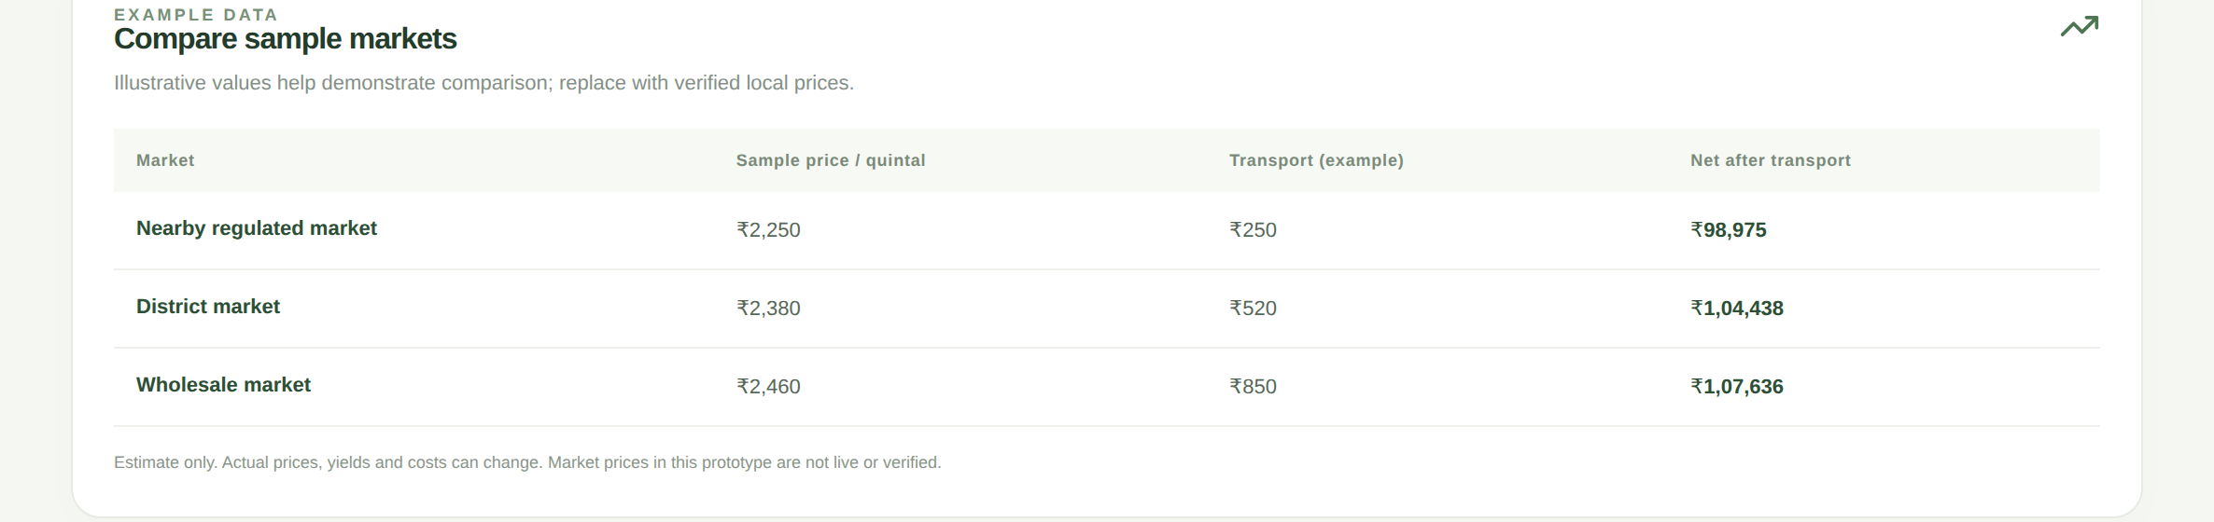
PROFIT PLANNER
Smart profit planner
INPUTS
Quantity
Selling price
Expenses
Transport
Commission
OUTPUTS
Estimated revenue
Estimated expenses
Net profit
Profit margin
ILLUSTRATIVE EXAMPLE · APP DEFAULTS
45 q × ₹2,300 = ₹1,03,500 sales
Costs ₹42,000 + ₹2,500 + ₹2,070 fee = ₹46,570
Net profit ₹56,930 · Margin 55.0%
Example prices are illustrative, not live market data.
Notes:
The profit planner answers a simple question: after all my costs, what do I actually earn? The farmer enters quantity, selling price, cultivation cost, transport and market commission. The page instantly shows estimated sales, total expenses, net profit and profit margin. For example, with the default values in our app — 45 quintals at 2,300 rupees — sales are 1,03,500, costs come to 46,570 including a 2 percent commission, so net profit is 56,930, a 55 percent margin. These prices are illustrative examples, not live mandi prices. The table at the bottom compares three sample markets after transport.

Slide 6
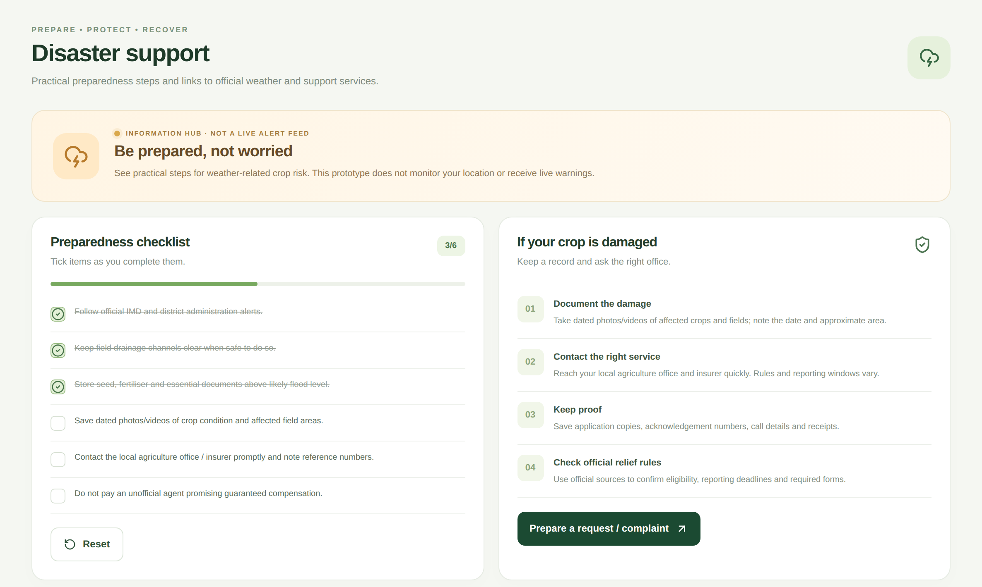
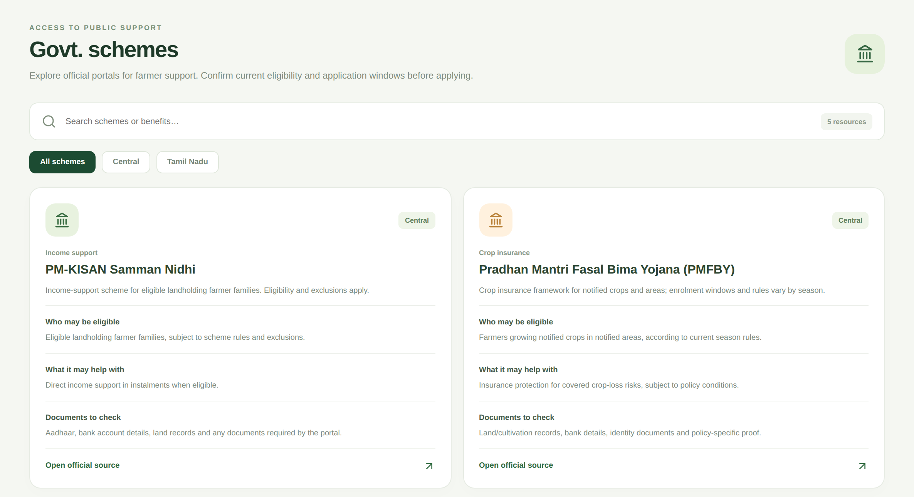
PROTECTION & SUPPORT
Farmer protection & government support
Disaster support
Government scheme finder
6-item preparedness checklist
Crop-damage next-step guidance
Links to IMD, TN disaster agency, PMFBY
Search plus Central / Tamil Nadu filters
Eligibility and document guidance
Official portal link on every card
Information hub — not a live alert feed.
Starter guide — verify rules on official sites.
Notes:
Two tools protect the farmer. On the left, disaster support: a tick-able preparedness checklist, practical steps if a crop is damaged — document it, contact the right office, keep proof — and links to official sources like IMD and the Tamil Nadu disaster agency. It does not fetch live alerts and does not use GPS. On the right, the scheme finder: searchable cards for central and Tamil Nadu resources, each with eligibility guidance, documents to check and a link to the official portal. These are starter guides — we always tell farmers to confirm current rules on the official website.

Slide 7
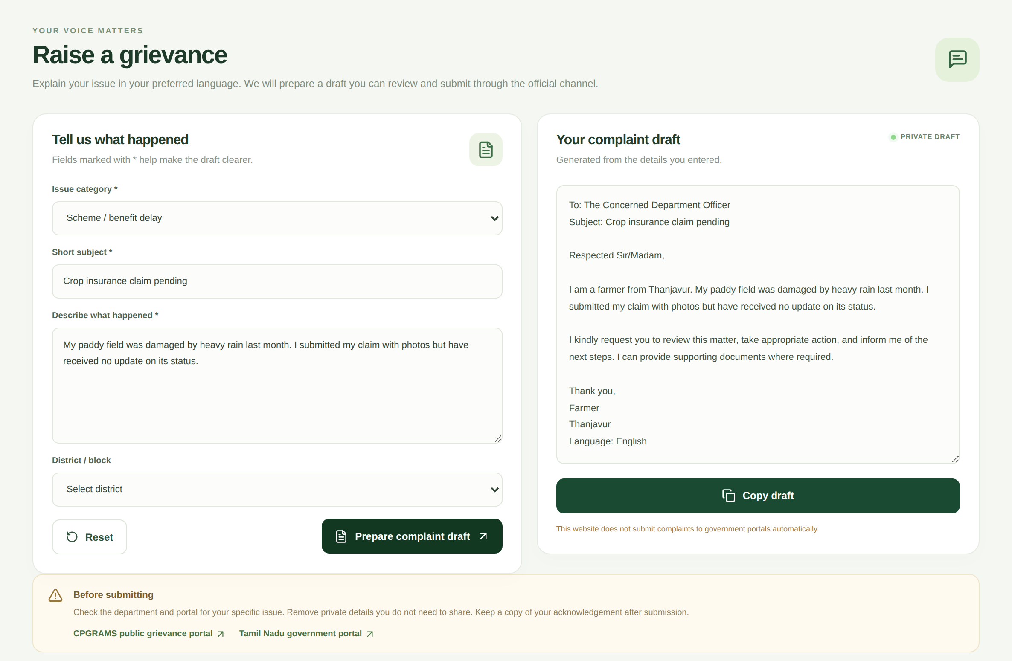
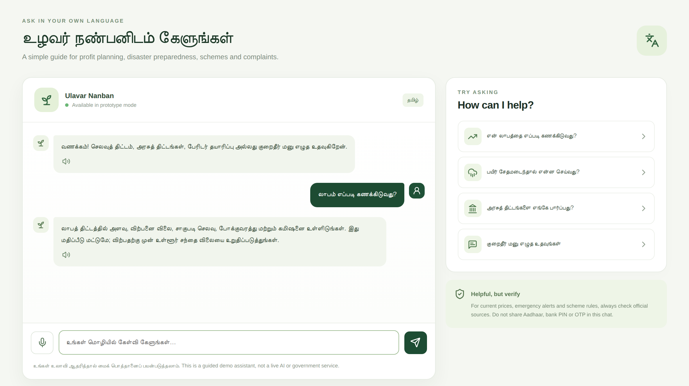




GRIEVANCE & LANGUAGE
Grievance drafting & multilingual help
Editable drafts
Review, edit, copy
EN · தமிழ் · हिन्दी
Interface labels
Voice & read-aloud
Where browser supports
Grievance assistant: editable draft
Language assistant: Tamil interface
1
Farmer describes an issue
2
Platform prepares guidance or a draft
3
Farmer reviews and edits it
4
Farmer submits via the official channel
Complaints are NOT submitted automatically — the farmer always files through the official channel.
Notes:
Many farmers struggle to put a problem into a formal letter. The grievance assistant asks for the issue type, a short subject and what happened, then prepares an editable draft in the selected language. The farmer reads it, edits it, copies it, and submits it through the right official portal. We are clear: the website never submits complaints by itself. Next to it, the language assistant gives guided answers in English, Tamil and Hindi using prepared responses and simple topic matching — it is not an external AI model. Voice input and read-aloud use the browser's own speech features where the browser supports them.

Slide 8

TECHNOLOGY
Technology & system architecture
Browser-side logic
Calculations · topic matching
Farmer
Responsive Web UI
Feature Modules
Phone or PC browser
React + Vite, custom CSS
7 pages: dashboard to profile
Local storage + links
Profile on device · official links
VERIFIED FROM THE SOURCE CODE
React (hooks)
Vite build tool
lucide-react icons
Responsive CSS
Web Speech API
localStorage
Intl ₹ formatting
Google Fonts
Not in this prototype: backend server · database · login/authentication · AI model · live data APIs — these are our roadmap, not claims.
Notes:
Here is the honest technology picture. Ulavar Nanban is a frontend prototype built with React and Vite, styled with custom responsive CSS, with lucide icons. The farmer uses the browser; the interface connects to seven feature modules; calculations and the assistant's topic matching run in the browser itself; the farmer profile is saved in the browser's local storage; and everything else is a link to an official source. Voice features use the standard Web Speech API where the browser supports it. We deliberately did not claim a backend, a database, authentication or an AI model — they do not exist yet, and they are in our roadmap.

Slide 9


IMPACT & ROADMAP
Innovation, impact & future scope
IMPLEMENTED TODAY
PROPOSED NEXT
Many support tools in one interface
Verified live market-price integration
Simple profit and margin estimation
District-specific weather & disaster alerts
Tamil, Hindi and English guidance
Maintained government scheme database
Pointers to official resources
Secure backend and authentication
Structured, editable complaint drafts
More regional languages & accessibility
Frontend prototype: no measured user impact is claimed yet.
Notes:
What is new here is not one clever feature but the combination: profit estimation, disaster guidance, scheme resources, complaint drafting and multilingual help in one accessible interface. On the left is what already works today. On the right is what we would build next with proper data and security: live verified market prices, district-level weather and disaster alerts, a maintained scheme database, a secure backend with authentication, and more languages and accessibility features. We have not run a user study, so we are not claiming measured impact — we are showing a working prototype and a clear path.

Slide 10





Empowering Farmers Through Accessible Technology
Making farmer support simpler, clearer and closer to every field.
One platform
Profit clarity
Protection & schemes
Help in local languages
Thank You Questions?
Actual screenshots from the working prototype
Team [Team Name] · [Member 1] · [Member 2] · [Member 3] · [Member 4]
Notes:
To close: farmers deserve information that is simple, in their language, and in one place. Ulavar Nanban is a working prototype that shows how profit planning, disaster readiness, scheme guidance and complaint drafting can live together — and we have been honest about what is built and what is next. Our vision is to make farmer support simpler and more accessible. Thank you — we would be happy to take your questions.

