Slide 1
Weekly Updates
Date: 23-01-2025

Slide 2
Sandman Ticket System
All functionalities have been implemented only the integration part is pending.
Till now we have added:
→Header Section
→Side Bar
→Ticket Section
→Search Bar
→Ticket List
→Open Ticket Buttons.
These are the welcome page contents

Slide 3
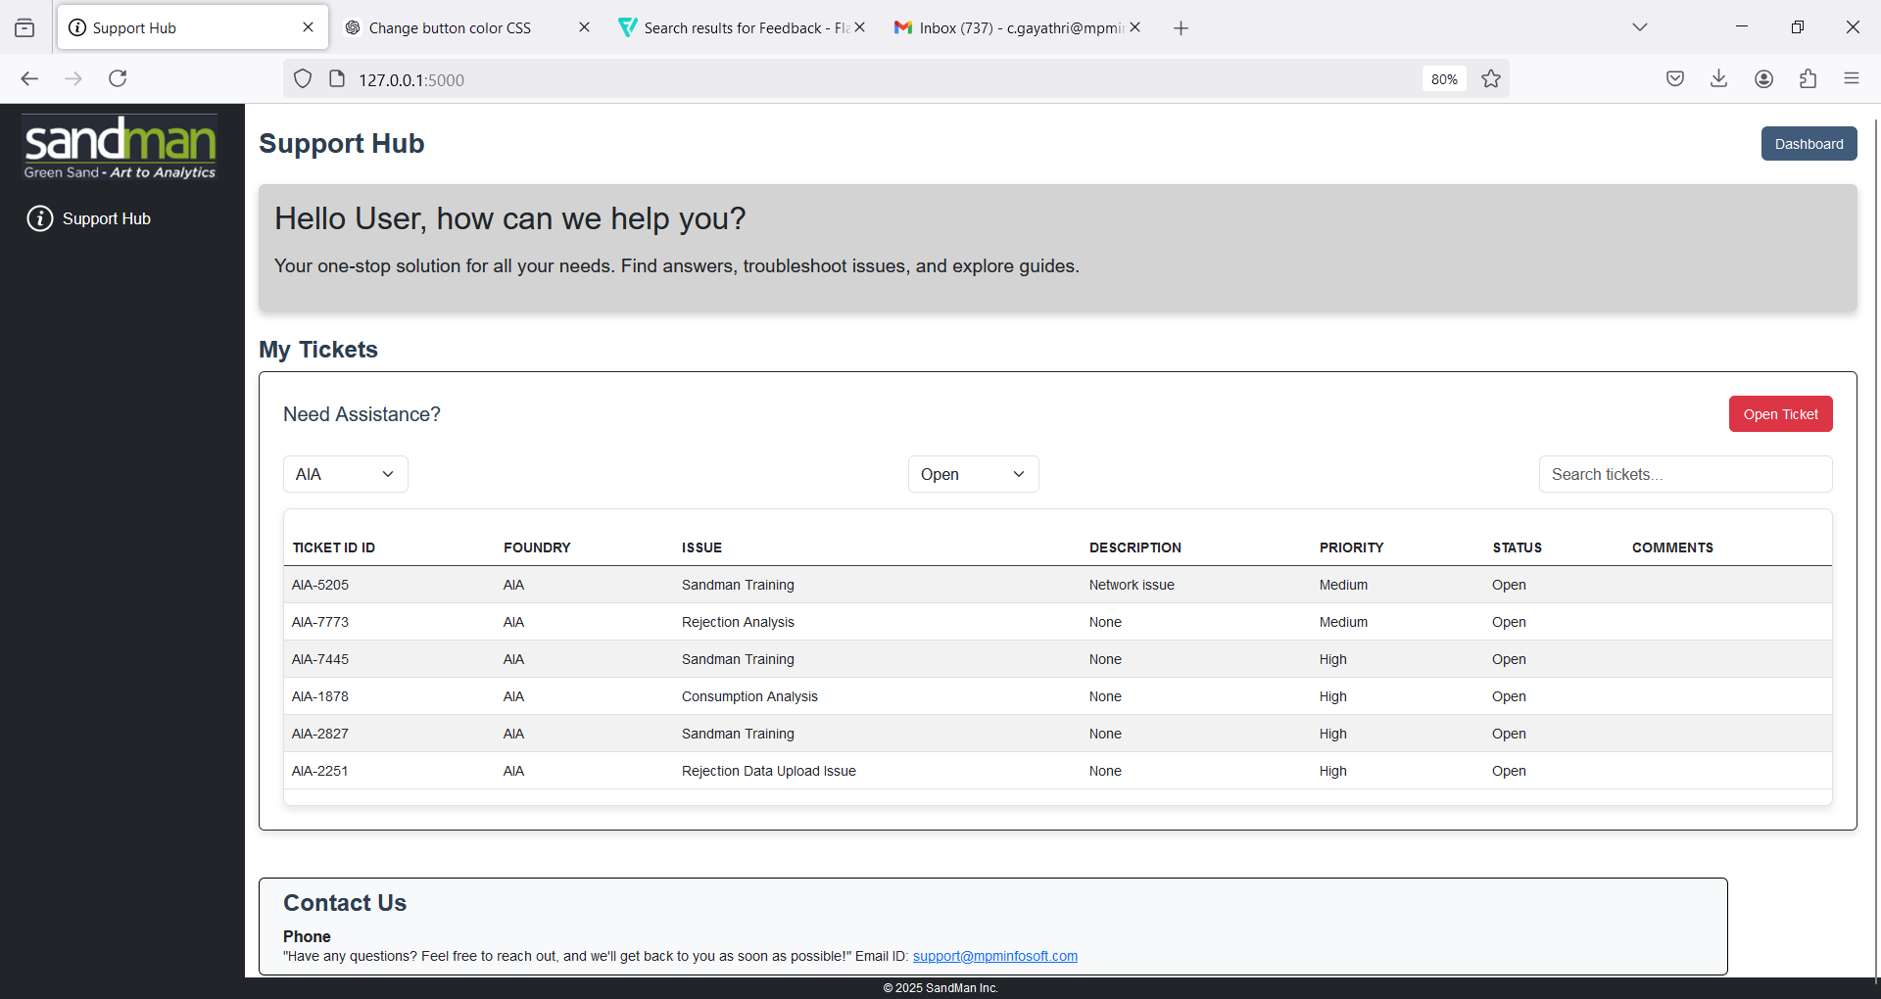

Slide 4
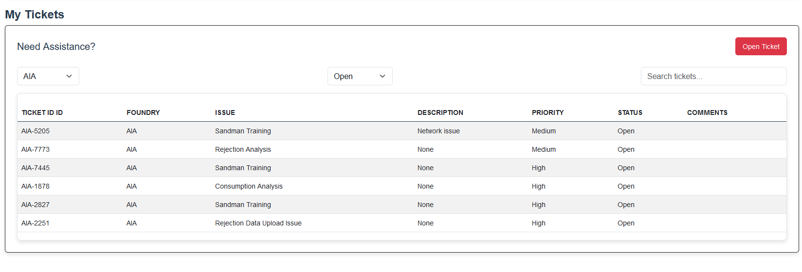

Slide 5
This is the user side ticket for each foundries. For every foundries mail id, phone number, will be individual the details will be fetched directly from the db. connection according to their foundry details. Remaining Help Topics, Issue and priority levels will be common for both user and admin.

Slide 6
Additional Suggestions
We can also add bar graphs, pie charts For Example: Total no. of tickets created or based on the priority levels created(Hight, Medium, Low)
And we can add attachments, Guide. Guide states that we can add pdf or file to make the users know how to create ticket or if they have any issues in creating ticket or about the ticket, they can go through the guide.

Slide 7
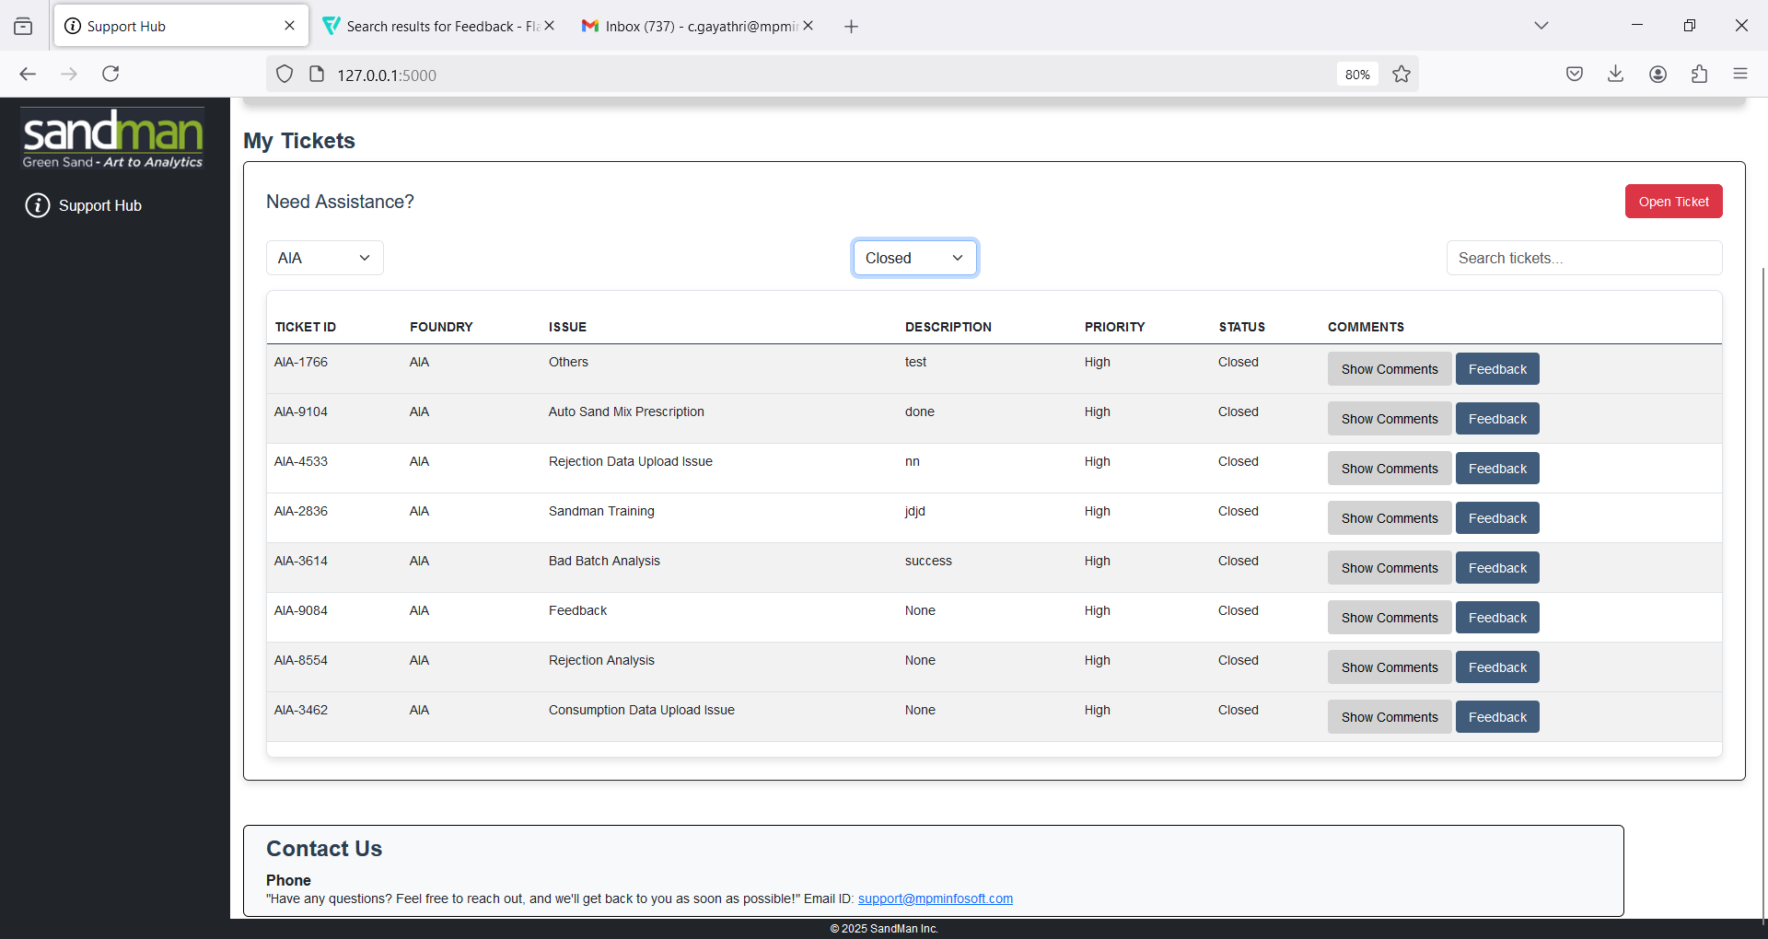

Slide 8
Newly added “Show Comments” and “Feedback” button. Here for this feedback button, we have customized according to the foundries that when the user creates ticket with unique ticket id, so it collects the ticket id the person who created and the mail id automatically and also the issue they mentioned.

