Slide 1



Optimizing Tissue Mill Locations: A Data-Driven Approach
Submitted by
Shamina Raja Mohamad
Arjun Madhusoodanan
Gayathri Sasikumar
Aakhash Ramakirushnan Selvam

Slide 2
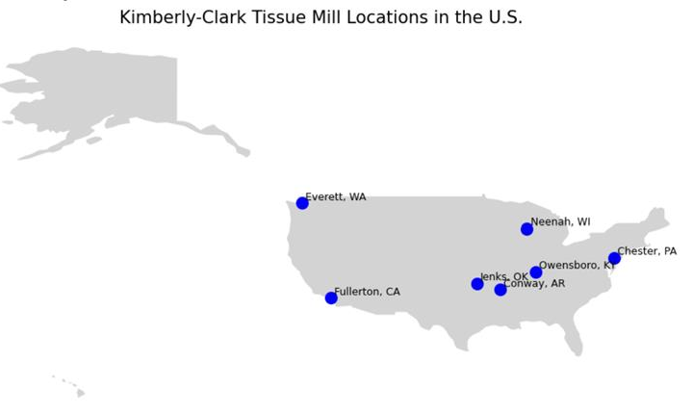
The Bigger Challenge: Choosing the Right Place to Build
Strategic Imperative
Facility location is critical across all industries.
It impacts operational efficiency and market access.
Flaws of Tradition
Traditional site selection is often slow and biased.
It relies on outdated intuition, not concrete data.
Need for Speed & Data
Businesses need real-time, data-driven decisions.
Optimize location strategy for a competitive edge.

Slide 3
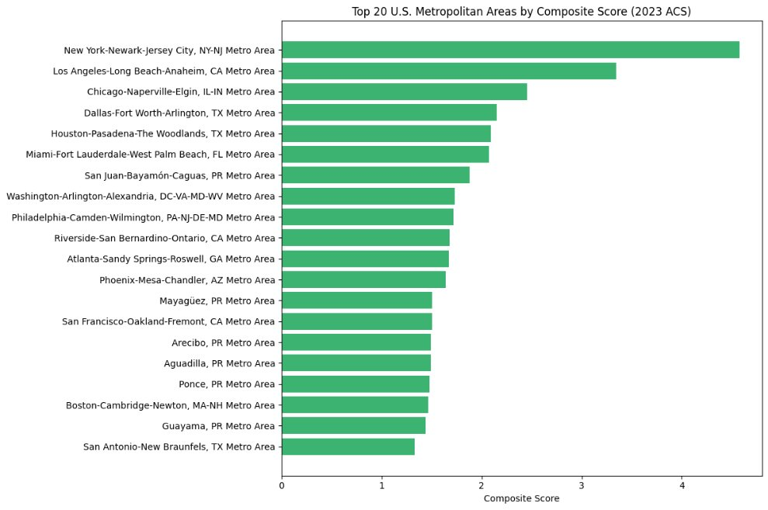
Top 20 US metropolitan Statistical Areas
The Top 20 metropolitan areas were selected by integrating population size with factors like median age for workforce balance, 25-34 age group for prime labor, adult citizen population for stability, and total housing units for infrastructure capacity, prioritizing MSAs that optimize logistics and labor potential.

Slide 4
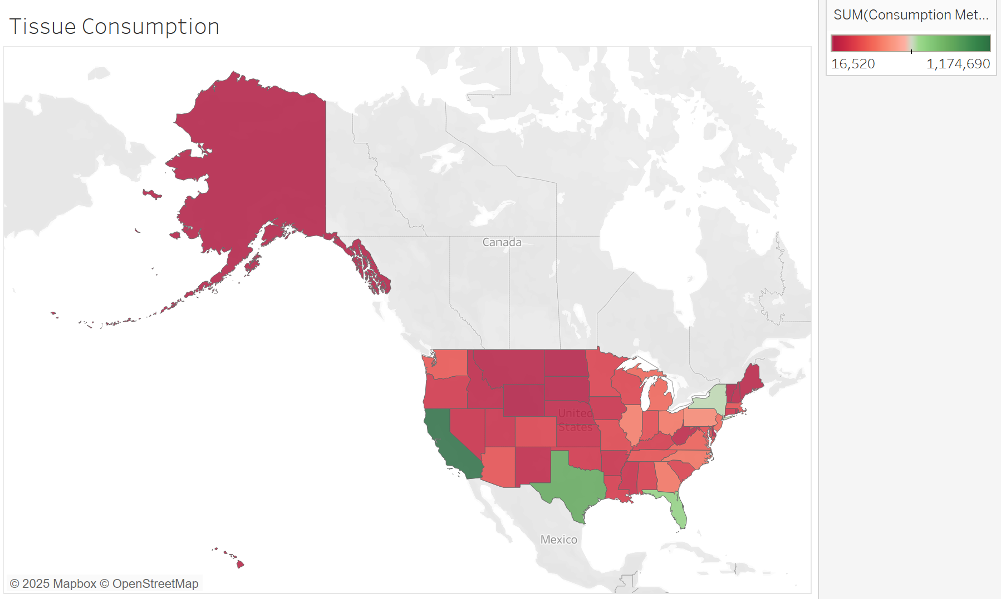
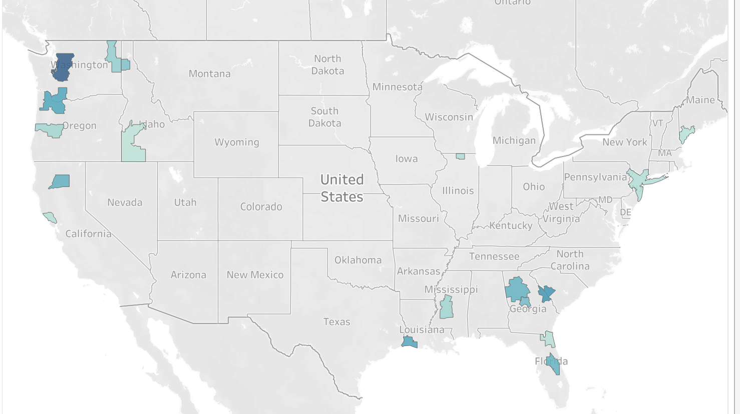
Optimizing Tissue Mill Locations
Strategic placement for efficient tissue demand fulfillment.
Regional Demand Distribution
Resource Availability
Target regions with the highest tissue consumption: Southeast (25%), Farwest (17%), Mideast (15%).
Ensure access to a skilled workforce, resolve labor availability issues, and align facility placement with resource accessibility and transportation infrastructure to minimize shipping costs.

Slide 5
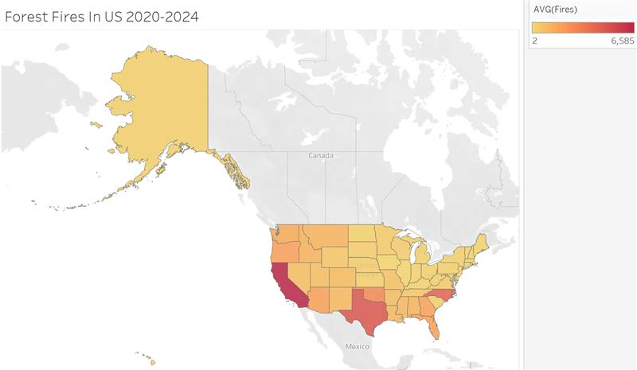
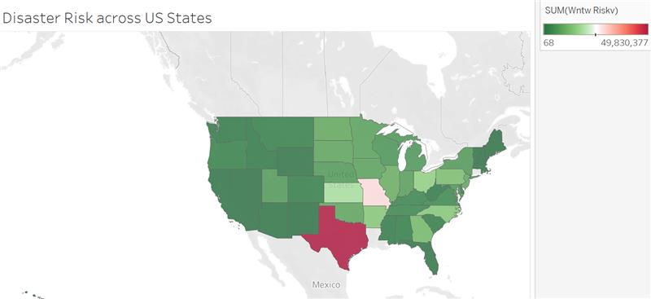
Building for the Long Haul: Resilience Against Natural Disasters
We integrated FEMA, GFW and NIFC data to identify regions prone to floods, hurricanes, and wildfires. Avoiding high-risk zones ensures uninterrupted operations and smarter infrastructure investment.

Slide 6
Harnessing Census ACS Data
Data Sources:
DP02 – Selected Social characteristics
DP03 – Selected Economic characteristics
DP05 – Demographic and housing estimate
Timber availability data – Forisk's report (2023)
Tissue Consumption data – US Bureau of economic analysis (2024)
Forest Fire Data - NIFC (nifc.gov), state forestry agencies, GFW (globalforestwatch.org)
Disaster Risk - National Risk Index from FEMA
Methodology:
Rank metro areas by employment rate and income levels
Factor in resource availability and demand
Compute average distance to top 20 metros

Slide 7



Data Integration: Key Elements
Collected and Merged Datasets
Preprocessed the Data
Calculated a Composite Score
Integrated Census ACS metrics for MSAs with Forisk’s 2023 Timber Data using GEO\_ID and coordinates. Unified data with projected tissue demand for a comprehensive view.
Cleaned missing values and normalized features across Census ACS, Timber Data, and projected tissue demand datasets to ensure data quality and consistency.
Ranked metro areas based on weighted factors, including timber availability, population density, and regional demand, to identify optimal locations for tissue mills.

Slide 8



Top Locations for Tissue Mills
Atlanta, GA
Portland-Vancouver
Jackson, MS
Composite Score: 0.659
Composite Score: 0.527
Composite Score: 0.524

Slide 9
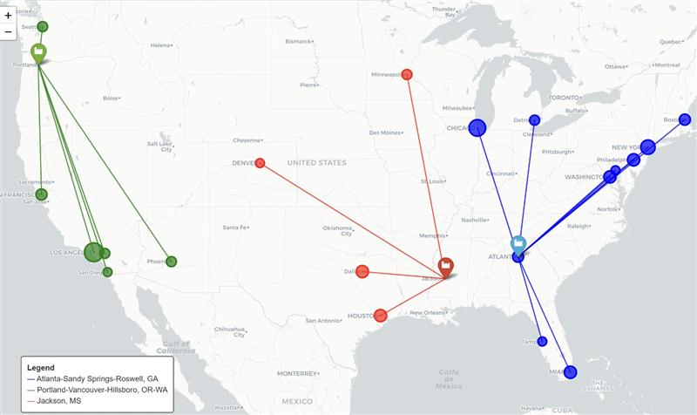
Summary
Atlanta offers exceptional connectivity to major East Coast and Midwest metropolitan areas, making it a strategic logistics hub.
Jackson delivers cost-effective access to key Southern and Central metros, ensuring efficient regional distribution.
Portland provides strong West Coast coverage with proximity to top Pacific metro markets, ideal for coastal operations.

Slide 10
THANK YOU

