Slide 1
Documentation
Travel blog

Slide 2
Travel blog
A travel blog is a place where an individual can share thoughts about, experiences with and tips on travel.

Slide 3
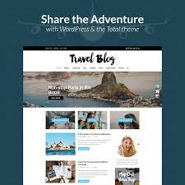

Slide 4
Project objective
Travel takes us out of our comfort zones and inspires us to see, taste and try new things. It constantly challenges us, not only to adapt to and explore new surroundings, but also to engage with different people, to embrace adventures as they come and to share new and meaningful experiences with friends and loved ones.

Slide 5
Design thinking
Design thinking is not simply a process. It also requires a shift in mindset. It differs from the kind of ‘scientific management’ processes you are probably used to. Because it’s deeply embedded in the local social context and the issues and challenges that stakeholders are experiencing, the actual process may vary from destination to destination, business to business, and context to context

Slide 6
Measure impact
implement, test and refine
Design and prototypeAnalyse
diagnose.
Discover and build empathy

Slide 7
Development phases for travel blog
1. Research Your Niche2. Come Up With a Memorable Blog Name
3. Pick a Blogging Platform
WordPress
Hostinger Website Builder
4. Set Up Web Hosting
5. Customize Your Travel Blog
Establish Your Branding
Pick a Theme for Your Travel Blog
Create a Logo and a Slogan
Design Your Travel Blog
Install the Necessary Plugins

Slide 8
6. Set Up the Pages
7. Publish Your First Blog Posts
Determine the Blog Topic
Write High-Quality Content
Set Up Scheduled Post Publishing
8. Promote and Grow Your Audience
Connect to Google Analytics
9. Make Money With Your Travel Blog
10. Take Blogging Courses to Scale Your Site Even Further
Conclusion

Slide 9
Website structure of travel blog
Here’s your step-by-step guide to start a travel blog:
Step 1: Pick a niche
Step 2: Select a domain name
Step 3: Purchase WordPress hosting and install WordPress
Step 4: Choose a travel blog theme
Step 5: Install helpful plugins for travel blogs
Step 6: Create and add content
Step 7: Build your blog’s audience
Step 8: How to make money from your travel blog

Slide 10
Content creation
Table Of Contents
Introduction
Why Travel Blog Articles?
Changing Trends
Travel Blogging is a Lot of Work
Getting Started with the Travel Blog
1. Conduct Research
2. Take a Look at Travel Niches and Select Yours
How to Create Travel Blog Articles?
3. Write Engaging Headlines
4. Write an Exciting Intro
5. Speak the Words of Your Audience
6. Find Your Brand's Voice
7. Giveaway Relevant Information
8. Convert Emotions into a Compelling Travel Story
9. Involve Different Content Types

Slide 11
10. Include a Call To Action
11. First not the Best
12. It's Okay to Fail
13. Create Value for Your Readers
How to Write First Travel Blog posts?
14. Explain The Goal of Your Travel Blog Articles
15. Express Your Personality
16. Focus on SEO
17. Keyword Research
Tools for Keyword Research
A First Key Step to Starting a Travel Blog
18. Network with Other Bloggers

Slide 12
Technical implementation details
The travel privileges differ in the organizational hierarchy and the calculations are dependent on the
assignment type, work or training,
location, domestic or foreign,
Duration & Distance, near or far,
Commute type, for travel arrangements, and
Grouping of employment grades.

Slide 13
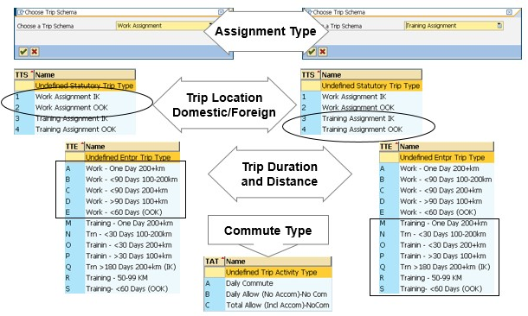

Slide 14
The travel expense manager records the details of the trip for employees, including the
Schema to differentiate between different types of travel,
General trip data such as dates, reasons and destination,
Options of receiving lump sum amount or arranged travel,
Cost Distribution to different cost centers,
Receipts to reimburse expenses incurred during travel,
Additional Destinations employee stayed in,
Trip Segments to split & record the Trip Legs,
Deductions to reduce the payment of specific meals provided

Slide 15
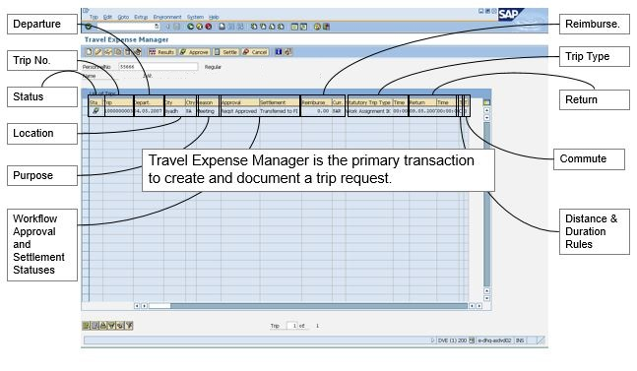

Slide 16
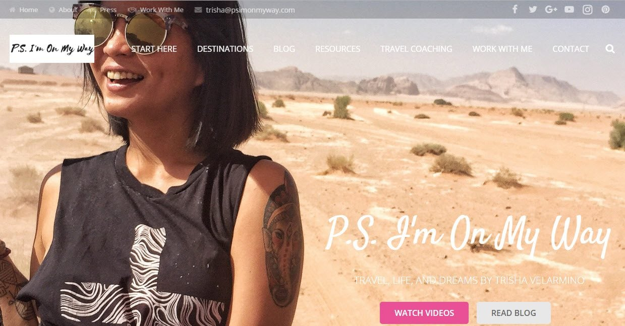
Images and screenshots
1. PS I’m On My Way

Slide 17
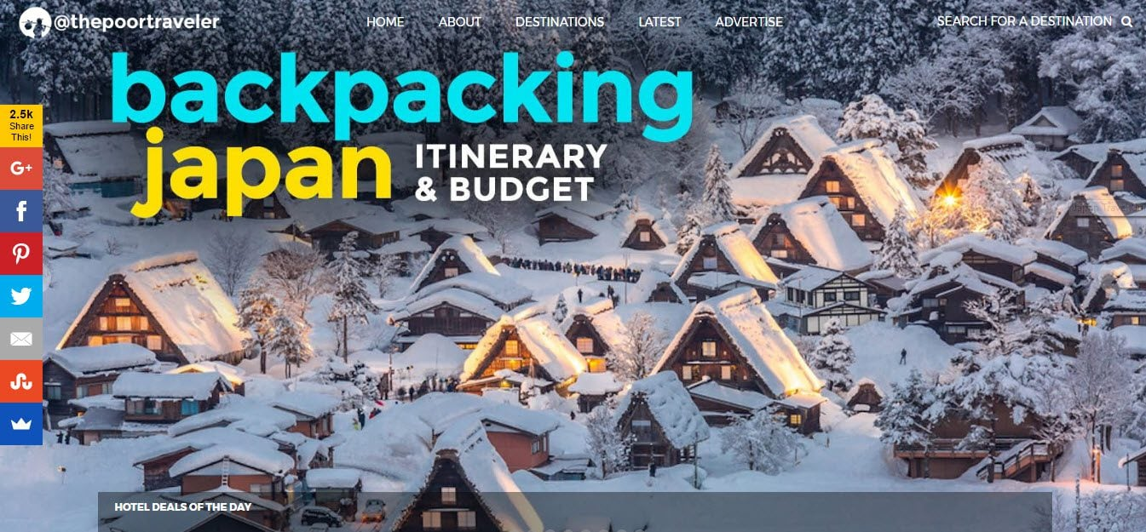
2. The Poor Traveler

Slide 18
