Slide 1
FitWise – A Personalized BMI & Lifestyle Recommendation Web Application
BY
Gayathri Devi Jarugu
01/30/2026

Slide 2
Contents
Executive Summary
Functional Requirements
Non-Functional Requirements
Business Rules
Use Case Diagram
Class Diagram
Sequence Diagram
State Diagram
Communication Diagram
Entity Relationship Diagram
Functional Test Plan

Slide 3
Executive Summary
FitWise is a health-focused web application that helps users calculate their Body Mass Index (BMI) and provides personalized diet, exercise, and lifestyle recommendations based on their health status. The app not only informs users about their BMI category but also guides them safely toward healthier choices, emphasizing personalized, culturally relevant suggestions and mental wellness. The app is built with a user-first approach, prioritizing simplicity, personalization, and safety, three features often overlooked in traditional health calculators. It supports both metric and imperial units and provides tailored health advice to suit each user’s profile.

Slide 4
Functional Requirements
User Account Management
Actors: End Users, System Administrators
1.1. The system allows users to register, log in, and log out securely.
1.1.1. Users register with personal details (name, email, age, gender, etc.).
1.1.2. The system provides password management (reset/recover).
1.2. The system allows administrators to manage user accounts (activate, deactivate, suspend).
1.2.1. System Administrators handle escalated account-related issues.

Slide 5
Functional Requirements
BMI Calculation & Classification
Actors: End Users
2.1. Users input weight and height in metric or imperial units.
2.1.1. The system calculates BMI values based on user inputs.
2.1.2. The system classifies BMI into categories: Underweight, Normal, Overweight, Obese.

Slide 6
Functional Requirements
Personalized Health Recommendations
Actors: End Users
3.1. The system provides diet recommendations.
3.2. The system provides exercise suggestions suitable for the user’s BMI.
3.3. The system generates adaptive lifestyle recommendations based on health inputs (e.g., sleep quality, fatigue, digestion issues).

Slide 7
Functional Requirements
Content & Media Management
Actors: Content Managers, System Administrators
4.1. The system provides exercise videos (embedded).
4.2. Content managers upload and update videos and diet plans.

Slide 8
Functional Requirements
System Administration & Monitoring
Actors: System Administrators, Network Administrators, Developers/Maintainers
5.1. System Administrators manage system configurations, user permissions, and maintain application availability.
5.1.1. They perform data backups and recovery operations.
5.1.2. They monitor logs and handle escalated technical issues.

Slide 9
Functional Requirements
5.2. Network Administrators monitor and maintain secure network connectivity, firewalls, and server performance.
5.2.1. They ensure uptime of hosted services.
5.2.2. They safeguard against external threats (e.g., DDoS, intrusion attempts).
5.3. Developers/Maintainers handle bug fixes, system updates, and feature enhancements.

Slide 10
Functional Requirements
Database & Data Management
Actors: Database Administrators (DBAs), System Administrators
6.1. The system stores user data securely in a database.
6.2. The system allows retrieval of BMI history (future scope with account system).
6.3. Database administrators manage schemas, backups, and migrations.

Slide 11
Functional Requirements
Testing & Quality Assurance
Actors: Developers, System Administrators
7.1. The system supports unit, integration, and functional testing.
7.2. Administrators and developers validate test outcomes.

Slide 12
Non-Functional Requirements
Performance Requirements
Actors: Developers, System Administrators
1.1. The system processes BMI calculations and returns results within 2 seconds.
1.2. The system supports at least 500 concurrent users with minimal performance degradation.

Slide 13
Non-Functional Requirements
Security Requirements
Actors: System Administrators, Network Administrators
2.1. All user data is encrypted during transmission (via HTTPS).
2.2. Passwords are hashed and salted in storage.
2.3. Administrators enforce role-based access control.

Slide 14
Non-Functional Requirements
Reliability & Availability
Actors: System Administrators, Network Administrators
3.1. The system maintains 99% uptime.
3.2. Network administrators ensure redundancy for critical services.

Slide 15
Non-Functional Requirements
Usability Requirements
Actors: End Users, Developers
4.1. The user interface is responsive and mobile-friendly.
4.2. The system provides intuitive navigation with minimal training.

Slide 16
Non-Functional Requirements
Maintainability & Scalability
Actors: Developers/Maintainers
5.1. The system is modular to support new features (e.g., mood tracking, AI advisor).
5.2. Developers document all updates for future scalability.

Slide 17
Non-Functional Requirements
Compliance Requirements
Actors: System Administrators, Legal/Compliance Officers
6.1. The system complies with healthcare data privacy guidelines (HIPAA/GDPR where applicable).
6.2. The system provides users with terms of service and a medical disclaimer.

Slide 18
Non-Functional Requirements
Monitoring & Auditability
Actors: System Administrators, Network Administrators
7.1. System administrators maintain audit logs of user and admin activities.
7.2. Logs are reviewed periodically for anomalies by network and system administrators.

Slide 19
Business Rules Summary
Unique verified email & strong password required
Locked after 5 failed logins (10 min)
BMI = Weight / Height² → stored with timestamp
Auto diet & exercise tips based on BMI, age, lifestyle
Only approved, verified content visible to users
Data encrypted (AES-256, HTTPS) & backed up daily
Admin manages roles, logs kept 90 days
Updates only after testing & approval
Users can export reports (PDF) & delete accounts
GDPR & HIPAA compliance ensured

Slide 20
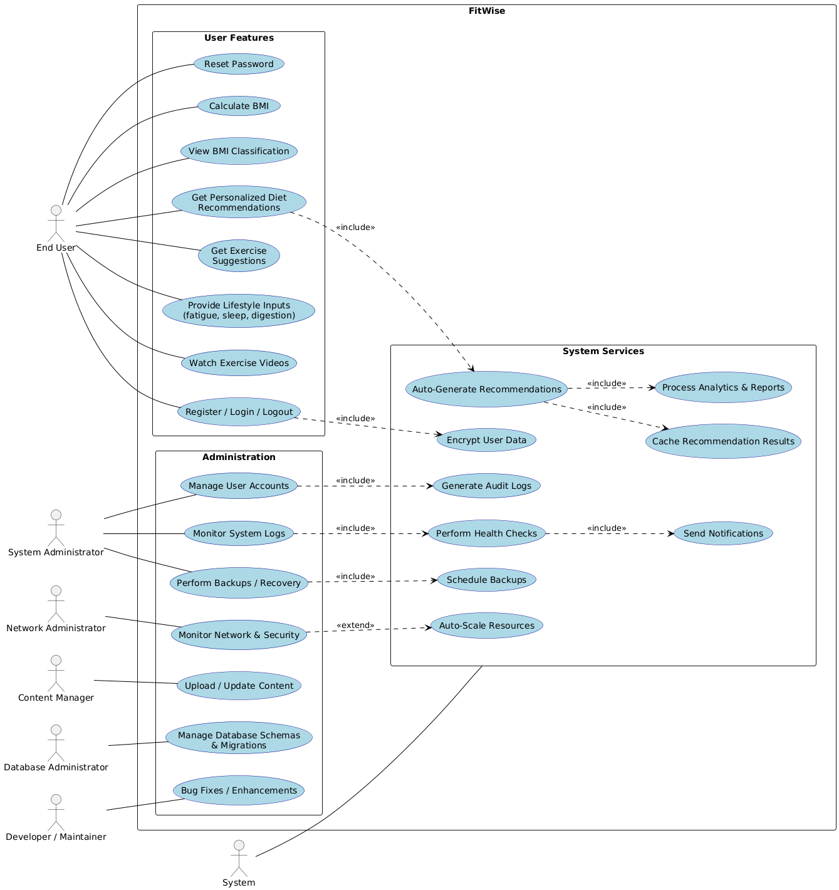
Usecase Diagram

Slide 21
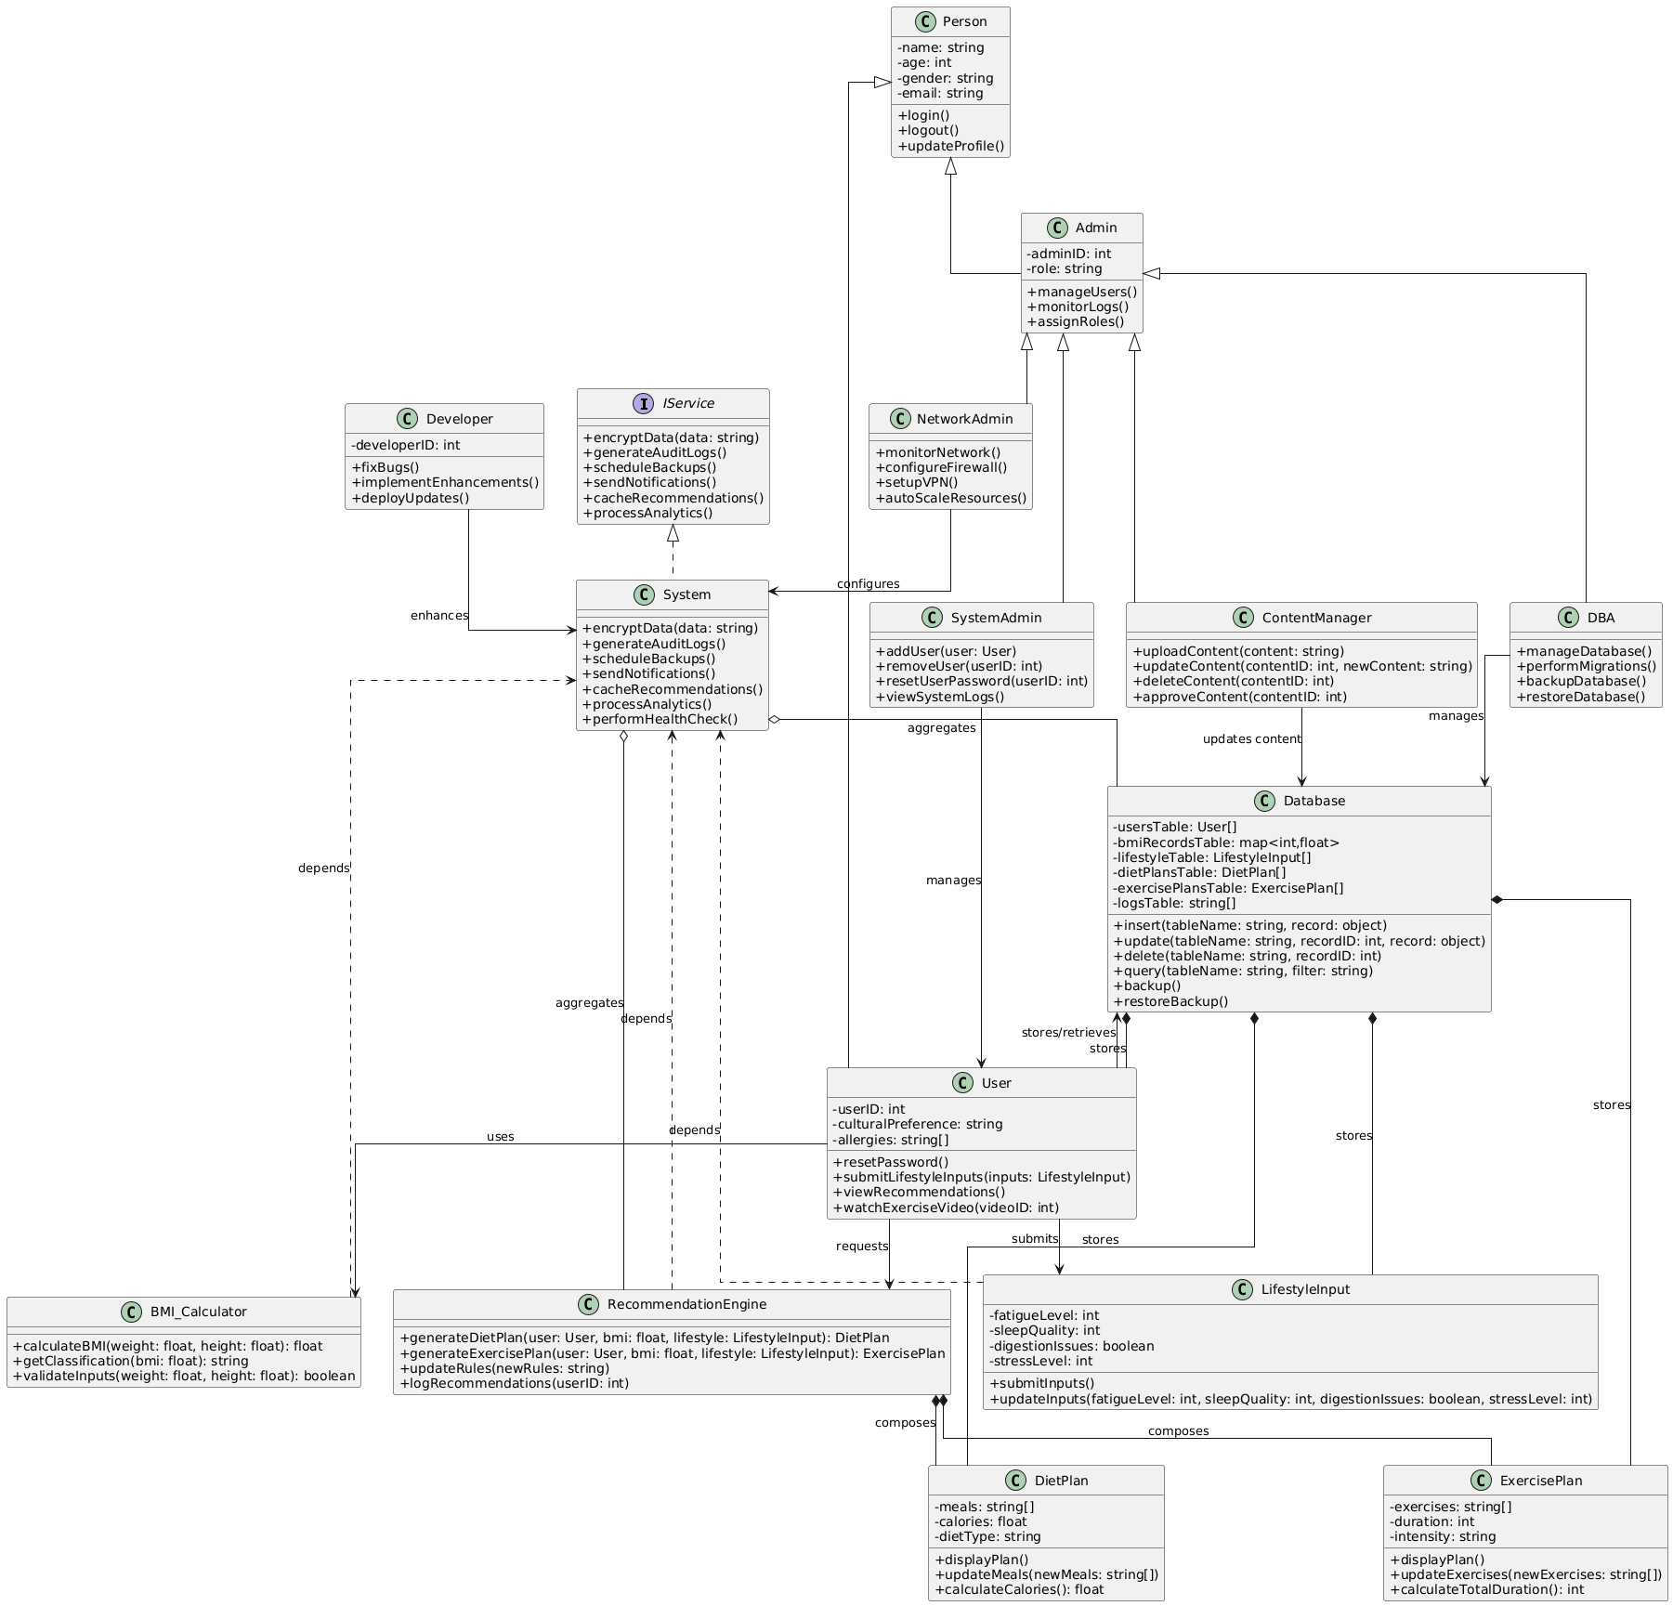
Class Diagram

Slide 22
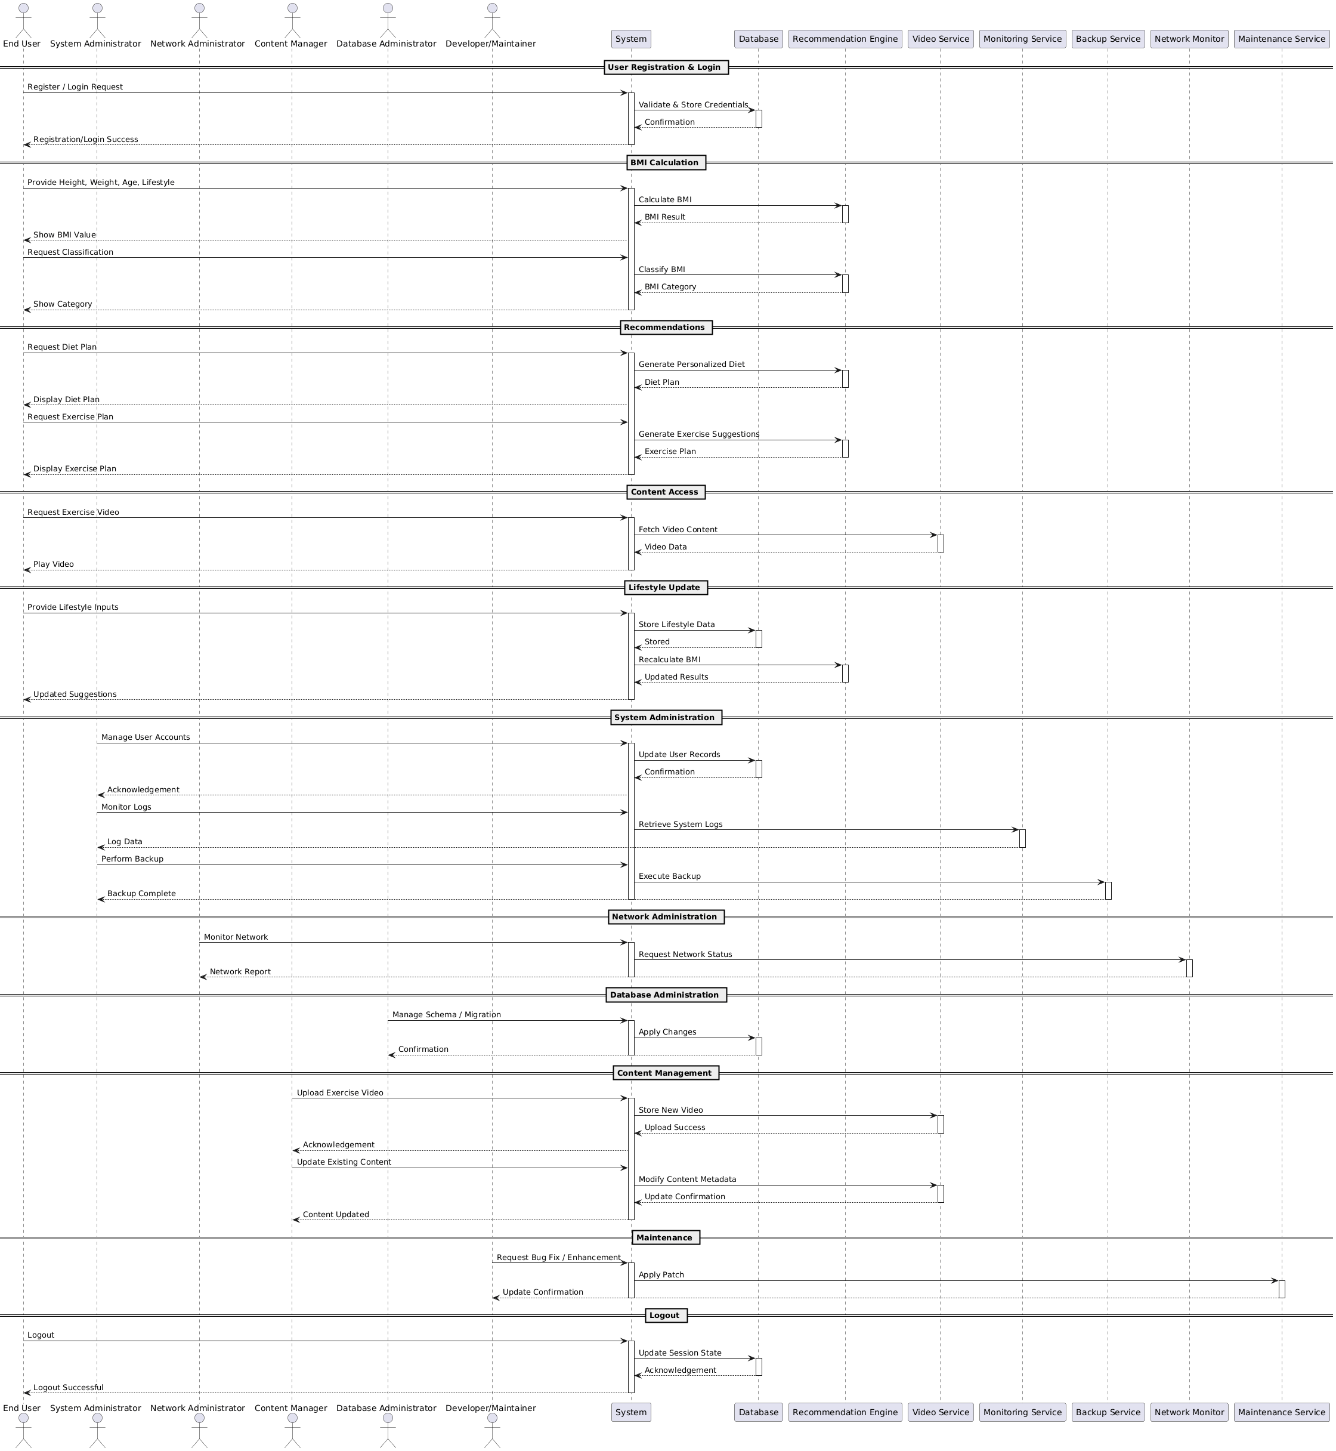
Sequence Diagram

Slide 23
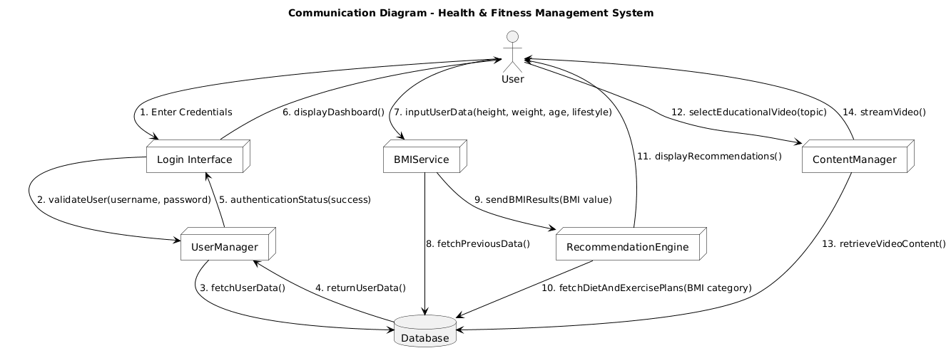
COMMUNICATION DIAGRAM

Slide 24
Functional Test Plan
4.1 Objective
The objective of this Functional Test Plan is to verify that each function of the FitWise Health & Fitness Management System operates in accordance with the defined functional requirements. The tests ensure that the system meets user expectations, performs accurately, and maintains data consistency and security across all modules.

Slide 25
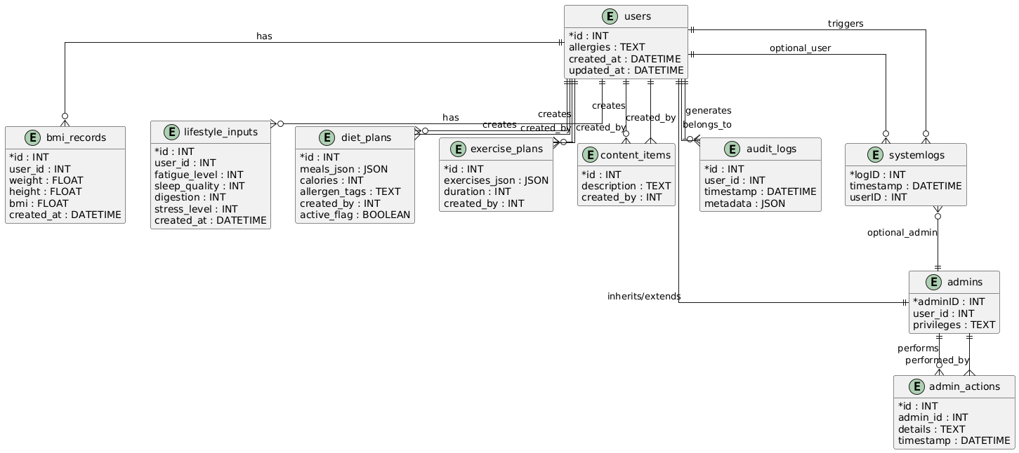
Entity Relationship Diagram

Slide 26
Functional Test Plan
4.2 Scope
This test plan covers all major functionalities of the system, including:
User registration, authentication, and session management
BMI calculation and classification
Diet and exercise recommendation generation
Lifestyle input handling and recalculation
Administrative operations (system, network, database, and content management)
Data persistence and content retrieval

Slide 27
References
BMI Calculators :
1. Centers for Disease Control and Prevention. (n.d.). BMI Calculator. https://www.cdc.gov/bmi
2. Centers for Disease Control and Prevention. (n.d.). About Adult BMI. https://www.cdc.gov/healthyweight/assessing/bmi/adult_bmi/index.html
3. National Heart, Lung, and Blood Institute. (n.d.). Calculate your body mass index.
https://www.nhlbi.nih.gov/calculate-your-bmi
4. MyFitnessPal. (n.d.). MyFitnessPal: Calorie counter app. Under Armour, Inc. https://www.myfitnesspal.com

Slide 28
References
Cultural and Regional Dietary Guidelines:
5. Food and Agriculture Organization of the United Nations. (2016). Promoting healthy diets through nutrition education and changes in the food environment: An international review of actions and their effectiveness. https://www.fao.org/3/i5640e/i5640e.pdf
6. Harvard T.H. Chan School of Public Health. (n.d.). Healthy eating plate & healthy eating pyramid. https://www.hsph.harvard.edu/nutritionsource/healthy-eating-plate/
7. Indian Council of Medical Research. (2024). Nutrient requirements for Indians. National Institute of Nutrition. https://www.nin.res.in/RDA_Full_Report_2024.html
8. National Health Service (UK). (n.d.). Eat well – How to eat a balanced diet. https://www.nhs.uk/live-well/eat-well/
9. U.S. Department of Health and Human Services, & U.S. Department of Agriculture. (2020). Dietary guidelines for Americans, 2020–2025. https://www.dietaryguidelines.gov/
10. World Health Organization. (2020). Healthy diet. https://www.who.int/news-room/fact-sheets/detail/healthy-diet

Slide 29


Slide 30


