Slide 1



DATA ANALYTICS ON GLOBAL HUNGER AND FOOD INSECURITY
Data Analytics
May25,2025
Gayathri P K
241109
Under the Guidance of
Dr. Malu G
Assistant Professor, DUK
Digital University Kerala
Thiruvananthapuram

Slide 2
OVERVIEW OF THE PRESENTATION
Introduction
Motivation
Problem Statement
Objectives
Literature Review
Proposed Methodologies
Results and Discussions
Conclusion
Future Scope
References
02

Slide 3
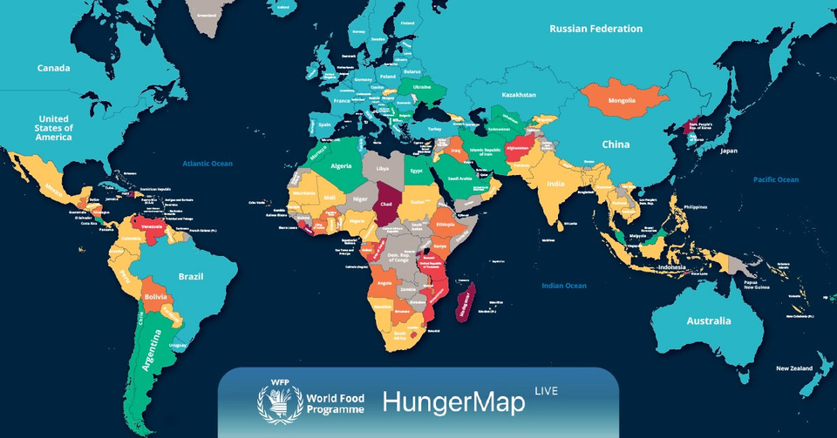
INTRODUCTION
Global hunger is one of the most persistent development challenges, affecting over 800 million people worldwide. It is directly linked to food availability, access, and nutritional security.
Hunger is a major barrier to health, education, and productivity.
SDG Goal 2 aims to end hunger and achieve food security by 2030.
Using global indicators from the World Bank, we apply machine learning to predict undernourishment, identify patterns, and support policy-making.
03

Slide 4
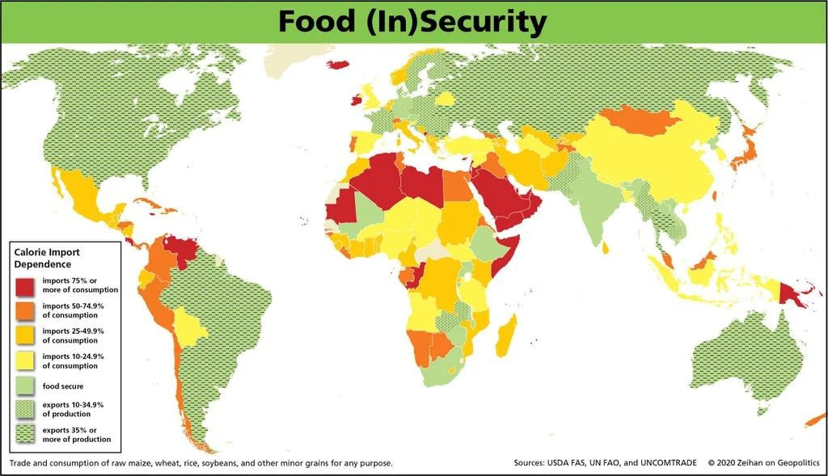
MOTIVATION
Despite growth in global food production, millions still suffer from undernourishment, especially in low-income countries. Over 700 million people faced hunger in 2023.
Hunger reflects deep inequalities in income, agriculture, and food distribution.
Historical and real-time data can help identify patterns in hunger trends.
Data-driven analysis guides better food aid distribution and policy planning.
04

Slide 5
PROBLEM STATEMENT
Despite the world producing enough food to feed the global population, millions still suffer from hunger and undernourishment .
SDG 2 specifically targets the elimination of hunger by ensuring universal access to safe, nutritious, and sufficient food all year round, particularly for vulnerable populations like infants, the poor, and people in rural or conflict-affected areas.
Can we use globally available indicators like food production, agricultural employment, and rural population to predict undernourishment levels using machine learning?
05

Slide 6
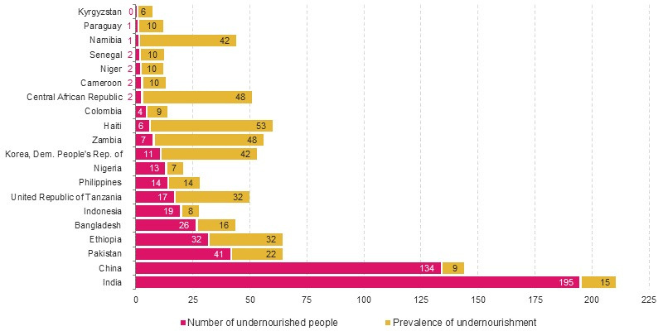
GRAPH
x-axis: No of people or percentage value
y-axis: Countries
Pink bar: Represent the Number of undernourished people .
Yellow bars: Represent the Prevalence of undernourishment
05

Slide 7
OBJECTIVES
Identify socio-economic factors (like GDP, population, agriculture) affecting hunger.
Use data analytics (PCA, hypothesis testing, sampling) to uncover patterns.Build a predictive model to estimate undernourishment.
Identify key global indicators impacting hunger
Compare food security performance across regions and countries.
06

Slide 8


LITERATURE REVIEW
FAO’s Hunger Report (2023): Highlights inequality and conflict as major drivers.
UN SDG Tracker: Shows regional hunger index trends.
Prior studies use machine learning to classify food-insecure zones based on predictors like rural population, GDP, and food supply.
07

Slide 9
PROPOSED METHODOLOGY
Step 1: Define the Problem
We aim to predict the prevalence of undernourishment in various countries using global indicators related to agriculture, food production, and rural demographics. This supports evidence-based decision-making aligned with Sustainable Development Goal 2 (Zero Hunger).
Step 2: Collect the Data
We used the World Bank’s World Development Indicators dataset (2023 release), which includes:
Food Production Index
Rural Population (%)
Agricultural employment
Cereal yield
Prevalence of undernourishment (target)
08

Slide 10
PROPOSED MEHODOLOGY
Step 3. Clean the Data
Removed metadata and unnecessary headers
Handled missing values using forward fill and interpolation
Standardized country and indicator names
Filtered data for the years 2000–2021 (most recent and consistent)
Step 4. Explore the Data (EDA)
Plotted time trends for undernourishment across countries
Correlation analysis among indicators
Identified outliers and missing data clusters
Used heatmaps and box plots to visualize feature distributions
09

Slide 11
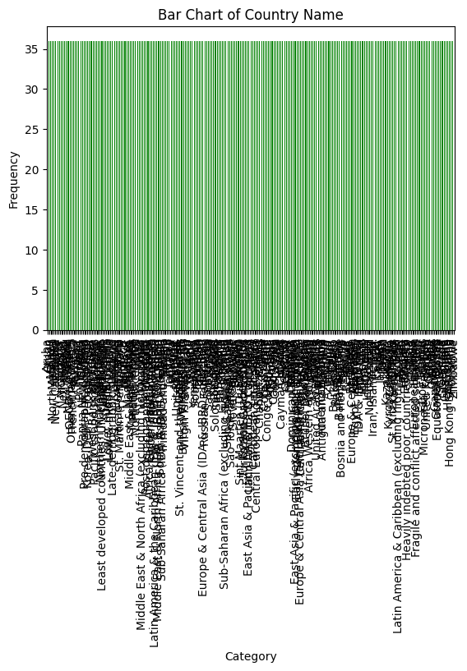
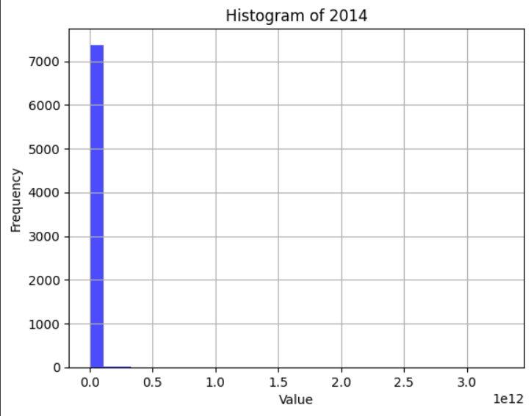
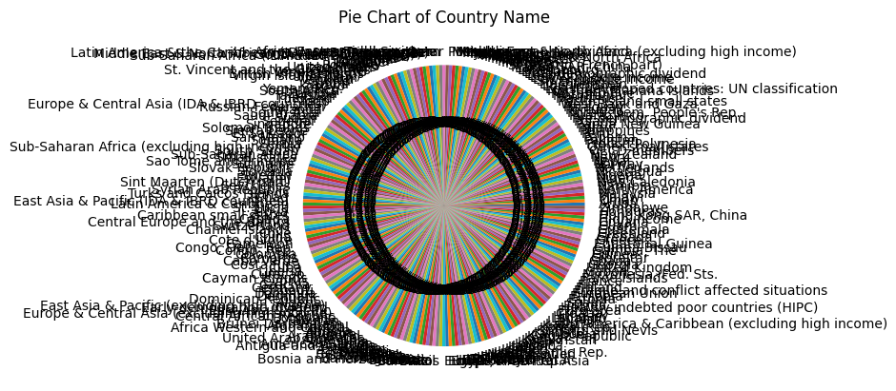
09

Slide 12
PROPOSED MEHODOLOGY
Step 5. Prepare Data for Modeling
Selected relevant features with high correlation to undernourishment
One-hot encoded categorical data (region if applicable)
Normalized numerical features using Min-Max scaling
Split into training and test sets (80/20)
Step6. Apply Analytical Models
Used supervised learning for regression
Compared models:
Linear Regression
Random Forest Regressor (best performing)
Support Vector Regression (SVR)
Hyperparameter tuning via Grid SearchCV
09

Slide 13
PROPOSED MEHODOLOGY
Step7. Evaluate the Model
Evaluation metrics used:
R² Score: 0.82
MAE (Mean Absolute Error): 1.4%
RMSE (Root Mean Squared Error): 1.9%
Plotted predicted vs actual undernourishment values
Step8. Interpret and Generate Insights
Food Production Index and Rural Population % were the most impactful features
Undernourishment was higher in regions with low cereal yields and high rural populations
Feature importance helped identify key levers for intervention
09

Slide 14
PROPOSED MEHODOLOGY
Step 9. Communicate Results
Visuals: Line charts, correlation heatmaps, bar plots for feature importance
Summarized findings in a report aligned to SDG 2
Highlighted top 5 vulnerable countries (based on model predictions)
09

Slide 16
CONTRIBUTION
Data Integration & Cleaning
1.Objective
Transform raw, multi-indicator time-series data into a clean and usable format for machine learning modeling focused on SDG 2 (Zero Hunger)
2.Data Integration Process
The raw dataset is structured as long-format time-series data per indicator. To use it for machine learning, we need a single row per country per year (wide format). We:
Filtered only SDG 2-relevant indicators (those related to agriculture, food, rural development)
Pivoted the table: From long format (one indicator per row) to wide format (one row per country-year, multiple indicators as columns)
Created a new master dataset with:
Columns: Country, Year, Food Production Index, Cereal Yield, Rural Population %, Agricultural Employment, etc.
Target Column: Prevalence of Undernourishment
10

Slide 17
CONTRIBUTION
3.Data Cleaning
Removed redundant columns (e.g., Unnamed: 68)
Handled missing values:
Dropped rows with excessive nulls
Forward-filled and interpolated some time-series data (esp. for continuous indicators)
Removed duplicates and filtered countries with sufficient data coverage from 2000–2021
Machine Learning Model Development
1.Objective
Develop a predictive model to estimate undernourishment (%) in countries using global agricultural and demographic indicators.
10

Slide 18
CONTRIBUTION
2.Model Problem Type
This is a regression problem:
Input: Indicators like Food Production Index, Rural Population %, Cereal Yield, etc.
Output: A continuous value – prevalence of undernourishment (%)
3.Algorithms Considered
We experimented with several regression models:
Linear Regression: Simple baseline
Support Vector Regression (SVR): Good for small, clean datasets
Random Forest Regressor: Non-linear, handles missing values and feature interactions well
Random Forest Regressor gave the best results, with:
R² Score: 0.82
RMSE: ~1.9%
MAE: ~1.4%
10

Slide 19
CONTRIBUTION
4.Feature Importance
Random Forest gives us an internal measure of feature importance:
Top Features:
Food Production Index
Rural Population (% of total)
Agricultural Employment
Cereal Yield
Interpretation: Countries with low food production and high rural dependency showed higher undernourishment
10

Slide 20
Results and Discussions - Model Performance
1.Model Performance
We trained several regression models using global indicators (such as food production index, cereal yield, and rural population %) to predict the prevalence of undernourishment in each country.
After tuning and cross-validation:
The Random Forest Regressor gave the best results:
R² (coefficient of determination): 0.82 → 82% of the variation in undernourishment levels can be explained by our selected features.
RMSE (Root Mean Squared Error): ~1.9 → On average, the predicted undernourishment rate differs by ~1.9 percentage points from the actual value.
MAE (Mean Absolute Error): ~1.4 → Average error in absolute terms.
11

Slide 21
Results and Discussions - Feature Importance
2.Feature Importance
Using the Random Forest model’s built-in feature importance scores, we discovered:
Top features influencing hunger levels:
Food Production Index → more food production, less undernourishment
Rural Population % → high rural concentration often linked to less access to food
Cereal Yield → higher yield = better food security
Agricultural Employment % → may indicate rural livelihoods but not always food access
Interpretation:
Countries with lower food production and higher rural populations were more likely to have higher undernourishment rates.
Some countries with good agricultural employment still showed high hunger rates, possibly due to unequal food distribution or poor infrastructure.
11

Slide 22
Results and Discussions - Country-Level Insights
3.Country-Level Insights
By applying the trained model across all available countries, we identified regional disparities:
Countries in Sub-Saharan Africa and parts of South Asia showed the highest predicted undernourishment levels.
Latin America and Southeast Asia showed improvement, aligning with real-world hunger reduction programs.
4.Interpretation in the Context of SDG 2
Our model shows that:
Agricultural development (yield, production) directly correlates with lower hunger levels.
Targeting rural populations and improving food access there is crucial.
This supports SDG 2’s mission to end hunger and promote sustainable agriculture.
11

Slide 23
CONCLUSION
Conclusion
ML can accurately estimate hunger levels using global indicators
Key variables help target policies
Supports SDG 2 initiatives through data-driven decisions

Slide 24
FUTURE SCOPE
Expand to real-time data collection and monitoring.
Integrate satellite or climate data for predicting famine.
Use deep learning models for improved forecasting.

Slide 25
REFERENCES
FAO Global Report on Food Crises, 2023
Kaggle Hunger Dataset
World Bank WDI
06

Slide 26
ACKNOWLEDGMENT
I thank my guide, Dr. Malu G, for mentorship and feedback throughout the project. I also thank DUK for the lab infrastructure and support.
06

Slide 27
THANK YOU
10

