Slide 1
ONLINE RESORT BOOKING SYSTEM
MINI PROJECT
Department of MCA, MES College of Engineering Kuttippuram
25th October 2023
PREPARED BY
GAYATHRI V (MES22MCA-2024)

Slide 2
GUIDED BY
FEBIN AZIZ
ASSISTANT PROFESSOR
MASTER OF COMPUTER APPLICATIONS
MES COLLEGE OF ENGINEERING,KUTTIPPURAM

Slide 3
CONTENTS .Introduction . Modules . Development Environment . product Backlog . User Story . Project plan . Sprint . Data Flow Diagram

Slide 4
INTRODUCTION Resort management system project main idea is to develop an online web portal for atomization of resort geographic locations. For every resort booking system and to create a scope for visiting tourists from different there will be different branches at different location so managing all these resorts information will be easy through this online application. This application will help to improve services for tourists and also improve revenue source for resorts management . In existing system manual work is used where tourists should contact through phone and know details about web availability of rooms and locations to view at that area. As the usage of internet had increased developing portal will be helpful and atomized. The objectives of the Resort Management System project are to create an online web portal that automates the locations. The resort booking system and provides a scope for attracting tourists from different geographic project aims to enhance the management of resorts and improve services for tourists, ultimately increasing revenue for resort management. Here are the specific objectives:

Slide 5
MODULES ADMIN > Login > Resort Verification > Resort Block/unblock > Resort Based Rating And Reviews > Complaint And Send Reply > View Location > View Users RESORT > Register > Login > Facility management > Manage Room > View Booking And Verify > View Rating And Reviews > Chat with Users > View payment

Slide 6
USER > Register > Login > View Nearest Resort And Track > View Room Allocation > Chat with Resort > View Facilities And Book > View Booking Status > Payment > Send Complaint > View Reply > View Location

Slide 7
DEVELOPMENT ENVIRONMENT HARDWARE SPECIFICATION Processor : Intel Pentium and above RAM : 4GB or more Storage : 40 GB hard disk and above Monitor : LED display Key Board : Windows compatible Mouse : Windows compatible SOFTWARE SPECIFICATION Operating System : Windows 8 or above Front End : HTML,CSS,BOOTSTRAP Back End : MYSQL , Python ,Java IDE : PyCharm community , Android studio Web browser : Chrome,Explorer,Edge.….eg Framework : django

Slide 8
PRODUCT BACKLOG
ID | PROPERTY | HOURS | SPRINT | STATUS | NAME
1 | Medium | 8 | 1 | Partially Completed | Login
2 | High | 10 | 2 | Partially Completed | Form design
3 | High | 11 | 3 | Planned | Table design
4 | High | 11 | 4 | Planned | Coding
5 | High | 7 | 5 | Planned | Testing Data

Slide 9
USER STORY
USER STORY ID | AS A <TYPE OF USER> | I WANT TO | SO THAT I CAN
1 | Admin | Login | Login successful with correct username and password
2 | Admin | Resort Verification | verify resort details
3 | Admin | Resort block/ unblock | Block or unblock resorts
4 | Admin | Resort based rating & reviews | View reviews and ratings
5 | Admin | Complaint and send reply | View the complaints and send reply
6 | Admin | View location | View resorts location
7 | Admin | View users | View users details
8 | Resort | Register | Register resort using valid username and password
9 | Resort | Login | Login successful with correct Username and password

Slide 10
USER STORY
USER STORY ID | AS A <TYPE OF USER> | I WANT TO | SO THAT I CAN
10 | Resort | Facility Management | Manage facilities
11 | Resort | Manage Room | Mange Room
12 | Resort | View Booking & verify | View booking details and verify
13 | Resort | View rating & review | View rating details and reviews
14 | Resort | Chat with users | Chat with customers
15 | Resort | View payment | view payment details
16 | User | Register | Register with Username and password
17 | User | Login | Login successfully with correct username and password
18 | User | View resort and track | View resort and give locations
19 | User | View room allocation | View room details

Slide 11
USER STORY
USER STORY ID | AS A <TYPE OF USER> | I WANT TO | SO THAT I CAN
20 | user | Chat with resort | chat resort details
21 | User | View facilities | View resort facilities
22 | User | View booking Status | View booking details
23 | User | payment | View payment details
24 | User | Send complaint | Send complaint
25 | User | View reply | View reply details
26 | User | View location | View resort location

Slide 12
Project Plan
User Story ID | Sprint | Start Date | End Date | Days | Status
1 , 2 , 3 , 9 , 10 , 11 | Sprint 1 | 15/09/23 | 29/09/23 | 14 | Planned
12 , 13 |  | 30/09/23 | 12/10/23 | 13 | Planned
14 , 4 | Sprint 2 | 13/10/23 | 29/10/23 | 16 | Planned
5 , 14 , 15 | Sprint 4 | 30/10/23 | 3/11/23 | 4 | Planned
6 , 7 ,8,16 | Sprint 3 | 8/11/23 | 30/11/23 | 22 | Planned

Slide 13
Sprint plan
Sprint:1
Backlog Item | Status and Completion date | Original Estimate in hours | Day 1 15/09 | Day 2 20/09 | Day 3 21/09 | Day 4 28/09 | Day 5 29/09 | Day 6 04/10 | Day 7 05/10 | Day 8 06/10 | Day 9 11/10 | Day 10 12/10
Form Design | 15/09/2023 | 2 | 2 | 0 | 0 | 0 | 0 | 0 | 0 | 0 | 0 | 0
Table Design | 28/09/2023 | 3 | 0 | 1 | 1 | 1 | 0 | 0 | 0 | 0 | 0 | 0
Coding | 06/10/2023 | 6 | 0 | 0 | 0 | 0 | 2 | 1 | 1 | 2 | 0 | 0
Testing & Validation | 12/10/2023 | 2 | 0 | 0 | 0 | 0 | 0 | 0 | 0 | 0 | 1 | 1
Total |  | 13 | 2 | 1 | 1 | 1 | 2 | 1 | 1 | 2 | 1 | 1

Slide 14
SPRINT 2
Backlog Item | Status and Completion date | Original Estimate in hours | Day 1 13/10 | Day 2 18/10 | Day 3 19/10 | Day 4 20/10 | Day 5 25/10 | Day 6 26/10 | Day 7 27/10 | Day 8 01/11 | Day 9 02/11 | Day 10 03/11
Form Design | 13/10/2023 | 2 | 2 | 0 | 0 | 0 | 0 | 0 | 0 | 0 | 0 | 0
Table Design | 18/10/2023 | 1 | 0 | 1 | 0 | 0 | 0 | 0 | 0 | 0 | 0 | 0
Coding | 01/11/2023 | 8 | 0 | 0 | 1 | 2 | 1 | 1 | 2 | 1 | 0 | 0
Testing & Validation | 03/11/2023 | 3 | 0 | 0 | 0 | 0 | 0 | 0 | 0 | 0 | 1 | 2
Total |  | 14 | 2 | 1 | 1 | 2 | 1 | 1 | 2 | 1 | 1 | 2

Slide 15
SPRINT 3
Backlog Item | Status and Completion date | Original Estimate in hours | Day 1 08/11 | Day 2 09/11 | Day 3 10/11 | Day 4 15/11 | Day 5 16/11 | Day 6 17/11 | Day 7 22/11 | Day 8 23/11 | Day 9 24/11 | Day 10 29/11 | Day 11 30/11
Coding | 22/11/2023 | 9 | 1 | 1 | 2 | 1 | 1 | 2 | 1 | 0 | 0 | 0 | 0
Testing & Validation | 30/11/2023 | 5 | 0 | 0 | 0 | 0 | 0 | 0 | 0 | 1 | 2 | 1 | 1
Total |  | 14 | 1 | 1 | 2 | 1 | 1 | 2 | 1 | 1 | 2 | 1 | 1

Slide 16
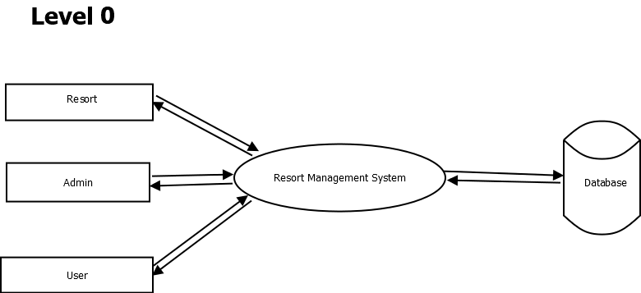
DATA FLOW DIAGRAM:-

Slide 17
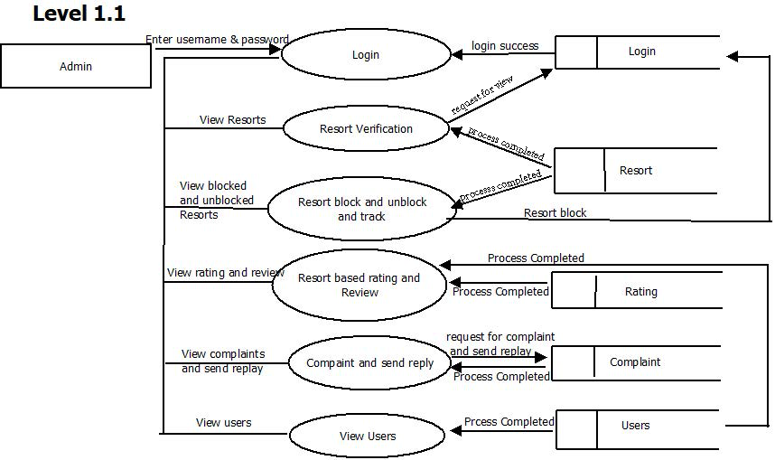

Slide 18
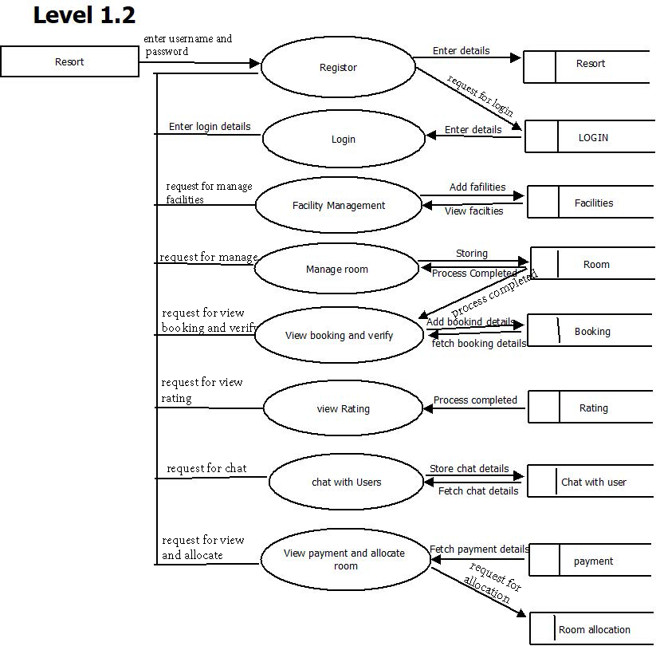

Slide 19
