Slide 1


Slide 2
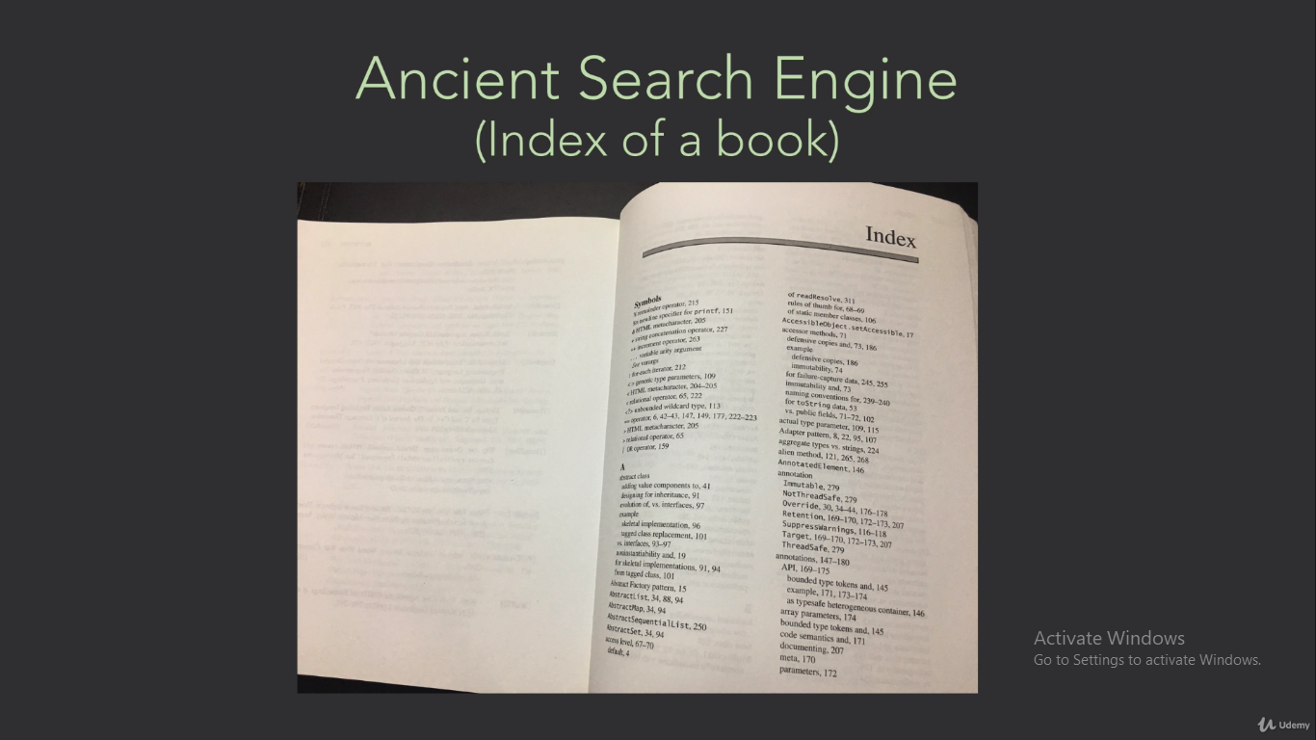

Slide 3


Slide 4
Inverted Index | Elasticsearch: The Definitive Guide [2.x] | Elastic

Slide 5


Slide 6
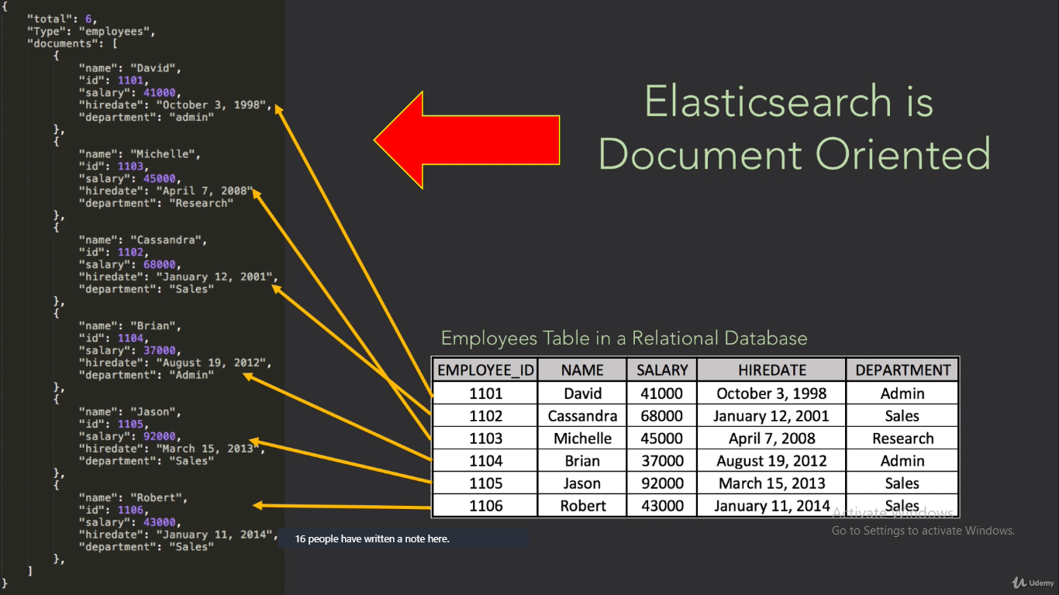

Slide 7
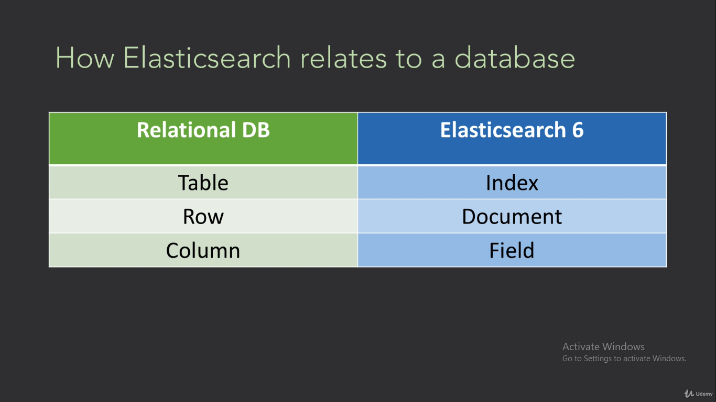

Slide 8
Indexing,Retrieving,Deleting,Updating the documents

Slide 9
Indexing = Inserting (Look at the mappings, Settings)
GET /twitter
PUT twitter
{
"settings":{
"number_of_shards":2,
"number_of_replicas":1
},
"mappings": {
"properties": {
"name": { "type": "text" },
"user_name": { "type": "keyword" },
"email": { "type": "keyword" }
}
}
}
POST twitter/_doc/1
{
"name": “Gayathri",
"user_name": “gaya",
"email": “gaya@hcl.com"
}

Slide 10
Retrieval of the documents
GET /twitter/_doc/1
GET /twitter/_search - retrieves all documents under this index

Slide 11
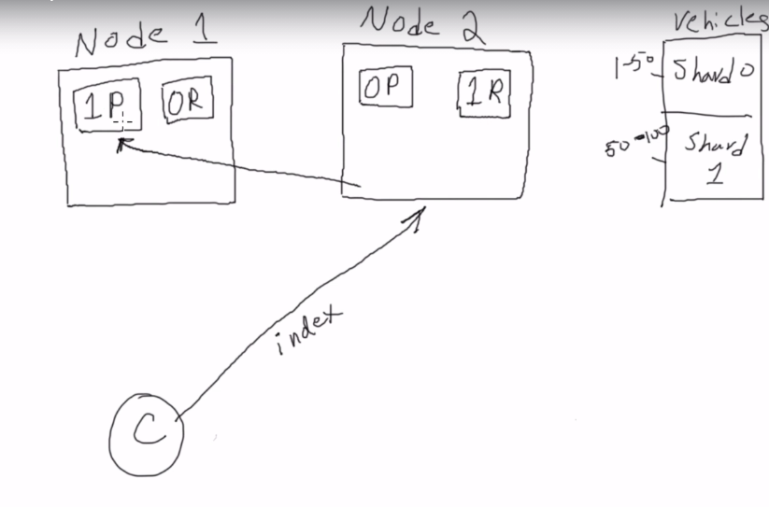
Behind the scenes
Primary shards, replica shards
While indexing/deleting, primary shard has to be written first
While reading, it can read from either primary /replica shards

Slide 12
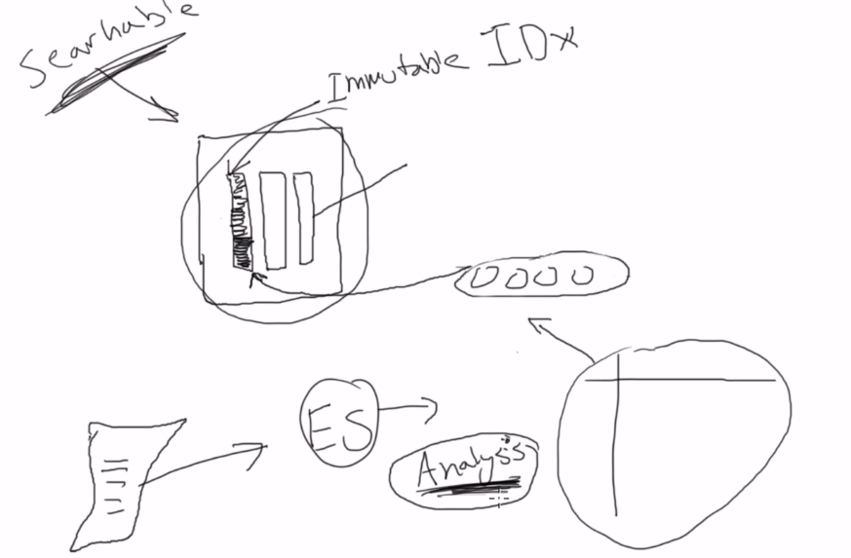
Behind the scenes
Indexing takes time and it is a slow process.

Slide 13
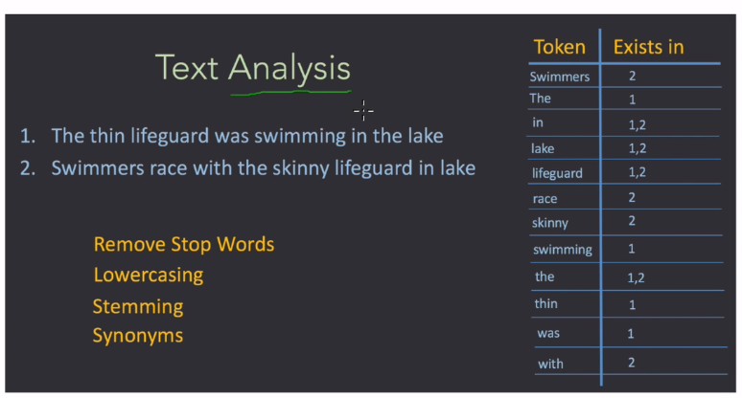
Analyzers

Slide 14
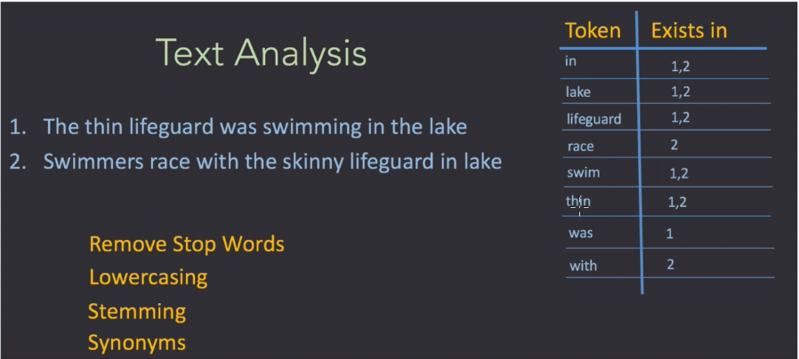
Analyzers
After applying analyzer:

Slide 15
Different Analyzers
Analyzers | Elasticsearch Reference [6.8] | Elastic
POST _analyze{ "analyzer": "whitespace", "text":"The quick brown fox."} – removes whitespace
POST _analyze{ "analyzer": "standard", "text":"The quick brown fox."} – removes full stops,capital converted to lower case
POST _analyze{ "analyzer": "simple", "text":"The quick brown12 fox."}
– removes numbers,full stops,capital converted to lower case
POST _analyze{ "analyzer": "english", "text":"The quick; ; brown12 foxes."} – remove the as it consider as stop words, make plural to singular
Custom analyzer

Slide 16
Analyzer is applied to a field title and keyword on genre – no analyzer will run on key word and it look for exact match
PUT /movies
{ "mappings": {
"properties": {
"id":{"type":"integer"},
"year":{"type":"date"},
"genre":{"type": "keyword"},
"title":{"type":"text","analyzer": "english"}
}
}
}

Slide 17
Index Settings and Mappings
GET /movies to view the index settings and mappings

Slide 18
Search after applying analyzers on title and keywords on genre
GET /movies/_search
{
"query": { "match": { “genre": "sci-fi" } }
}
GET /movies/_search
{
"query": { "match": { “genre": “Sci-Fi" } }
}

Slide 19
Dynamic mapping:
Even though in mapping, the schema is defined, Elastic search accepts other fields while indexing the doc, it accepts gender
PUT /customer/_doc/2
{
"name":"Gaya",
"gender":"F"
}
Make the mapping strict(throws error) or false(ignores the extra field)
PUT /customer/_mapping{ "dynamic":"strict"}
PUT /customer/_doc/3
{
"name":"Gaya",
"address":"Chennai"
}.
Now try to add extra field,it will throw error

Slide 20

DSL components (Domain Specific Components)

Slide 21
Create index courses to perform search query/filter operations for the practice

Slide 22
Match_all : retrieves all documents in the index
GET /courses/_search
{
"query": { "match_all": {}
}
}

Slide 23
To search for specific terms within a field, you can use a match query. GET /courses/_search { "query": { "match": {"name":"computer"} } }
Match Multiple criteria
GET /courses/_search
{
"query": {
"match": {"name":"computer"} , -→ will throw error
"match": {"room":"c8"}
}
}
Use bool and must:
GET /courses/_search
{
"query": {
"bool":{
"must":[
{"match": {"name":"computer"}}, you can also use must not
{"match": {"room":"c8"}}
]
}
}
}

Slide 24
GET /courses/_search
{
"query": {
"bool":{
"must":[
{"match": {"name":"computer"}},
{"match": {"room":"c8"}}
],
"must_not": [
{
"match": {"professor.name": "bill"}}
]
}
}
}

Slide 25
Multimatch:
GET /courses/_search
{
"query":{
"multi_match":{
"fields":["name","professor.department"],
"query":"accounting"
}
}
}

Slide 26
Match Phrase: Match the sentence or part of the sentence(the word shud be complete
GET /courses/_search
{
"query":{
"match_phrase":{
"course_description":"from the business school taken by final year"
}
}
}
Match Phrase_prefix: Match the sentence or part of the sentence(even the word is broken half way like fin instead of final
GET /courses/_search
{
"query":{
"match_phrase_prefix":{
"course_description":"from the business school taken by fin"
}
}
}

Slide 27
Terms : Returns documents that contain one or more exact terms in a provided field.
GET /courses/_search
{
"query": {
"terms": {
"name":[“computer","accounting"]
}
}
}
Range:
GET /courses/_search
{
"query":{
"range": {
"students_enrolled": {
"gte": 10,
"lte": 20
}
}
}
}

Slide 28
Filter: Will just filter the criteria, will not calculate relevancy score like search syntax . Filters are cached. Hence it is faster. If u don’t care about relevancy scoring, we can use filter
GET /courses/_search
{
"query":{
"bool": {
"filter": {
"match":{"name":"accounting"}
}
}
}
}

Slide 29
Now you can see the relevancy score for "must":[{"match":{"room":"e3"}}]
GET /courses/_search
{
"query":{
"bool": {
"filter": {
"match":{"name":"accounting"}
},
"must":[{"match":{"room":"e3"}}]
}
}
}

Slide 30
Aggregation DSL:
GET /vehicles/_search
{
"size":"20", -- display 20 documents )default is 10
"query": { "match_all": {}
}
}
GET /vehicles/_search
{
"query": { "match_all": {} },
"sort": [
{ "price": "asc" }
]
}

Slide 31
Aggregation DSL:
Count
GET /vehicles/_count
{
"query": { "match":{"make":"dodge"}}
}
Group by
-------------------
GET /vehicles/_search
{
"aggs":{
"popular_cars":{
"terms":{
"field":"make.keyword"
}
}
}
}

Slide 32
Aggregation DSL: Average
GET /vehicles/_search
{
"aggs":{
"popular_cars":{
"terms":{
"field":"make.keyword"
},
"aggs":{
"avg_price":{
"avg":{
"field":"price"
}
}
}
}
}
}

Slide 33
Aggregation DSL: Average,max,min
GET /vehicles/_search
{
"aggs":{
"popular_cars":{
"terms":{
"field":"make.keyword"
},
"aggs":{
"avg_price":{
"avg":{
"field":"price"
}
},
"max_price":{
"max":{
"field":"price"
}
},
"min_price":{
"min":{
"field":"price"
}
}
}
}
}
}

Slide 34
Aggregation DSL: Average,max,min based on condition – size 0 will not display the documents
GET /vehicles/_search
{
"size": 0,
"query": {
"match": {
"color": "red"
}
},
"aggs":{
"popular_cars":{
"terms":{
"field":"make.keyword"
},
"aggs":{
"avg_price":{
"avg":{
"field":"price"
}
},
"max_price":{
"max":{
"field":"price"
}
},
"min_price":{
"min":{
"field":"price"
}
}
}
}
} }

Slide 35
Aggregation DSL: stats
GET /vehicles/_search
{
"size": 0,
"query": {
"match": {
"color": "red"
}
},
"aggs":{
"popular_cars":{
"terms":{
"field":"make.keyword"
},
"aggs":{
"stats_price":{
"stats":{
"field":"price"
}
}
}
}
}
}

Slide 36
Aggregation DSL: ranges
GET /vehicles/_search
{
"size": 0,
"aggs":{
"popular_cars":{
"terms":{
"field":"make.keyword"
},
"aggs":{
"sold_date_range":{
"range":{
"field":"sold",
"ranges":[
{"from":"2016-01-01",
"to":"2016-05-18"}
]
}
}
}
}
}
}

Slide 37
Aggregation DSL: ranges
Find how many number of cars are in good/bad/okay condition for each car type

Slide 38
Aggregation DSL: Answer
GET /vehicles/_search
{
"size": 0,
"aggs":{
"car_type":{
"terms":{
"field":"make.keyword"
},
"aggs":{
"car_condition":{
"terms":{
"field":"condition.keyword"
}
}
}
}
}
}

Slide 39
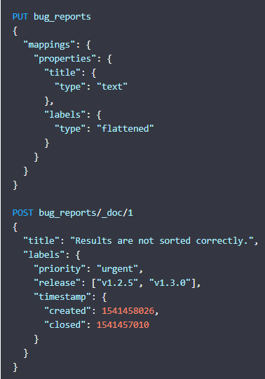
Flattened- If the fields in the mappings keep growing, it explode. Use flattened to avoid
Flattened treat the fields as string keyword. You have to give exact value for the search criteria.

Slide 40
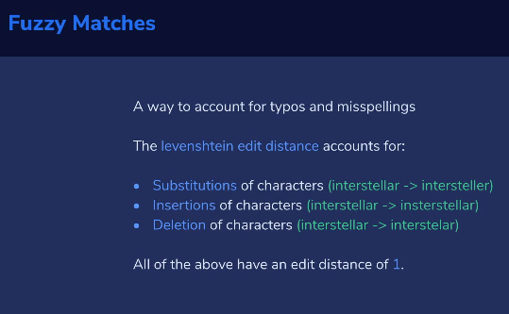
Fuzzy Matches.

Slide 41
Fuzzy Matches.
GET /movies/_search
{
"query":{
"fuzzy": {
"title": {"value":"intrsteller","fuzziness": 2}
}
}
}

Slide 42
Partial Matching using Prefix query;Wildcard query
GET /movies/_search
{
"query": {
"wildcard": {
"year": "1*"
}
}
}
GET /movies/_search
{
"query": {
"prefix": {
"year": "201"
}
}
}

Slide 43
# Sample Logstash configuration for creating a simple
# Kafka -> Logstash -> Elasticsearch pipeline.
input {
kafka {
bootstrap_servers=>"localhost:9092"
topics=>["kafka-logs"]
}
}
output {
elasticsearch {
hosts => ["http://localhost:9200"]
index => "kafka-logs"
#user => "elastic"
#password => "changeme"
}
}

Slide 44
ReIndex API
POST _reindex { "source": { "index": "my-index-000001" }, "dest": { "index": "my-new-index-000001" } }

Slide 45
Alias
POST /_aliases { "actions" : [ { "add" : { "index" : "test1", "alias" : "alias1" } } ] }
POST /_aliases { "actions" : [ { "remove" : { "index" : "test1", "alias" : "alias1" } }, { "add" : { "index" : "test1", "alias" : "alias2" } } ] }

Slide 46
ElasticSearch SQL
An Introduction to Elasticsearch SQL with Practical Examples - Part 1 | Elastic Blog
An Introduction to Elasticsearch SQL with Practical Examples - Part 2 | Elastic Blog

