Slide 1

Productivity Prediction of Garment Industry Employees

Slide 2
Introduction
The Garment Industry is one of the key examples of the industrial globalization of this modern era. It is a highly labour-intensive industry with lots of manual processes.
Satisfying the huge global demand for garment products is mostly dependent on the production and delivery performance of the employees in the garment manufacturing companies.
So, it is highly desirable among the decision makers in the garments industry to track, analyze and predict the productivity performance of the working teams in their factories.

Slide 3
About The Data Set
This dataset includes important attributes of the garment manufacturing process and the productivity of the employees which had been collected manually and also been validated by the industry experts.
Sample data collected through the period from Jan 2015 to Mar 2015
It can be used for regression purpose by predicting the productivity range (0-1) or for classification purpose by transforming the productivity range (0-1) into
classes.
To build a model which is efficient in either
predicting the productivity of the workers
(or)
predicting if the workers can achieve the set target

Slide 4

EXPLORATORY DATA ANALYSIS

Slide 5
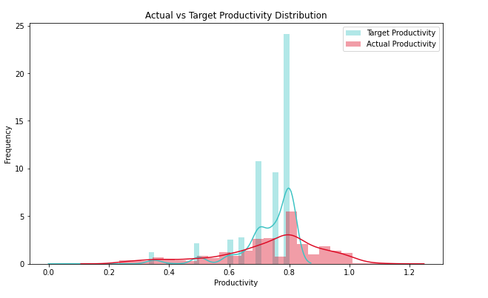
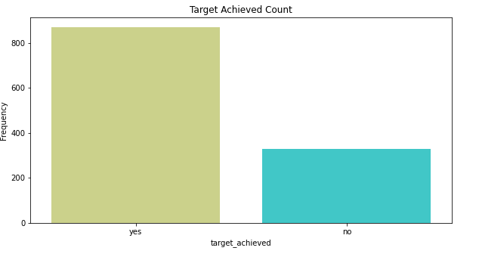
How is actual and target productivity distributed in the sample?
Distribution for both actual and target productivity is slightly left skewed.
For both peak is around 0.8. Maximum value for Target Productivity seems to be set around 0.8 but in few cases Actual Productivity goes beyond 0.8 which is good.
Almost 80 % of the time target has been achieved. It shows that it is an imbalanced dataset

Slide 6
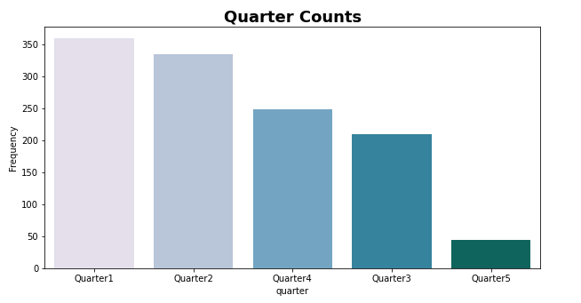
How is the sample data distributed across quarter column?
Quarter1 has more data samples and Quarter5 has least samples.
From Quarter1 to Quarter4 variation is sample is very less ranging from 350 to 220 but Quarter5 has less than 50 samples

Slide 7
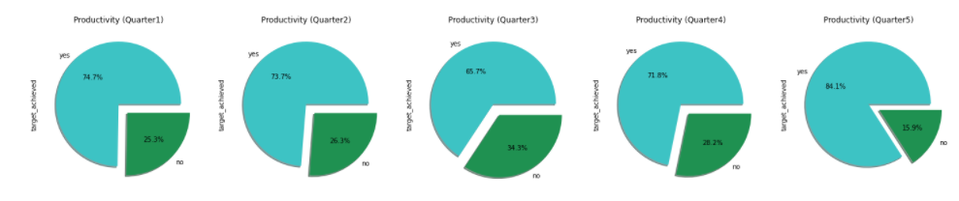
How does quarter column relate to productivity of the workers?
Quarter5 shows 84.1% of data where the target is achieved. This could also be misleading due to very less sample size for the quarter.
If we compare the samples between Quarter1 to Quarter4
Quarter3 is where the target achieved is only 65.7%.
Quarter1 , Quarter2 and Quarter4 is having almost approximately same productivity with Quarter1 being highest of 74.7%

Slide 8
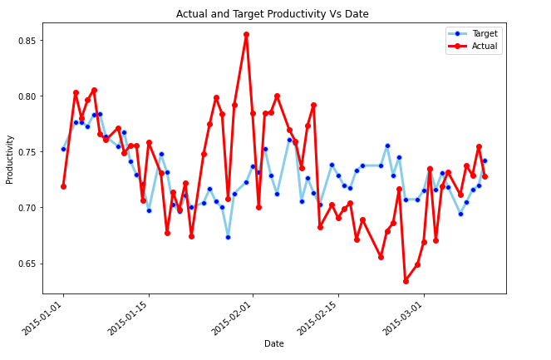
How does productivity of workers vary through the month of Jan 2015 to Mar 2015?
Maximum actual productivity achieved is in the beginning of Feb 2015 where the value is approx. 0.86
Least actual productivity achieved is in the beginning of Mar 2015 where the value is less than 0.5

Slide 9
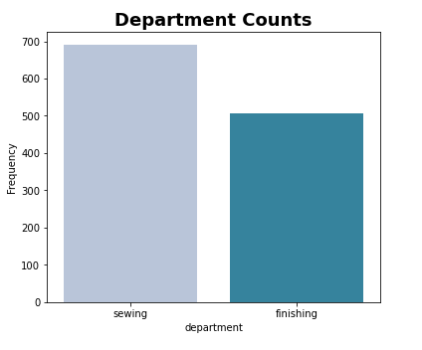
How is sample data distributed with respect to departments?
There are less sample data for finishing around 500 when compared to that of sewing which has 700 records approx.

Slide 10
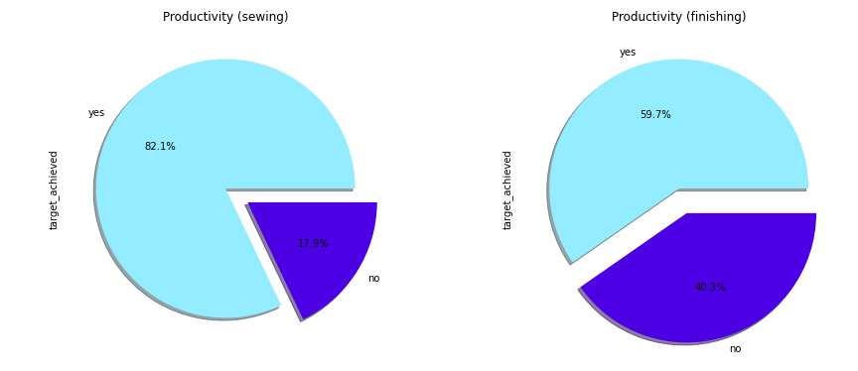
Which of the 2 departments have achieved the target most number of times?
Finishing department is showing only 59.7% of data where the target is achieved whereas sewing department was able to achieve the target 82.1% times.

Slide 11
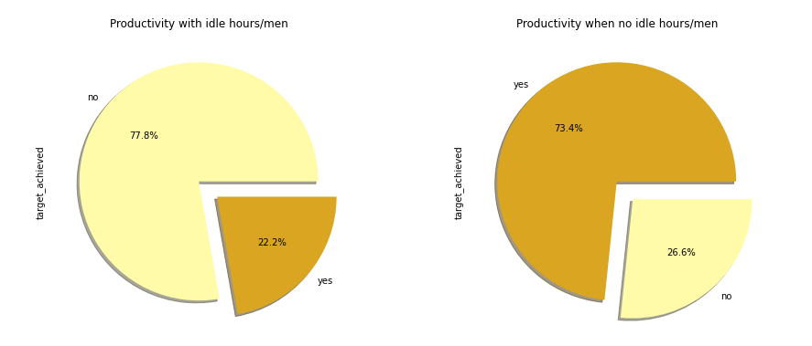
Did "idle hours" / "idle men" affect the productivity?
Productivity has certainly taken a hit when there are idle men or idle hours. The target could not be achieved 77.8% of times when the men were idle.

Slide 12
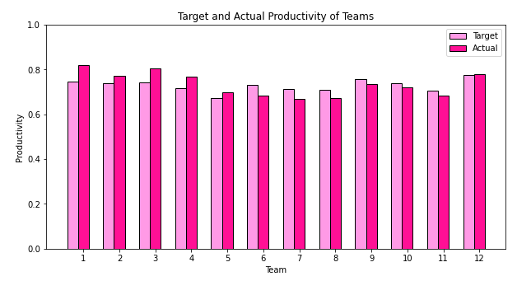
How is the productivity of each team through Jan 2015 to Mar 2015?
Team 1 has highest actual productivity and has done a good job with actual productivity of 0.82 far greater than target 0.73 approx.

Slide 13
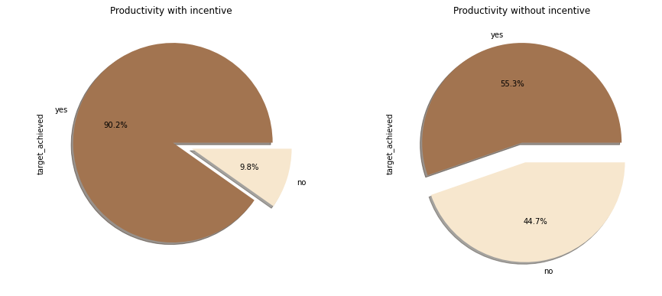
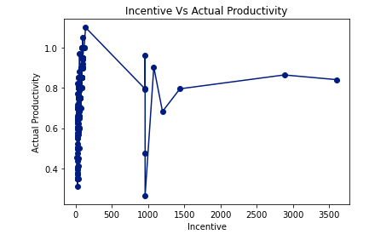
Did incentives help in increasing the productivity?
Productivity is good with incentive. The target was achieved 90.2% of times when incentives were given compared to when incentives were not given which is only 56.3% . It could be possible that incentive contributed to productivity but cannot be definitely concluded that it is the only reason.

Slide 14
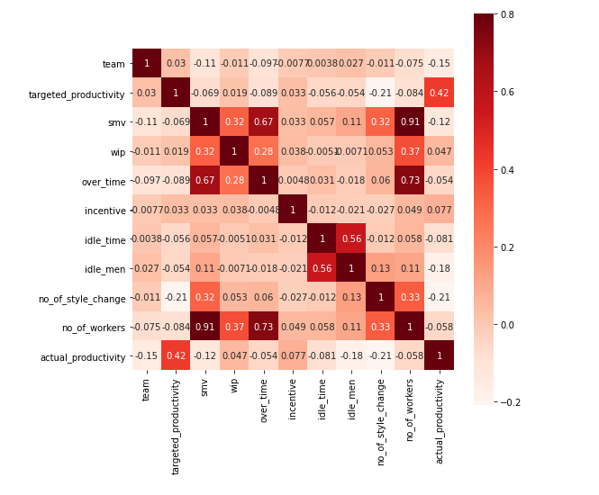
Are there any correlation between the features?
There is high correlation observed between no_of_workers , smv , overtime
There is some correlation between no_of_style_change and no_of_workers
There is correlation between idle_time and idle_men
But, we dont see any variable having strong correlation between target variable actual_productivity and other independent variables execept for targeted productivity

Slide 15
Conclusion:
Maximum value for Target Productivity seems to be set around 0.8 but in few cases Actual Productivity goes beyond 0.8 which can be considered good. This gives us the oppurtunity to create a categorical column where target_productivity can be a compared to actual_productivity to check whether the target is achieved or not.
There is only one variable target_productivity having strong correlation between target variable actual_productivity. This could also mean the regression models could fail in predicting the productivity.
idle_time/ idle_men has caused some dip in productivity.
The other variables did not provide any conclusive evidence of being directly affecting the productivity

Slide 16

Model EVALUATION

Slide 17
Regression Models

Slide 18
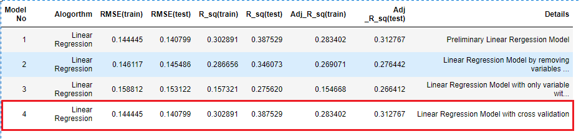
Linear Regression Models
On summarizing the models built on linear regression, none of the models seem to be efficient .
Adjusted R Square value for the testing data is only ranging from 0.26 to 0.31

Slide 19
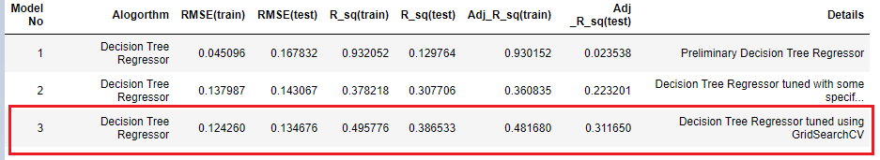
Decision Tree Regressor Models
Decision tree algorithm in model 1 seems to be overfitting where Adjusted R2 for training is as good as 0.93 compared that on testing dataset is as poor as 0.023.
The overfitting problem seems to be resolved in model 2 and 3 but still the values are not satisfactory

Slide 20
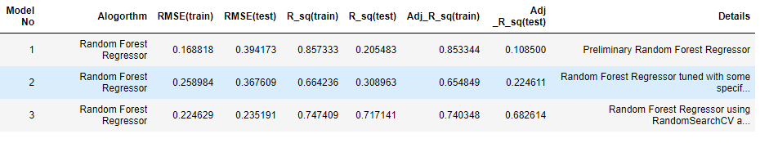
Random Forest Regressor Models
Random Forest Regressor algorithm in model 1 also seems to be overfitting where Adjusted R2 for training is as good as 0.85 compared that on testing dataset is as poor as 0.1083.
The overfitting problem seems to be resolved in model 2 and 3 but still the values are not satisfactory
Model 3 appears to be better compared to all the other models

Slide 21
Classification Models

Slide 22

Logistic Regression Models
The Logistic Regression model is giving better result when compared to Linear regression model which failed to give any satisfying Adjusted R squared value.
Since , this is an imbalanced dataset we can look into F1 score along with accuracy.
The logistic regression model 1 is giving the accuracy of 0.79 and F1 score of 0.86. Model 1 is better than Model 2 in this case

Slide 23
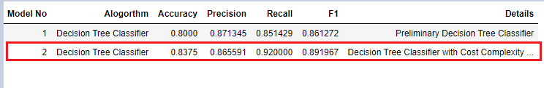
Decision Tree Classifier Models
The Decision tree algorithm seems to be performing better in this case compared to Logistic Regression .
The model 2 with cost complexity pruning is giving the accuracy of 0.83 and F1 score of 0.89 which is better than model 2 accuracy

Slide 24
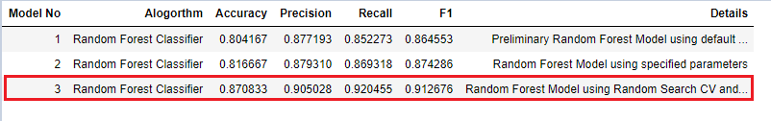
Random Forest Classifier Models
Random Forest Classifier model 3 which is using both RandomSearchCV and GridSearchCV is giving the accuracy of 0.87 and F1 score of 0.912 is the best model so far when classification model is considered

Slide 25
Summary

Slide 26
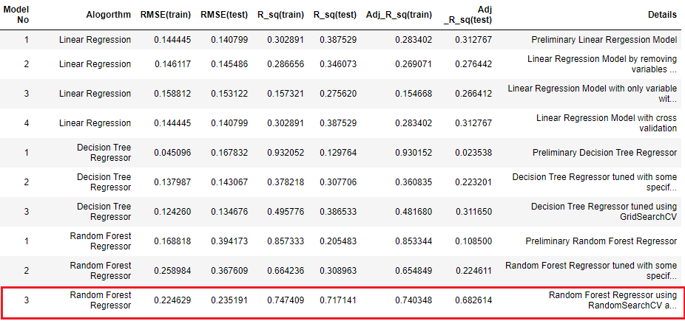
Summary of Regression Models Evaluations

Slide 27
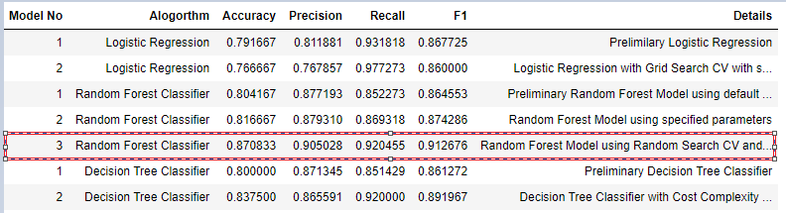
Summary of Classification Models Evaluations

Slide 28
Thank You

