Slide 1

GENE Expression DatAset Molecular Classification of Cancer by Gene Expression Monitoring

Slide 2
Introduction
Gene Expression dataset comes from a proof-of-concept study published in 1999 by Golub et al.
It shows how new cases of cancer could be classified by gene expression monitoring (via DNA microarray) and thereby provided a general approach for identifying new cancer classes and assigning tumors to known classes.
These data were used to classify patients with acute myeloid leukemia (AML) and acute lymphoblastic leukemia (ALL).

Slide 3
About The Data Set
There are two datasets containing the initial (training, 38 samples) and independent (test, 34 samples) datasets used in the paper.
These datasets contain measurements corresponding to ALL and AML samples from Bone Marrow and Peripheral Blood.
data_set_ALL_AML_train.csv
data_set_ALL_AML_independent.csv
There is also actual dataset, which stores the labels / target variable, the patent ids go from 1 to 72.
actual.csv
Intensity values have been re-scaled such that overall intensities for each chip are equivalent.

Slide 4
Data Cleaning
Before jumping to the sophisticated methods, some very basic data cleaning had to be performed.
Initially, training dataset had shape of (7129,78) and testing (7129, 70) which clearly shows that the columns in the dataset are not matching.
Actual dataset which stores the label of each patient had shape of (72, 2) i.e. 72 rows / 72 patients.
After doing the data cleaning , the full dataset had the shape of (72,7131) i.e. 72 rows and 7131 columns.

Slide 5

EXPLORATORY DATA ANALYSIS

Slide 6
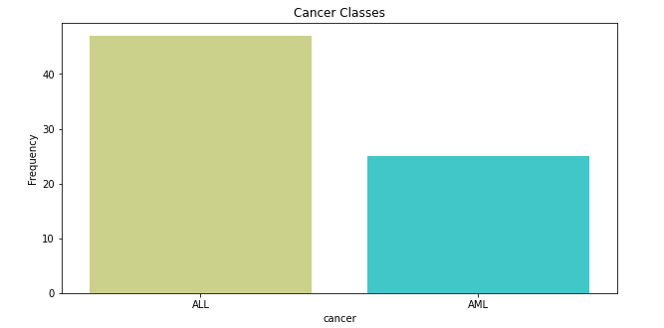
As there are 7130 features in the dataset, leaves very little scope to perform EDA. We can perform some analysis on target variable
The value count of ALL and AML and 47 and 25 respectively which shows that dataset is highly imbalanced

Slide 7
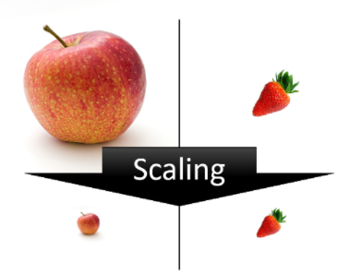
Feature Scaling

Slide 8
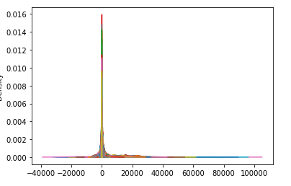
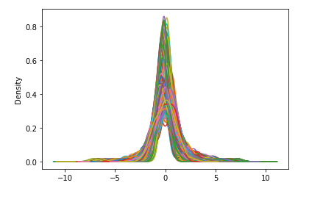
Before Scaling
After Scaling

Slide 9
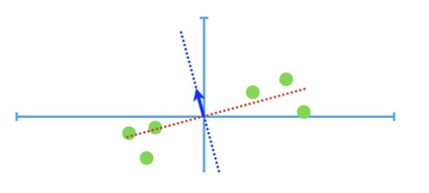
Principle Component Analysis

Slide 10
One of the major problems with this dataset is that it has too many predictors (almost 7000+).
To go through each of these predictors and see which ones are significant for the model is going to be a tedious task.
Instead, we can use a dimensionality reduction technique - Principle Component Analysis.

Slide 11
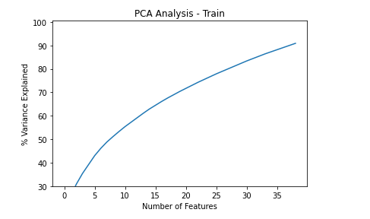
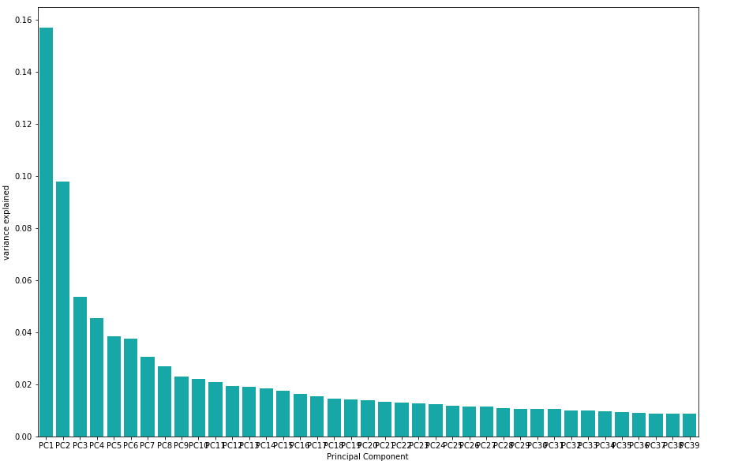
DIMENTIONALITY REDUCTION- PCA
39 components out of 7131 explain 39% variance in data which is NOT bad.

Slide 12
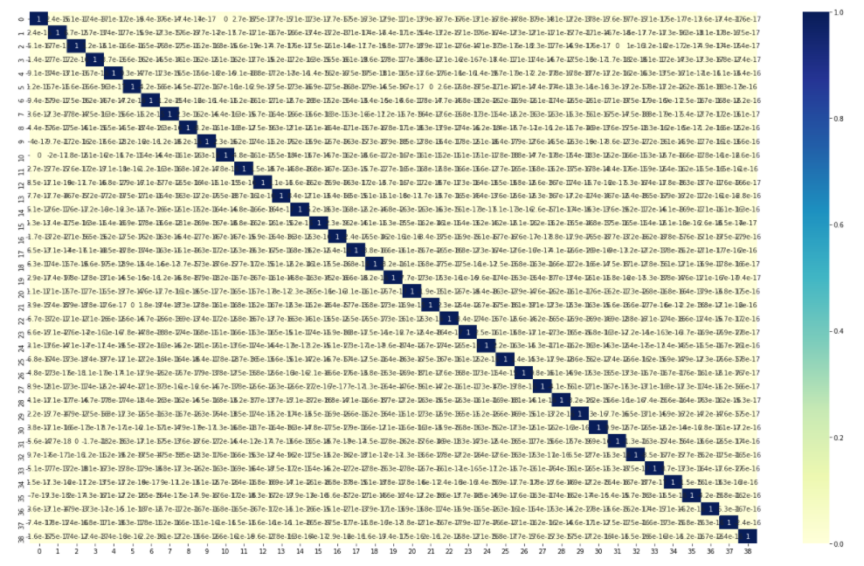
This confirms the claim that PCA gives us output where Multi-collinearity is eliminated.
The above output has numbers that show correlation coef's as close to 0

Slide 13
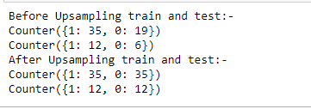
SMOTE Technique
Note :Target variable is encoded by replacing ALL to 1 and AML to 0

Slide 14

Model EVALUATION

Slide 15


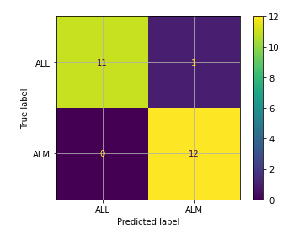
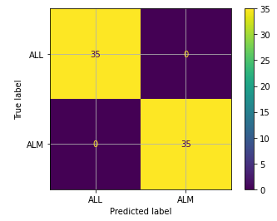
Logistic Regression
Hyper parameter Tuning
TRAIN Set Score
TEST Set Score

Slide 16


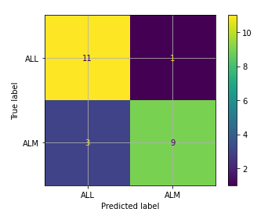
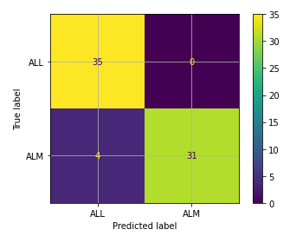
Naïve Bayes
Hyper parameter Tuning
No parameters to tune for Naïve Bayes
TRAIN Set Score
TEST Set Score

Slide 17



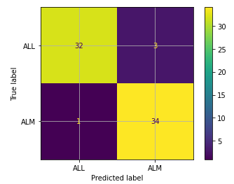
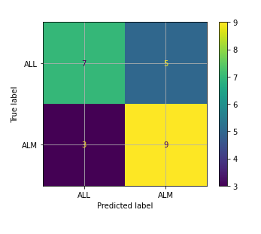
Decision Tree Classifier
Hyper parameter Tuning
TRAIN Set Score
TEST Set Score

Slide 18



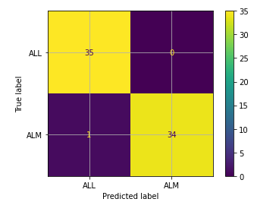
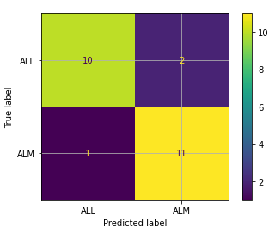
Random FOREST Classifier
Hyper parameter Tuning
TRAIN Set Score
TEST Set Score

Slide 19


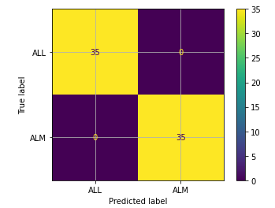
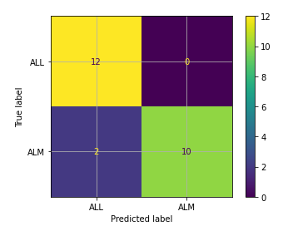
KNN Classifier
Hyper parameter Tuning
TRAIN Set Score
TEST Set Score

Slide 20


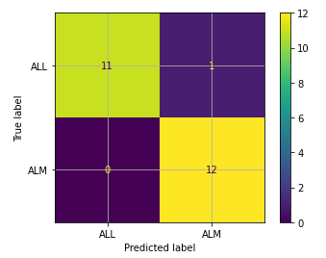
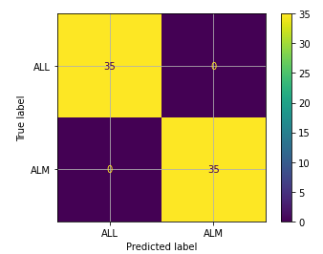
SVM Classifier
Hyper parameter Tuning
TRAIN Set Score
TEST Set Score

Slide 21
Summary

Slide 22
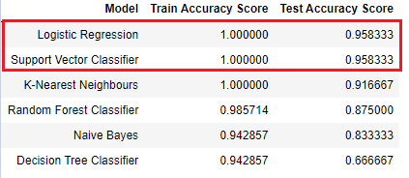
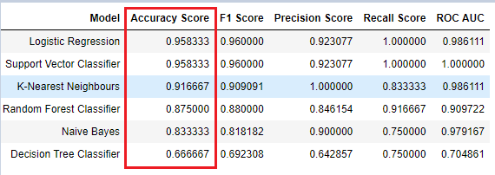
Summary of Model Performances Since the dataset is balanced by using SMOTE technique , we will focus on the accuracy of the model
Both Logistic Regression and SVM Classifier model is giving approx. 95% accuracy. Both have the similar test and train accuracy scores

Slide 23
Thank You

