Slide 1

Work-Life-Balance during COVID19
Team 13
Ausaf Ahmed
Gayathri Ganesh
Osama Soliman

Slide 2









What does being happy mean to you ?

Slide 3
OUR AIM
Study
Study factors contributing to happiness
Find
Find relationships between demographics and categories of happiness
Identify
Identify distributions of stress elevation elements

Slide 4
SOURCE DATASET
Referenced from the research paper published in Cornell University
100,000 happy moments
Crowd sourced via Amazon
Demographics of contributors are part of the dataset

Slide 5
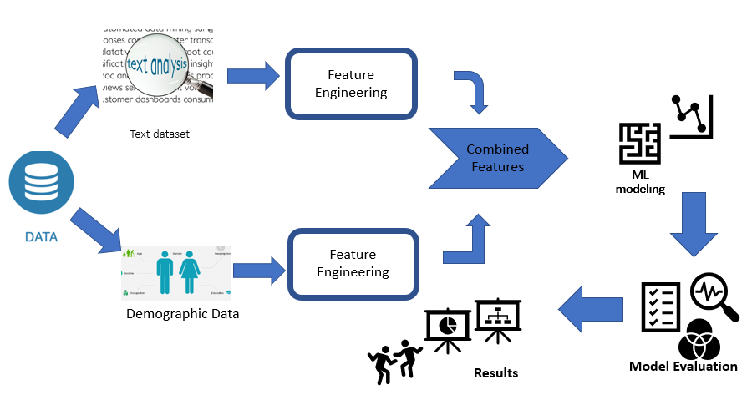
SYSTEM MODEL DESIGN

Slide 6
DATA PREPROCESSING
Encoded categorical values from string categories to numbers
Merged demographics and happy moments
Remove punctuation and stop words
Lemmatizing performed on sentences
Stemming performed on sentences
TFIDF CALCULATION

Slide 7
DATA ANALYSIS
Most frequent words
Happiness category per demographic
Most used word per category
Most used word per demographic

Slide 8
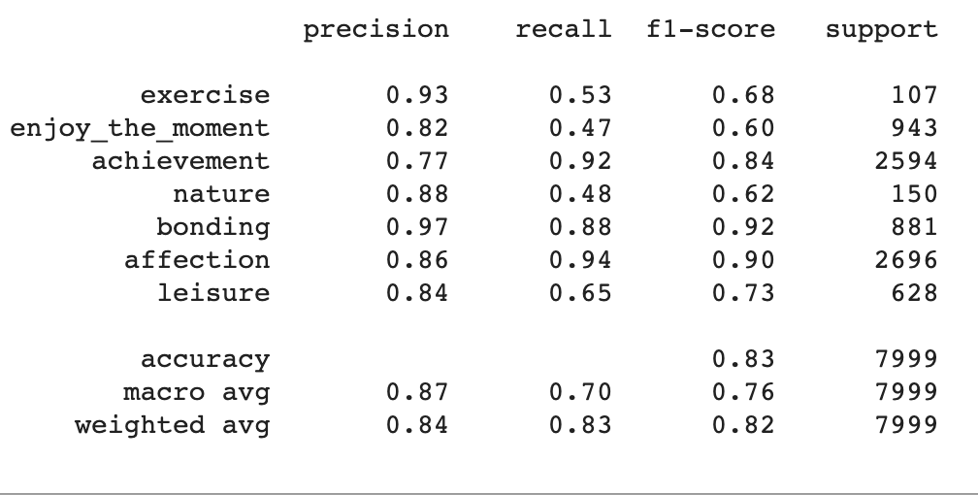
RANDOM FOREST

Slide 9
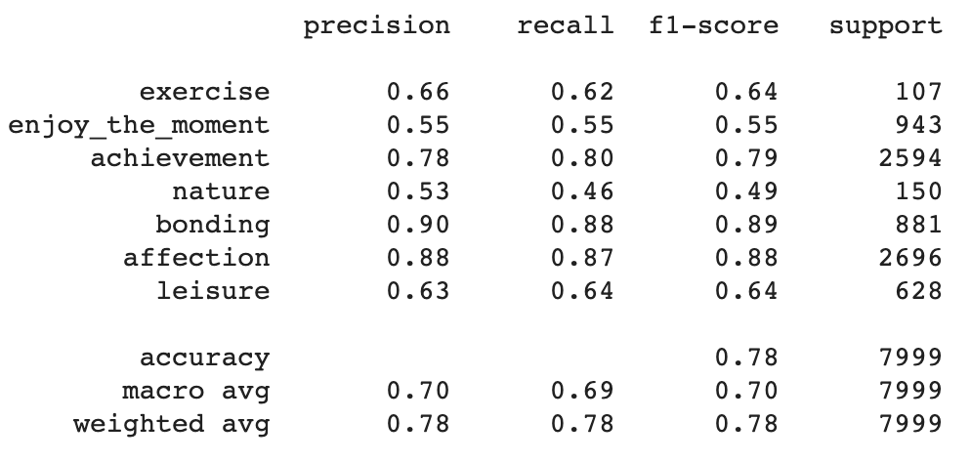
DECISION TREE

Slide 10
CHALLENGES FACED
Cache restrictions
Models selection
Hyper parametrization
Feature Engineering

Slide 11
CONCLUSION
Happiness and family
Happiness and friends
Happiness and achievements
Correlations between demographics and happiness

Slide 12
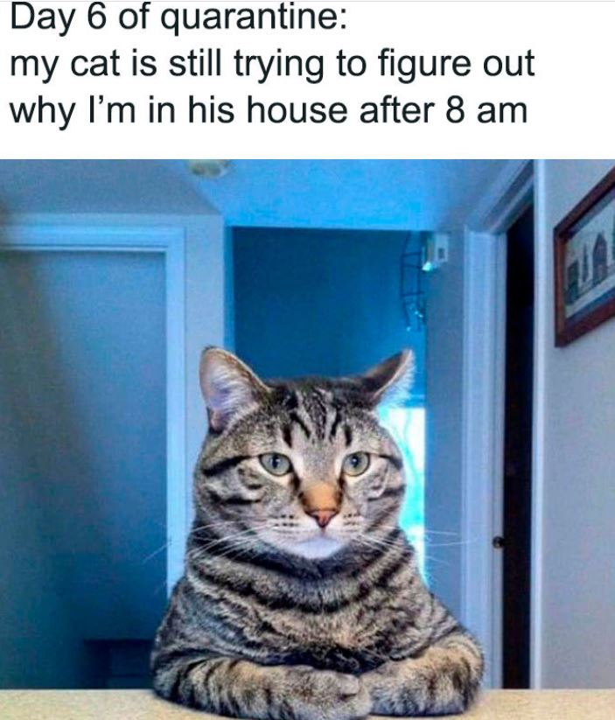
Hopefully we are out of this isolation ‘happy’ !

