Slide 1

Lung and Colon Cancer Detection from Scanning Images using EfficientNetB3
tEam members
md. Naseema 22c51a6634
sk. Meeravali 22c51a6650
g. gayathri 22c51a6613
b. jeshvanth verma 22c51a6607
guided by: head of THE department
Mrs. N. sudharani Dr. t. veeranna
ASSISTANT PROFESSOR associate professor

Slide 2
Scope of this Project
Introduction
Existing System
Proposed System
System Architecture
Modules
System Requirements
UML Diagrams
Output Screenshots
Conclusion

Slide 3
Introduction
Lung and colon cancer are among the leading causes of cancer-related deaths worldwide, where early detection plays a critical role in improving survival rates.
Traditional diagnosis using histopathological images is time-consuming and depends heavily on expert pathologists.
This project proposes an automated deep learning-based system for cancer detection from microscopic tissue images.
The model uses the EfficientNetB3 architecture to extract meaningful features and perform multi-class classification.
The system is deployed through a web application to provide fast, accurate, and real-time cancer prediction support.

Slide 4
Actual problem in Existing models
Manual Diagnosis Process: Cancer detection from histopathological images is performed manually by pathologists, which is time-consuming and requires expert knowledge.
Limited Accuracy: Human analysis may sometimes lead to misclassification due to fatigue, subjectivity, or complex tissue patterns.
Slow Processing: Large volumes of scanning images increase workload and delay diagnosis.
No Automation: There is no intelligent automated system to assist doctors in real-time cancer classification.

Slide 5
Objective of the Proposed System
Improve Detection Accuracy: Develop a highly accurate deep learning model using EfficientNetB3 that captures complex tissue patterns and microscopic features.
Automate Diagnosis Process: Implement an AI-based system to automatically classify lung and colon cancer from histopathology images.
Increase Efficiency: Reduce diagnosis time by providing fast and real-time prediction results through a web application.
Improve Diagnostic Support: Assist medical professionals in identifying cancer types more reliably and consistently, supporting early detection and better treatment decisions.

Slide 6
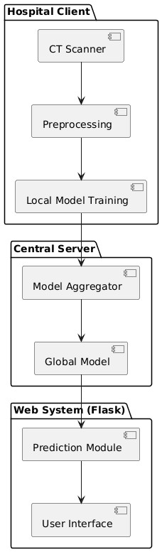
System Architecture

Slide 7
Modules
Image Upload: The user uploads lung or colon scanning images through the web interface, and the system validates and stores them for further processing.
Preprocessing: The uploaded image is resized, normalized, enhanced, and converted into an array format to prepare it for the EfficientNetB3 model.
EfficientNetB3 Model: The EfficientNetB3 model extracts important features from the image and classifies it into lung cancer, colon cancer, or normal category with prediction confidence.
Prediction: The system processes the model output, generates a readable prediction label, and prepares the final result.
Web Interface: The system displays the predicted cancer type, confidence percentage, and uploaded image through a user-friendly interface.

Slide 8
System Requirements
Hardware Requirements
Software Requirements
System: Pentium IV 2.4 GHz
Hard Disk: 40 GB
Floppy Drive: 1.44 MB
Monitor: 15 VGA Colour
Mouse: Logitech
Ram: 512 MB
Operating System: Windows
Coding Language: Python 3.7

Slide 9
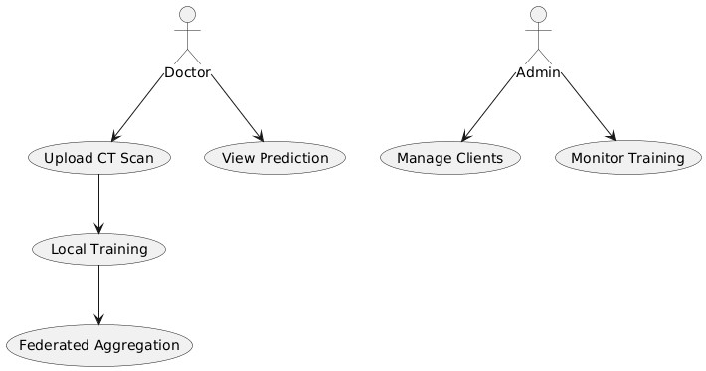
UML Diagrams
Use case Diagram:

Slide 10
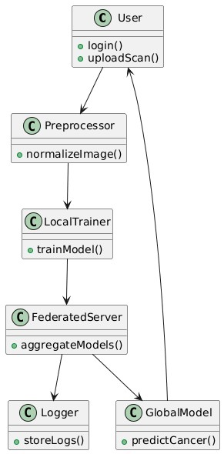
Class Diagram:

Slide 11
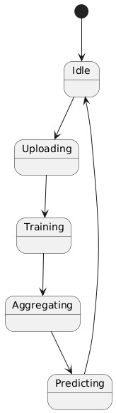
State Diagram:

Slide 12
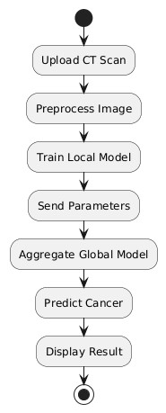
Activity Diagram:

Slide 13
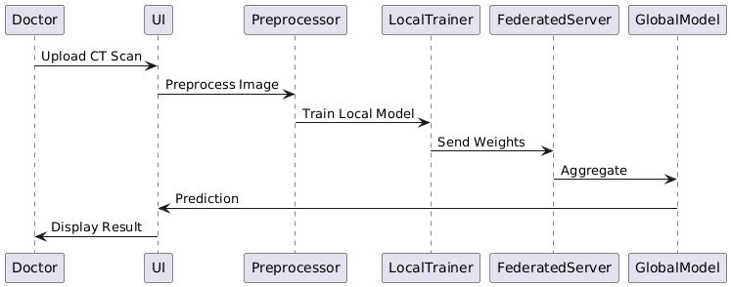
Sequence Diagram:

Slide 14
Collaboration Diagram:

Slide 15
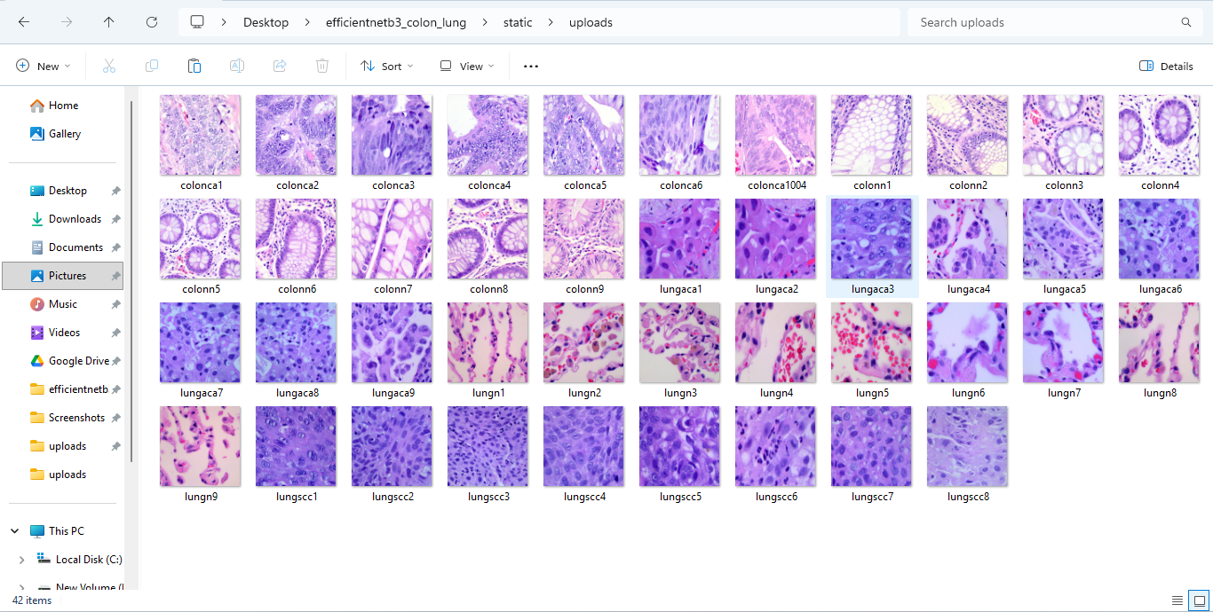
Output Screenshots

Slide 16
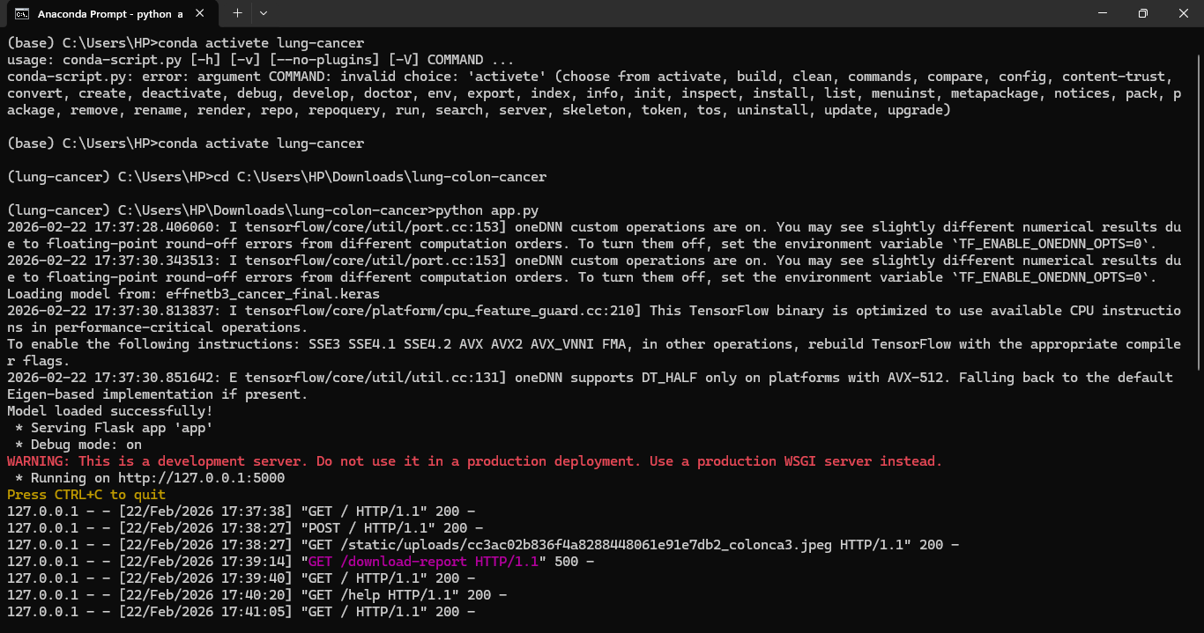

Slide 17
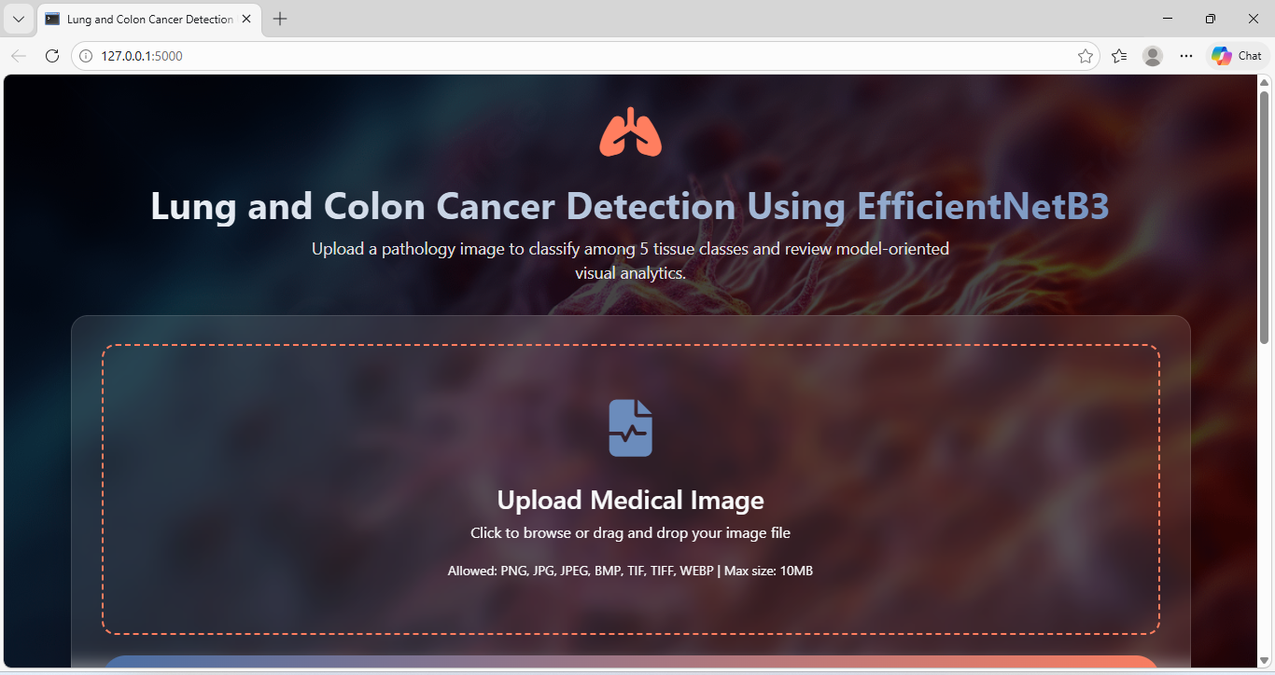

Slide 18
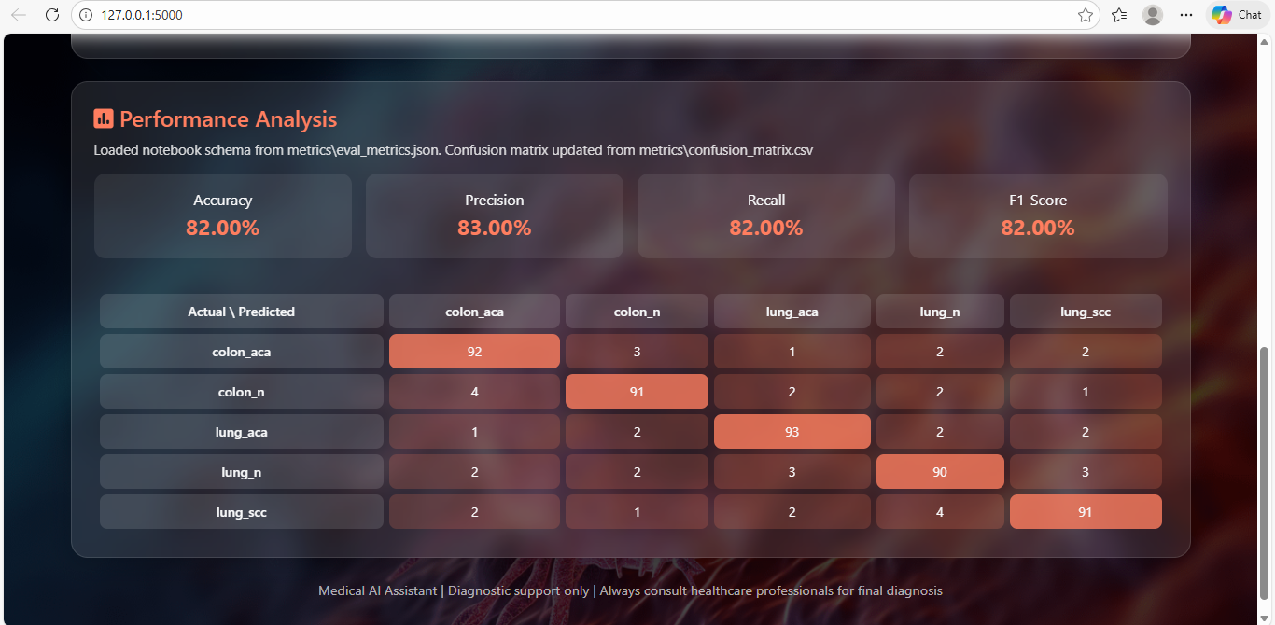

Slide 19
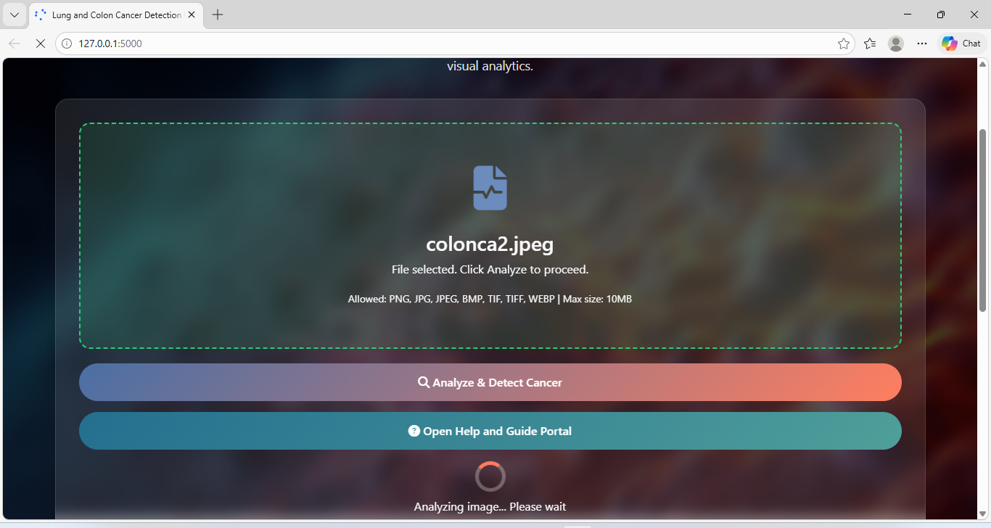

Slide 20
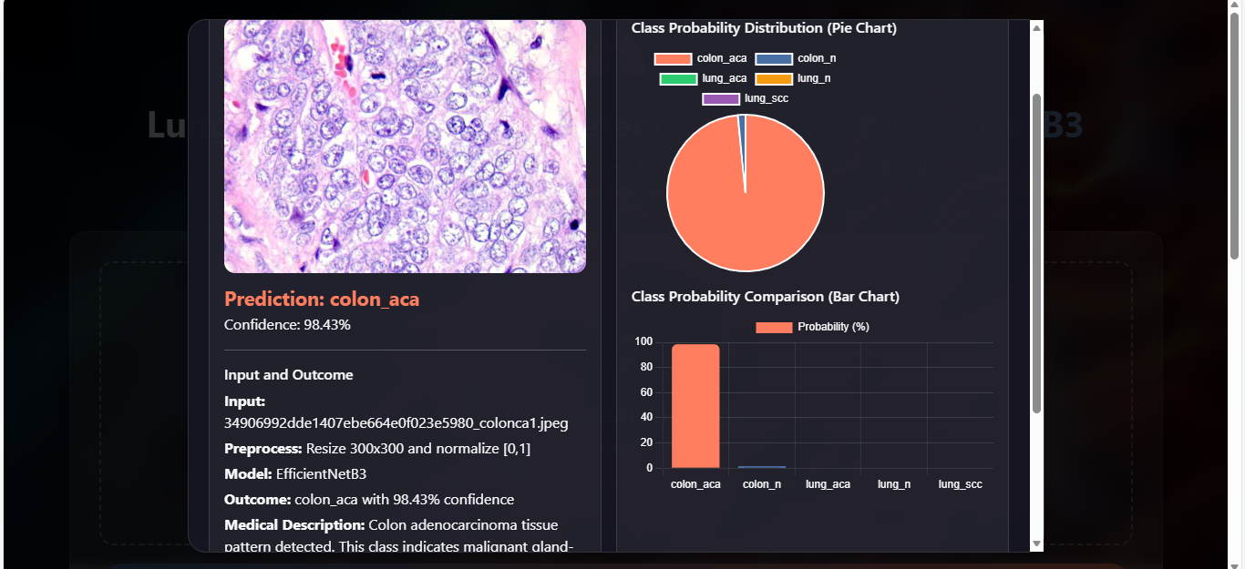

Slide 21
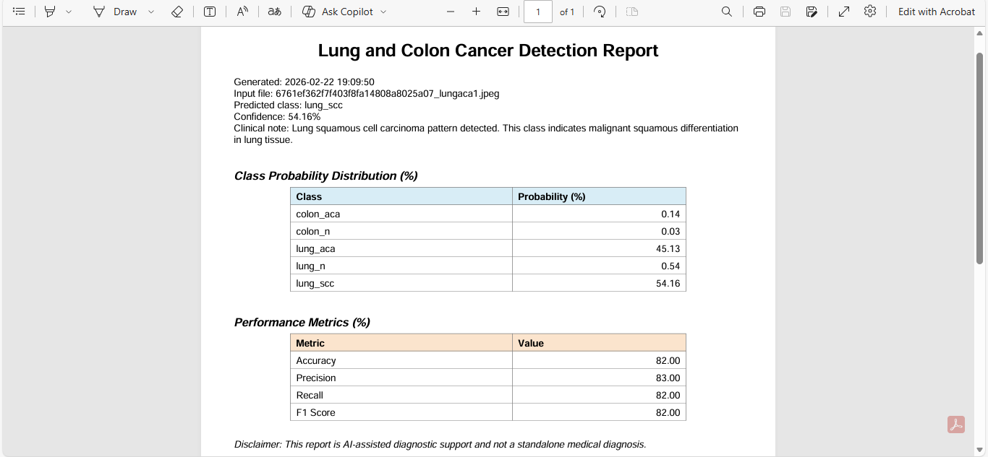

Slide 22
Conclusion & Future Scope
Conclusion:
The project successfully implements an AI-based multi-class cancer detection system. EfficientNetB3 provides high accuracy with efficient computation. The system reduces manual effort and supports faster diagnosis. It can assist doctors in early detection of lung and colon cancer. Future improvements can include larger datasets and deployment in hospitals.
Future Scope:
The system can be improved by training on larger datasets to increase accuracy. It can be integrated into hospital systems for real-time use. The model can also be extended to detect more cancer types and deployed as a cloud or mobile healthcare application.

Slide 23


