Slide 1
DAY 1

Slide 2
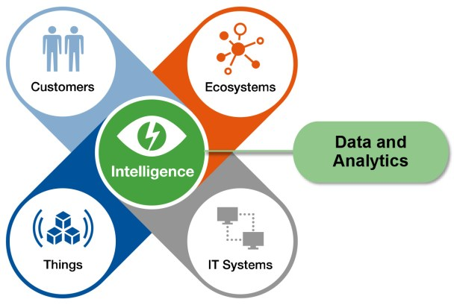
Analytics - Statistics
Modeling
What?

Slide 3
Customer :customer behavior is used to help make key business decisions via market segmentation.
Eco systems :Three types of data: structured, unstructured, and multi-structured. Like the name implies, structured data is clean, labeled, and organized, such as a website’s total number of site visits exported into an Excel spreadsheet. Unstructured is data that hasn’t been organized for analysis, for example, text from articles. Multi-structured data is data that’s being delivered from different sources in a variety of formats–it could be a combination of both structured and unstructured.
Applications :are the walls and roof to the data ecosystem house–they’re services and systems that act upon the data and make it usable. For example, a product team might decide to port its analytics data into its marketing, sales, and operations platforms. This would allow the marketing team to score leads based on activity, the sales team to get alerts when ideal prospects engage, and operations teams to automatically charge customers based on product usage.

Slide 4
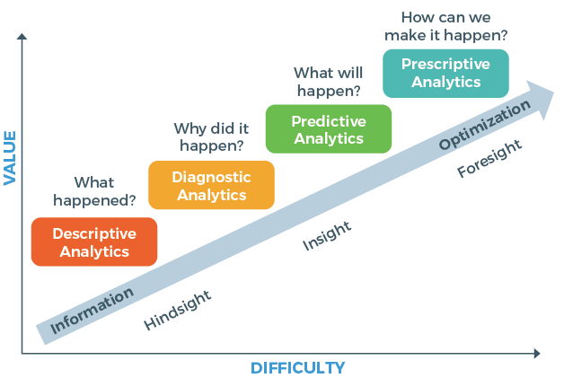

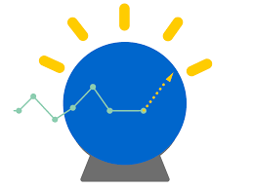



Types?

Slide 5
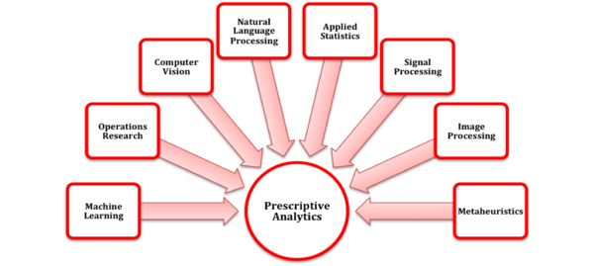
Descriptive Analytics: With descriptive statistics you are simply describing what is or what the data shows.
Ex:Cash flow analysis, sales and revenue reports, performance analysis etc are common examples of descriptive analytics.
Diagnostic Analytics is a form of advanced analytics which examines data or content to answer the question “Why did it happen?”, and is characterized by techniques such as drill-down, data discovery, data mining and correlations.
Predictive analytics is the practice of extracting information from existing data sets in order to determine patterns and predict future outcomes and trends.
It forecasts what might happen in the future with an acceptable level of reliability, and includes what-if scenarios and risk assessment.
Prescriptive analytics
prescriptive analytics entails the application of mathematical
and computational sciences and suggests decision options

Slide 6





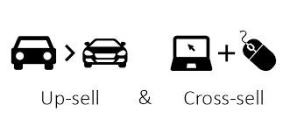
Why?
Fraud Detection
Application Screening
Marketing Optimization
Customer buying Habits

Slide 7
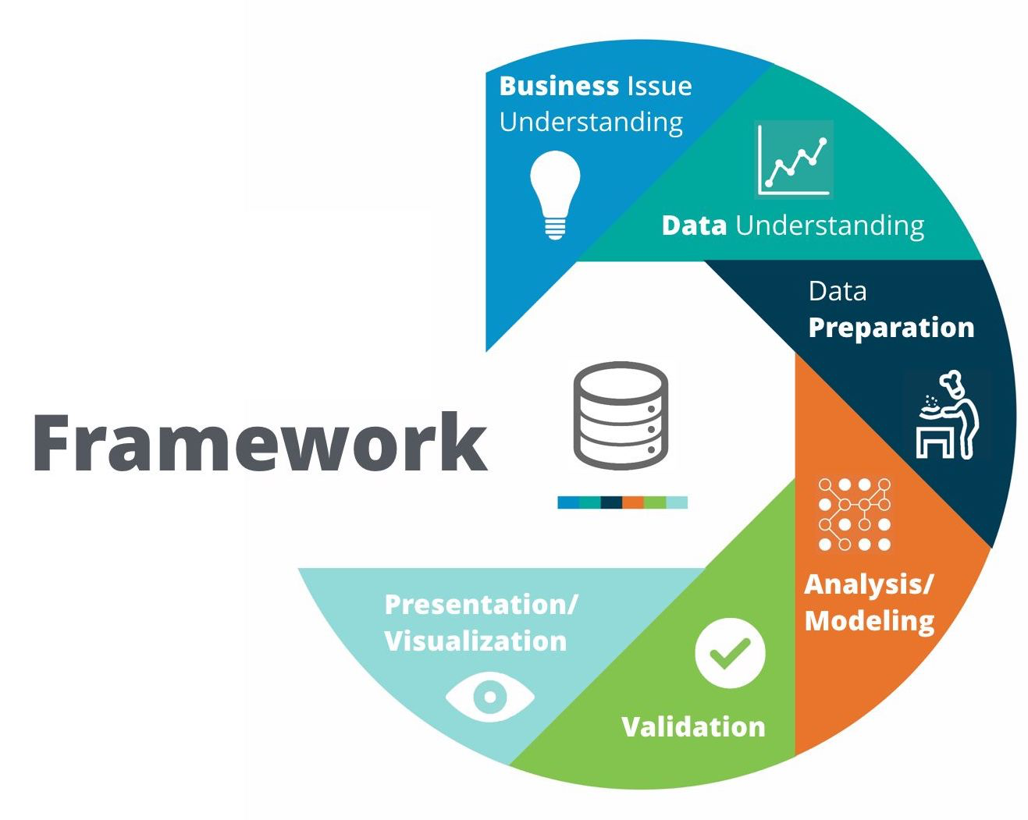
CRISP Analysis Approach
Business Understanding
Data Understanding
Data Preparation
Modeling
Evaluation
Visualization

Slide 8
https://socialresearchmethods.net/kb/statdesc.php

Slide 9
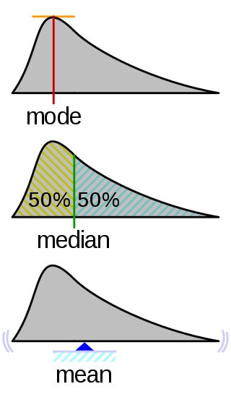
Central tendency
Mean:Sum of all observations/number of observations.
2+4+6+8+10+12+14+16+18+20 = 11
10
Median: Middle value separating highest and lowest
1,3,3,6,7,8,9 → 6
1,2,3,4,5,6,7,8 → (4+5)/2=4.5
Mode:Highest repeating frequency
12,3,2,4,5,2,14→ 2

Slide 10
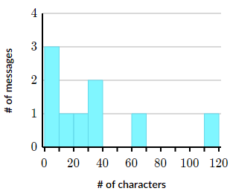
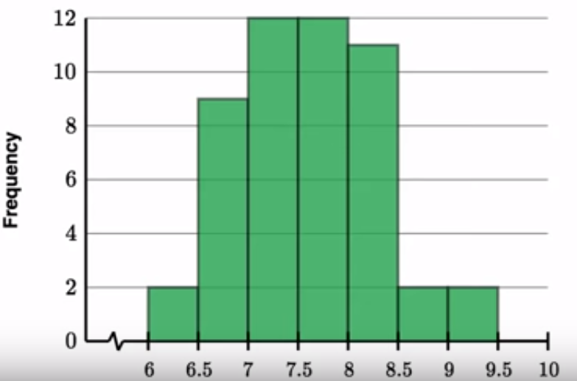
Quiz::
1.The following data points represent the number of slices of pizza that each person at Thorton's birthday party ate.
Sort the data from least to greatest.
77 99 33 22 44 33 11
Find the median number of slices.
2.The following data points represent the number of pumpkins at each pumpkin patch in Witchton, Kansas.
52, 24, 41, 61, 89, 36, 5652,24,41,61,89,36,56
Find the median number of pumpkins.
3.Jade recorded how many characters she used in each of her 99 most recent text messages. Here's a histogram showing her data:
Which interval contains the median number of characters?
4.Mike tracked how much sleep he gets for 50 consecutive days,and made a histogram, which interval contains median sleep amount.

Slide 12
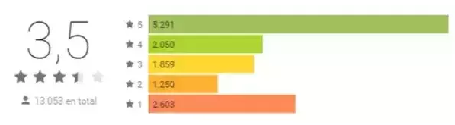
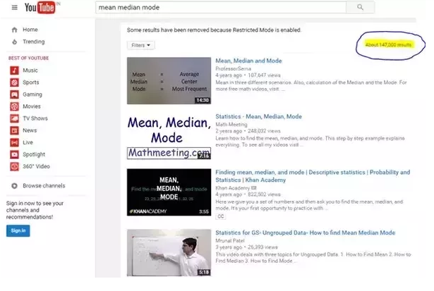
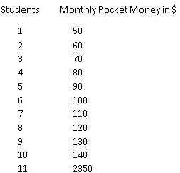
When to use?
1.
2.
3.

Slide 13
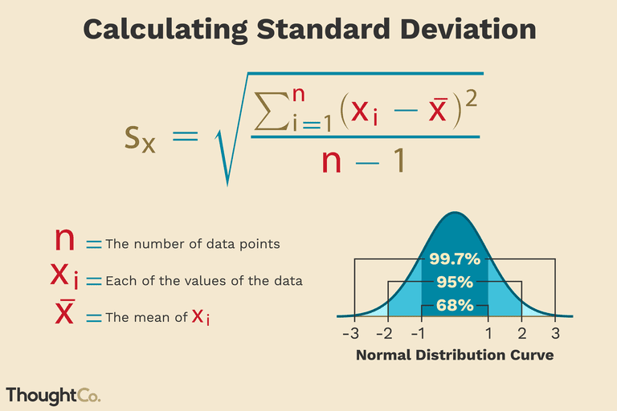

Slide 14
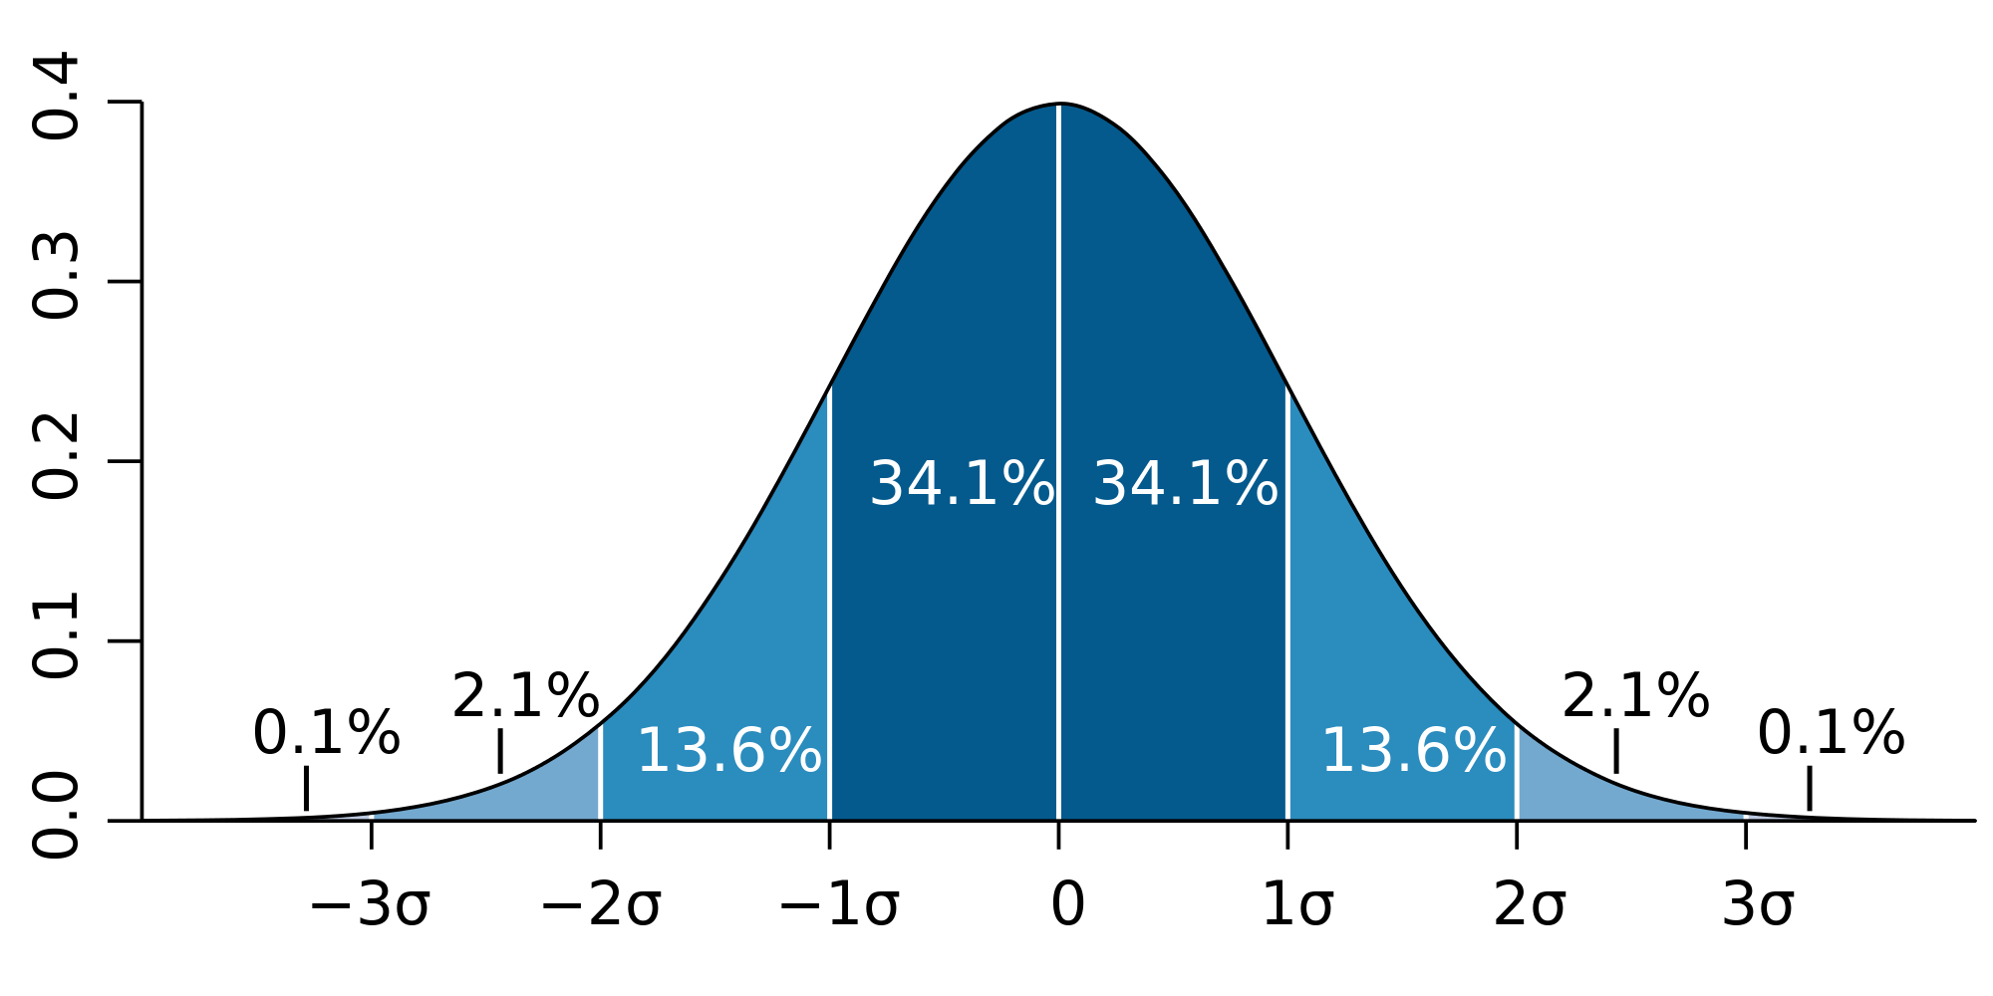
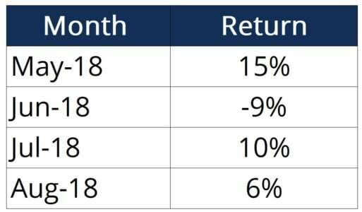
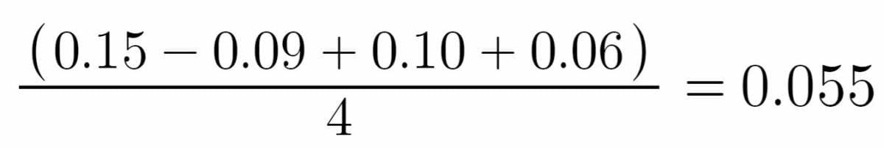
Standard Deviation and Normal distribution
The first step is to calculate Ravg, which is the arithmetic mean:
The arithmetic mean of returns is 5.5%.
Next, we can input the numbers into the formula as follows:

Slide 15
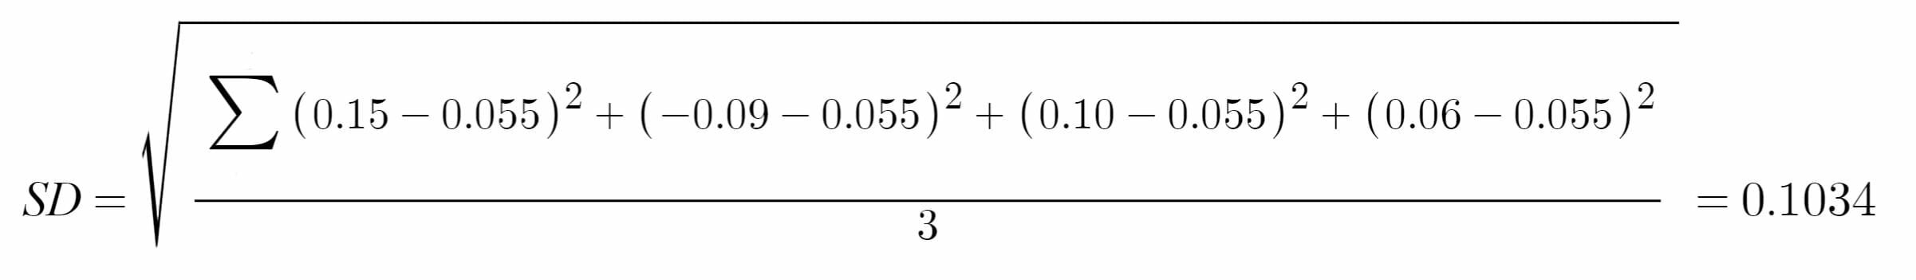
The standard deviation of returns is 10.34%
Thus, the investor now knows that the returns of his portfolio fluctuate by approximately 10% month-over-month.
The information can be used to modify the portfolio to better the investor’s attitude towards risk.
If the investor is risk-loving and is comfortable with investing in higher-risk, higher-return securities and can tolerate a higher standard deviation, he/she may consider adding in some small-cap stocks or high-yield bonds.
Conversely, an investor that is more risk-averse may not be comfortable with this standard deviation and would want to add in safer investments such as large-cap stocks or mutual funds.

Slide 16
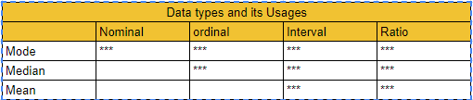
Data types
Nomial -- categorical data , gender, type of school.(categories)
Oridinal data-- Ordinal Number is a number that tells the position of something in a list, such as 1st, 2nd, 3rd, 4th, 5th etc.
Interval data -- 6-7,8-9,100-200
Ratio -- Ex: Number of Applications/Number of Loans

Slide 17
Hypothesis testing
Correlations of the data ::
Null Hypothesis. H0
The null hypothesis is a general statement or default position that there is no relationship between two measured phenomena, or no association among groups
The null hypothesis is generally assumed to be true until evidence indicates otherwise.
In statistics, it is often denoted H₀; and, regardless of whether the expression is pronounced "H-nought", "H-null", or "H-zero"
Alternative Hypothesis. Ha
The alternative hypothesis is Opposite to the null hypothesis. It is usually taken to be that the observations are the result of a real effect (with some amount of chance variation superposed).
In statistics, it is often denoted H_{0.}

Slide 18
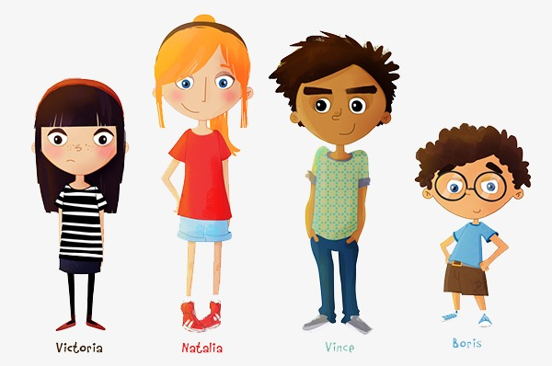

P value and Alpha 𝛂
P - Probability.
Alpha 𝛂- Threshold.
Ex: There were 4 siblings:
Problem-- Who should do the Dishes each night?
Decision-- Oldest sibling decided “ we ll put all of our names into a bowl and pick them each night, whoseever name appears, they will wash the dish”.Three days passed and Oldest sibling name didnot appear??!!!!.All other 3 thought she might be cheating?. What is the Probability that Rose randomly taking names and is not cheating?
P(Rose not picked on a particular night) = ¾
P(Rose not Picked on all three nights) = ¾ *¾*¾ = 27/64 = 0.42 = 42% chances that ROSE may not pick. So not bad, Hypothesis is truly random.
P(Rose not picked on 12 nights) = ¾*¾*¾ ….. =(¾)^12 =0.032 = 3.2% chances that ROSE may not pick.. Now You can think that there is something fishy.
We decide The Threshold(LIMIT) if it is less than 2% then its FISHY. -- 𝛂

Slide 19
Types of T tests to find the significance
A t-test is commonly used to determine whether the mean of a populatsample significantly differs from a specific value (called the hypothesized mean) or from the mean of another sample.
One sample T test -- One Numeric variables and One expected, to test whether it is significant or not.
Two sample T-Test -- One numeric 1 categorical less than 2 levels.
Paired T-Test -- Two numeric variables
ANOVA -- One numeric 1 categorical More than 2 levels.
Chi SQ test (Test of independence) -- Two Categorical Variables.

Slide 20
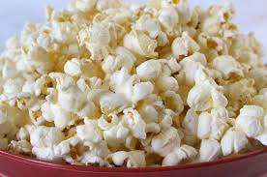


Independent and Dependent variable
Independent-- variable that stands alone and isn't changed by the other variables you are trying to measure. the independent variable causes some kind of change in the other variables.
Ex: Age ,Height,Time
Dependent Variable -- It is something that depends on other factors.
Ex:Income,Weight
Experiment 1: You want to figure out which brand of microwave popcorn pops the most kernels so you can get the most value for your money. You test different brands of popcorn to see which bag pops the most popcorn kernels.
Independent Variable: Brand of popcorn bag (It’s the independent variable because you are actually deciding the popcorn bag brands)
Dependent Variable: Number of kernels popped (This is the dependent variable because it's what you measure for each popcorn brand)
Experiment 2: You want to see which type of fertilizer helps plants grow fastest, so you add a different brand of fertilizer to each plant and see how tall they grow.
Independent Variable: Type of fertilizer given to the plant
Dependent Variable: Plant height

Slide 21
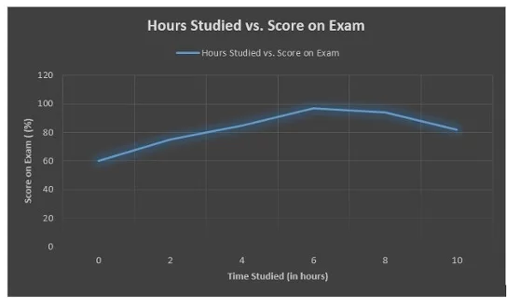
Where Do You Put Independent and Dependent Variables on Graphs?
The independent variable always goes on the x-axis, or the horizontal axis. The dependent variable goes on the y-axis, or vertical axis.

Slide 22
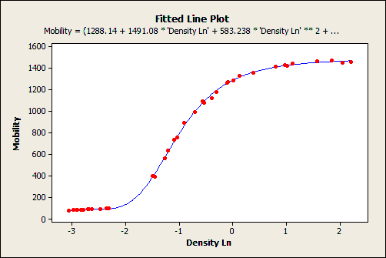
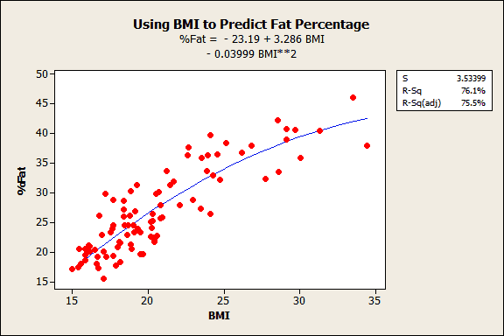
Regression
A statistical measure that attempts to determine the strength of the relationship between one dependent variable(usually denoted by Y) and series of other variables(independent variable).
REGRESSION
LINEAR REGRESSION
NON-LINEAR REGRESSION
SINGLE LINEAR REGRESSION
MULTI LINEAR REGRESSION

Slide 23
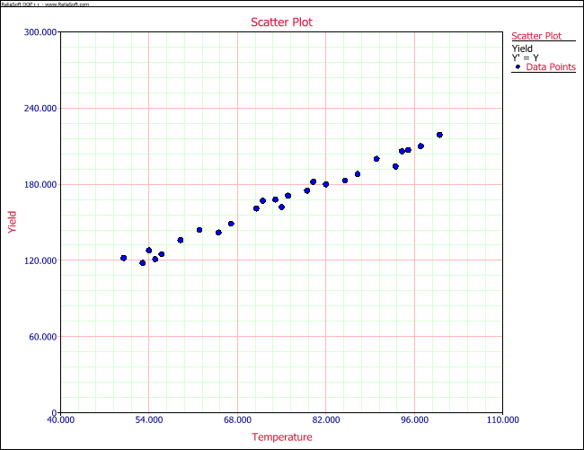
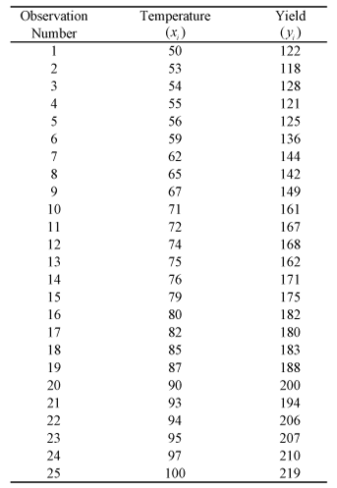
Single linear Regression Model
Estimates the relationship between one dependent variable and one Independent variable.

Slide 24
Linear equation --- >Y = C+mx1+mx2
Y-- Dependent variable
C- Intercept
M -slope
X1- independent variables
X2 - independent variables

Slide 25
R square and adjusted R square
0<= R2<=1 --- the value of R square lies between zero and one.
Please predit according to the code sent

Slide 26
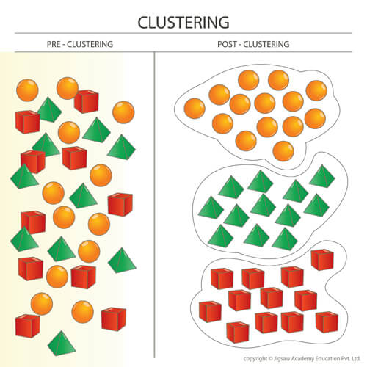
Cluster Analysis
Cluster analysis or clustering is the task of grouping a set of objects in such a way that objects in the same group (called a cluster) are more similar (in some sense) to each other than to those in other groups (clusters).

Slide 27
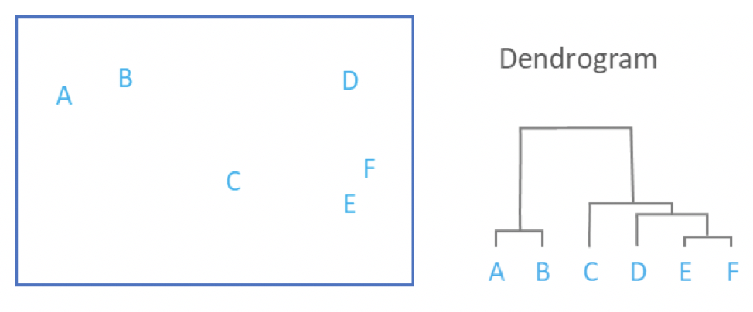
Types of Clustering
Hierarchical Clustering :In the below example , the distance between two clusters has been computed based on length of the straight line drawn from one cluster to another. This is commonly referred to as the Euclidean distance. Many other distance metrics have been developed.

Slide 28
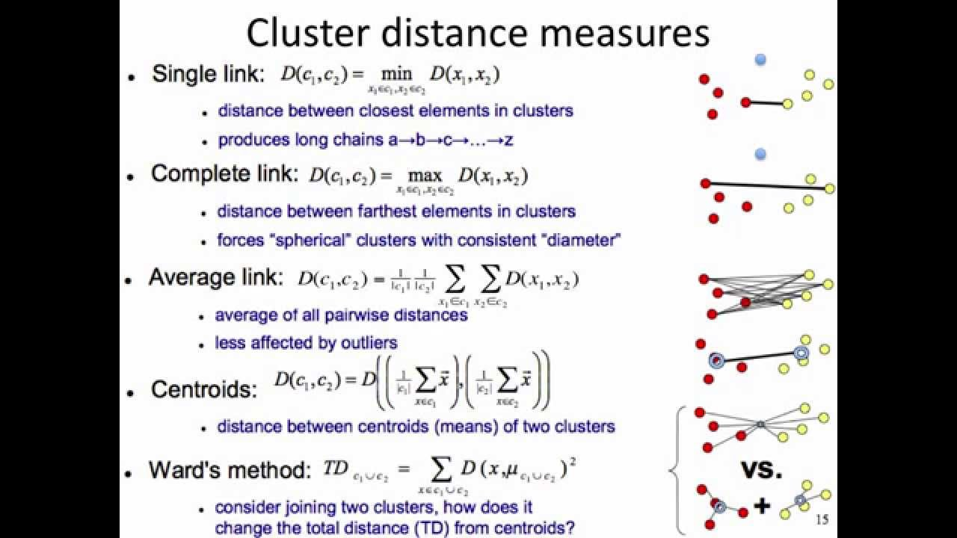
Linkage Criteria
After selecting a distance metric, it is necessary to determine from where distance is computed. For example, it can be computed between the two most similar parts of a cluster (single-linkage), the two least similar bits of a cluster (complete-linkage), the center of the clusters (mean or average-linkage)

Slide 29
Outliers
26

Slide 30
K-Means
Difference between Hierarchical and K means
In Hierarchial clustering --- We Donot provide(give) to the system the number of clusters to be formed .
In K means clustering -- We provide(give) to the system How many clusters to be formed. (k= 1 or 2 or 3 or ……..)
Different methods to identify the number of clusters
1.Gap statistic --- Gives the optimal number of clusters -- mostly used
2.Elbow method.-- rarely used.

Slide 31
Kmeans
Explanation in the below video. Well explained.
https://www.youtube.com/watch?v=4b5d3muPQmA&pbjreload=10

