Slide 1
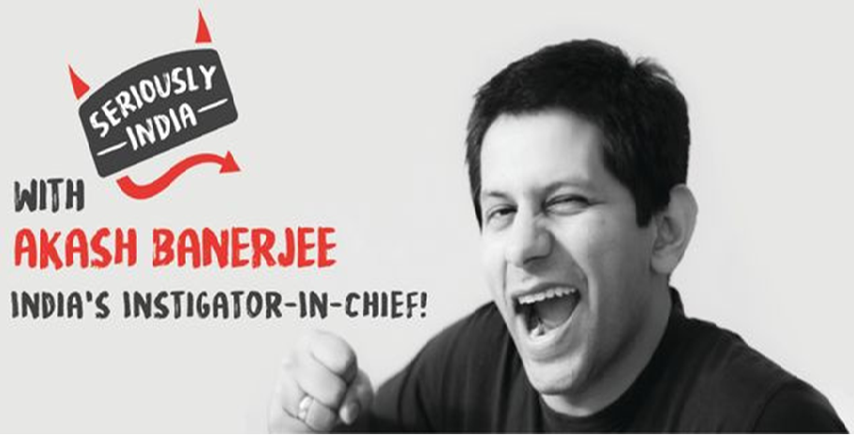
By Redwood Algorithms
Tweet Analysis
RaGa vs NaMo

Slide 2
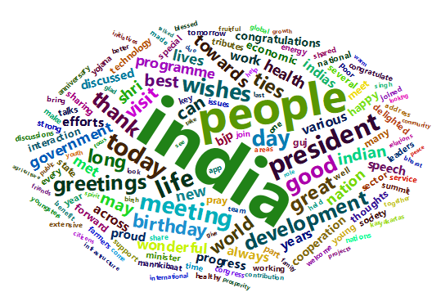
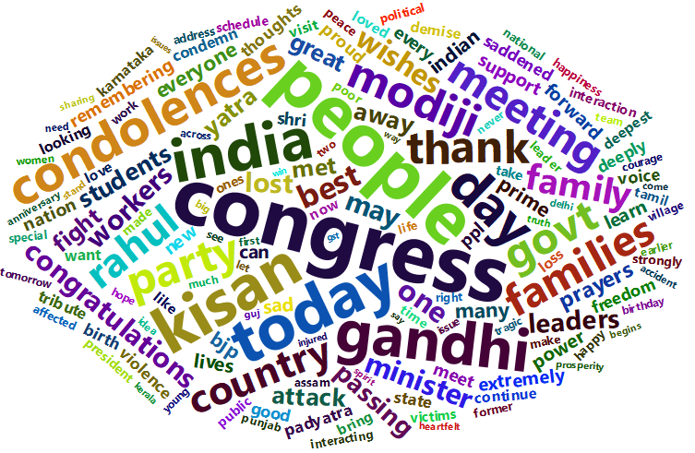
Word cloud 2015-2018
Rahul
Total tweets 3335
Namo
Total tweets 11140

Slide 3
Word Histogram 2015-2018
Notes:
Priorities of Rahul and Namo(Top 30 words)
Rahul
Congress
People
Today
India
Gandhi

Slide 4
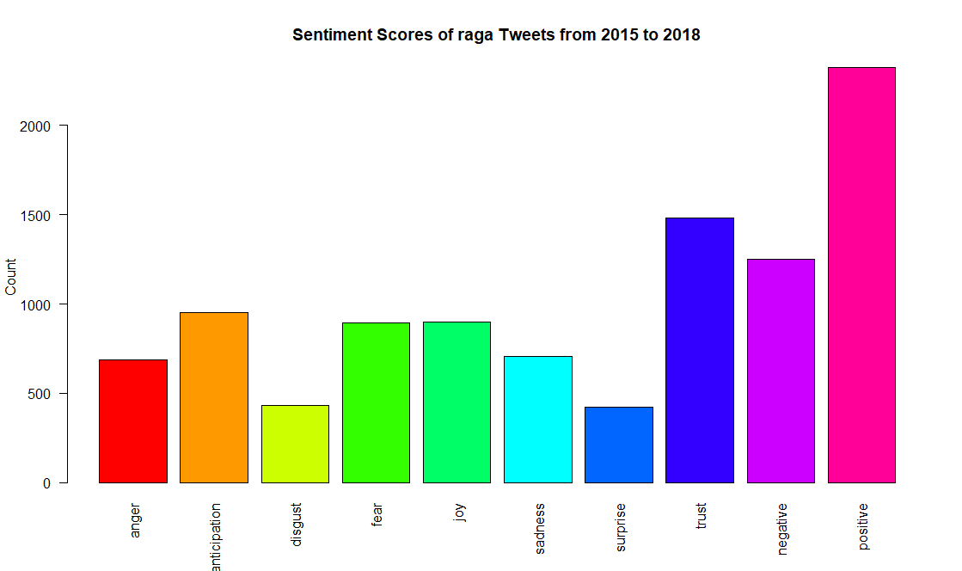

Slide 5
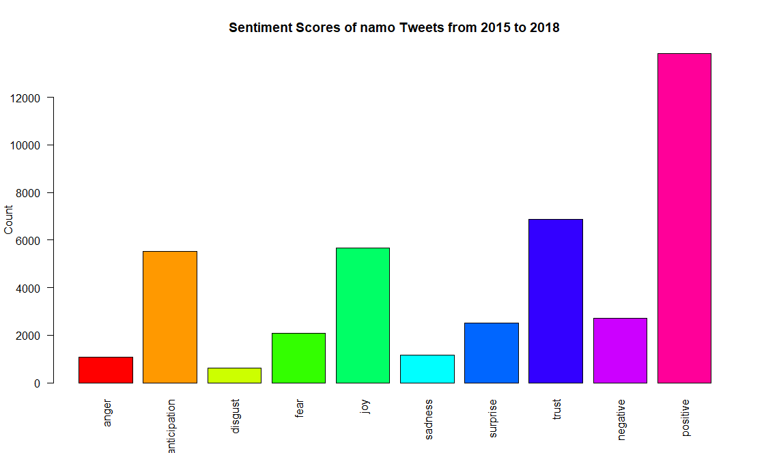

Slide 6
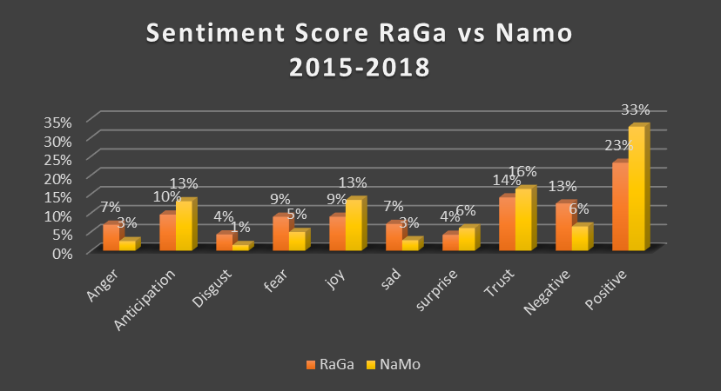

Slide 7
Most famous tweets of rahul
1.Youth are struggling to find jobs;
farmers are committing suicide & soldiers are dying at the border. What exactly is the Govt
celebrating?pic.twitter.com/327xm48Wgs“
Number of replies--14701
Number of retweets- 10027
Favorites- 29686
2. Dear PM; Welcome to Switzerland! Please tell DAVOS why 1% of Indias population gets 73% of its wealth? Iam
attaching a report for your ready reference. https://thewire.in/216160/richest-1-cornered-73-wealth-generated
-india-2017-oxfam-su
rvey/ ¦ 13734 10243 24729
Number of replies--13734
Number of retweets- 10243
Favorites- 24729
3. 4 Yr. Report Card Agriculture: F Foreign Policy: F Fuel Prices: F Job Creation: F Slogan Creation: A+ Self Promotion: A+ Yoga: B-
Remarks: Master communicator; struggles with complex issues; short attention span. 13140 17001 48938
Number of replies--13140
Number of retweets- 17001
Favorites- 48938

Slide 8
Most famous tweets of Rahul contd.
4.Dear PM; Glad to see you accept the @imVkohli fitness challenge. Hereâ€™s one from me: Reduce Fuel prices or
the Congress will do a nationwide agitation and force you to do so. I look forward to your response. #FuelChallenge
12318 22462 63237
Number of replies--12318
Number of retweets- 22462
Favorites- 63237 --------- THIS IS THE MOST FAVOURITE TWEET OF PEOPLE
5. Will be out of India for a few days; accompanying Sonia ji to her annual medical check up. To my friends in the
BJP social media troll army: donâte get too worked up...I'll be back soon! 12261 11256 44176
Number of replies--12261
Number of retweets- 11256
Favorites- 44176
6. A central pillar of the RSS/BJPs fascist vision for India is that Dalits should remain at the bottom of Indian society.
Una; Rohith Vemula and now Bhima-Koregaon are potent symbols of the resistance. 10133 10842 29422
Number of replies--10133
Number of retweets- 10842
Favorites- 29422

Slide 9
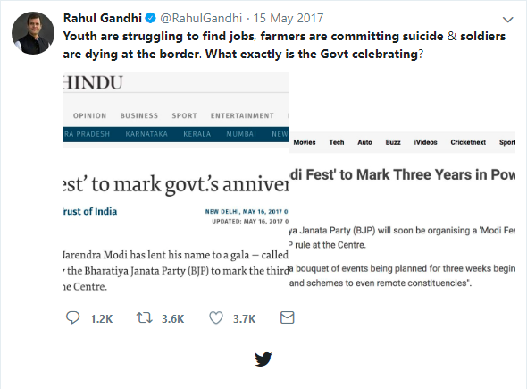
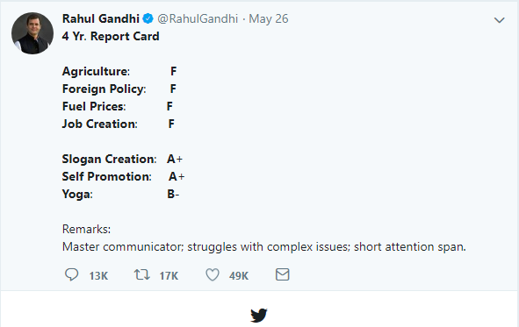
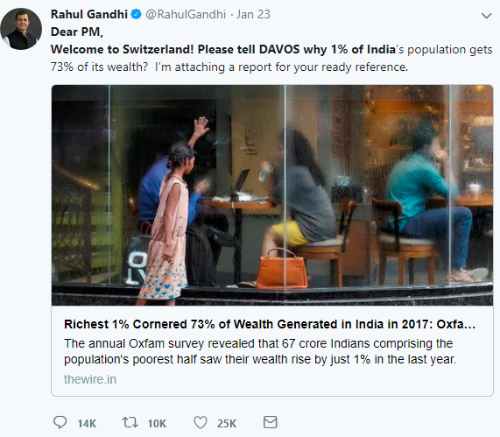
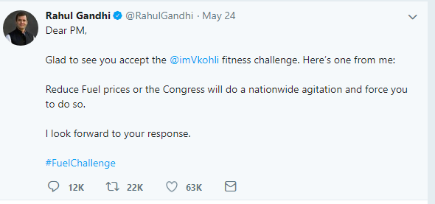
The highest number of favorites

Slide 10
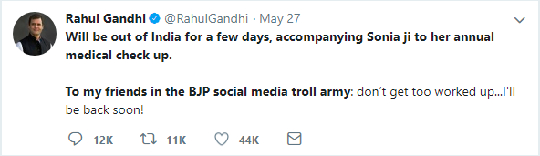
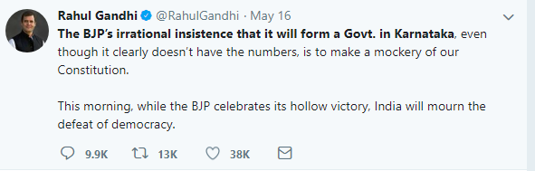
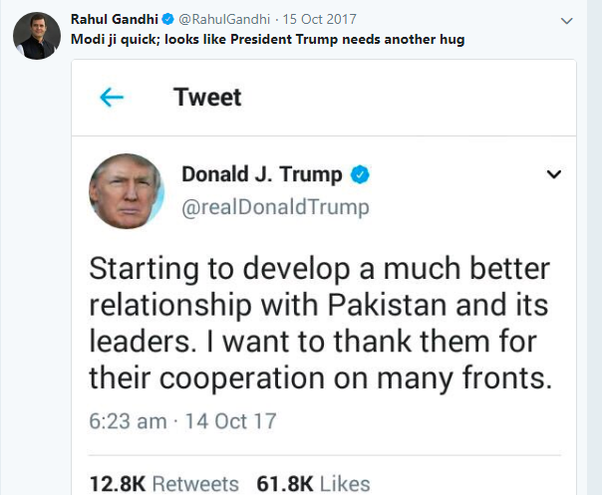
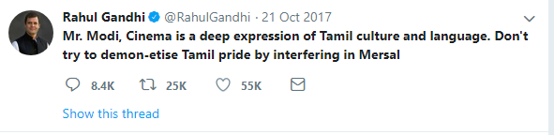

Slide 11
Number of times Modi used Rahul's name and vice versa
Modi hardly mentioned Rahul Gandhi’s name in his tweets, except the birthday wishes and congratulating for being president.
But he always focused on the congress party as whole in his attacks. The following slides show the most famous tweets on congress May be he don’t want to showcase Rahul s name.
Rahul Gandhi mentioned MODI s name in most of his tweets, as we can see in word cloud 92 times in count.

Slide 12
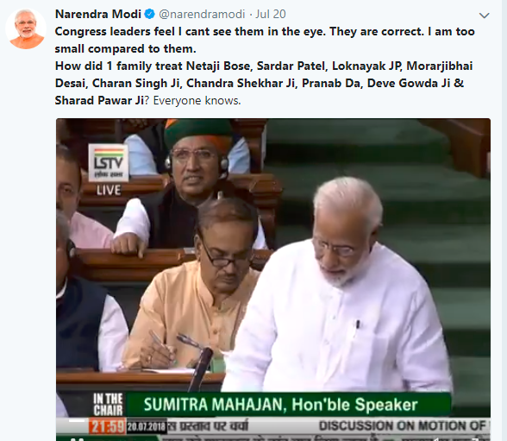
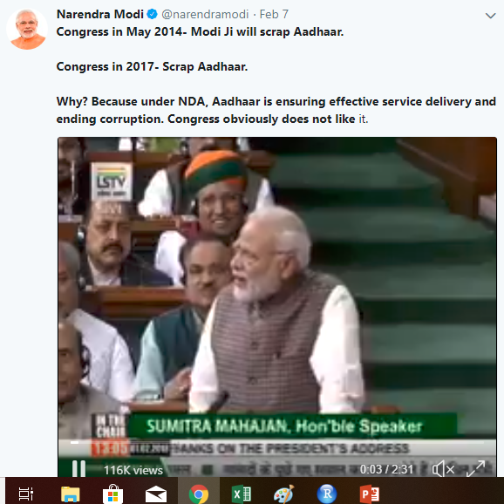
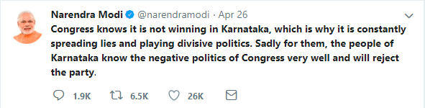
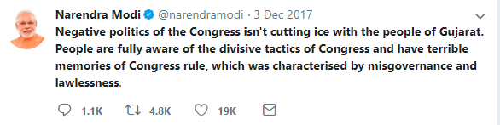

Slide 13
Notes:
Rahul priorities: The one of the highest spoken word is govt, he mainly concentrated on BJP govt, and modiji, his intention is to removing the Narendra Modi government from power in the 2019 elections and not on who the next prime minister should be.
Rahul highlights Gandhiji in many places. 1.The fight which Gandhi ji fought is our fight. We will fight that and we will win: Rahul Gandhi. May be he wants to create Gandhi effect similar like Modi effect.
2.We owe it to him; to the memory of Gandhiji and to every single Indian student who dreams of an India free from prejudice and injustice
Rahul says Nationalism is in my blood; I have seen my family sacrifice again & again for the nation.

Slide 14
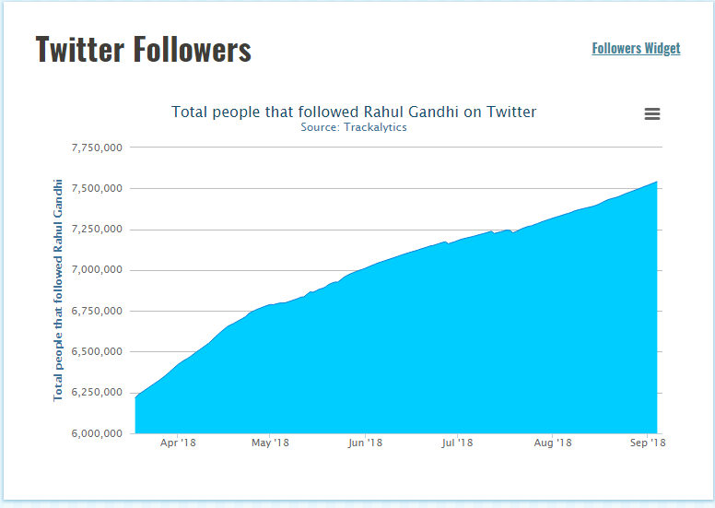
RaGa’s Tweet Analysis

Slide 15
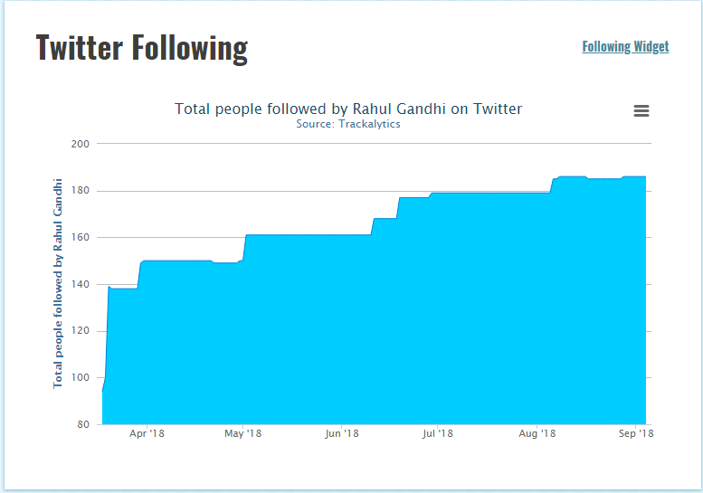

Slide 16
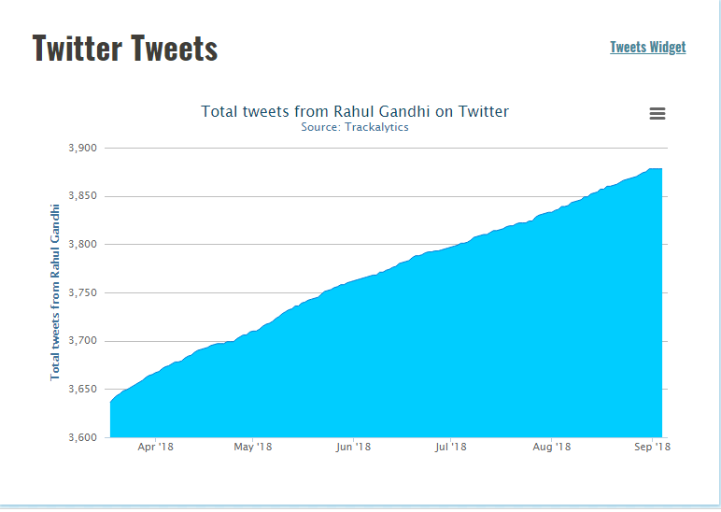

Slide 17
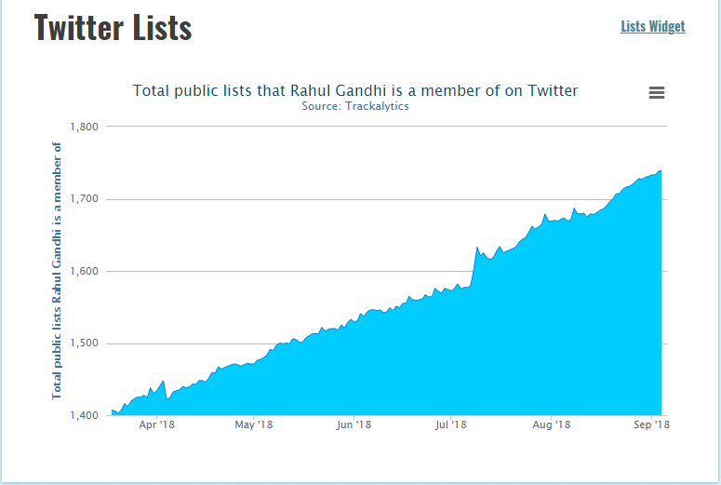

Slide 18
