Slide 1
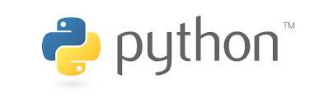
Syllabus DAY 1
Module 1 - Python Basics
Your first program ,Types,Expressions and Variables,String Operations
Module 2 - Python Data Structures
Lists and Tuples,Sets,Dictionaries
Module 3 - Python Programming Fundamentals
Conditions and Branching,Loops,Functions,Objects and Classes
Module 4 - Working with Data in Python
Reading files with open,Writing files with open,Loading data with Pandas,Working with and Saving data with Pandas.

Slide 2
Output of Day1 syllabus
After completing all four modules, you’ll be able to start writing your very own Python Programs.
It is comprised of four modules. We'll start off with Python basics, writing your first program, and then cover, in detail, types, expressions, variables, strings and string operations.
In the 2nd module we'll introduce you to Python data structures, namely lists and tuples, sets and dictionaries. Lists and tuples, are called compound data types and are one of the key types of data structures in Python. Sets and dictionaries are types of collections.
In the 3rd module we'll cover Python programming fundamentals, including conditions, branching, loops, functions, and objects and classes. Specifically, you’ll learn about comparison and logic operators, and the if, else, and elif statements, for and while loops, how to use some of Python’s built-in functions, as well as how build your own functions, and how to create objects and classes using object constructors and attributes.
And finally, in the 4th module we'll show you how to work with data in Python. Specifically, how to read and write with the open method, and how to load, work with, and save data in pandas.

Slide 3
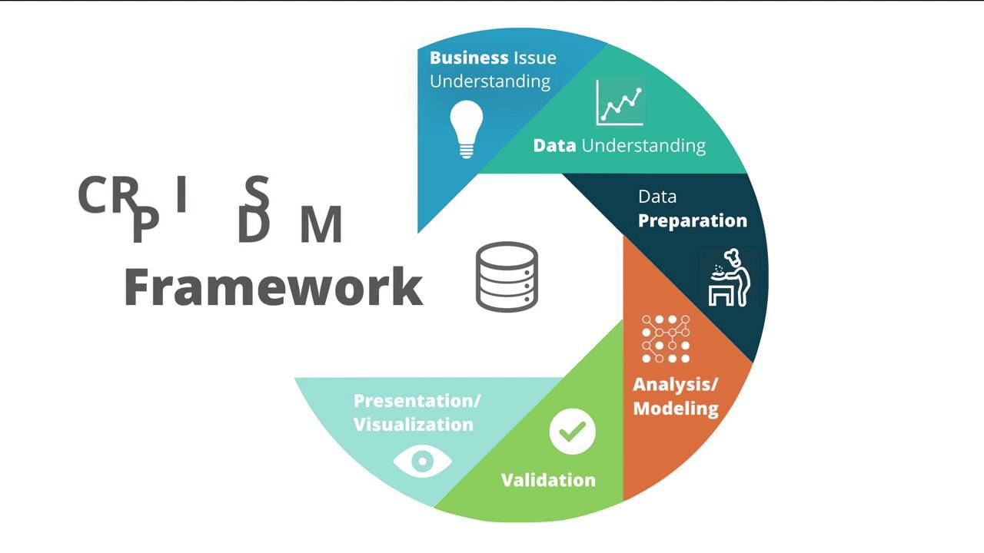

Slide 4
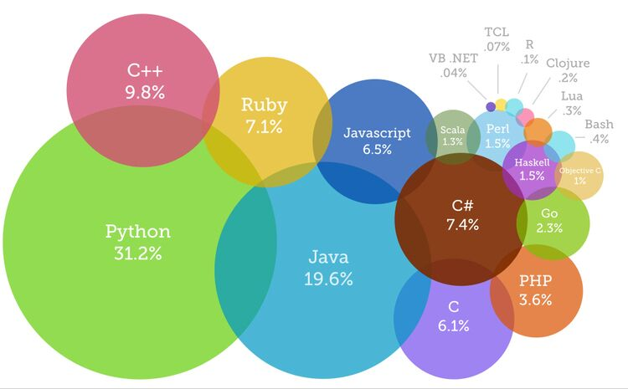
Why python?

Slide 5
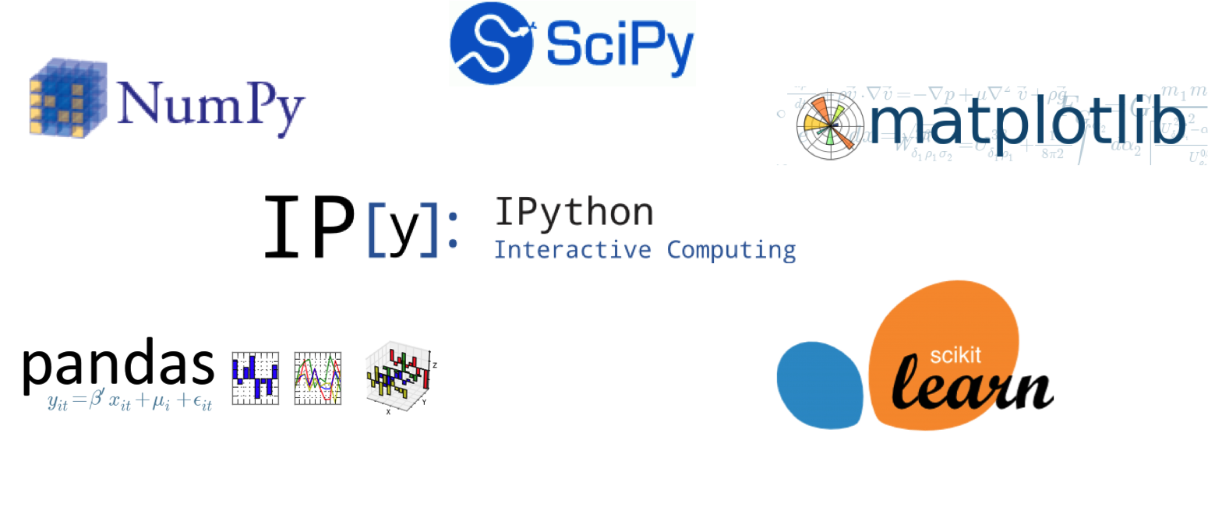
Python Libraries

Slide 6
Data types in python
Numbers
x = 3
print(type(x)) # Prints "<class 'int'>"
print(x) # Prints "3"
print(x + 1) # Addition; prints "4"
print(x - 1) # Subtraction; prints "2"
print(x * 2) # Multiplication; prints "6"
print(x ** 2) # Exponentiation; prints "9"
x += 1
print(x) # Prints "4"
x *= 2
print(x) # Prints "8"
y = 2.5
print(type(y)) # Prints "<class 'float'>"
print(y, y + 1, y * 2, y ** 2) # Prints "2.5 3.5 5.0 6.25"
Integers
Floating point numbers

Slide 7
Booleans
t = True
f = False
print(type(t)) # Prints "<class 'bool'>"
print(t and f) # Logical AND; prints "False"
print(t or f) # Logical OR; prints "True"
print(not t) # Logical NOT; prints "False"
print(t != f) # Logical XOR; prints "True"
Strings
hello = 'hello' # String literals can use single quotes
world = "world" # or double quotes; it does not matter.
print(hello) # Prints "hello"
print(len(hello)) # String length; prints "5"
hw = hello + ' ' + world # String concatenation
print(hw) # prints "hello world"
hw12 = '%s %s %d' % (hello, world, 12) # sprintf style string formatting
print(hw12) # prints "hello world 12"

Slide 8
Strings contd ..
s = "hello"
print(s.capitalize()) # Capitalize a string; prints "Hello"
print(s.upper()) # Convert a string to uppercase; prints "HELLO"
print(s.rjust(7)) # Right-justify a string, padding with spaces; prints " hello"
print(s.center(7)) # Center a string, padding with spaces; prints " hello "
print(s.replace('l', '(ell)')) # Replace all instances of one substring with another;
# prints "he(ell)(ell)o"
print(' world '.strip())
Containers
Python includes several built-in container types: lists, dictionaries, sets, and tuples.
xs = [3, 1, 2] # Create a list
print(xs, xs[2]) # Prints "[3, 1, 2] 2"
print(xs[-1]) # Negative indices count from the end of the list; prints "2"
xs[2] = 'foo' # Lists can contain elements of different types
print(xs) # Prints "[3, 1, 'foo']"
xs.append('bar') # Add a new element to the end of the list
print(xs) # Prints "[3, 1, 'foo', 'bar']"
x = xs.pop() # Remove and return the last element of the list
print(x, xs) # Prints "bar [3, 1, 'foo']"

Slide 9
Slicing
nums = list(range(5)) # range is a built-in function that creates a list of integers
print(nums) # Prints "[0, 1, 2, 3, 4]"
print(nums[2:4]) # Get a slice from index 2 to 4 (exclusive); prints "[2, 3]"
print(nums[2:]) # Get a slice from index 2 to the end; prints "[2, 3, 4]"
print(nums[:2]) # Get a slice from the start to index 2 (exclusive); prints "[0, 1]"
print(nums[:]) # Get a slice of the whole list; prints "[0, 1, 2, 3, 4]"
print(nums[:-1]) # Slice indices can be negative; prints "[0, 1, 2, 3]"
nums[2:4] = [8, 9] # Assign a new sublist to a slice
print(nums) # Prints "[0, 1, 8, 9, 4]"
LOOPs
animals = ['cat', 'dog', 'monkey']
for animal in animals:
print(animal)
# Prints "cat", "dog", "monkey", each on its own line.
----------------------
animals = ['cat', 'dog', 'monkey']
for idx, animal in enumerate(animals):
print('#%d: %s' % (idx + 1, animal))
# Prints "#1: cat", "#2: dog", "#3: monkey", each on its own line

Slide 10
Enumerate
# Python program to illustrate
# enumerate function
l1 = ["eat","sleep","repeat"]
s1 = "geek"
# creating enumerate objects
obj1 = enumerate(l1)
obj2 = enumerate(s1)
------
print "Return type:",type(obj1)
print (list(enumerate(l1)))
# changing start index to 2 from 0
print (list(enumerate(s1,2)))
List comprehensions: When programming, frequently we want to transform one type of data into another. As a simple example, consider the following code that computes square numbers:
nums = [0, 1, 2, 3, 4]
squares = []
for x in nums:
squares.append(x ** 2)
print(squares) # Prints [0, 1, 4, 9, 16]

Slide 11
Dictionaries
d = {'cat': 'cute', 'dog': 'furry'} # Create a new dictionary with some data
print(d['cat']) # Get an entry from a dictionary; prints "cute"
print('cat' in d) # Check if a dictionary has a given key; prints "True"
d['fish'] = 'wet' # Set an entry in a dictionary
print(d['fish']) # Prints "wet"
# print(d['monkey']) # KeyError: 'monkey' not a key of d
print(d.get('monkey', 'N/A')) # Get an element with a default; prints "N/A"
print(d.get('fish', 'N/A')) # Get an element with a default; prints "wet"
del d['fish'] # Remove an element from a dictionary
print(d.get('fish', 'N/A')) # "fish" is no longer a key; prints "N/A"

Slide 12
LOOPs with dictionaries
d = {'person': 2, 'cat': 4, 'spider': 8}
for animal in d:
legs = d[animal]
print('A %s has %d legs' % (animal, legs))
# Prints "A person has 2 legs", "A cat has 4 legs", "A spider has 8 legs"
Sets --- A set is an unordered collection of distinct elements. As a simple example, consider the following:
animals = {'cat', 'dog'}
print('cat' in animals) # Check if an element is in a set; prints "True"
print('fish' in animals) # prints "False"
animals.add('fish') # Add an element to a set
print('fish' in animals) # Prints "True"
print(len(animals)) # Number of elements in a set; prints "3"
animals.add('cat') # Adding an element that is already in the set does nothing
print(len(animals)) # Prints "3"
animals.remove('cat') # Remove an element from a set
print(len(animals)) # Prints "2

Slide 13
Tuples
A tuple is an (immutable) ordered list of values. A tuple is in many ways similar to a list; one of the most important differences is that tuples can be used as keys in dictionaries and as elements of sets, while lists cannot. Here is a trivial example:
t = (5, 6) # Create a tuple
print(type(t))
Functions
def sign(x):
if x > 0:
return 'positive'
elif x < 0:
return 'negative'
else:
return 'zero'
for x in [-1, 0, 1]:
print(sign(x))
# Prints "negative", "zero", "positive"

Slide 14
Functions
A function is a set of statements that take inputs, do some specific computation and produces output. The idea is to put some commonly or repeatedly done task together and make a function, so that instead of writing the same code again and again for different inputs, we can call the function.
Python provides built-in functions like print(), etc. but we can also create your own functions. These functions are called user-defined functions.
# A simple Python function to check
# whether x is even or odd
def evenOdd( x ):
if (x % 2 == 0):
print "even"
else:
print "odd"
# Driver code
evenOdd(2)
evenOdd(3)

Slide 15
Pass by Reference or pass by value?
One important thing to note is, in Python every variable name is a reference. When we pass a variable to a function, a new reference to the object is created. Parameter passing in Python is same as reference passing in Java.
# Here x is a new reference to same list lst
def myFun(x):
x[0] = 20
# Driver Code (Note that lst is modified
# after function call.
lst = [10, 11, 12, 13, 14, 15]
myFun(lst);
print(lst)
When we pass a reference and change the received reference to something else, the connection between passed and received parameter is broken. For example, consider below program.
def myFun(x):
# After below line link of x with previous
# object gets broken. A new object is assigned
# to x.
x = [20, 30, 40]
# Driver Code (Note that lst is not modified
# after function call.
lst = [10, 11, 12, 13, 14, 15]
myFun(lst); print(lst)

Slide 16
Exercise: Try to guess the output of following code
def swap(x, y):
temp = x;
x = y;
y = temp;
# Driver code
x = 2
y = 3
swap(x, y)
print(x)
print(y)
Default arguments:
A default argument is a parameter that assumes a default value if a value is not provided in the function call for that argument.The following example illustrates Default arguments.
# Python program to demonstrate
# default arguments
def myFun(x, y=50):
print("x: ", x)
print("y: ", y)
# Driver code (We call myFun() with only
# argument)
myFun(10)

Slide 17
Keyword arguments:
The idea is to allow caller to specify argument name with values so that caller does not need to remember order of parameters.
# Python program to demonstrate Keyword Arguments
def student(firstname, lastname):
print(firstname, lastname)
# Keyword arguments
student(firstname ='Geeks', lastname ='Practice')
student(lastname ='Practice', firstname ='Geeks')

Slide 18
Classes
# A simple example class
class Test:
# A sample method
def fun(self):
print("Hello")
# Driver code
obj = Test()
obj.fun()
The __init__ method
The __init__ method is similar to constructors in C++ and Java. It is run as soon as an object of a class is instantiated. The method is useful to do any initialization you want to do with your object.
class Person:
# init method or constructor
def __init__(self, name):
self.name = name
# Sample Method
def say_hi(self):
print('Hello, my name is', self.name)
p = Person('Shwetanshu')
p.say_hi()

Slide 19
# Python program to show that the variables with a value
# assigned in class declaration, are class variables and
# variables inside methods and constructors are instance
# variables.
# Class for Computer Science Student
class CSStudent:
# Class Variable
stream = 'cse'
# The init method or constructor
def __init__(self, roll):
# Instance Variable
self.roll = roll
# Objects of CSStudent class
a = CSStudent(101)
b = CSStudent(102)
print(a.stream) # prints "cse"
print(b.stream) # prints "cse"
print(a.roll) # prints 101
# Class variables can be accessed using class
# name also
print(CSStudent.stream) # prints "cse"

Slide 20
NUMpy
Numpy is the core library for scientific computing in Python. It provides a high-performance multidimensional array object, and tools for working with these arrays.
Arrays
A numpy array is a grid of values, all of the same type, and is indexed by a tuple of nonnegative integers. The number of dimensions is the rank of the array; the shape of an array is a tuple of integers giving the size of the array along each dimension.
import numpy as np
a = np.array([1, 2, 3]) # Create a rank 1 array
print(type(a)) # Prints "<class 'numpy.ndarray'>"
print(a.shape) # Prints "(3,)"
print(a[0], a[1], a[2]) # Prints "1 2 3"
a[0] = 5 # Change an element of the array
print(a) # Prints "[5, 2, 3]"
b = np.array([[1,2,3],[4,5,6]]) # Create a rank 2 array
print(b.shape) # Prints "(2, 3)"
print(b[0, 0], b[0, 1], b[1, 0]) # Prints "1 2 4"

Slide 21
Other functions of NUMpy
import numpy as np
a = np.zeros((2,2)) # Create an array of all zeros
print(a) # Prints "[[ 0. 0.]
# [ 0. 0.]]"
b = np.ones((1,2)) # Create an array of all ones
print(b) # Prints "[[ 1. 1.]]"
c = np.full((2,2), 7) # Create a constant array
print(c) # Prints "[[ 7. 7.]
# [ 7. 7.]]"
d = np.eye(2) # Create a 2x2 identity matrix
print(d) # Prints "[[ 1. 0.]
# [ 0. 1.]]"
e = np.random.random((2,2)) # Create an array filled with random values
print(e) # Might print "[[ 0.91940167 0.08143941]
# [ 0.68744134 0.87236687]]"

Slide 22
Array indexing
Numpy offers several ways to index into arrays.
Slicing: Similar to Python lists, numpy arrays can be sliced. Since arrays may be multidimensional, you must specify a slice for each dimension of the array:
import numpy as np
# Create the following rank 2 array with shape (3, 4)
# [[ 1 2 3 4]
# [ 5 6 7 8]
# [ 9 10 11 12]]
a = np.array([[1,2,3,4], [5,6,7,8], [9,10,11,12]])
# Use slicing to pull out the subarray consisting of the first 2 rows
# and columns 1 and 2; b is the following array of shape (2, 2):
# [[2 3]
# [6 7]]
b = a[:2, 1:3]
# A slice of an array is a view into the same data, so modifying it
# will modify the original array.
print(a[0, 1]) # Prints "2"
b[0, 0] = 77 # b[0, 0] is the same piece of data as a[0, 1]
print(a[0, 1]) # Prints "77"

Slide 23
You can also mix integer indexing with slice indexing.
import numpy as np
# Create the following rank 2 array with shape (3, 4)
# [[ 1 2 3 4]
# [ 5 6 7 8]
# [ 9 10 11 12]]
a = np.array([[1,2,3,4], [5,6,7,8], [9,10,11,12]])
# Two ways of accessing the data in the middle row of the array.
# Mixing integer indexing with slices yields an array of lower rank,
# while using only slices yields an array of the same rank as the
# original array:
row_r1 = a[1, :] # Rank 1 view of the second row of a
row_r2 = a[1:2, :] # Rank 2 view of the second row of a
print(row_r1, row_r1.shape) # Prints "[5 6 7 8] (4,)"
print(row_r2, row_r2.shape) # Prints "[[5 6 7 8]] (1, 4)"
# We can make the same distinction when accessing columns of an array:
col_r1 = a[:, 1]
col_r2 = a[:, 1:2]
print(col_r1, col_r1.shape) # Prints "[ 2 6 10] (3,)"
print(col_r2, col_r2.shape) # Prints "[[ 2]
# [ 6]
# [10]] (3, 1)"

Slide 24
Integer array indexing: When you index into numpy arrays using slicing, the resulting array view will always be a subarray of the original array. In contrast, integer array indexing allows you to construct arbitrary arrays using the data from another array. Here is an example:
import numpy as np
a = np.array([[1,2], [3, 4], [5, 6]])
# An example of integer array indexing.
# The returned array will have shape (3,) and
print(a[[0, 1, 2], [0, 1, 0]]) # Prints "[1 4 5]"
# The above example of integer array indexing is equivalent to this:
print(np.array([a[0, 0], a[1, 1], a[2, 0]])) # Prints "[1 4 5]"
# When using integer array indexing, you can reuse the same
# element from the source array:
print(a[[0, 0], [1, 1]]) # Prints "[2 2]"
# Equivalent to the previous integer array indexing example
print(np.array([a[0, 1], a[0, 1]])) # Prints "[2 2]"

Slide 25
import numpy as np
# Create a new array from which we will select elements
a = np.array([[1,2,3], [4,5,6], [7,8,9], [10, 11, 12]])
print(a) # prints "array([[ 1, 2, 3],
# [ 4, 5, 6],
# [ 7, 8, 9],
# [10, 11, 12]])"
# Create an array of indices
b = np.array([0, 2, 0, 1])
# Select one element from each row of a using the indices in b
print(a[np.arange(4), b]) # Prints "[ 1 6 7 11]"
# Mutate one element from each row of a using the indices in b
a[np.arange(4), b] += 10
print(a) # prints "array([[11, 2, 3],
# [ 4, 5, 16],
# [17, 8, 9],
# [10, 21, 12]])

Slide 26
Boolean array indexing: Boolean array indexing lets you pick out arbitrary elements of an array. Frequently this type of indexing is used to select the elements of an array that satisfy some condition. Here is an example:
import numpy as np
a = np.array([[1,2], [3, 4], [5, 6]])
bool_idx = (a > 2) # Find the elements of a that are bigger than 2;
# this returns a numpy array of Booleans of the same
# shape as a, where each slot of bool_idx tells
# whether that element of a is > 2.
print(bool_idx) # Prints "[[False False]
# [ True True]
# [ True True]]"
# We use boolean array indexing to construct a rank 1 array
# consisting of the elements of a corresponding to the True values
# of bool_idx
print(a[bool_idx]) # Prints "[3 4 5 6]"
# We can do all of the above in a single concise statement:
print(a[a > 2]) # Prints "[3 4 5 6]"

Slide 27
x = np.array([1, 2]) # Let numpy choose the datatype
print(x.dtype) # Prints "int64"
x = np.array([1.0, 2.0]) # Let numpy choose the datatype
print(x.dtype) # Prints "float64"
x = np.array([1, 2], dtype=np.int64) # Force a particular datatype
print(x.dtype) # Prints "int64"
Array math
Basic mathematical functions operate elementwise on arrays, and are available both as operator overloads and as functions in the numpy module:
x = np.array([[1,2],[3,4]], dtype=np.float64)
y = np.array([[5,6],[7,8]], dtype=np.float64)
# Elementwise sum; both produce the array
# [[ 6.0 8.0]
# [10.0 12.0]]
print(x + y)
print(np.add(x, y))
# Elementwise difference; both produce the array
# [[-4.0 -4.0]
# [-4.0 -4.0]]
print(x - y)
print(np.subtract(x, y))

Slide 28
# Elementwise product; both produce the array
# [[ 5.0 12.0]
# [21.0 32.0]]
print(x * y)
print(np.multiply(x, y))
# Elementwise division; both produce the array
# [[ 0.2 0.33333333]
# [ 0.42857143 0.5 ]]
print(x / y)
print(np.divide(x, y))
# Elementwise square root; produces the array
# [[ 1. 1.41421356]
# [ 1.73205081 2. ]]
print(np.sqrt(x))

Slide 29
import numpy as np
x = np.array([[1,2],[3,4]])
y = np.array([[5,6],[7,8]])
v = np.array([9,10])
w = np.array([11, 12])
# Inner product of vectors; both produce 219
print(v.dot(w))
print(np.dot(v, w))
Numpy provides many useful functions for performing computations on arrays; one of the most useful is sum:
x = np.array([[1,2],[3,4]])
print(np.sum(x)) # Compute sum of all elements; prints "10"
print(np.sum(x, axis=0)) # Compute sum of each column; prints "[4 6]"
print(np.sum(x, axis=1)) # Compute sum of each row; prints "[3 7]"

Slide 30
Apart from computing mathematical functions using arrays, we frequently need to reshape or otherwise manipulate data in arrays. The simplest example of this type of operation is transposing a matrix; to transpose a matrix, simply use the T attribute of an array object:
x = np.array([[1,2], [3,4]])
print(x) # Prints "[[1 2]
# [3 4]]"
print(x.T) # Prints "[[1 3]
# [2 4]]"
# Note that taking the transpose of a rank 1 array does nothing:
v = np.array([1,2,3])
print(v) # Prints "[1 2 3]"
print(v.T) # Prints "[1 2 3]

Slide 31
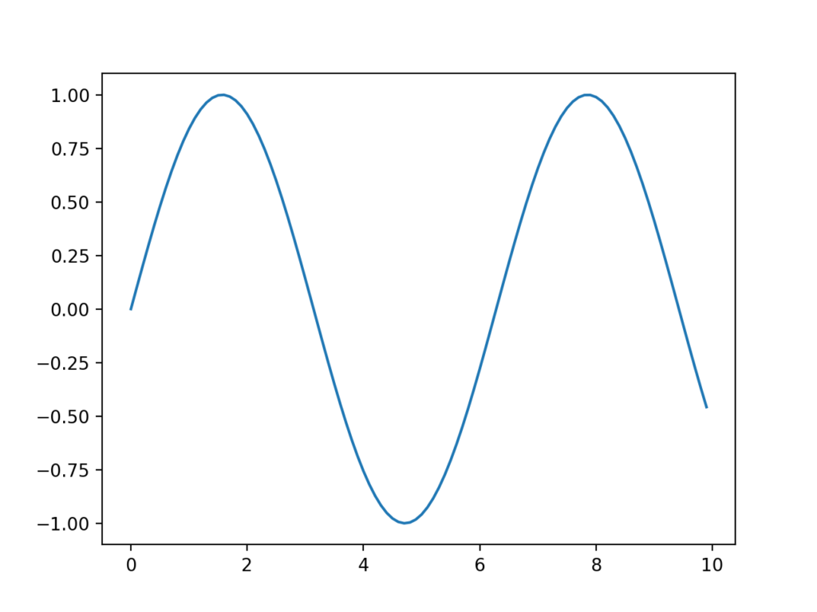
Basic Visualization using Matplotlib
import matplotlib as plt
import matplotlib.pyplot as plotlin
from numpy import sin
x = [x*0.1 for x in range(100)]
print(x)
y= sin(x)
print(y)
plotlin.plot(x,y)

Slide 32
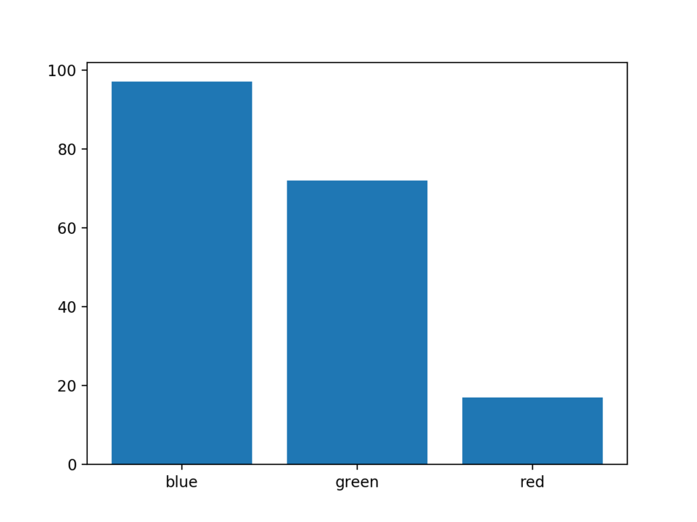
from random import seed
from random import randint
from matplotlib import pyplot
# seed the random number generator
seed(1)
# names for categories
x = ['red', 'green', 'blue']
# quantities for each category
y = [randint(0, 100), randint(0, 100),
randint(0, 100)]
# create bar chart
pyplot.bar(x, y)

Slide 33
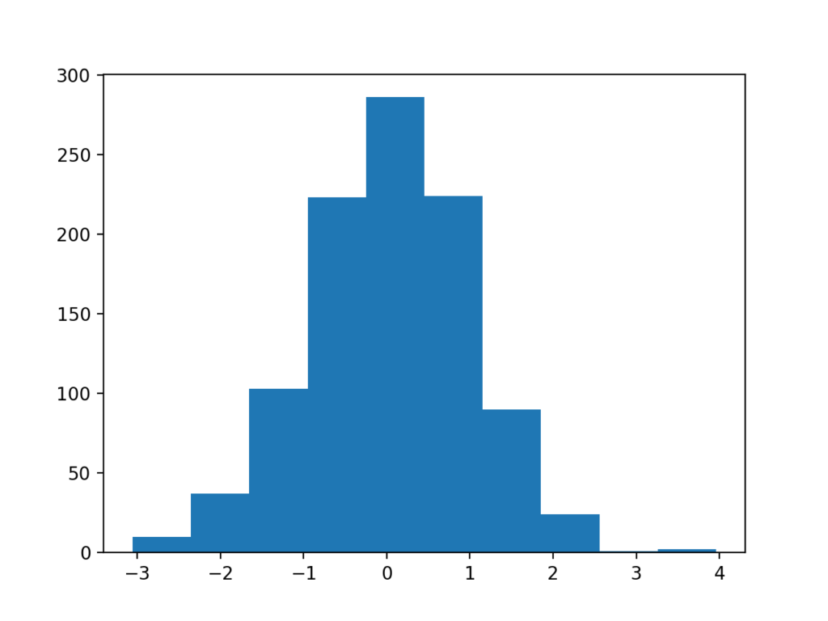
# example of a histogram plot
from numpy.random import seed
from numpy.random import randn
from matplotlib import pyplot
# seed the random number generator
seed(1)
# random numbers drawn from
# a Gaussian distribution
x = randn(1000)
# create histogram plot
pyplot.hist(x)
# show line plot
pyplot.show()

Slide 34
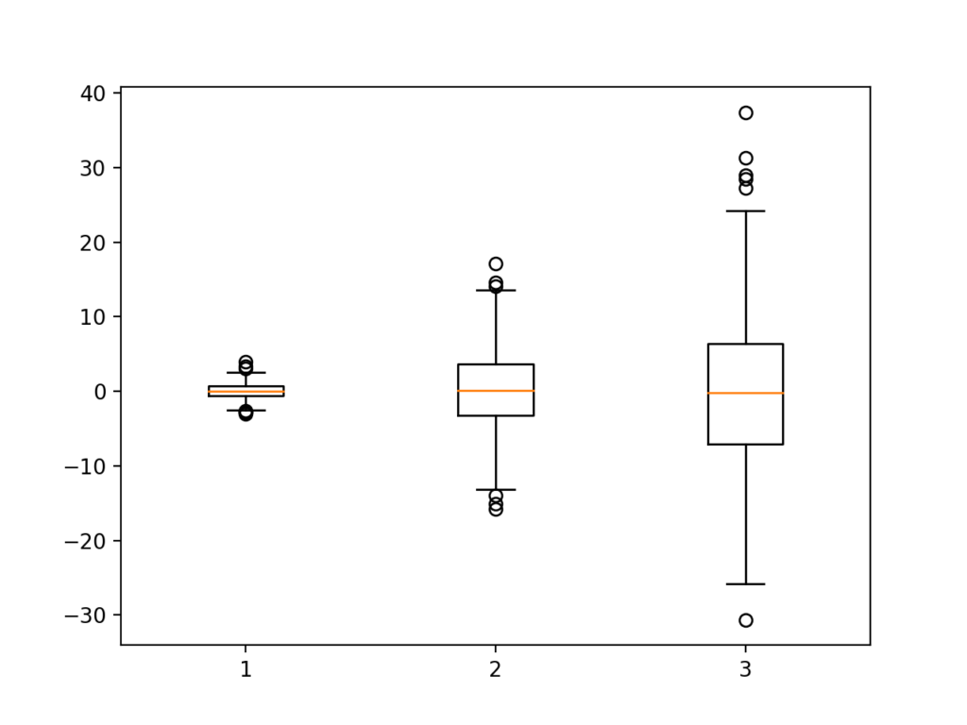
# example of a box and whisker plot
from numpy.random import seed
from numpy.random import randn
from matplotlib import pyplot
# seed the random number
generator
seed(1)
# random numbers drawn
from a Gaussian distribution
x = [randn(1000), 5 * randn(1000),
10 * randn(1000)]
# create box and whisker plot
pyplot.boxplot(x)
# show line plot
pyplot.show()

Slide 35
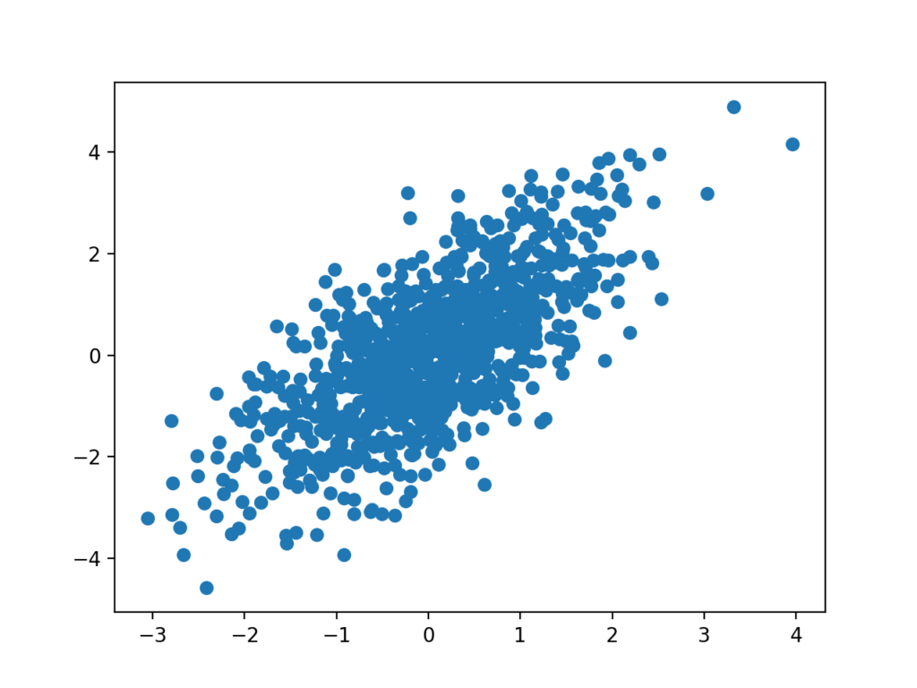
Scatter plots can be created by calling the scatter() function and passing the two data sample arrays.
# create scatter plot
pyplot.scatter(x, y)
Scatter plots are useful for showing the association or correlation between two variables. A correlation can be quantified, such as a line of best fit, that too can be drawn as a line plot on the same chart, making the relationship clearer.
# example of a scatter plot
from numpy.random import seed
from numpy.random import randn
from matplotlib import pyplot
# seed the random number generator
seed(1)
# first variable
x = 20 * randn(1000) + 100
# second variable
y = x + (10 * randn(1000) + 50)
# create scatter plot
pyplot.scatter(x, y)
# show line plot
pyplot.show()

Slide 36
Python is a great language for doing data analysis, primarily because of the fantastic ecosystem of data-centric python packages. Pandas is one of those packages and makes importing and analyzing data much easier.
# Import pandas
import pandas as pd
# reading csv file
pd.read_csv("C:/Users/ATI.Redwood/Desktop/iris.csv",index_col= “ “,delim_whitespace =False,)
pd.read_csv(filepath_or_buffer, sep=’, ‘, delimiter=None, header=’infer’, names=None, index_col=None, usecols=None, squeeze=False, prefix=None, mangle_dupe_cols=True, dtype=None, engine=None, converters=None, true_values=None, false_values=None, skipinitialspace=False, skiprows=None, nrows=None, na_values=None, keep_default_na=True, na_filter=True, verbose=False, skip_blank_lines=True, parse_dates=False, infer_datetime_format=False, keep_date_col=False, date_parser=None, dayfirst=False, iterator=False, chunksize=None, compression=’infer’, thousands=None, decimal=b’.’, lineterminator=None, quotechar='”‘, quoting=0, escapechar=None, comment=None, encoding=None, dialect=None, tupleize_cols=None, error_bad_lines=True, warn_bad_lines=True, skipfooter=0, doublequote=True, delim_whitespace=False, low_memory=True, memory_map=False, float_precision=None)

Slide 37
Data =[1, 3, 4, 5, 6, 2, 9]
print(Data)
Data =pd.Series(Data)
print(Data)
***********************
# Program to Create series with scalar values
Data =[1, 3, 4, 5, 6, 2, 9] # Numeric data
# Creating series with default index values
s = pd.Series(Data)
# predefined index values
Index =['a', 'b', 'c', 'd', 'e', 'f', 'g']
# Creating series with predefined index values
si = pd.Series(Data, Index)

Slide 38
# Program to create Dataframe of three series
import pandas as pd
s1 = pd.Series([1, 3, 4, 5, 6, 2, 9]) # Define series 1
s2 = pd.Series([1.1, 3.5, 4.7, 5.8, 2.9, 9.3]) # Define series 2
s3 = pd.Series(['a', 'b', 'c', 'd', 'e']) # Define series 3
Data ={'first':s1, 'second':s2, 'third':s3} # Define Data
dfseries = pd.DataFrame(Data)

Slide 39
# Program to create DataFrame from 2D array
import pandas as pd # Import Library
d1 =[[2, 3, 4], [5, 6, 7]] # Define 2d array 1
d2 =[[2, 4, 8], [1, 3, 9]] # Define 2d array 2
Data ={'first': d1, 'second': d2} # Define Data
df2d = pd.DataFrame(Data) # Create DataFrame
*********************

Slide 40
from pandas.plotting import parallel_coordinates
from pandas.plotting import andrews_curves
df2 = pd.read_csv("C:/Users/ATI.Redwood/Desktop/iris.csv")
#print(df2)
andrews_curves(df2,'Name')
parallel_coordinates(df2,’Name’)

Slide 41
TITANIC
import pandas as pd
import numpy as np
import matplotlib.pyplot as plt
import seaborn as sns
dataset = sns.load_dataset('titanic')
dataset.head()
dataset.corr()
**********************
From the output, you can see that the column headers contain useful information such as passengers survived, their age, fare etc. However the row headers only contains indexes 0, 1, 2, etc. To plot matrix plots, we need useful information on both columns and row headers. One way to do this is to call the corr() method on the dataset. The corr() function returns the correlation between all the numeric columns of the dataset. Execute the following script:

Slide 42
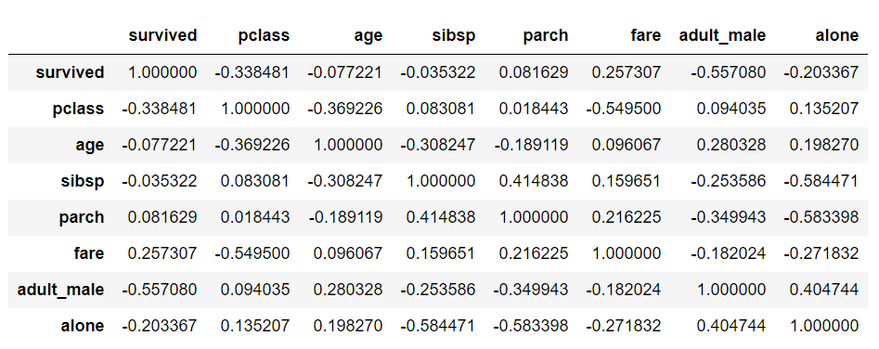
dataset.corr()

Slide 43
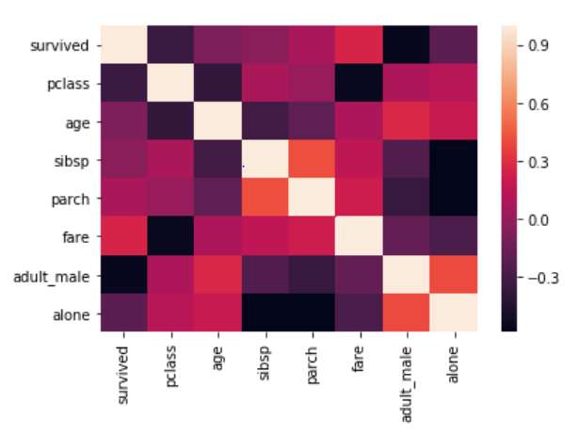
Now to create a heat map with these correlation values, you need to call the heatmap() function and pass it your correlation dataframe. Look at the following script:
corr = dataset.corr()
sns.heatmap(corr)

Slide 44
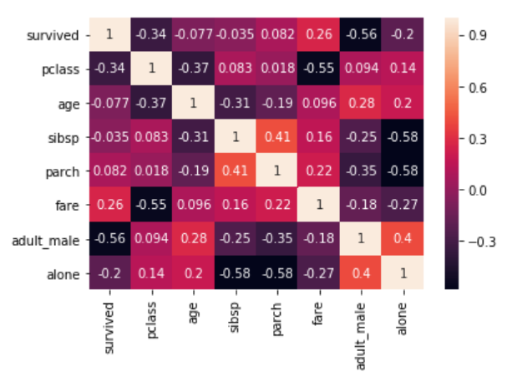
corr = dataset.corr()
sns.heatmap(corr, annot=True)

Slide 45
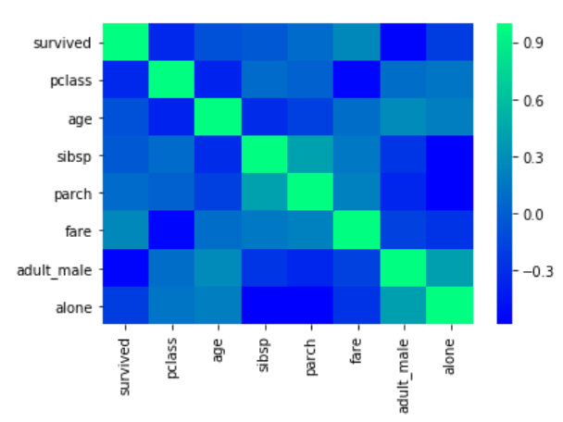
You can also change the color of the heatmap by passing an argument for the cmap parameter. For now, just look at the following script
corr = dataset.corr()
sns.heatmap(corr, cmap='winter')

Slide 46
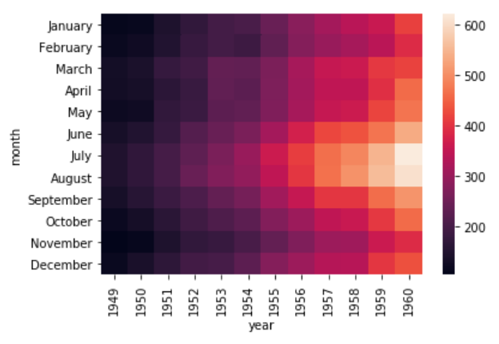
In addition to simply using correlation between all the columns, you can also use pivot_tablefunction to specify the index, the column and the values that you want to see corresponding to the index and the columns. To see pivot_table function in action, we will use the "flights" data set that contains the information about the year, the month and the number of passengers that traveled in that month.
import pandas as pd
import numpy as np
import matplotlib.pyplot as plt
import seaborn as sns
dataset = sns.load_dataset('flights')
dataset.head()
Now using the pivot_table function, we can create a heat map that displays the number of passengers that traveled in a specific month of a specific year. To do so, we will pass month as the value for the index parameter. The index attribute corresponds to the rows. Next we need to pass year as value for the column parameter. And finally for the values parameter, we will pass the passengers column. Execute the following script:

Slide 47
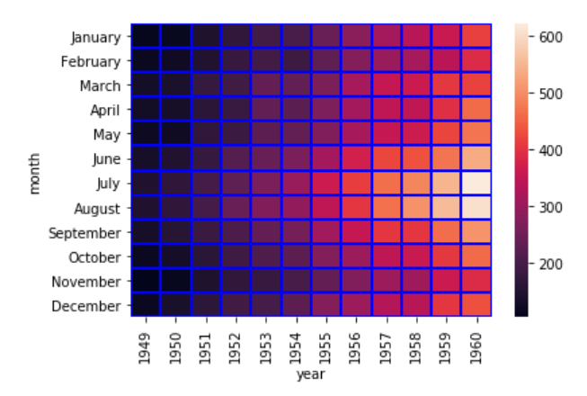
It is evident from the output that in the early years the number of passengers who took the flights was less. As the years progress, the number of passengers increases.
Currently, you can see that the boxes or the cells are overlapping in some cases and the distinction between the boundaries of the cells is not very clear. To create a clear boundary between the cells, you can make use of the linecolor and linewidths parameters. Take a look at the following script:
data = dataset.pivot_table(index='month',
columns='year', values='passengers' )
sns.heatmap(data, linecolor='blue', linewidth=1)

Slide 48
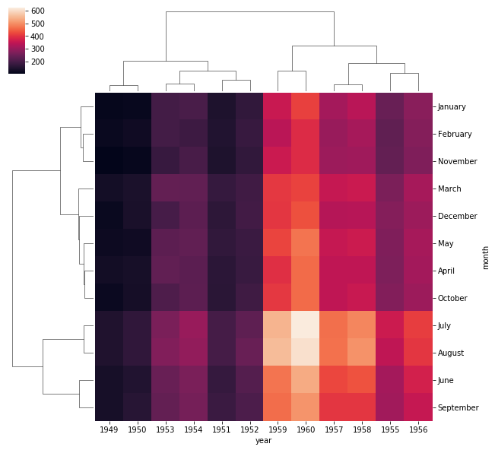

Slide 49
Seaborn Grids
Grids in Seaborn allow us to manipulate the subplots depending upon the features used in the plots.
Pair Grid
In Part 1 of this article series, we saw how pair plot can be used to draw scatter plot for all possible combinations of the numeric columns in the dataset.
Let's revise the pair plot here before we can move on to the pair grid. The dataset we are going to use for the pair grid section is the "iris" dataset which is downloaded by default when you download the seaborn library. Execute the following script to load the iris dataset:

Slide 50
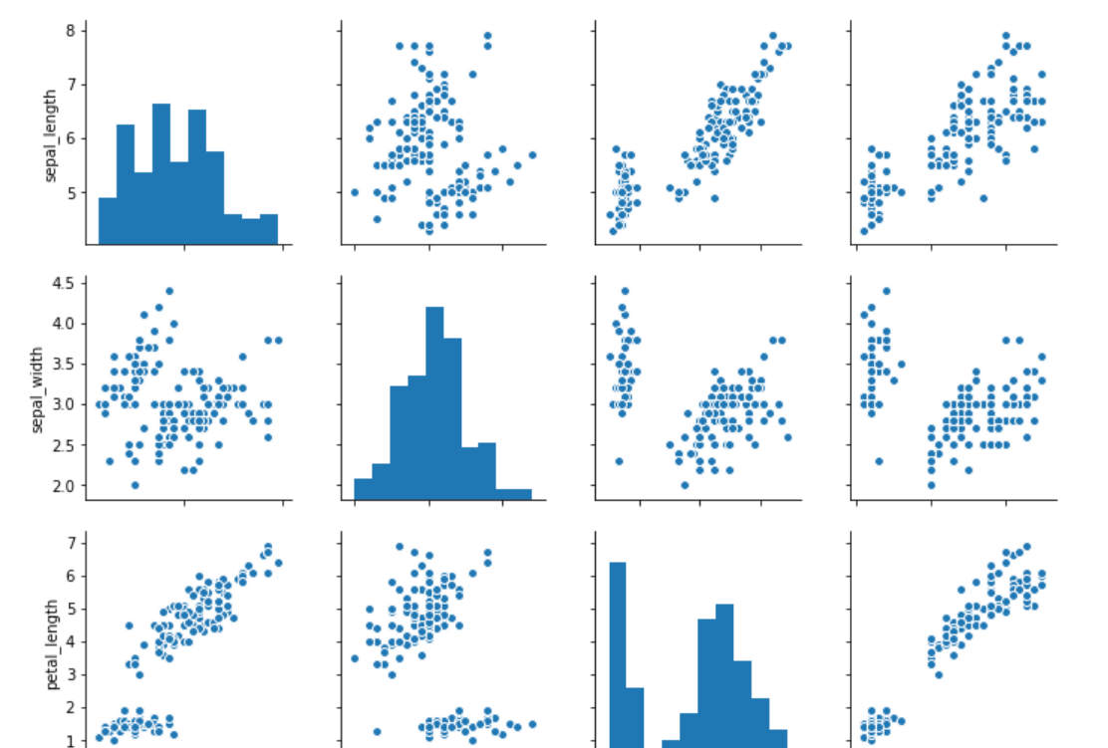
import matplotlib.pyplot as plt
import seaborn as sns
dataset = sns.load_dataset('iris')
dataset.head()
sns.pairplot(dataset)

Slide 51
Useful Links
---console.cloud.google.com/billing/linkedaccount?project=redwood-db-cloud-1&organizationId=724817557879
-- https://seaborn.pydata.org/tutorial/color_palettes.html
-- https://pandas.pydata.org/pandas-docs/stable/user_guide/visualization.html
-- https://pandas.pydata.org/pandas-docs/stable/user_guide/visualization.html
-- geeksforgeeks.org
--

