Slide 1
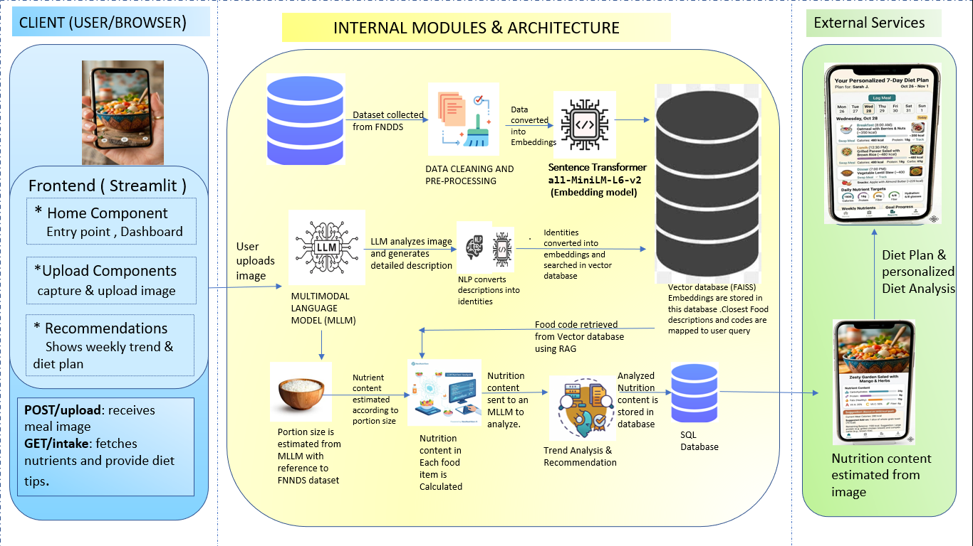
PROJECT TITLE:
AI-BASED DIETARY ASSESSMENT AND NUTRIENT ESTIMATION USING MULTIMODAL LARGE LANGUAGE MODELS
SYSTEM ARCHITECTURE

