Slide 1
VIDYA JYOTHI INSTITUTE OF TECHNOLOGY
(Autonomous)
TUNNEL ACCIDENT DETECTION USING MACHINE LEARNING
Under the guidance of
Dr.B. NANDITHA
Assistant Professor
Department of IT
By :Team 07
A.Sri Vaishnavi [21911A1271]
G.Shiva Sai Reddy [21911A1288]
K.Vasantha [21911A1293]
K.Gayathri [21911A1294]

Slide 2
ABSTRACT
Detecting accidents in tunnels is crucial for ensuring the safety of commuters. This project proposes a deep learning-based approach using YOLOv7 to identify accidents in tunnel images. The proposed method involves importing necessary libraries, acquiring and preprocessing the dataset, splitting it into training, validation, and testing sets, selecting and training the YOLOv7 model, and evaluating its performance. The model is fine-tuned on a tunnel accident dataset to predict accidents based on provided annotations or bounding boxes. The training progress is monitored and logged, and the model's performance is evaluated using metrics such as accuracy, precision, and recall. The proposed approach demonstrates the potential of deep learning for accident detection in tunnels, paving the way for safer and more efficient transportation systems. Future Enhancement: Automated Emergency Alerts. Integration of an automated alert system to notify nearby hospitals and police stations in case of a tunnel accident.

Slide 3
PROJECT INTRODUCTION
Ensuring the safety of commuters in tunnels is paramount, and detecting accidents promptly is critical for effective response. This project presents a deep learning-based approach utilizing YOLOv7 for accident identification in tunnel images. The proposed method encompasses importing essential libraries, acquiring and preprocessing the dataset, dividing it into training, validation, and testing sets, selecting and training the YOLOv7 model, and assessing its performance. The model is fine-tuned on a tunnel accident dataset to predict accidents based on supplied annotations or bounding boxes. The training progress is monitored and logged, and the model's performance is evaluated using metrics including accuracy, precision, and recall. This study highlights the potential of deep learning for accident detection in tunnels, paving the way for safer and more efficient transportation systems.

Slide 4
LITERATURE SURVEY
Simple Online and Realtime Tracking:
This paper explores a pragmatic approach to multiple object tracking where the main focus is to associate objects efficiently for online and real time applications. To this end, detection quality is identified as a key factor influencing tracking performance, where changing the detector can improve tracking by up to 18.9%. Despite only using a rudimentary combination of familiar techniques such as the Kalman Filter and Hungarian algorithm for the tracking components, this approach achieves an accuracy comparable to state-of-the-art online trackers. Furthermore, due to the simplicity of our tracking method, the tracker updates at a rate of 260 Hz which is over 20x faster than other state-of-the-art trackers.

Slide 5
LITERATURE SURVEY
The Relationship Between Precision-Recall and ROC Curves:
Receiver Operator Characteristic (ROC) curves are commonly used to present results for binary decision problems in machine learning. However, when dealing with highly skewed datasets, Precision-Recall (PR) curves give a more informative picture of an algorithm’s performance. We show that a deep connection exists between ROC space and PR space, such that a curve dominates in ROC space if and only if it dominates in PR space. A corollary is the notion of an achievable PR curve, which has properties much like the convex hull in ROC space; we show an efficient algorithm for computing this curve. Finally, we also note differences in the two types of curves are significant for algorithm design. For example, in PR space it is incorrect to linearly interpolate between points. Furthermore, algorithms that optimize the area under the ROC curve are not guaranteed to optimize the area under the PR curve.

Slide 6
LITERATURE SURVEY
Self-enhancement of automatic tunnel accident detection (TAD) on CCTV by AI deep-learning:
The deep-learning-based tunnel accident detection (TAD) system (Lee 2019) has installed a system capable of monitoring 9 CCTVs at XX site in November, 2018. The initial deep-learning training was started by studying 70,914 labeled images and label data. However, sunlight, the tail light of a vehicle, and the warning light of the working vehicle were recognized as a fire, and many pedestrians were detected in the lane of the tunnel or a black elongated black object the false detection data detected in the field were trained with labeled data and reapplied in the field. As a result, false detection of pedestrians and fire could be significantly reduced.

Slide 7
LITERATURE SURVEY
Guideline of installation of disaster prevention facilities on road tunnels:
Road tunnels are an important part of the transportation infrastructure in many countries. However, they can also be a potential fire hazard. In order to protect people and property from fires in road tunnels, it is important to install appropriate disaster prevention facilities. This guideline provides recommendations for the installation of disaster prevention facilities on road tunnels. These recommendations are based on a review of existing literature and on the experience of experts in road tunnel fire safety.
The guideline covers the following topics: Fire detection and alarm systems These systems are essential for detecting fires in road tunnels early on, so that evacuation can be initiated and firefighters can be alerted.

Slide 8
LITERATURE SURVEY
Fire suppression systems: These systems are used to extinguish fires in road tunnels. There are several different types of fire suppression systems available, and the type of system that is most appropriate for a particular tunnel will depend on a number of factors, including the size of the tunnel, the type of traffic that uses it, and the availability of water.
Evacuation routes: Evacuation routes are used to evacuate people from road tunnels in the event of a fire. Evacuation routes should be well-marked and easy to follow, and they should be designed to minimize the time it takes to evacuate the tunnel.
Emergency lighting: Emergency lighting is essential for providing illumination in road tunnels in the event of a fire or other emergency. Emergency lighting should be powered by a separate source from the normal lighting system, so that it will continue to operate in the event of a power failure.

Slide 9
LITERATURE SURVEY
Emergency ventilation: Emergency ventilation is used to remove smoke and other combustion products from road tunnels in the event of a fire. Emergency ventilation systems should be designed to provide adequate ventilation for the entire length of the tunnel.
Firefighting access: Firefighting access is essential for firefighters to be able to access road tunnels in the event of a fire. Firefighting access should be provided at both ends of the tunnel, as well as at any intermediate points that may be necessary.
Training and maintenance: Training and maintenance are essential for ensuring that disaster prevention facilities in road tunnels are properly installed and maintained. Disaster prevention facilities should be regularly tested and inspected to ensure that they are in working order. By following the recommendations in this guideline, road tunnel owners and operators can help to protect people and property from fires in road tunnels.

Slide 10
PROBLEM STATEMENT
Prompt detection of accidents in tunnels is crucial for ensuring commuter safety and facilitating effective emergency response. However, conventional accident detection methods often face challenges due to the complex and dynamic environment of tunnels, such as low lighting, varying traffic patterns, and potential occlusions of vehicles or pedestrians. Deep learning, particularly YOLOv7, offers a promising approach for accurate and reliable accident detection in tunnel images .

Slide 11
EXISTING SYSTEM
The existing system, the deep-learning-based video accident detection system can adapt to the unclear and dark image environment of the tunnel itself. By learning the verified data set, the deep-learning-based video accident detection system can be employed in a tunnel site (Lee 2018). The Deep learning model classifies objects such as a car, a fire, or person and regresses the bounding box, represented by data in the form of a rectangular box.

Slide 12
PROPOSED SYSTEM
The proposed system, to detect accidents in tunnel images, a deep learning approach using YOLOv7 is proposed. The model is trained on a tunnel accident dataset and fine-tuned to predict accidents based on provided annotations or bounding boxes. The model's performance is evaluated using metrics like accuracy, precision, and recall, demonstrating its effectiveness in accident detection. This approach paves the way for safer and more efficient transportation systems. Future Enhancements are Automated Emergency Alerts, Integration of an automated alert system to notify nearby hospitals and police stations in case of a tunnel accident.

Slide 13
OBJECTIVES
To develop a deep learning-based system for detecting accidents in tunnel images using YOLOv7. The system will be trained on a tunnel accident dataset and evaluated using metrics such as accuracy, precision, and recall.

Slide 14
SYSTEM REQUIREMENTS
Environment | Speciﬁcations
Hardware | 8GB RAM 80GB Hard Disk i5 and above Processor
Software | Windows OS Python GUI or Anaconda OS: Windows 10

Slide 15
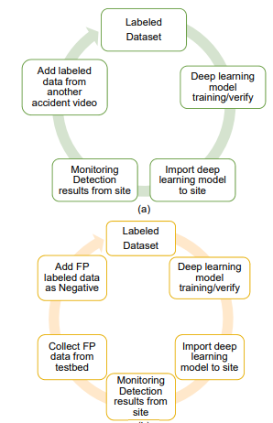
SYSTEM ARCHITECTURE

Slide 16
TIMELINE
Review 0 | Requirements & Speciﬁcations
Review 1 | Data Collection
Review 2 | Data Pre-Processing Apply Algorithm
Review 3 | Evaluation

Slide 17
DESIGN
Software design is the foundation of software development, ensuring quality and stability in the final product. It translates system requirements into a structured model that guides coding and testing. A strong design enables quality assessment at every stage and reduces the risk of building an unstable system. It involves refining data structures, program flow, and procedural details to enhance efficiency. The key aspects of design include architectural, data structure, interface, and procedural design.

Slide 18
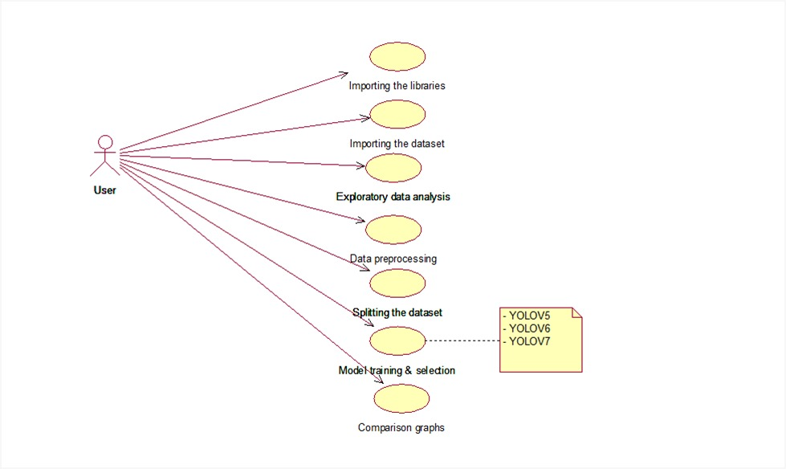
UML DIAGRAMS
USE CASE DIAGRAM

Slide 19
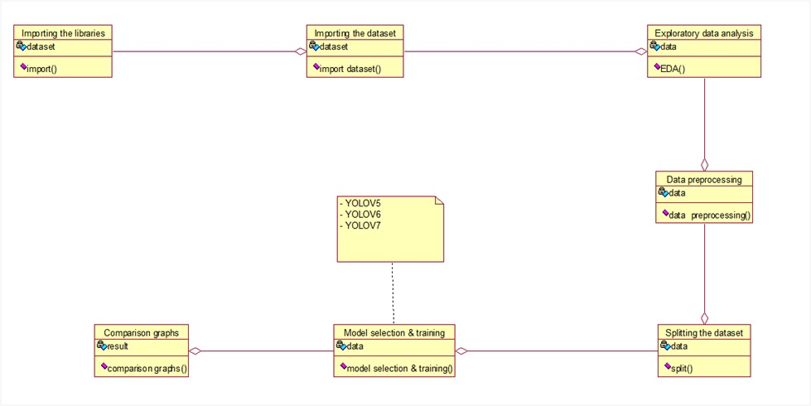
UML DIAGRAMS
CLASS DIAGRAM

Slide 20
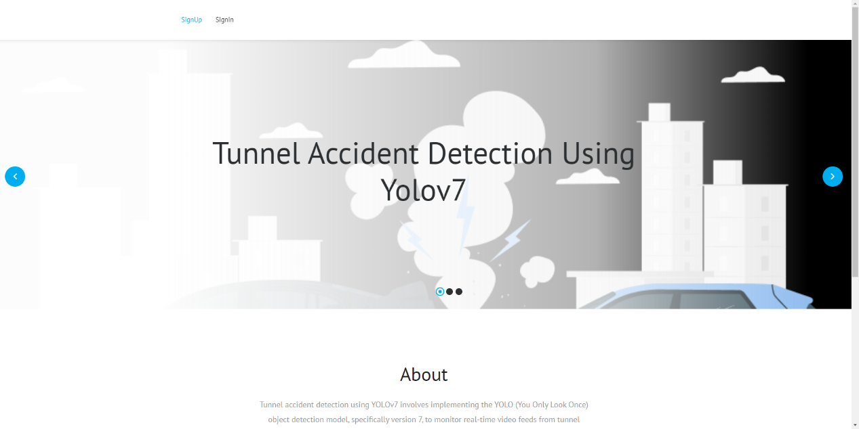
Sample screens

Slide 21

Sample screens

Slide 22

Sample screens

Slide 23

Sample screens

Slide 24
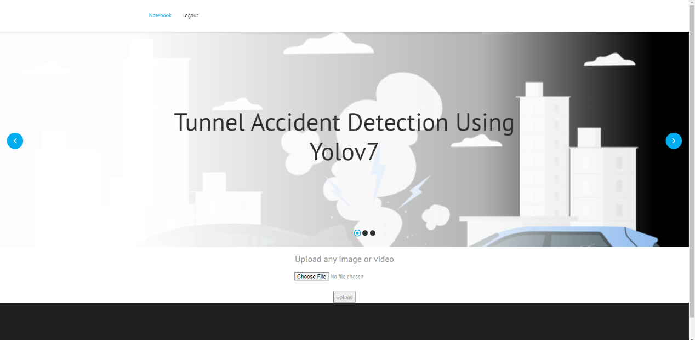
Sample screens

Slide 25
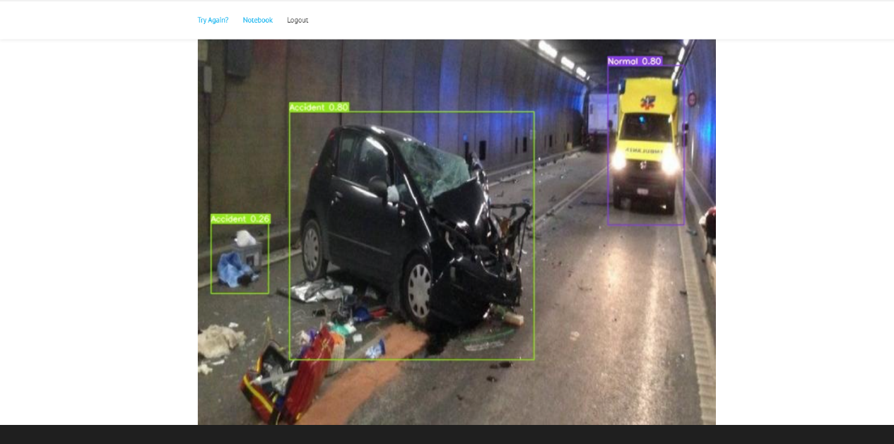
Sample screens

Slide 26
CONCLUSION
Deep learning has emerged as a powerful tool for various applications, including accident detection in tunnels. This study utilized the YOLOv7 architecture to effectively identify accidents in tunnel images. The proposed approach involved acquiring and preprocessing a tunnel accident dataset, splitting it into training, validation, and testing sets, fine-tuning the YOLOv7 model on the training data, and evaluating its performance. The model achieved promising results, demonstrating the viability of deep learning for accident detection in tunnels. The trained model can be deployed in real-time monitoring systems to enhance tunnel safety and minimize the impact of accidents. Further research can focus on improving the model's robustness against variations in lighting conditions and tunnel environments. Additionally, integrating the model with IoT sensors and emergency response systems can create a comprehensive accident detection and response system for tunnels.

Slide 27
REFERENCES
Alex, B., Zongyuan, G., Lionel, O., Fabio, R., Ben, U. (2016), “Simple online and realtime tracking”, Proceedings of the Image Processing (ICIP) 2016 IEEE International Conference, 3464-3468.
Davis, J., Goadrich, M. (2006), “The relationship between Precision-Recall and ROC curves”, Proceedings of the 23rd International Conference on Machine Learning, 233- 240.
Lee, K.B., Shin, H.S. and Kim, D.K. (2018), “Development of a deep-learning based automatic tracking of moving vehicles and incident detection processes on tunnels”, J. Kor. Tunnel Eng., KTA, 20(6), 1161-1175.
Lee, K.B., Shin, H.S (2019), “Effect on self-enhancement of deep-learning inference by repeated training of false detection cases in tunnel accident image detection”, J. Kor. Tunnel Eng., KTA, 21(3), 419-432.
Ministry of Land, Infrastructure and Transport (MOLIT) (2016), “Guideline of installation of disaster prevention facilities on road tunnels”.

Slide 28
💐 Thank You 💐

