Slide 1


Dunnhumby - The Complete Journey
consumer MARKETING ANALYSIS
Gayathri Mulagund

Slide 2
Objectives
Business Overview:
Merchandise and Sales
Consumer Profile:
Demographics and Purchase Patterns
Marketing Strategy:
Campaign Offers, Effectiveness Analysis

Slide 3

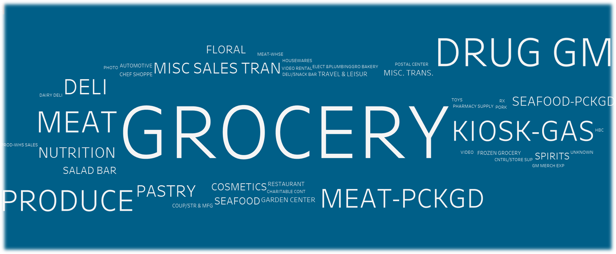



Merchandise (Department)

Slide 4
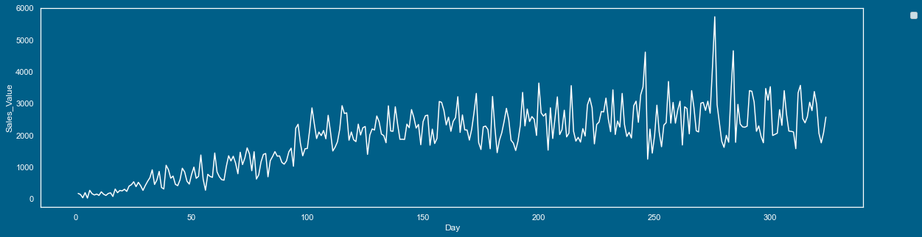
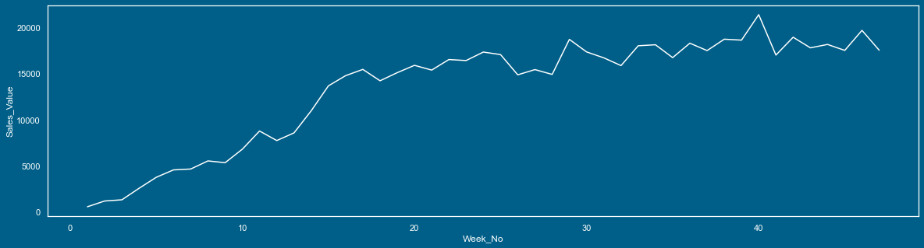
Sales: Daily and Weekly
Average daily Sales: $ 9696
Average weekly Sales: $ 66659
430 Stores and 2500 Consumers

Slide 5
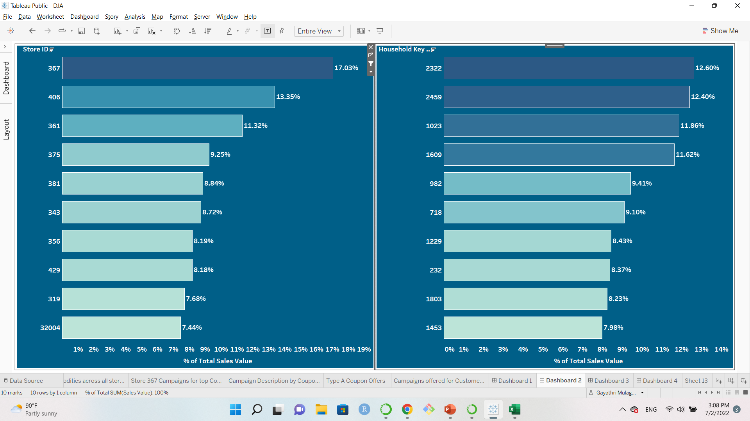
Sales: Top Revenue Generators
17%
13%
By Store
By Customer

Slide 6
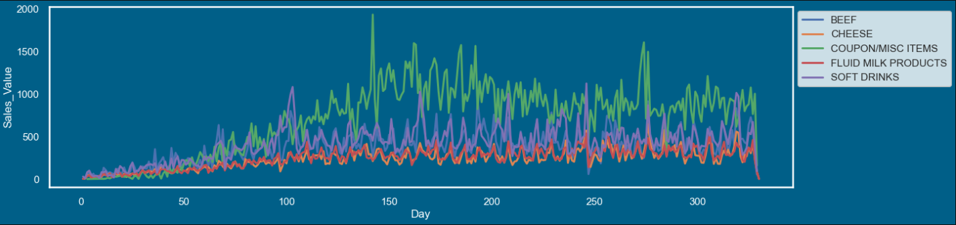
Sales: Top 5 Categories
Daily Sales
Coupons are contributing to maximum sales

Slide 7
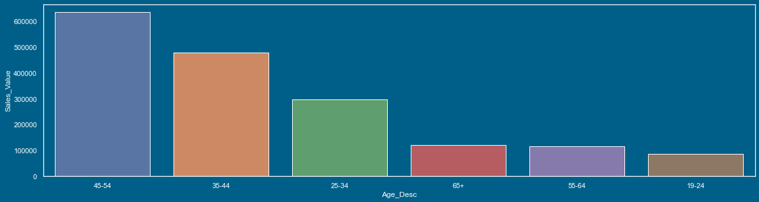
Consumer Profile
Parents to a single child
50K – 74K
45 – 54K
37%
Age Group
28%
17%
Segment:
Age Group 45 – 54
Over all Sales: 37%

Slide 8
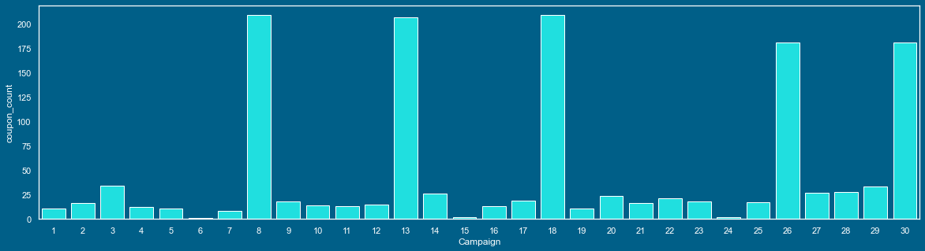
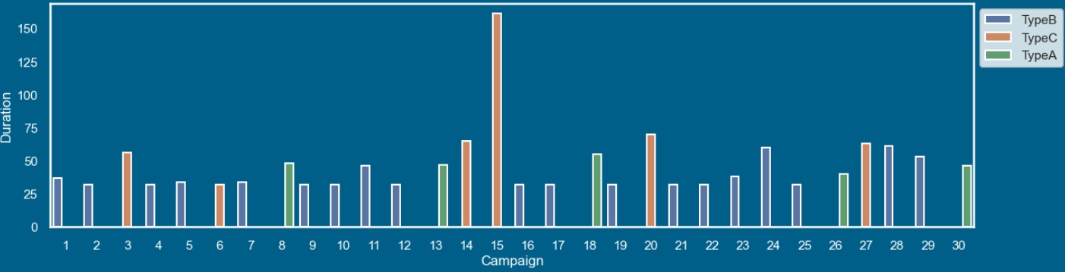
Campaign Offers
Coupons and Products per Campaign
Average duration:
Type A: 47 days
Type B: 38 days
Type C: 75 days
Campaign Time Duration

Slide 9
Promotional Pricing
Multiple Discount Strategy for Private labels and National brands

Slide 10
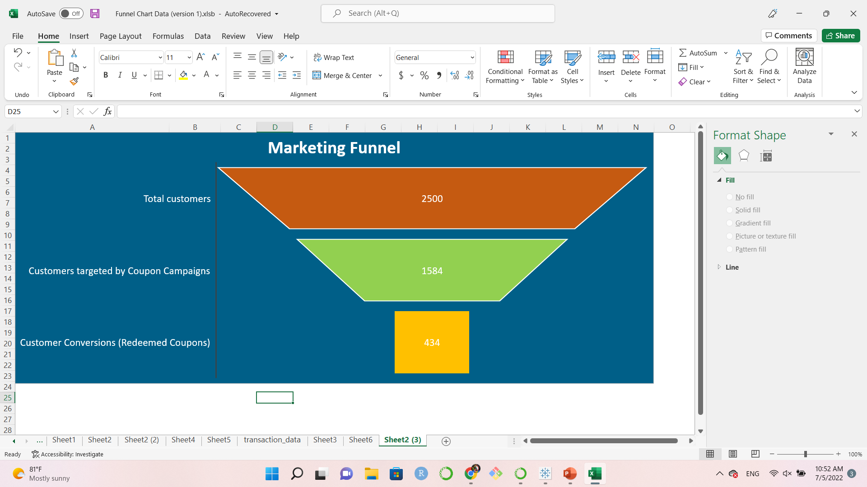
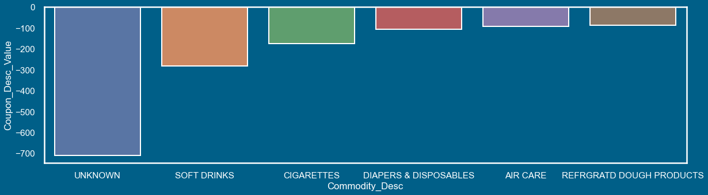
Campaign Effectiveness
Conversion Rate:
27%
Segment:
Age Group 45 – 54
Over all Sales: 37%
Coupons Redeemed
Coupons are offered on variety of products, not just top categories

Slide 11
AB Testing (z-test)
Significance = 0.05
Type A
Type B
p_value: 0
p is low
Type A
Type C
p_value: 0
p is low
Type B
Type C
p_value: 0
p is low
Null Hypothesis is invalid
Type A was less successful than Type B
Null Hypothesis is invalid
Type A was less successful than Type C
Null Hypothesis is invalid
Type B was less successful than Type C
Most effective : Type C
Notes:
SPLIT TESTING / BUCKET TESTING
method of comparing two versions against each other to determine which one performs better
a significance level of 0.05 indicates a 5% risk of concluding that a difference exists when there is no actual difference
(in a statistical test) the hypothesis that there is no significant difference between specified populations, any observed difference being due to sampling or experimental erro
the p-value is less than 0.05, we reject the null hypothesis that there's no difference between the means and conclude that a significant difference does exist.

Slide 12
Recap
Grocery: Top Merchandise
Consumer Segment: Age Group (45 – 54) contributes 37% of sales
Offers on Private labels and National Brands
Multiple Discount Strategy
Most effective campaign: Type C

Slide 13
Further Analysis
Campaigns for specific demographic groups
Product details of Private label coupon offers
Churn Prediction

Slide 14




Thank you!
Kaggle: Data Source
Excel, PowerPoint, Python and Tableau
Python resources and help on the internet
Dennis, my instructor and project mentor
Vadim, MaryBeth and Myra
All at TTP and Fullstack Academy and my fellow cohort members
Let’s Connect:
Gayathri Mulagund
Data Analyst
gmulagund@gmail.com
www.linkedin.com/in/gayathri-mulagund

