Slide 1
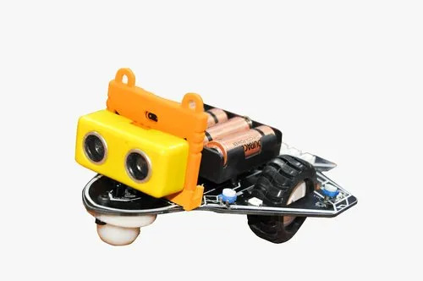

Slide 2
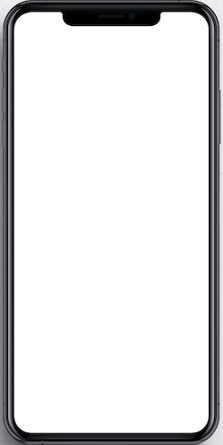
1 Notification
1-person detected in the room- laying bricks

Slide 3
1 Notification
Brick Laying – 2 more days to finish!

Slide 4


Brick-laying : Follow up!

Slide 5
1 Message
Progress on Brick Laying:
2 Bedrooms – Completed
1 wall - Overdue

