Slide 1
IBM University Engagement Project Submission
“Exploring the Power of Machine Learning with IBM Cloud”

Slide 2

Project Tile – [Network Intrusion Detection using Mechine Learning]
Domain of Project – [ Cyber Security]
Student Name | Recent Passport Photo | Email ID | Mobile number [WhatsApp]
Gayathri Ponnam |  | gayathriponnam03@gmail.com | 9160149497

Slide 3
Problem Statement -
Problem Statement: Network Intrusion Detection Using Machine Learning :
Modern computer networks face increasing cyber threats such as unauthorized access, malware, and denial-of-service (DoS) attacks. Traditional intrusion detection methods are often unable to detect evolving attacks efficiently. This project aims to develop a machine learning-based Network Intrusion Detection System that accurately classifies network traffic as normal or malicious using network connection features. The solution helps improve network security by enabling faster, more reliable, and automated cyber threat detection.

Slide 4
Proposed Solution -
(IBM watsonx.ai Studio – AutoAI):
We propose an AI-powered Network Intrusion Detection System using IBM watsonx.ai Studio and AutoAI.
Network traffic data is collected and uploaded to watsonx.ai for analysis.
AutoAI automatically performs data preprocessing, feature engineering, and hyperparameter optimization.
Multiple machine learning models are trained and evaluated to select the best-performing model.
The selected model classifies network traffic as Normal or cyber attacks such as DoS, Probe, R2L, and U2R, enabling fast and accurate intrusion detection.

Slide 5
Technology Used
IBM Cloud –It provides the infrastructure to build, train, deploy, and scale the Network Intrusion Detection System efficiently. IBM Cloud offers a reliable, secure, and scalable environment for developing machine learning models using IBM watsonx.ai Studio and AutoAI, enabling accurate detection and classification of network intrusions.
ML Algorithm/ Model Used : Decision Tree Classifier (Pipeline 4).
Accuracy Obtained: 0.999(99.9%)
Enhancements and Hyperparameter tuning: AutoAI automatically performed Feature Engineering (FE), Hyperparameter Optimization (HPO-1 & HPO-2), and model optimization to achieve the best-performing machine learning mode.

Slide 6
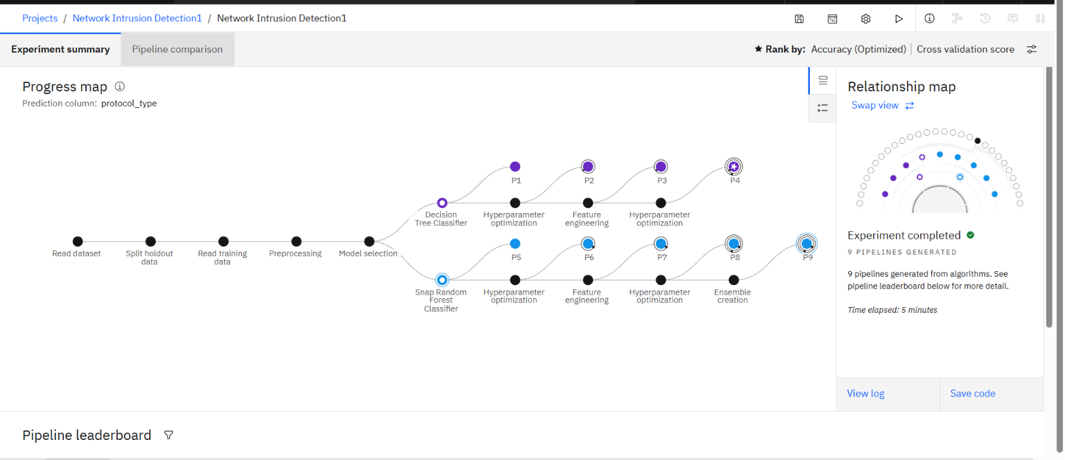
Training Screenshots-

Slide 7
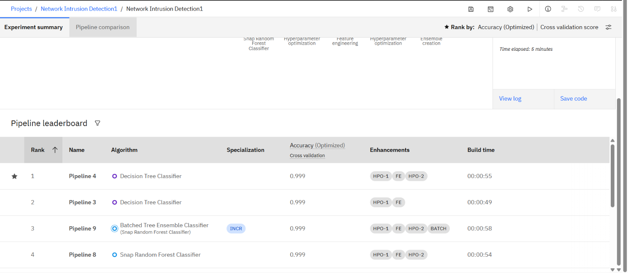
Best Model Screenshot:

Slide 8
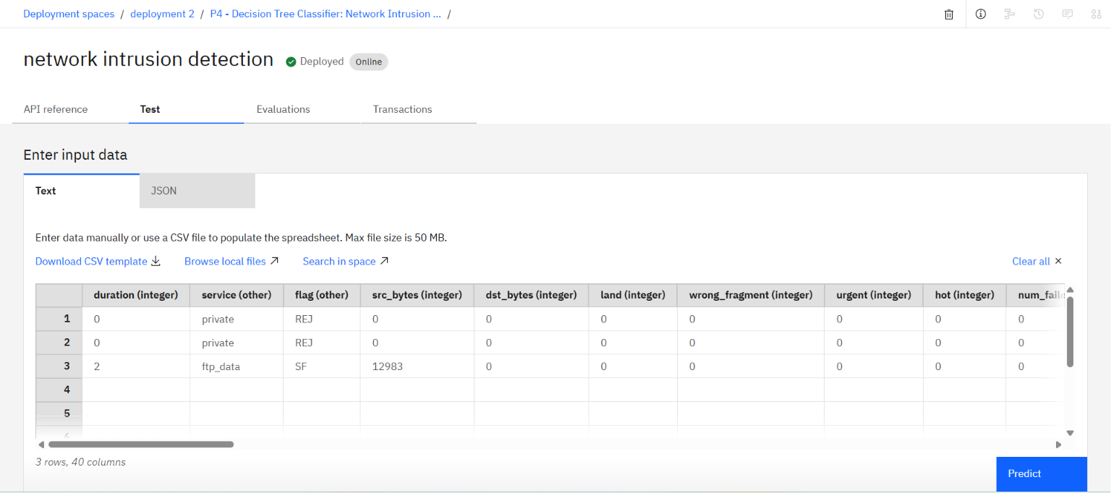
Testing Screenshot:

Slide 9
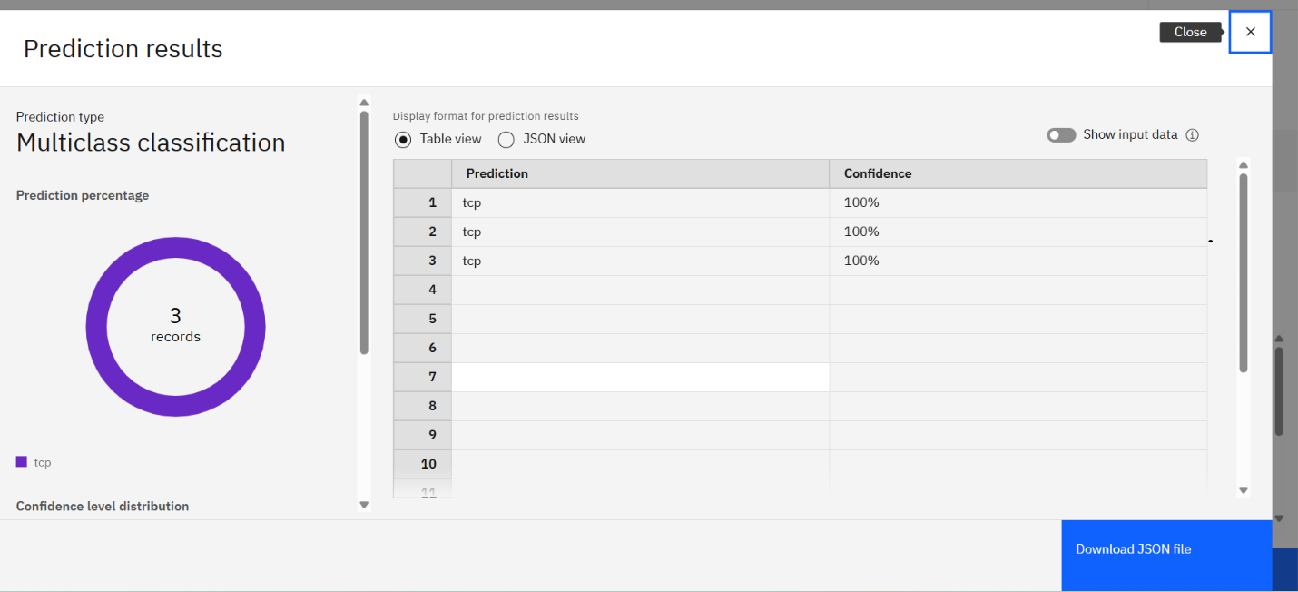
Testing Screenshot:

Slide 10
Git Hub Link
https://github.com/gayathriponnam/Network-Intrusion-Detection.git
·
·
·

Slide 11
Novelty and Uniqueness
The solution automates network intrusion detection, reducing manual monitoring efforts and improving the speed of cyber threat identification.
It uses IBM watsonx.ai AutoAI to automatically discover the best machine learning model without requiring extensive coding or manual model selection.
The system can accurately classify network traffic into normal and malicious categories through a single intelligent platform.
Automated feature engineering and hyperparameter optimization help identify hidden patterns in network traffic, improving intrusion detection accuracy.
The model ensures reliable, consistent, and real-time detection of cyber attacks, minimizing false positives and enhancing overall network security.

Slide 12
Future Scope
The system can be integrated with enterprise networks for real-time intrusion detection.
New cyber attack types can be added to improve detection capabilities.
Advanced AI models in IBM watsonx.ai can further enhance prediction accuracy.
The solution can be deployed across cloud and enterprise environments for scalable cybersecurity protection.
Future enhancements can include real-time threat monitoring and automated incident response.
·
·
·

Slide 13

Certificates Earned:

Slide 14

Certificates Earned:​

Slide 15


