Slide 1
Automated Log Anomaly Detection Using Machine Learning and LLM Support
RAPARTHI GAYATHRI
111724720005
NMDS

Slide 2
ABSTRACT
Modern software systems generate a huge amount of monitoring and log data, which is difficult to check manually. This project builds an intelligent AIOps system that uses machine learning to automatically detect abnormal server behavior from metrics such as CPU, memory, disk, and network usage. Unsupervised models like Isolation Forest and Local Outlier Factor are used to learn normal patterns, identify anomalies, and mark ultra‑critical servers that may need immediate action. Simple self‑healing rules then flag cases that require an urgent restart, and an LLM‑based layer converts these technical anomalies into easy‑to‑understand explanations and suggested fix commands. This reduces manual log analysis, speeds up failure detection, and helps teams monitor large‑scale systems more reliably.

Slide 3
Introduction
Modern software and cloud systems generate huge amounts of monitoring data, such as CPU, memory, disk, and network usage for many servers. This data can reveal early signs of failures, but the volume is too large and fast for people to analyze manually. Traditional monitoring mostly relies on fixed thresholds, which are hard to tune and often miss new or unusual problems. In this project, we build an intelligent AIOps system that uses machine learning to learn normal server behavior and automatically detect abnormal patterns. On top of this, an explanation layer converts technical anomaly details into simple, human‑readable messages and suggested actions, helping operators quickly understand and respond to critical issues.

Slide 4
Existing System
In existing systems, server logs and metrics are shown on dashboards and alerts are triggered using simple fixed rules. These rules do not adapt to changing traffic or new failure types and usually treat each metric separately. As a result, engineers must still inspect raw data and decide what is wrong and how to fix it, which slows down response and increases the chance of missing important issues.

Slide 5
Proposed System
The proposed system is an intelligent solution that uses machine learning to learn normal server behavior and automatically flag abnormal records. It applies Isolation Forest and Local Outlier Factor on key metrics like CPU, memory, disk, and network, and treats cases detected by both models as ultra‑critical. Self‑healing rules then identify situations that need immediate action, such as restarting a server. An LLM layer finally turns these technical anomalies into simple explanations and suggested commands, all shown in a user‑friendly dashboard.

Slide 6
Data Collection
This project uses a structured CSV dataset of server monitoring and anomaly records, where each row is one timestamped anomaly event with multiple descriptive fields. It covers several anomaly types (System, Database, Network, Security, Storage, Application) and severity levels (Low, Medium, High, Critical). The dataset has about 100,000 records and 31 columns, making it realistic for simulating a production environment and suitable for building, testing, and demonstrating the anomaly detection and explanation system.

Slide 7
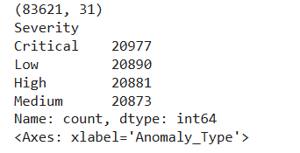
Data Description
The dataset includes both context information and numeric performance metrics for each anomaly event. Context fields (such as timestamp, type, severity, source, service, user role, location, and escalation level) describe what the event is and where it occurred. Numeric metrics (CPU, memory, disk, and network usage) show how heavily resources were used, while impact fields (like response time, resolution time, affected services, failed transactions, duration, alert count, and retry count).

Slide 8
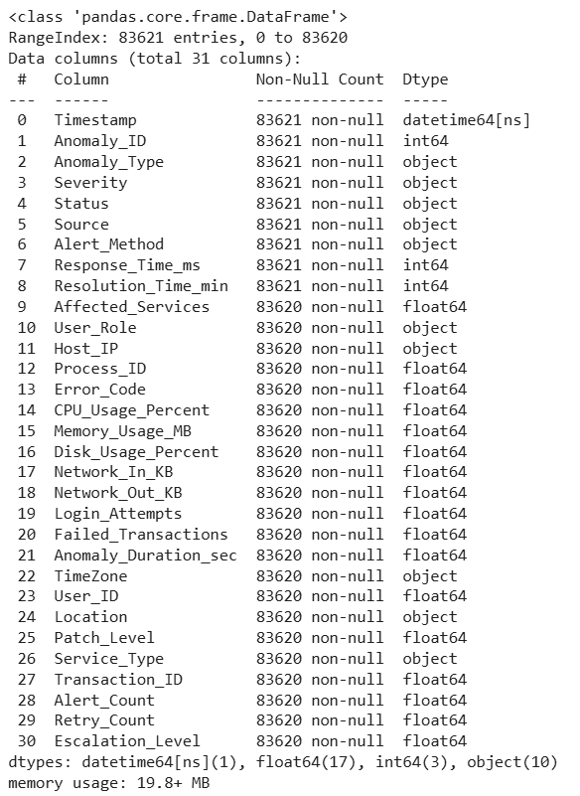

Slide 9
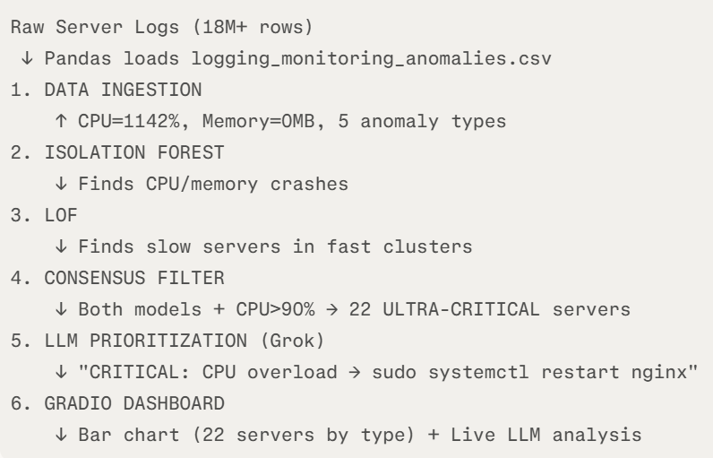
Methodology
Isolation Forest finds exploding CPU logs
LOF finds slow response logs among fast ones.
Normal log: "CPU=45%, Memory=2GB" ← blends with millions of normal logs
CRASH log: "CPU=1142%, Memory=0MB" ← SCREAMS "BROKEN!"
Isolation Forest reads all log lines, finds the crazy one instantly.

Slide 10
Methodology
LOF = "Find Weird Log in Normal Group"
Fast servers logs:
log1: "CPU=35%, response=0.2s"
log2: "CPU=38%, response=0.3s"
log3: "CPU=40%, response=0.1s"
SLOW log:
"CPU=30%, response=15s" ← suspicious in fast group!

Slide 11
