Slide 1

Edubridge project name :Brick breaker game
BY :
R. GAYATHRI
EBEON0922661103
BATCH NO : 7943

Slide 2
CONTENT
Abstract
Software Requirements
Functions
Brick breaker game Architecture Diagram
Visual Representations
Conclusion

Slide 3
Abstract
The project that is going to be implemented will consist of a game in which the player smashes awall of bricks by deflecting the bouncing ball with a paddle.The paddle will only move in a horizontalway and will be controlled by the player with the left and right arrows of the keyboard or with themousse. The player will win this game after destroying all the bricks in the level. Similarly, the player willose if he fails to catch the ball with the paddle

Slide 4
Software Requirements
Software Requirements :
Java Development kit (JDK).
sts Spring Tool or Eclipse or net Beans (IDE).
Operating System :
Windows,
Other OS…

Slide 5
Functions
In this game, has one paddle, one ball and some bricks. I have created an image for a ball, paddle and brick using java applet.
I use a timer to create a game cycle.
Top, bottom, left and right.

Slide 6
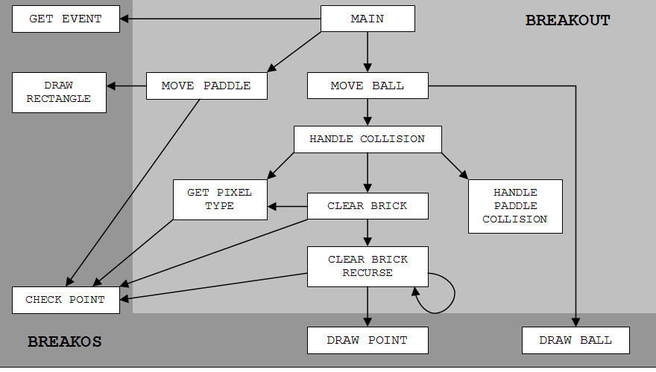
Brick breaker game
Architecture Diagram

Slide 7
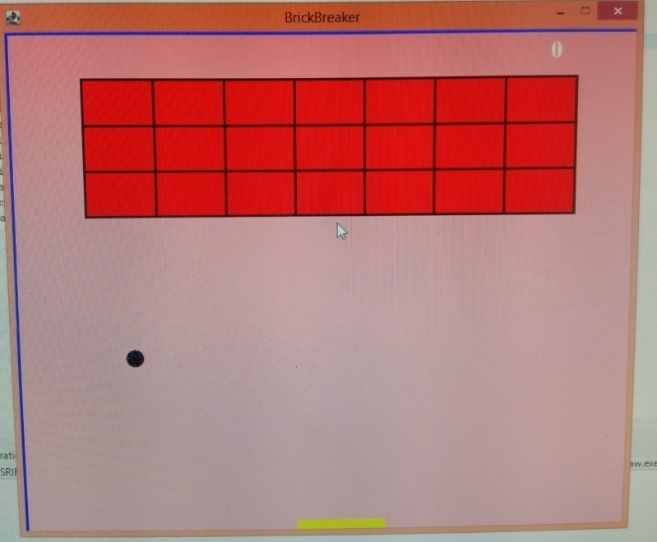
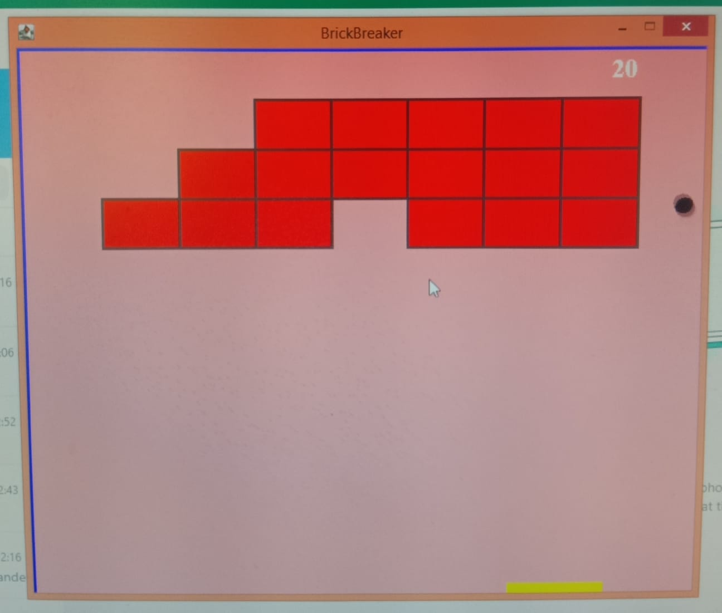
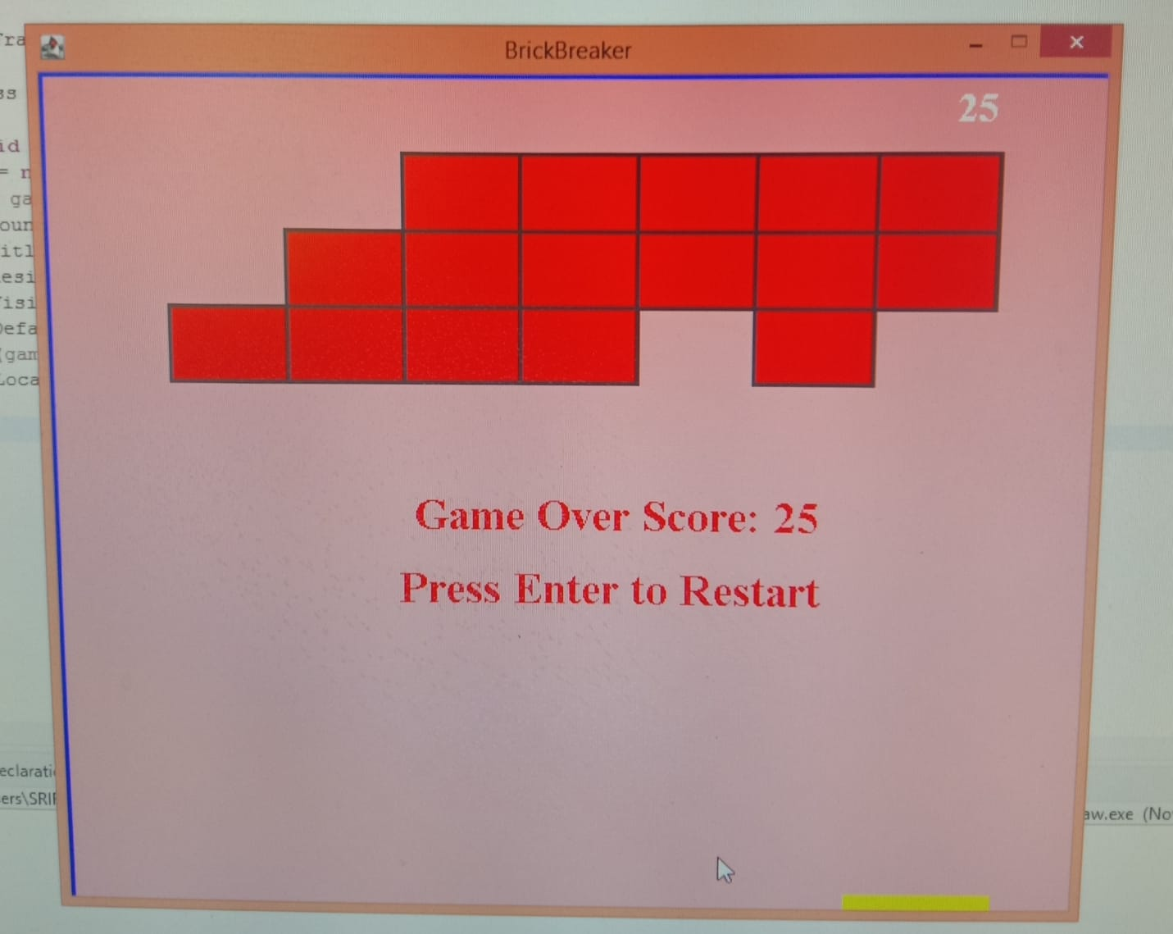
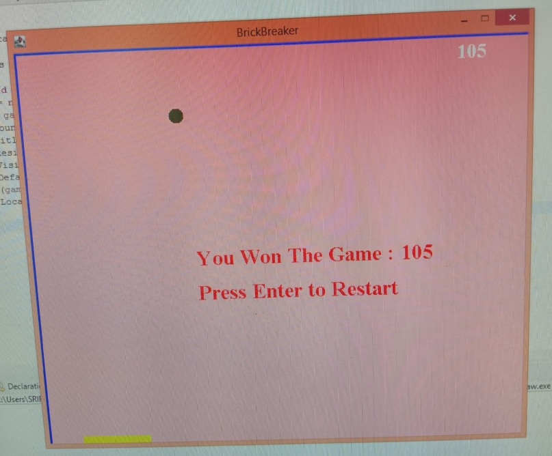
Visual Representations

Slide 8
Conclusion
Brick Breaker successfully ran and it is a a fun experience Brick Breaker break my boring learning and right now i'm very interested to learn in coding and do new projects
I hopefully that it gives you a good idea about what the game is about and how it has been constructed.

Slide 9
THANK YOU

