Slide 1
EduBridge Breakout room - 1

Slide 2
What is Design pattern ?
Design patterns represent the best practices used by experienced object-oriented software developers.
Design patterns are solutions to general problems that software developers faced during software development.

Slide 3
Advantage of design pattern:
They are reusable in multiple projects.
They provide the solutions that help to define the system architecture.
They capture the software engineering experiences.
They provide transparency to the design of an application.
They are well-proved and testified solutions since they have been built upon the knowledge and experience of expert software developers.
Design patterns don?t guarantee an absolute solution to a problem. They provide clarity to the system architecture and the possibility of building a better system.

Slide 4
Types of Design Patterns
1.Creational Design Pattern
2. Structural Design Pattern
3. Behavioral Design Pattern
4. J2EE

Slide 5
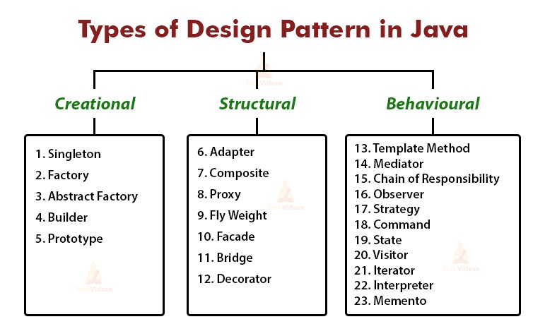

Slide 6
What is structural design pattern java?
Structural design patterns are those that simplify the design of large object structures by identifying relationships between them.
They describe common ways of composing classes and objects so that they become repeatable as solutions.

Slide 7
What are creational design patterns in java?
Creational design patterns are concerned with the way of creating objects.
These design patterns are used when a decision must be made at the time of instantiation of a class (i.e. creating an object of a class). But everyone knows an object is created by using new keyword in java.

Slide 8
What is behavioral design pattern in Java?
Behavioral Patterns are concerned with the strategy of object collaboration and the delegation of responsibilities among objects.
This pattern characterizes object communication and simplifies the dynamic control flow of object behavior.

Slide 9
What is J2EE design patterns in Java?
The J2EE design patterns pioneered by Sun Microsystems are a set of best practices for solving recurring design problems.
Patterns are ready-made solutions that can be adapted to different problems, and leverage the experience of successful J2EE developers

Slide 10
Thank You

