Slide 1

SCAM DETECTION FOR ONLINE TRANSACTIONS
CSI1007 – Software Engineering Principles Laboratory
23MID0238-Abinaya.M
23MID0192-Gayathri.S
23MID0248-Mahalakshmi.S

Slide 2
SCAM DETECTION FOR ONLINE TRANSACTIONS
Description of the Project:
The Scam Detection System for Online Transactions is designed to identify and prevent fraudulent activities during online financial transactions. It leverages advanced technologies to analyze transaction data in real-time, aiming to safeguard users and financial institutions from potential scams.
Key Features:
1.Real-Time Monitoring: Continuously observes transaction activities to detect and flag suspicious behaviors as they occur.
2.Machine Learning Algorithms: Utilizes machine learning techniques to analyze transaction patterns and identify anomalies indicative of fraud.
3.User Behavior Analysis: Assesses typical user behaviors, such as spending habits and transaction locations, to detect deviations that may signal fraudulent activity.
4. Risk Scoring: Assigns risk scores to transactions based on various parameters, enabling prioritization of high-risk activities for further investigation.
5.Automated Alerts: Generates immediate notifications to users and administrators upon detection of potentially fraudulent transactions, facilitating prompt action.

Slide 3
Scope of the Project:
➤ User Authentication & Verification:
Multi-Factor Authentication (OTP, biometrics).
Device fingerprinting & IP tracking.
CAPTCHA to block bots.
➤ Real-Time Fraud Detection:
AI-Based Risk Scoring (Machine learning detects anomalies).
Rule-Based Checks (Flagging large/unusual transactions).
Velocity Checks (Multiple transactions in a short time).
Blacklist/Whitelist (Block known fraudsters, allow trusted users).
➤ Secure Payment Processing:
3D Secure (3DS), CVV, AVS Checks for card verification.
2. AI-powered monitoring of payment patterns.
3. Chargeback & refund fraud detection.

Slide 4
➤ AI & Anomaly Detection:
Detect outliers using machine learning
Graph-based fraud detection* for connected fraudsters.
Deep learning for pattern recognition.
➤ Alerts & Reporting:
Instant SMS/Email alerts for suspicious activity.
Admin dashboard for real-time fraud tracking.
➤ Compliance & Security:
KYC & AML checks.
2. PCI DSS compliance for payment security.
➤ Tech Stack:
Backend: Python, Java, Node.js
2. ML: TensorFlow, Scikit-Learn3. Database: PostgreSQL, MongoDB, Neo4j

Slide 5
Impact of the developing Project:
Protecting Users' Money: By identifying and stopping fraudulent transactions, the system helps prevent financial losses for individuals and businesses.
Building Trust in Digital Payments: When users know their transactions are secure, they are more likely to use online payment methods, supporting the growth of digital commerce.
Adapting to New Fraud Techniques: Using advanced technologies like machine learning, the system can learn from past data to detect and respond to new types of scams effectively.
Reducing Operational Costs: Automating fraud detection reduces the need for manual monitoring, saving time and resources for organizations.
Encouraging Economic Growth: Secure online transactions promote more digital financial activities, contributing to broader economic development.

Slide 6
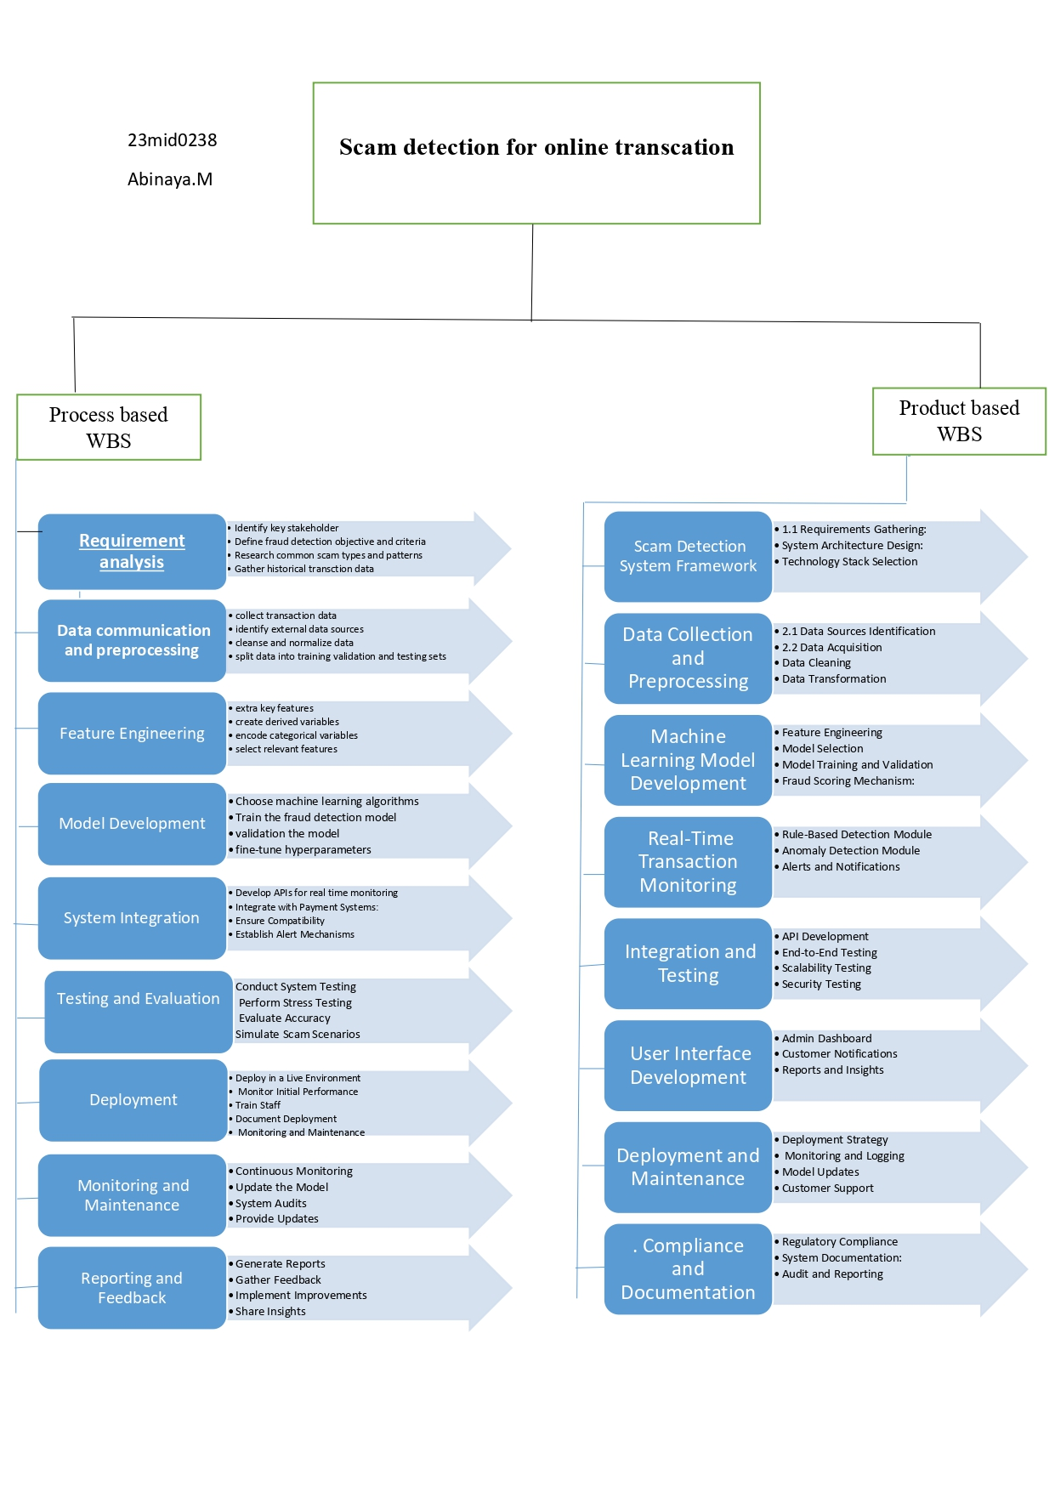
Work Breakdown Structure

Slide 7
SRS Document
Functional Requirements:
1.User Authentication: The system must verify user identity via multi-factor authentication (MFA).
2. Transaction Monitoring: Continuously track and analyze transactions in real time.
3. Fraud Detection Algorithm: Implement AI/ML-based anomaly detection to identify
suspicious transactions.
4. Risk Scoring System: Assign risk scores to each transaction based on fraud indicators.
5. Blacklist Database: Maintain a list of known fraudulent accounts and flagged transactions.
6. Alert Mechanism: Send real-time alerts via email, SMS, or push notifications when a
suspicious transaction is detected.
7. Transaction Verification: Allow users to confirm or dispute flagged transactions.
8. Integration with Payment Gateways: Ensure compatibility with different online
payment platforms.
9. Automated Blocking: Block high-risk transactions automatically based on fraud detection rules.

Slide 8
Non-Functional Requirements:
1. Scalability: The system should handle a high volume of transactions without performance degradation.
2. Performance: Transaction analysis should be completed in under a second for real-time fraud detection.
3. Security: Use encryption (SSL/TLS, AES) to protect sensitive transaction data.
4. Reliability: The system should have an uptime of 99.99% to ensure continuous fraud monitoring.
5. Compliance: Must adhere to financial regulations such as PCI-DSS, GDPR, and local banking laws.
6. Usability: The UI should be user-friendly and allow quick dispute resolution.
7. Maintainability: The system should be easy to update and improve with new fraud detection algorithms
8.Interoperability: Should work seamlessly with different banks, payment processors, and digital wallets.

Slide 9
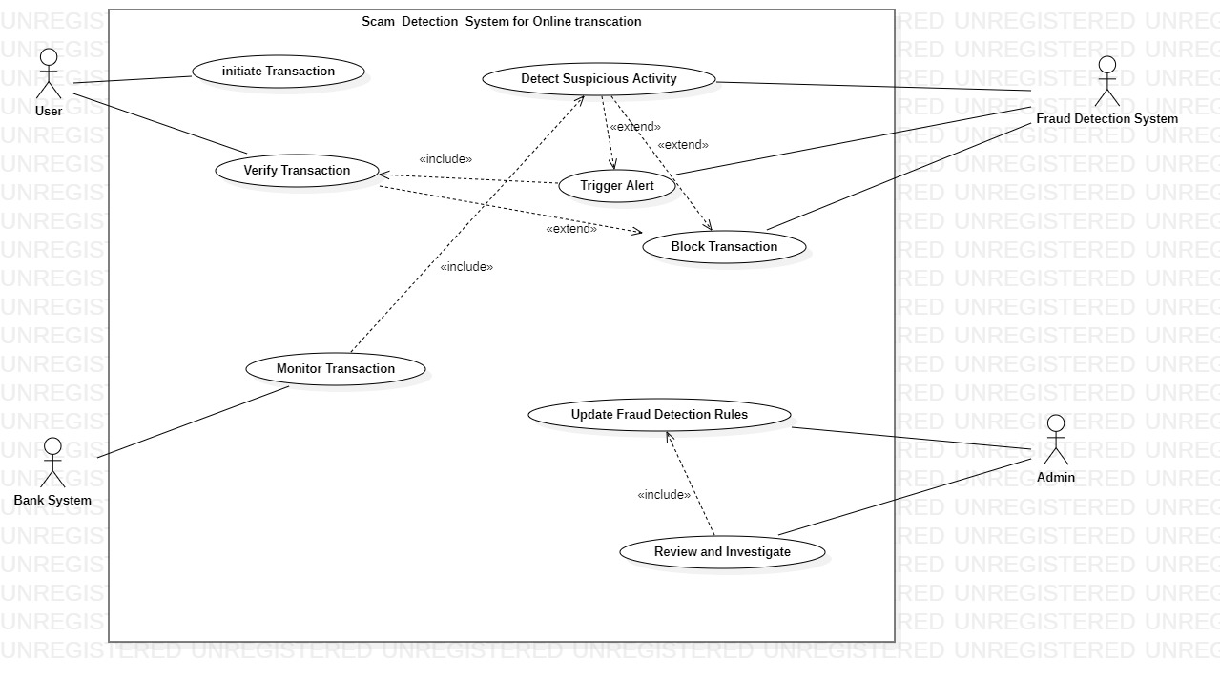
UML - Diagrams
Use case diagram:

Slide 10
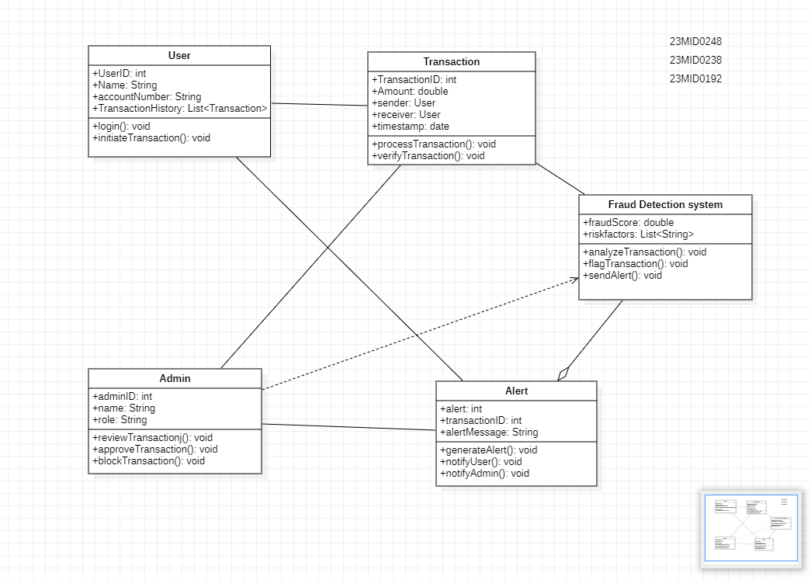
Class Diagram

Slide 11
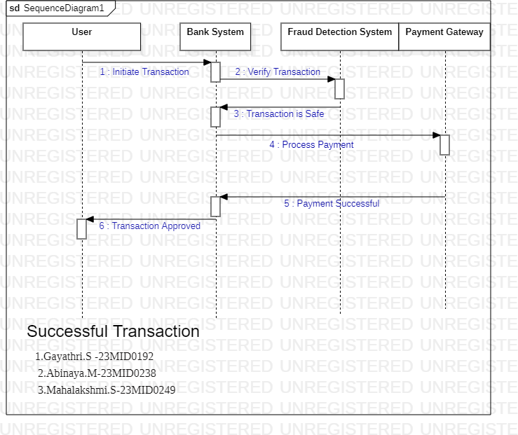
Sequence Diagram:

Slide 12
Testing
Test Scenario 1: Successful Transaction
Test Case Description:
Ensure that a legitimate transaction with valid details is processed successfully without any fraud alerts.
Test Steps:
1. Open the online transaction page.
2. Enter valid payment details (card number, expiration date, CVV).
3. Enter valid personal details (name, billing address).
4. Click the "Pay Now" button.
5. The system sends the transaction details to the Bank System.
6. The Bank System calls the Fraud Detection System (FDS) for verification.
7. FDS analyzes the transaction and confirms it is safe.
8. The Bank System processes the payment through the Payment Gateway.
9. Receive a confirmation that the payment was successful.

Slide 13
Test Data:
Valid Case:
Payment Amount: $50
Card Number: 4111 1111 1111 1111
Expiration: 12/25
CVV: 123
Device/Location: Registered device and usual location
Test Expected Result:
The transaction should be processed without interruption.
The user should see a confirmation message such as "Transaction Approved" or be redirected to a success page.
Actual Result:
Valid transaction was processed successfully, and a confirmation message was displayed.
Pass/Fail:Pass

Slide 14
Test Scenario 2: Fraud Detected (Transaction Blocked)
Test Case Description:
Ensure that the system correctly identifies and blocks a fraudulent transaction, preventing
unauthorized payment processing.
Test Steps:
1. Open the online transaction page.
2. Enter payment details that appear suspicious (e.g., a stolen or fake card).
3. Enter mismatched personal details or use a new/unregistered device.
4. Click the "Pay Now" button
5. The system sends the transaction details to the Bank System.
6. The Bank System calls the Fraud Detection System (FDS) for verification
7. FDS detects high-risk factors (e.g., unusual amount, location, or device) and flags the
transaction as fraudulent.
8. The Bank System blocks the transaction.
9. The system displays an error message and sends a fraud alert notification to the user.

Slide 15
Test Data:
Fraudulent Case:
Payment Amount: $5000
Card Number: 4000 0000 0000 0002 (or similar test data for a flagged card)
Expiration: 11/23
CVV: 321
Device/Location: New, unregistered device from an unusual location
IP Address: Suspicious or blacklisted IP
Test Expected Result:
The transaction should be blocked.
The user should receive a message stating "Transaction Blocked – Fraud Detected" along
with a fraud alert notification.
Actual Result:
The system blocked the transaction and displayed the fraud alert message as expected.
Pass/Fail:Pass

Slide 16
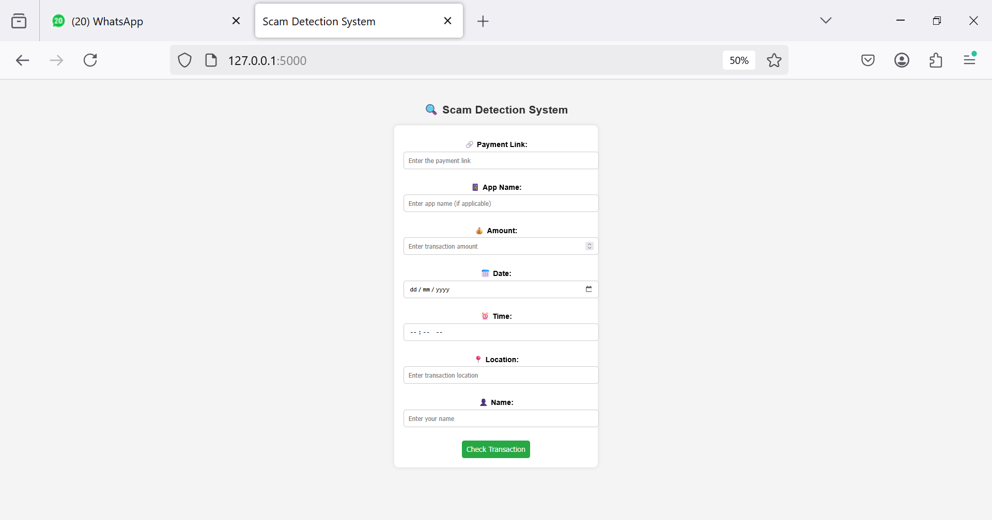
Project – UI Screenshots

Slide 17
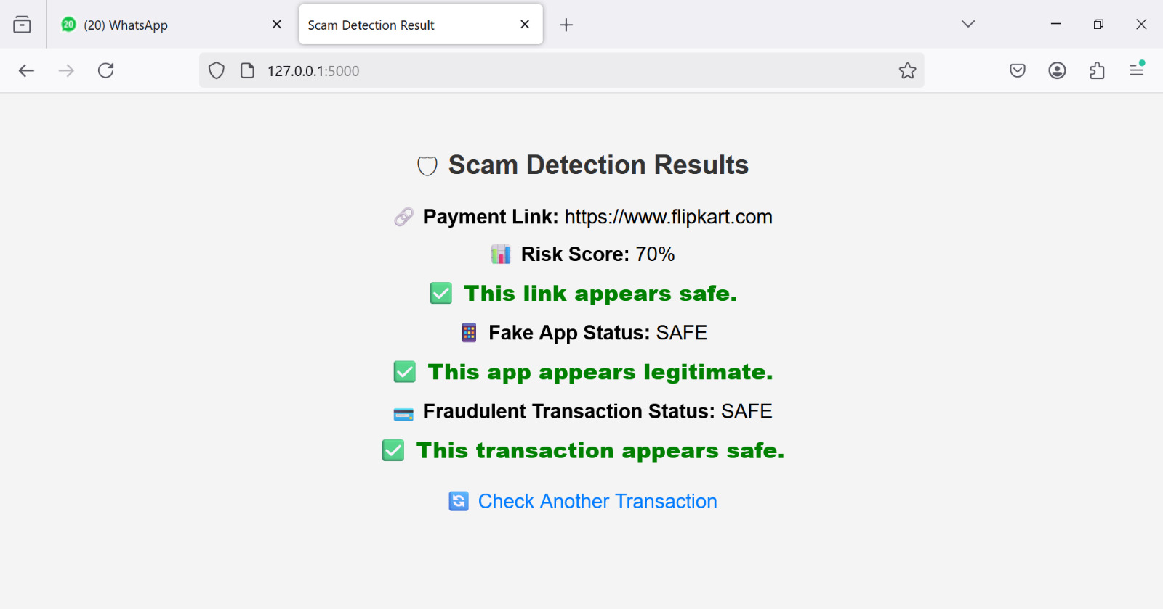

Slide 18
