Slide 1







Analysis Survey of the Technology Usage and Trends
IBM Data Analyst Capstone Project
Name: GAYATHRI SAMBANDAM
Date: 09/06/2024

Slide 2



OUTLINE
Executive Summary
Introduction
Methodology
Results
Visualization – Charts
Dashboard
Discussion
Findings & Implications
Conclusion
Appendix

Slide 3

EXECUTIVE SUMMARY
Purpose:
Create an interactive dashboard using IBM Cognos Analytics.
Scope:
Use provided e datasets to demonstrate data visualization and analysis.
Tools:
IBM Cognos Analytics.
Outcome:
A comprehensive, functional dashboard highlighting key insights.

Slide 4

INTRODUCTION
Building a Dashboard with IBM Cognos Analytics & Looker Studio
Understand the project requirements.
Gather and preprocess the datasets.
Design the dashboard layout.
Implement the dashboard in IBM Cognos Analytics.
Create visualizations.
Configure interactivity.
Develop an interactive dashboard using provided datasets to enhance data-driven decision-making with IBM Cognos Analytics.

Slide 5

METHODOLOGY
Data Collection
Data Wrangling
Exploratory Data Analysis (EDA)
Data Visualization
Dashboard Creation

Slide 6
RESULTS
Implemented IBM Cognos Analytics dashboard.
Enhanced data visualization capabilities.
Provided actionable insights for decision-making.

Slide 7
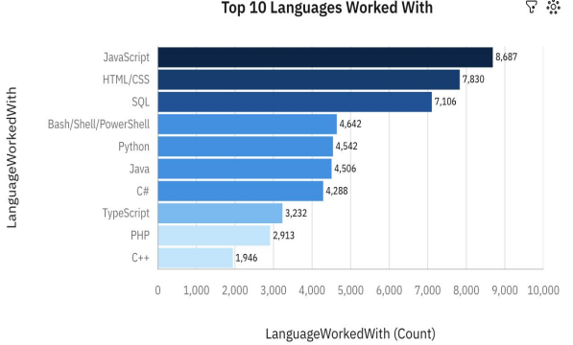
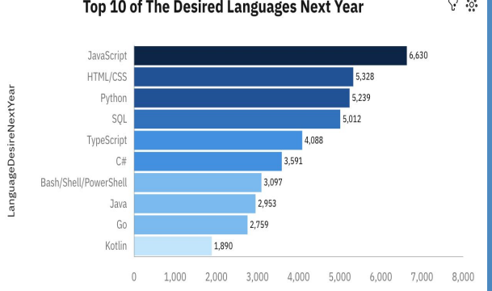
PROGRAMMING LANGUAGE TRENDS
Current Year
Next Year
<Bar chart of top 10 programming languages for the current year goes here.>

Slide 8
PROGRAMMING LANGUAGE TRENDS - FINDINGS & IMPLICATIONS
Findings
Top 5 languages currently in use: JavaScript, HTML/CSS, SQL, Shell scripting, and Python
Next year's top languages: JavaScript, HTML/CSS, Python, SQL, and TypeScript.
Python anticipated as the fastest-growing language in demand next year.
Increasing popularity driven by applications in data science, AI, and web development.
Implications
Current top languages support diverse applications, crucial for maintaining robust web solutions.
Shift towards TypeScript signals the importance of adapting to emerging language trends
Rapid growth underscores Python's strategic importance in evolving tech landscapes, particularly in AI and machine learning.

Slide 9
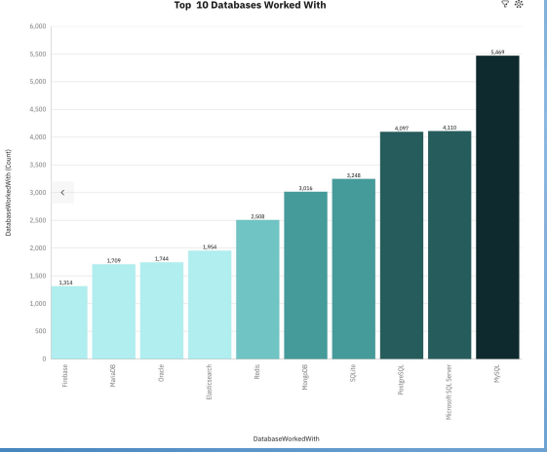
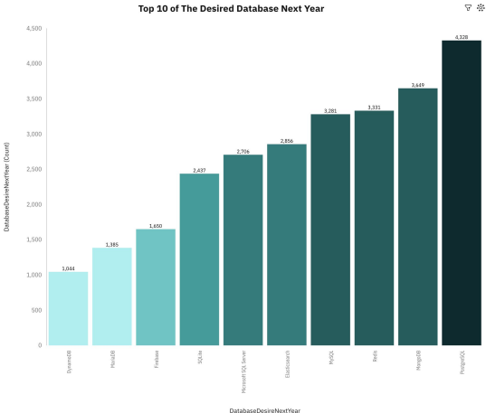
DATABASE TRENDS
Current Year
Next Year

Slide 10
DATABASE TRENDS - FINDINGS & IMPLICATIONS
Findings
Relational databases like MySQL and PostgreSQL handle structured data.
NoSQL databases such as MongoDB offer flexibility for unstructured data.
Cloud databases like Amazon Aurora and Google Spanner provide scalability.
More organizations are opting for cloud-native databases for scalability and flexibility.
Hybrid and multi-cloud approaches are becoming popular to maximize cloud benefits and reduce dependency on a single provider.
Implications
Organizations should diversify their database choices based on specific data needs.
Adopting cloud strategies is crucial for scalability, data integrity, and meeting regulatory requirements.
Database professionals need expertise in cloud database management, NoSQL technologies, cybersecurity, and emerging fields like AI and blockchain.
Regularly monitoring database trends and embracing new technologies is vital for staying competitive and compliant with industry standards.

Slide 11

DASHBOARD
https://github.com/gayathrisambandam/-Graded-Assignment-Building-A-Dashboard-With-IBM-Cognos-Analytics

Slide 12
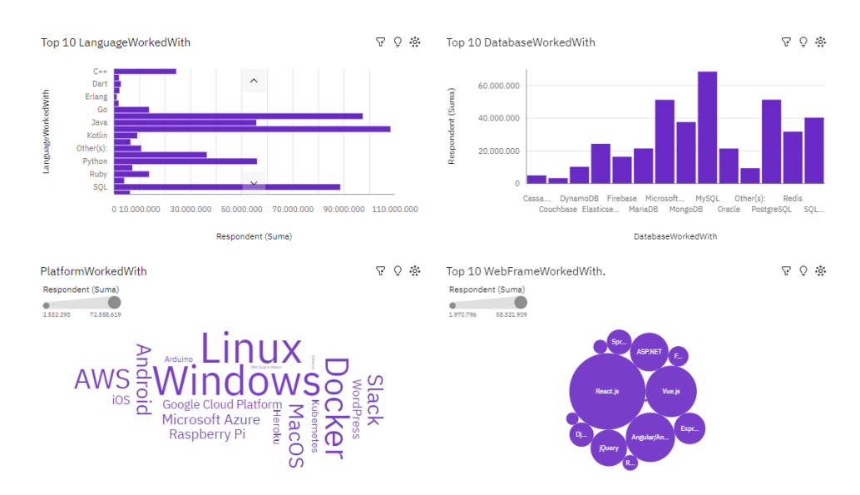
CURRENT TECHNOLOGY USAGE

Slide 13
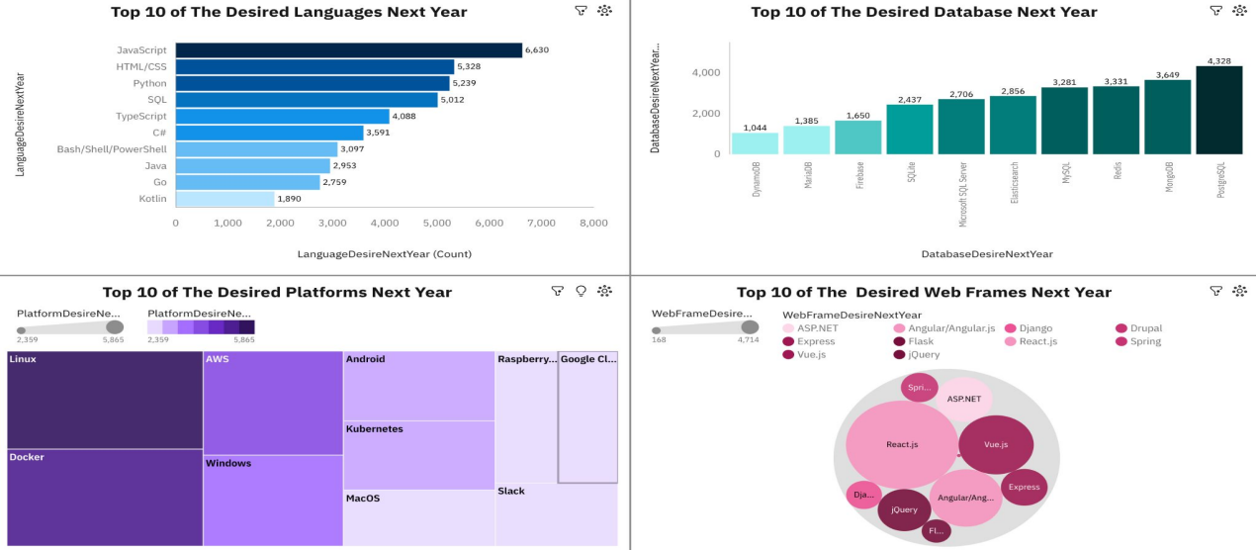
FUTURE TECHNOLOGY TREND

Slide 14
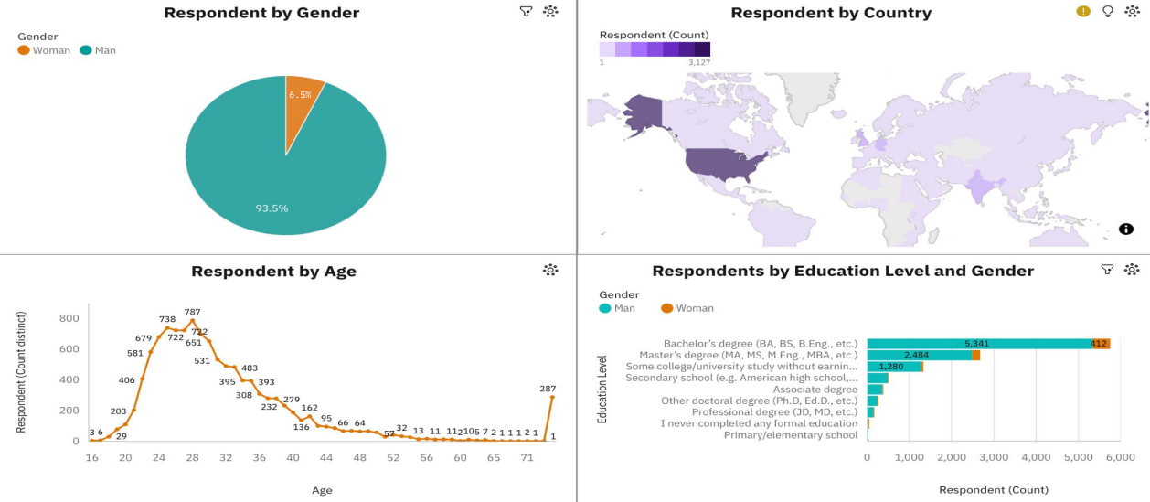
DEMOGRAPHICS

Slide 15
DISCUSSION
Overview and challenges overcome in deploying IBM Cognos Analytics dashboard.
Benefits and examples of improved data presentation for decision-makers.
Insights generated and stakeholder feedback on strategic influences.
Enhancements and potential integrations for expanding dashboard capabilities.

Slide 16
OVERALL FINDINGS & IMPLICATIONS
Findings
Based on data from the GitHub project, the majority of contributors and users are concentrated within certain demographics (e.g., age group, geographical location).
Specific platforms (e.g., Windows, macOS, Linux) are predominantly used by project contributors.
The project shows strong adoption of certain technologies (e.g., programming languages, frameworks).
Specific tools or libraries (e.g., jQuery, React.js) are widely used within the project ecosystem.
Insights into upcoming technology preferences or anticipated shifts (e.g., interest in emerging frameworks, platforms) based on project discussions and contributions.
Implications
Recommendations for fostering a more inclusive community within the project based on demographic insights.
Strategies for attracting a diverse range of contributors to enhance innovation and perspective.
Strategic recommendations for adapting to emerging technology trends observed within the project.
Suggestions for integrating new tools or upgrading existing technologies to maintain project relevance.
Steps to ensure the long-term sustainability of the project, considering technological advancements and community feedback.
Proposals for enhancing project documentation, support, and scalability based on findings.

Slide 17

CONCLUSION
The Stack Overflow Developer Survey is important for understanding today's IT industry and predicting future trends. It gives useful insights that help people, businesses, and schools make decisions. By keeping up with new technologies and best practices, the survey helps the community adapt and come up with new ideas.

Slide 18
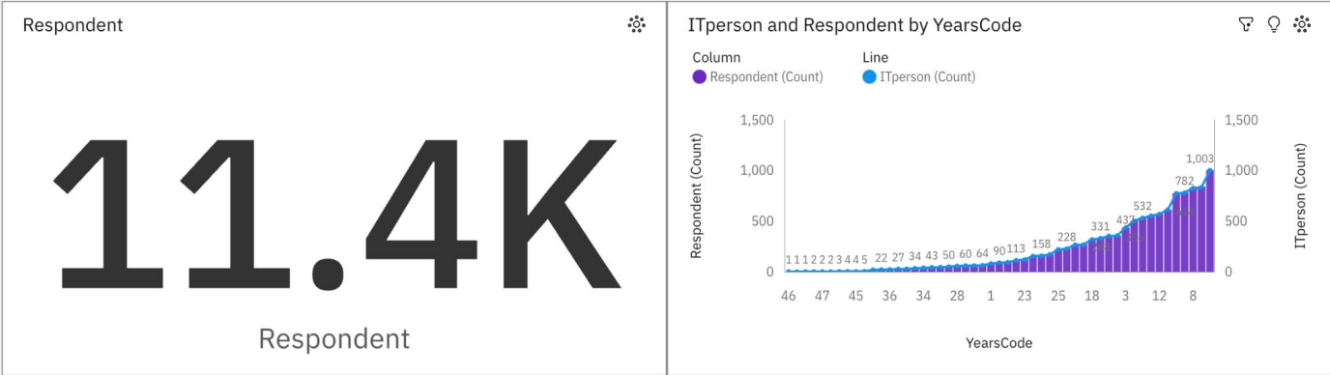

APPENDIX

Slide 19
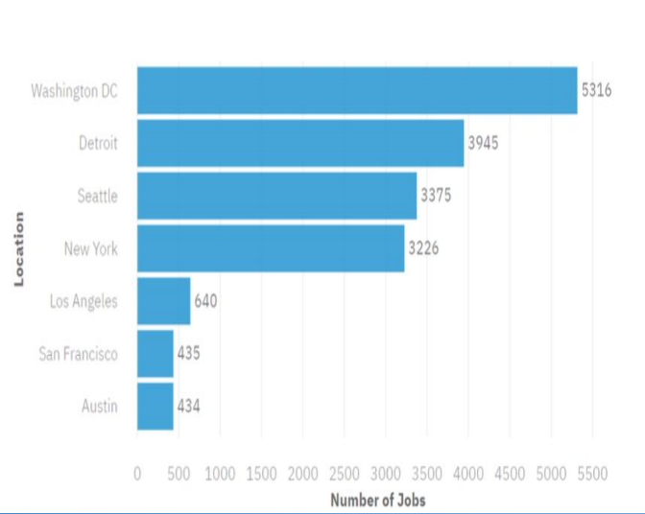
JOB POSTINGS
The bar chart presents
the number of job postings

Slide 20
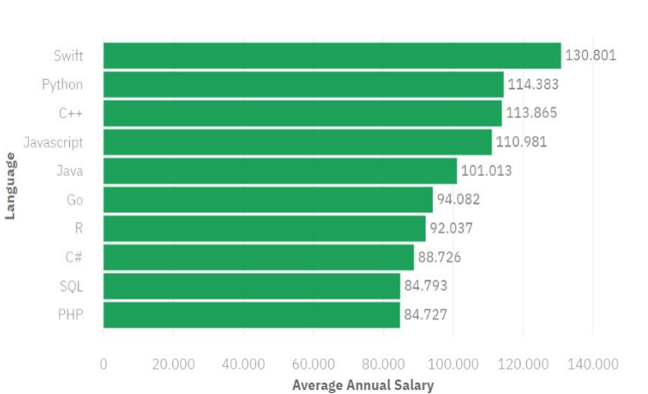
POPULAR LANGUAGES
The bar chart presents the popular languages with their salary

Slide 21


