Slide 1
AeroGuide
PROPOSED SOLUTION
An AI-powered airport assistance platform that unifies flight tracking, smart indoor navigation, crowd monitoring, and voice-enabled passenger support
— all within a single intelligent dashboard.

Slide 2
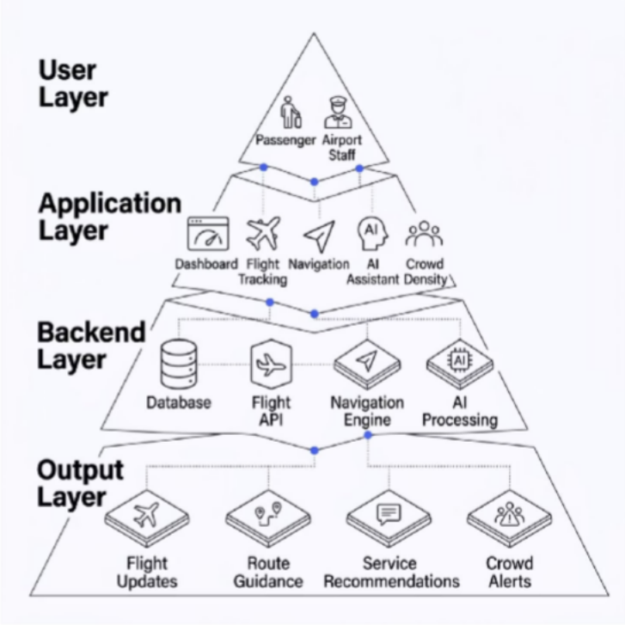
System Architecture
ARCHITECTURE
AeroGuide operates across four integrated layers — from passenger interaction through to intelligent output delivery.
Layered Intelligence
Each layer communicates seamlessly to deliver real-time airport assistance. The User Layer captures passenger and staff interactions, the Application Layer processes requests through dedicated modules, the Backend Layer retrieves and analyzes live data, and the Output Layer delivers actionable results — flight updates, route guidance, service recommendations, and crowd alerts.

Slide 3




Technology Stack
TECH STACK
Modern, proven technologies power every layer of the AeroGuide platform.
Frontend
HTML5, CSS3 & JavaScript with glassmorphism effects and a dark theme interface.
Backend
Node.js server with MySQL database for reliable, scalable data management.
AI Technologies
Natural Language Processing and chatbot integration power the intelligent assistant.
UI Design
Responsive dashboard with glassmorphism effects and a cohesive dark theme.

Slide 4

Working Process
WORKFLOW
From a single search to intelligent output — AeroGuide processes every request in real time.
Route & Services
Results Displayed
User Input
AI Processing
Intelligent assistance is delivered through seamless real-time processing and live analytics at every step.

Slide 5
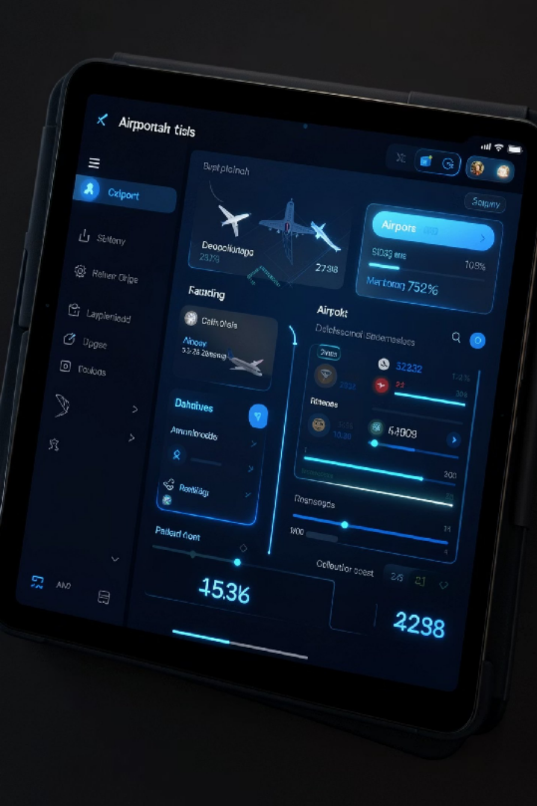
Smart Airport Dashboard
DASHBOARD
The central hub for all airport services — unified search, voice input, and real-time data in one place.
Smart Search & Voice
Search flights, gates, and services instantly. Voice-enabled for hands-free use.
Live Flight Cards
Real-time tracking, upcoming departures, and status alerts at a glance.
Navigation & AI Assistant
Indoor wayfinding and chat-based support accessible directly from the home screen.
Services & Notifications
Nearby lounges, restaurants, and ATMs — plus a live alert center for flight updates.

Slide 6
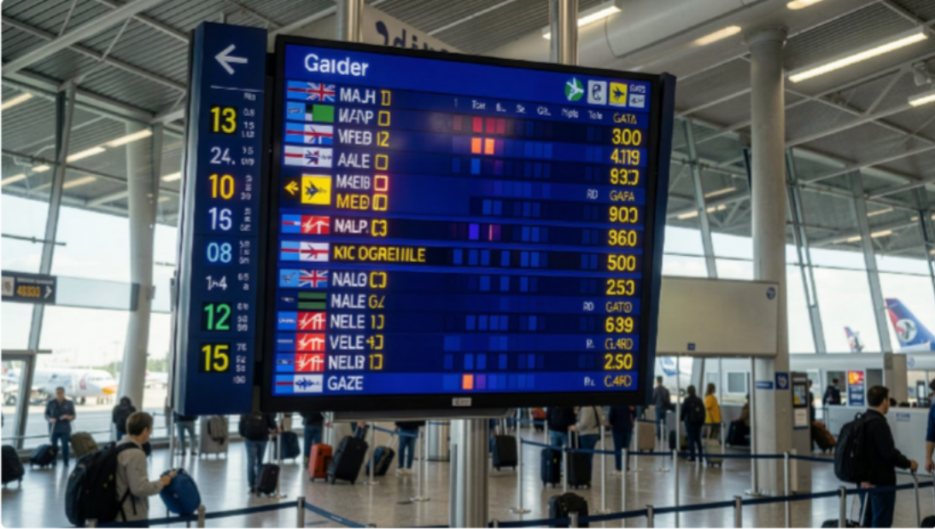
Flight Tracking & Smart Navigation
CORE MODULES
Real-Time Flight Tracking
Live departure and arrival monitoring with filters for all, delayed, and boarding flights. Dynamic status indicators and gate information keep passengers informed.
Smart Indoor Navigation
Interactive floor maps with multi-level support, route optimization, and estimated travel time. A 3D view mode and waypoints list guide passengers through security, duty- free, and beyond.

Slide 7

Nearby Services & Crowd Analytics
CORE MODULES
Nearby Services Locator
Discover lounges, restaurants, ATMs, and shops with category filters and walking-time estimates. Voice search support makes finding facilities effortless.
Crowd Density Analytics
Real-time heatmap visualization with color- coded congestion levels — Low, Medium, and High. Live terminal analytics help passengers avoid crowded zones and plan smoother routes.

Slide 8


AI Assistant & User Profile
CORE MODULES
AI-Powered Passenger Assistant
Ask questions in natural language or by voice. Receives instant responses on flights, navigation, and nearby services — personalized to each traveler.
User Profile & Travel Management
Manage traveler info, view flight history, track loyalty miles, and personalize notification settings. Secure logout ensures account safety.

Slide 9

Security, Privacy & Advantages
TRUST & BENEFITS
Security & Privacy
Secure authentication with role-based access control
End-to-end data encryption for all user and flight information
Privacy-protected travel history and personal data storage
Notification security ensuring alerts reach only authorized users
•
•
•
For Passengers
Faster navigation, reduced confusion, real-time flight updates, and effortless service discovery.
For Airports
Better crowd management, reduced staff workload, higher satisfaction, and smart modernization.

Slide 10
Impact & Future Vision
ROADMAP
Passenger Impact
Stress-free travel, easy information access, and smarter trip planning.
Airport Impact
Improved crowd management, reduced staff workload, and efficient resource use.
Success Metrics
Navigation accuracy, user satisfaction, reduced missed flights, and crowd prediction.
Future Scope
AR navigation, multilingual voice assistant, smart parking, and predictive analytics.
Thank You
AeroGuide represents the next generation of intelligent airport assistance — enhancing passenger convenience while driving operational efficiency.

