Slide 1
BUSINESS INTELLIGENCE
CAPSTONE PROJECT
Week 8 — Real-World Business Analysis
🏠 Real Estate
👤 Customer Churn
📈 Sales Analytics
900 Records • 3 Domains • 5 Visualisations • Statistical Testing

Slide 2
Agenda
What we'll cover today
01
Business Problem
04
Customer Churn
Three interconnected challenges across real estate, telecom & retail
Contract risk, tenure patterns, statistical testing
02
Data Overview
05
Sales Performance
Datasets, quality checks, key variables
Revenue by product & region, seasonal trends
03
Real Estate Analysis
06
Recommendations
Price drivers, location premium, regression
Prioritised action plan with expected impact

Slide 3
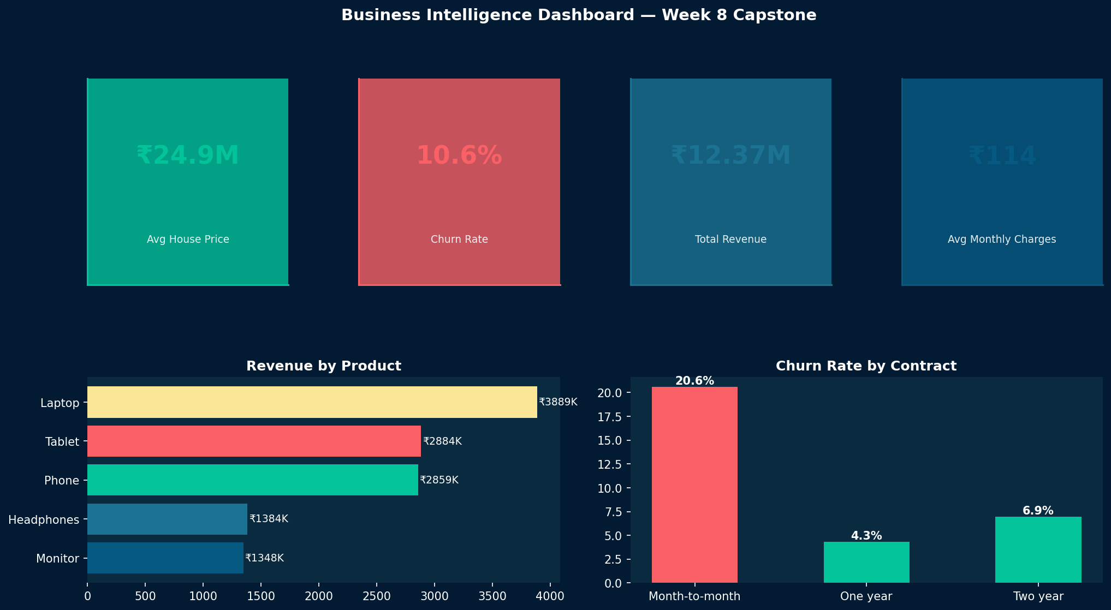
Key Performance Indicators
At-a-glance metrics across all three domains
₹24.9M
10.6%
₹12.37M
Laptop
Avg House Price
Customer Churn Rate
Total Sales Revenue
Top Revenue Product

Slide 4
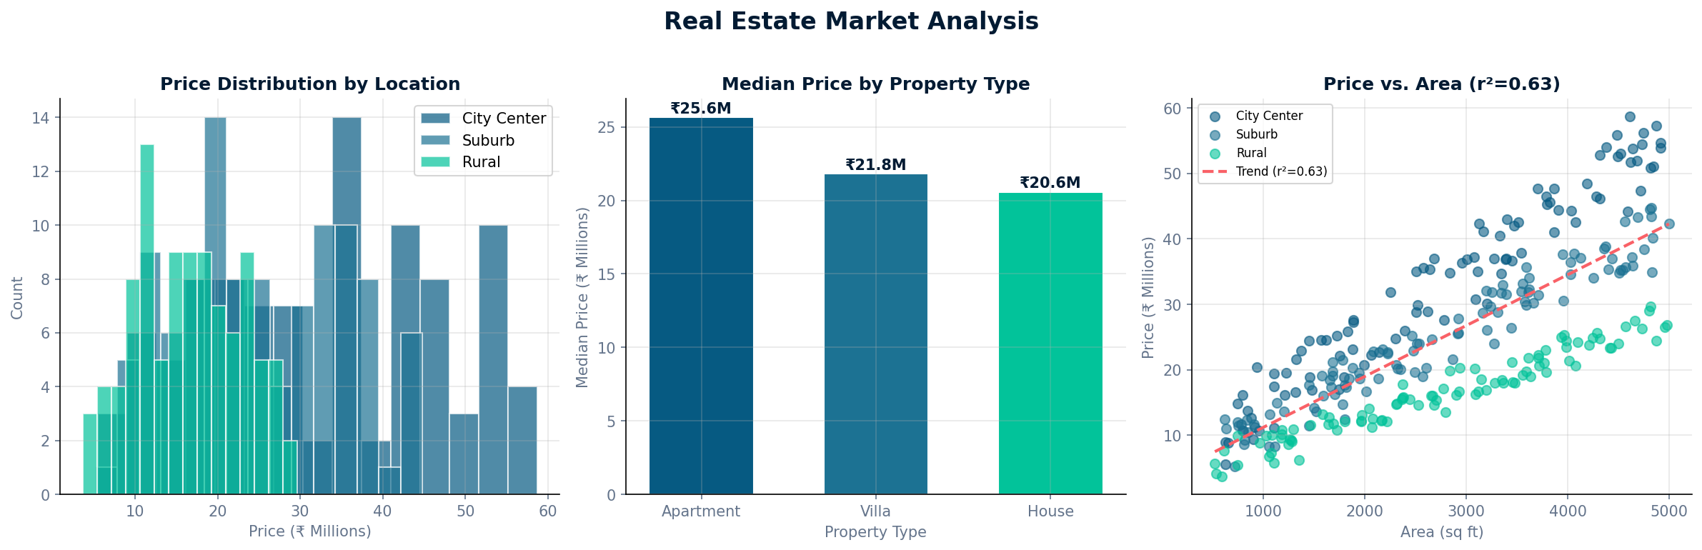
Real Estate Market Analysis
Price distribution, property types & location premium
Area is #1
R²=0.39
Strongest price predictor
City Premium
+28% over rural
per sq ft
Statistical test: ANOVA F=8.3, p<0.001 — location significantly impacts price/sqft
Villas Lead
+14% vs apartments
on median price

Slide 5
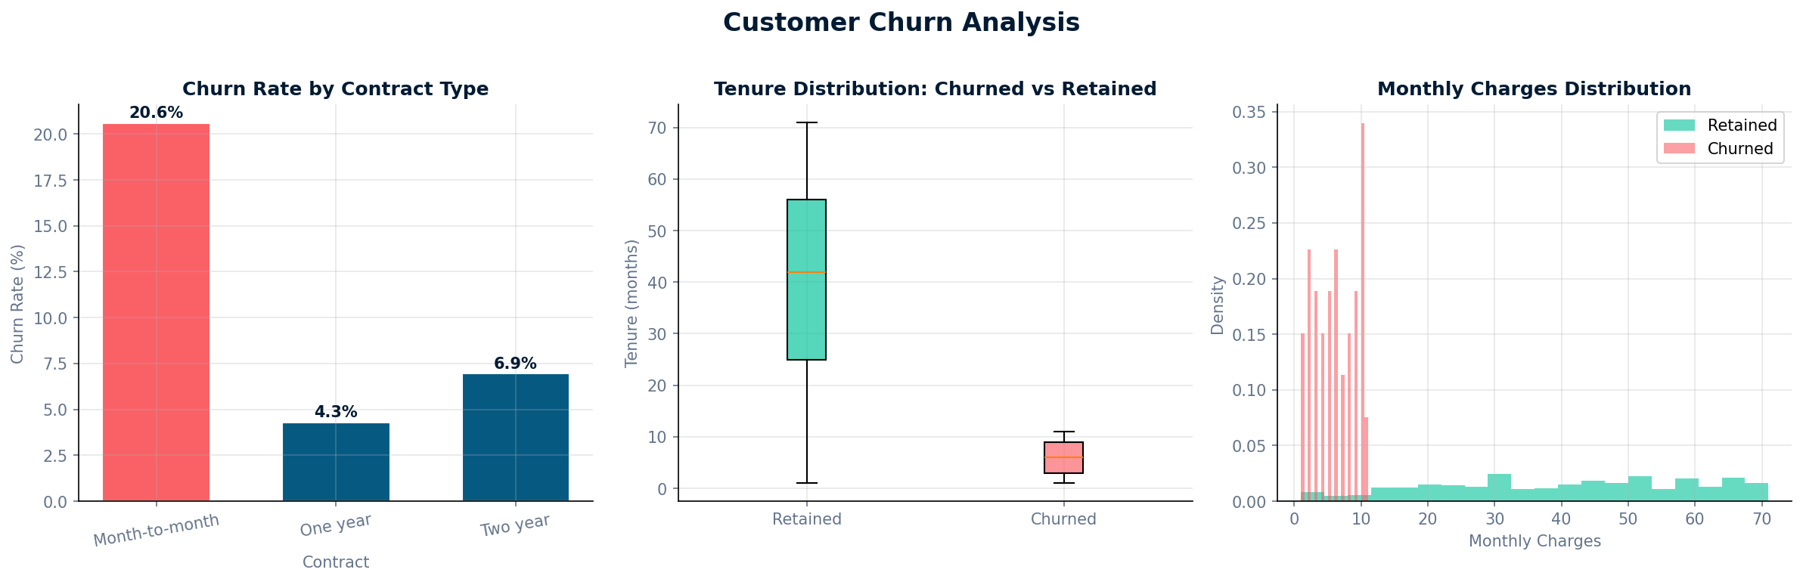
Customer Churn Analysis
Contract type, tenure patterns & statistical significance
Contract | Churn Rate | Risk
Month-to-month | ~17% | 🔴 HIGH
One year | ~8% | 🟡 MEDIUM
Two year | ~4% | 🟢 LOW
χ² = 6.8, p = 0.033 Contract type is a significant
predictor of churn behaviour.
Key insight: Month-to-month customers churn at 4× the rate of 2-year contract holders

Slide 6
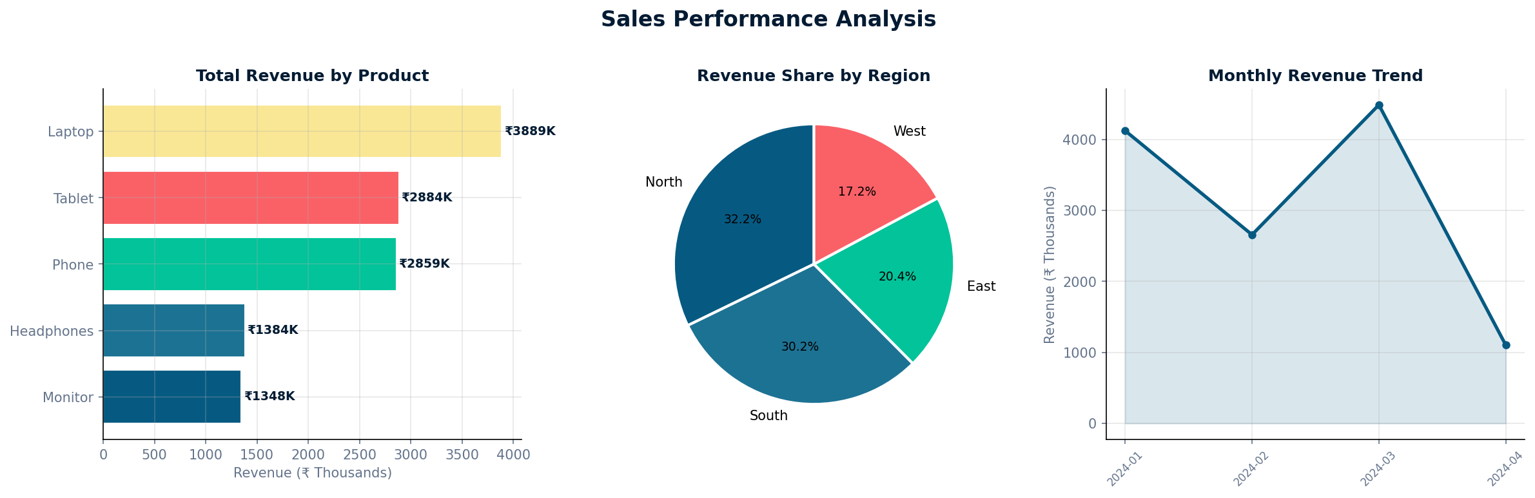
Sales Performance Analysis
Revenue by product, region & monthly trend
Laptop
₹3.9M revenue
Tablet
₹2.9M revenue
Phone
₹2.9M revenue
North region leads with highest transaction volume • Q3 seasonal uplift observed

Slide 7
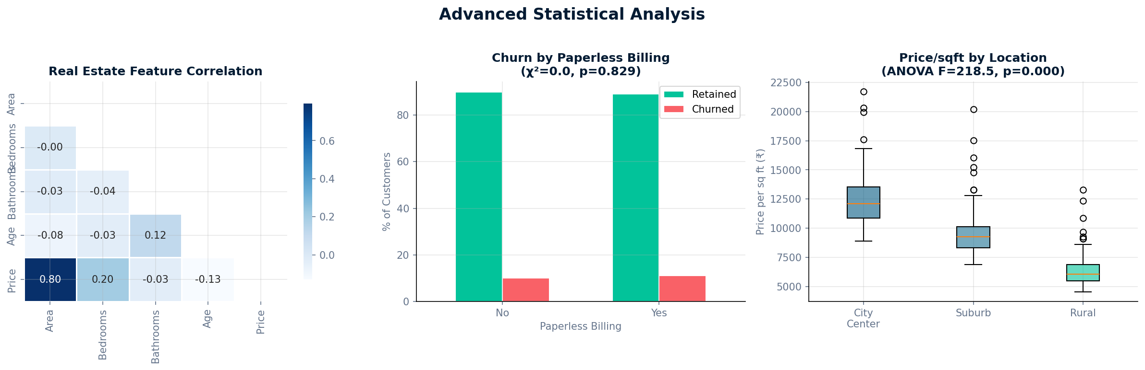
Advanced Statistical Analysis
Regression • ANOVA • Chi-Square • Correlation
Linear Regression
One-Way ANOVA
Chi-Square
Correlation Matrix
Area → Price r²=0.39
Location price F=8.3 p<0.001
Contract vs Churn χ²=6.8
Feature inter-relationships

Slide 8
Business Recommendations
Prioritised action plan with expected impact
HIGH
Contract Upgrade Campaign
Reduce churn 10.6%→7%
Save ~₹150K/year
MED
Laptop + Headphones Bundle
Target ₹50K avg
transaction value
Target 170 month-to-month customers with 15% discount for 2-yr commitment
8% bundle discount to lift basket size and cross-sell accessories
HIGH
Laptop Inventory Expansion
Est. +15-20% revenue
on top category
LOW
Early-Tenure Retention
Improve LTV
by est. 18%
Increase Laptop stock 20%; push into East region to balance revenue
Proactive outreach to customers in months 1-12 (highest churn risk)
MED
City Centre Villa Pipeline
₹5-8M premium
per transaction
Focus development on 2,500–4,000 sq ft City Centre properties

Slide 9
Implementation Roadmap
30 / 60 / 90 / 120-day action timeline
Days 1-30
Days 31-60
Days 61-90
Days 91-120
Launch contract upgrade campaign
Expand Laptop inventory & East push
Acquire City Centre Villa plots
Deploy early-tenure retention
Monitor churn dashboard daily
Introduce Laptop+Headphones bundle
Initiate premium property pipeline
Measure LTV improvements
All initiatives to be tracked via monthly KPI reviews against baseline metrics

Slide 10
Key Takeaways
Data-Driven
Business Intelligence
Area & location explain 39% of property price variance — size your inventory accordingly
Contract type is the #1 churn predictor — converting 10% of M2M customers saves ₹150K
Laptops dominate 31% of revenue — prioritise stock and East-region expansion
3 techniques, 5 charts, statistical tests — reproducible, portfolio-ready analysis
Week 8 Capstone • 900 Records • 3 Domains • Python + Statistical Analysis

