Slide 1

.
Presentation on :
“AI Agent for Smart Farming Advice”
DEPARTMENT OF ARTIFICIAL INTELLIGENCE & MACHINE LEARNING
School of Engineering & Technology
Sanjivani University
Semester-V, Academic Year 2025-2026
Presented By:
Gayatri Jagtap (2124UMLF2061)
Sanket Parjane (2124UMLM2044)
Soham Wadale (2124UMLM2081)
Sakshi Abak (2124UMLF2019)
Guided by
Prof. Rajeshwar Gupta

Slide 2
Smart homes use the Internet of Things (IoT) to make life easier and better. Devices like lights, fans, ACs, and cameras are connected to the internet and can be controlled using a phone or voice.
OUTLINE
;
Problem Statement
Proposed System/Solution
System Development Approach
Algorithm & Deployment
Result (Output Image)
Conclusion
Future Scope
References

Slide 3
Problem Statement
Small-scale farmers play a vital role in the agricultural sector, yet they face several challenges that affect their productivity and income. One of the major issues is the lack of access to real-time and reliable information about weather conditions, soil health, crop suitability, pest control, and market prices. Due to limited digital literacy and infrastructure, farmers often rely on outdated or inaccurate advice, leading to poor decision-making. Additionally, most agricultural information available online is in English, creating a language barrier for farmers who primarily communicate in their local languages. The absence of personalized and data-driven guidance makes it difficult for farmers to plan effectively, resulting in reduced crop yields, financial losses, and increased risk. Therefore, there is a strong need for an intelligent system that can provide localized, accurate, and easily understandable agricultural advice to empower small-scale farmers and support sustainable farming practices.

Slide 4
Proposed Solution
The proposed system introduces an AI Agent for Smart Farming Advice powered by Retrieval-Augmented Generation (RAG). This intelligent agent retrieves and generates real-time, localized agricultural information to support farmers in their decision-making. It accesses trusted data sources such as meteorological departments, soil condition databases, and agricultural market platforms. Farmers can interact with the system in their local language to ask questions like “Which crop should I grow this season?” or “What is today’s market rate for tomatoes?”. The system combines retrieved factual data with the generative power of AI to provide accurate, context-specific, and easily understandable responses. By doing so, it bridges the knowledge gap and empowers small-scale farmers to improve crop yield and income.

Slide 5
System Approach
1. System Requirements
Hardware Requirements:
Minimum 4 GB RAM and dual-core CPU
IBM Cloud account with provisioned cloud runtime
Secure internet connection for real-time data streaming
Software Requirements:
Operating System: Windows
Python
Cloud Platform: IBM Cloud (Watson Studio, Cloud Functions)
Model Serving: Flask/ FastAPI for REST API deployment

Slide 6
Algorithm & Deployment
The RAG model forms the foundation of the system. It operates in two main stages: retrieval and generation. In the retrieval stage, the system searches a document or database repository for the most relevant information related to the farmer’s query. In the generation stage, the AI model (IBM Granite) synthesizes this retrieved information to produce a meaningful and precise answer. The algorithm ensures factual accuracy and contextual understanding. For deployment, the system utilizes IBM Cloud Lite services, where the backend RAG model, API endpoints, and user interface are hosted. This allows real-time access to data and scalable deployment for multiple users across regions.

Slide 7
Result
The output of the system displays a simple, user-friendly chat interface where farmers can type or speak their questions in their local language. The AI agent responds with accurate and context-based answers retrieved from verified agricultural data sources. For example, when a user asks, “Which crop should I grow this season in Maharashtra?”, the system displays the best-suited crops based on weather conditions, soil type, and market trends. Similarly, for “What is today’s mandi rate for tomatoes?”, it provides real-time price updates. The results demonstrate that the system effectively delivers localized and reliable agricultural guidance in an accessible format.

Slide 8
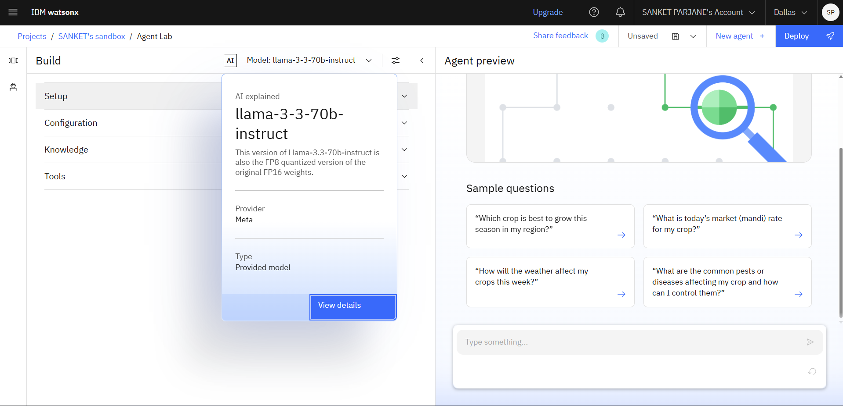
Result

Slide 9
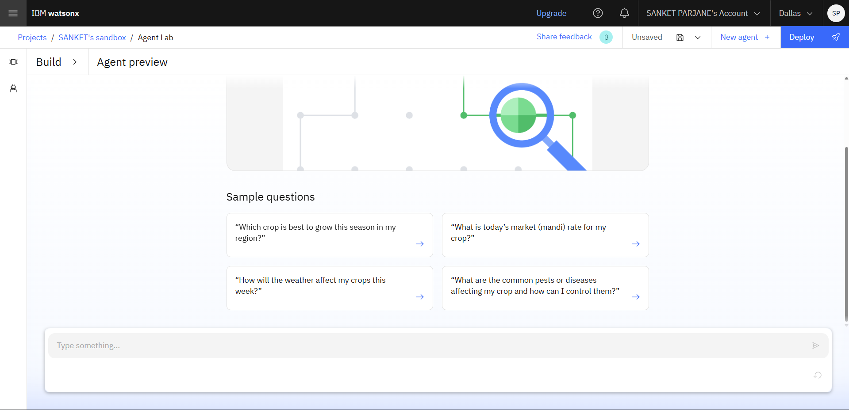
Result

Slide 10
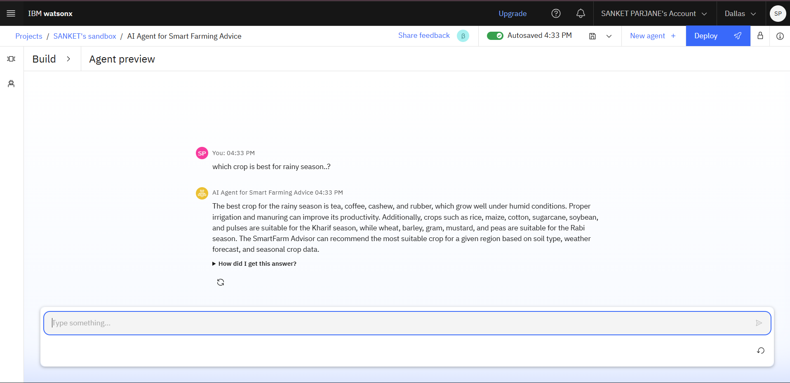
Result

Slide 11
Conclusion
The AI Agent for Smart Farming Advice successfully addresses the challenges faced by small-scale farmers by providing them with accurate, real-time, and localized agricultural insights. By leveraging Retrieval-Augmented Generation and IBM’s cloud-based AI services, the system bridges the information gap between farmers and expert agricultural knowledge. It enhances decision-making related to crop selection, pest management, and market selling, ultimately improving productivity and profitability. The project demonstrates how AI can play a transformative role in sustainable and smart agriculture at the grassroots level.

Slide 12
Future Scope
In the future, the system can be expanded to include IoT-based sensor integration for real-time soil and crop monitoring, image recognition for pest and disease detection, and multilingual voice assistants to support a wider range of local languages. Integration with blockchain technology can ensure data transparency and traceability in crop supply chains. The system can also be connected with government agricultural schemes and subsidy information to provide farmers with complete financial and technical support. Continuous improvement of the RAG model with domain-specific datasets can further enhance the accuracy and personalization of advice.

Slide 13
References
References
IBM Cloud Lite Documentation – https://cloud.ibm.com/docs
IBM Granite Models – https://www.ibm.com/granite
Indian Meteorological Department (IMD) – https://mausam.imd.gov.in
National Agriculture Market (eNAM) – https://www.enam.gov.in
Food and Agriculture Organization (FAO) Reports on Smart Farming – https://www.fao.org

Slide 14
THANK YOU

