Slide 1
Sales Performance Analysis Dashboard
Data Visualization & Insights Report
Your Name

Slide 2
Data Overview
Data Source: External sales dataset (CSV/Excel)
Dimensions: Product Category, Region, Sales Channel, Customer Segment
KPIs: Total Revenue, Profit Margin, Units Sold, Customer Count

Slide 3
Key Findings
Top Products: Electronics and Home Appliances contributed 40% of total sales
Top Regions: North and West regions showed highest revenue growth
Trends: Q3 recorded peak sales; Online channel outperformed Offline

Slide 4
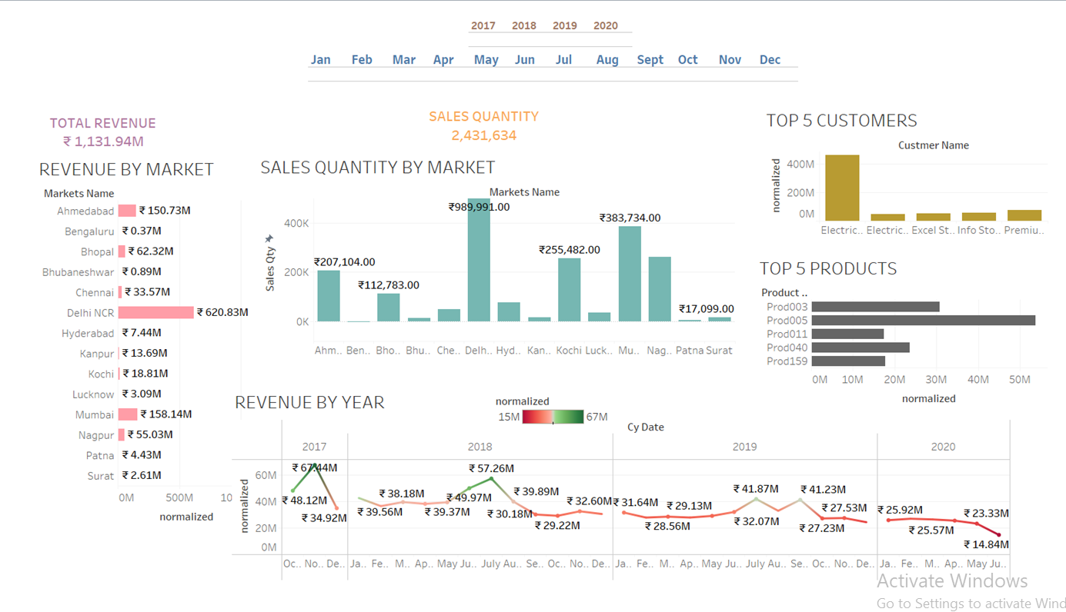
Tableau Dashboards Visuals

Slide 5
Business Recommendations
Focus marketing efforts on high-performing regions to maximize ROI
Expand product range in Electronics and Home Appliances
Invest in enhancing Online Sales Channels for sustained growth
Monitor Q3 seasonal trends for inventory optimization

