Slide 1
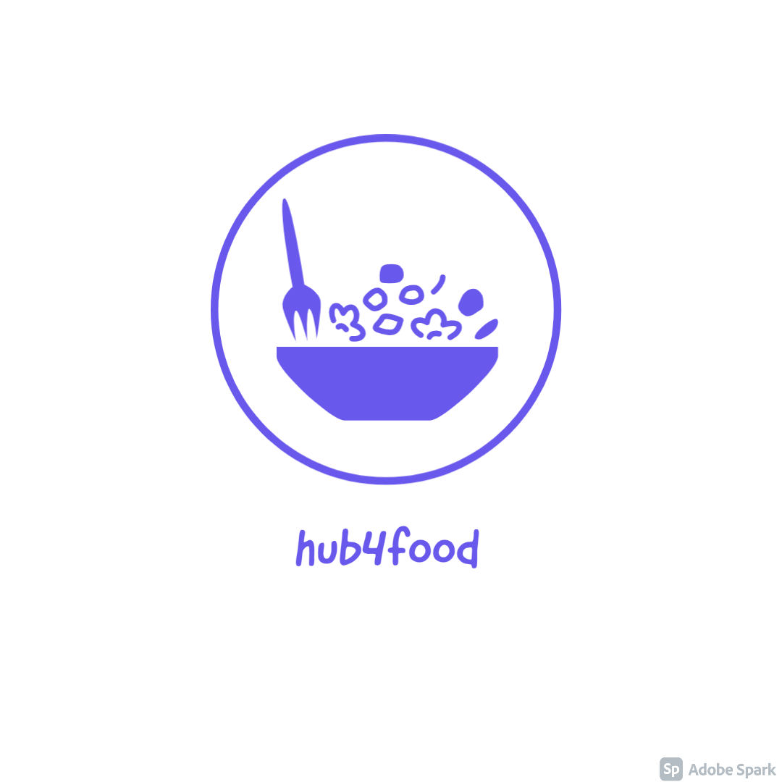
ERP System for Restaurant
hub4food ~
Team Name – HS301_PS13 Tech tycoons

Slide 2
Our team
Team Leader – Gayatri Godbole (PICT CS TE)
Pushkar Jain (PICT CS TE)
Omkar Gaikwad (PICT CS TE)
Om Tayade (PICT CS TE)

Slide 3

Problem Statement
Restaurant aggregator - ERP for one
Restaurant to fetch ALL orders from Swiggy,
Zomato, Foodpanda etc marketplaces.
Using the ERP, all the restaurants with different
markets, place an order that is easily managed,
track product inventory and update easily, invoice
and accounting will smartly manage live tracking
of kitchen order status from the screen, linked with
the order, invoice and inventory management,
Print/email/download the advance documents of
order, invoice and shipment, using aggregator easily
manage fetching order using import/export and
scheduler by every minute.

Slide 4
Our Understanding
We aim to create a platform where restaurant business owners can keep a track of
Incoming order
Inventory
Status of Orders
Accounting

Slide 5

Our Solution
We propose to build a web application to provide resource planning solution by focusing on 2 main aspects
The site should feature real time updates such that new orders and updates will be updated automatically without refreshing the page
The site works on the principle of 3 Clicks Rule
The system will have features such as
Time keeping for each order
Individual status and overall status for every order
Inventory management for purchased goods
Cancel order

Slide 6


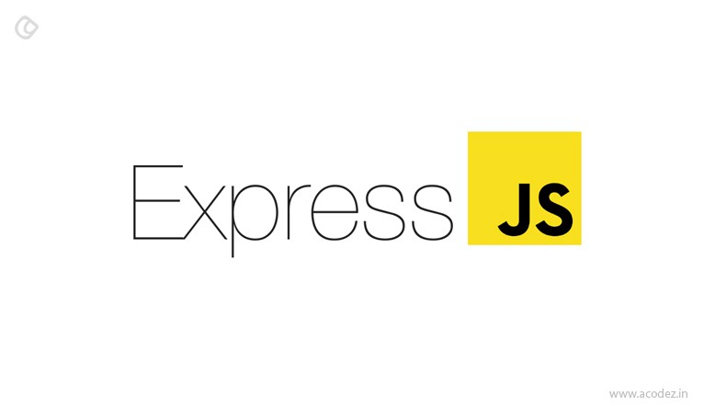


Tech Stack
Frontend
Backend
Database

Slide 7
Application Description
This is an all-in-one real-time application for restaurants. All the orders generated for a particular restaurant by zomato, swiggy, foodpanda etc. will be handled by this single app.
Keeping in mind the need of a Realtime update system we have choose React and Redux in frontend
Inventory management of that particular restaurant has also been taken care of.
After the successful completion of all items in an order, an invoice will be generated for it.
Due to number of NPM libraries available and easy integration with React we have chosen Nodejs for backend
And lastly, we have chosen a nosql database because they can be scaled horizontally.
And specifically, we went with Mongo DB because we can host it on cloud using Atlas also more query customizations are available as compared to firebase

Slide 8
Flow Chart
Landing Page
Login/Signup
Home Page (Dashboard of live orders)
Inventory Page
Update Inventory
Completed Orders
Catalogue Page
Orders (live)
Live Tracking
Invoicing
Orders
Invoicing

Slide 9
Timeline - Day 1, Day 2
Day 1:
UI UX designs, Front end implementation.
Back-end authentication (JWT tokens), basic API set up, connecting to Mongo DB and setting up all the models.
Day 2:
Order, Invoices API
Front end and Back-end integration
Final Changes and touch ups.

Slide 10
Future Scope
Timer functionality for orders to help chefs prioritize orders
Notification updates for better user experience
Data archiving solutions for old data
Recommendation System for inventory management to show products whose quantity rate of depletion is higher
Update order

Slide 11
Journey, Challenges, Experiences
Lifetime experience of a fun-filled hackathon and working in a team.
Managing time was a challenge since the problem statements were pretty much into depth.
Due to online mode, coordination with teammates was difficult.
Learnt new things, not just technical but also professional etiquettes and confidence.

Slide 12

Thank you

