Slide 1
ITA0329 – MOBILE COMPUTING
Multiple Access Techniques Comparison Tool (FDMA/TDMA/CDMA/OFDMA/SDMA)
PRESENTED BY
Manasa.M-192425189
Gayathri.P-192424324
GUIDED BY
Dr. Saravanan.M.S

Slide 2
INDEX
ABSTRACT
INTRODUCTION
PROBLEM STATEMENT AND OBJECTIVES
EXISTING SYSTEM AND PROPOSED SYSTEM
METHODOLOGY
MODULES
RESULTS
IEEE STANDARDS
SDG CONTRIBUTION
CONCLUSION
REFERENCES

Slide 3
ABSTRACT
Multiple access techniques allow multiple users to share a communication channel.
FDMA, TDMA, CDMA, OFDMA, and SDMA are used in wireless communication.
The existing system analyzes each technique separately.
The proposed system compares all five techniques using common input parameters and graphs.
The tool compares bandwidth, data rate, user capacity, interference, and overall performance.

Slide 4
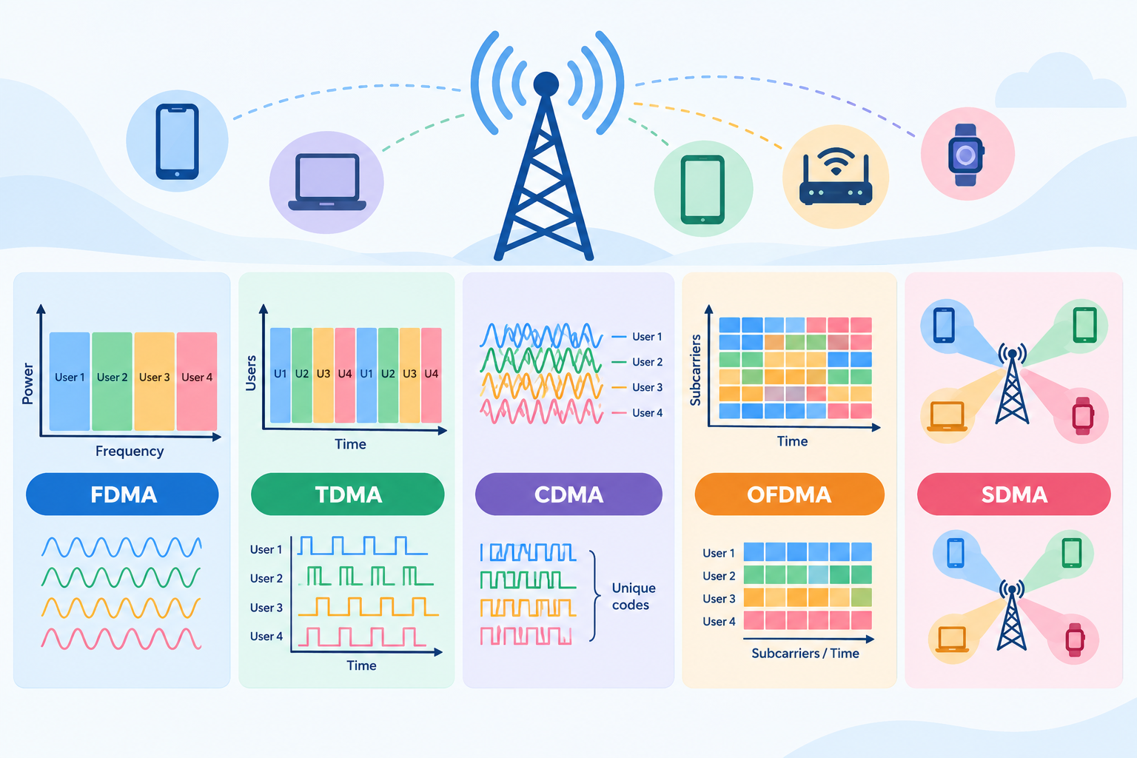
INTRODUCTION
This project focuses on comparing five multiple access techniques: FDMA, TDMA, CDMA, OFDMA, and SDMA.
It analyzes how multiple users share available communication resources.
It displays performance results using graphs and comparison metrics.
Importance: Helps identify efficient techniques based on bandwidth, data rate, interference, and user capacity.
Applications: Used in mobile networks, 4G, 5G, Wi-Fi, and wireless communication systems.

Slide 5
PROBLEM STATEMENT
To analyze, visualize, and compare FDMA, TDMA, CDMA, OFDMA, and SDMA techniques based on bandwidth, data rate, user capacity, interference, and spectral efficiency to evaluate their overall performance.

Slide 6
Objectives
To analyze and visualize the working and performance of FDMA, TDMA, CDMA, OFDMA, and SDMA techniques.
To compare all five techniques based on bandwidth, data rate, user capacity, interference, and spectral efficiency.

Slide 7
EXISTING SYSTEM
Techniques are explained separately in textbooks and notes.
Analysis is done by hand or with separate, one-off scripts.
Static examples give limited insight into parameter changes.
No common framework for fair comparison on the same inputs.
Resource allocation and interference are hard to visualize.

Slide 8
PROPOSED SYSTEM
1. Multiple Access Techniques Analysis and Visualization: The system analyzes the working principles of FDMA, TDMA, CDMA, OFDMA, and SDMA and visualizes their resource allocation and performance.
2. Comparative Analysis and Results: The system compares all five techniques based on bandwidth utilization, data rate, user capacity, interference, and spectral efficiency to identify their performance differences.

Slide 9
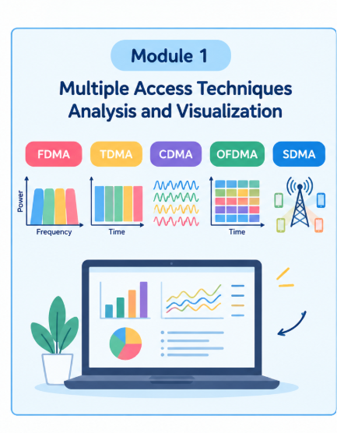
Module 1: Multiple Access Techniques Analysis and Visualization
Allows users to select FDMA, TDMA, CDMA, OFDMA, and SDMA.
Explains the working principles and resource allocation methods of each technique.
Displays interactive diagrams to visualize how each technique works.
Provides Play, Pause, and Reset controls for visual demonstrations.
Explains the advantages, limitations, and applications of each technique.

Slide 10
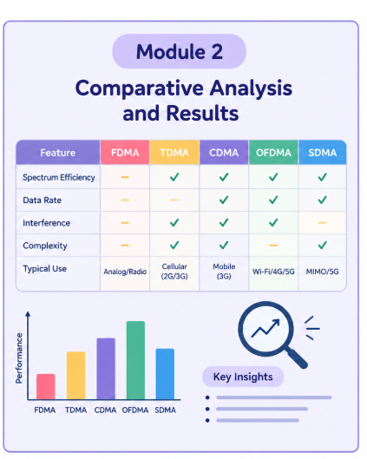
Module 2: Comparative Analysis and Results
Allows users to select two or more techniques for comparison.
Generates a dynamic comparison table based on the selected techniques.
Compares resource allocation, synchronization, interference, and performance characteristics.
Displays comparative insights highlighting the similarities and differences between techniques.
Presents the comparison results and conclusion to help users understand the techniques.

Slide 11
.
Thank You

