Slide 1

Namma Yatri: Data-Driven Operational Strategy
A Report on Visualisation and Analysis Based on Power BI Analysis (By Gayatri Behera) Presented to: Technical Leadership

Slide 2

Agenda
Introduction & Objective
Data Overview & Methodology
Key Findings (Data Story)
Strategic Recommendations
Conclusion & Next Steps

Slide 3
Introduction & Objective
Analyse Namma Yatri ride data using Power BI
Understand demand patterns across time and zones
Identify key operational challenges (conversion & cancellations)
Provide data-driven recommendations to improve efficiency

Slide 4
Data Overview & Methodology
Dataset includes:
  Trips, Trip Details, Location (From/To), Payment, Duration
Key Metrics:
  Searches (Demand), Trips, Revenue, Conversion Rate
Methodology:
  Used Power BI for analysis and visualization
  Built star schema data model
Created measures:
  Conversion Rate
  Revenue %
  Success & Cancellation %
Analyzed patterns across:
  Time
  Zones
  Demand vs Revenue

Slide 5
Key Findings
Demand Trends
Peak demand observed at:
  0–1 (~50 searches)
  6–8 (~45–50 searches)
  13–15 (~50+ searches)
  22–23 (~48 searches)
Demand follows time-based commute pattern
Demand vs Revenue
  Positive correlation between demand and revenue
  Not perfectly aligned
Revenue influenced by:
  Trip distance
  Pricing strategy
  Surge pricing

Slide 6
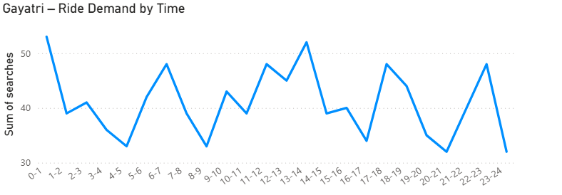

Slide 7
Key Findings – Zone Analysis
Top Demand Zones:
  Ramanagaram (~39 trips)
  Yeshwanthpur (~36 trips)
  Bangalore South (~33 trips)
Top Revenue Zones:
  Bangalore South (~30K)
  Yeshwanthpur (~29K)
High demand does not always mean high revenue
Conversion & Cancellation
  Conversion Rate = 45%
  Customer Cancellation = 48.17%
  Driver Cancellation = 47.25%
Nearly 1 in 2 rides gets cancelled
Indicates major operational inefficiency

Slide 8
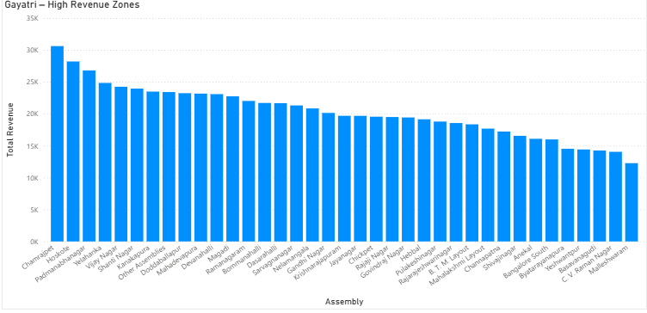

Slide 9
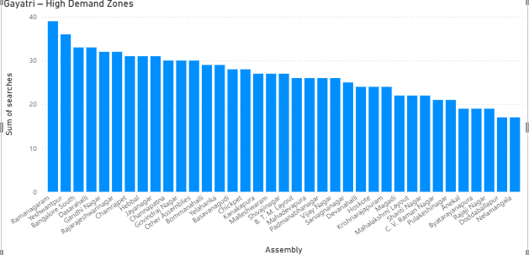

Slide 10
Key Findings Summary
Demand is time and zone dependent
Conversion is low (45%)
Cancellation is high (~48%)
Revenue depends on pricing and distance

Slide 11
Strategic Recommendations
Improve Conversion
  Show accurate ETA and fare estimates
  Improve driver availability during peak hours
  Retarget users who drop after search
👉 Conversion can improve from 45% → 55%+
Reduce Cancellations
  Customer: Introduce cancellation penalties
  Driver: Incentives for ride completion
👉 Can reduce cancellations by 10–15%

Slide 12
Strategic Recommendations
Optimize Supply
Focus on peak hours: 0–1, 6–8, 13–15, 22–23
👉 Increase supply and provide incentives
Zone Focus
Focus on High-Performing Zones
  Ramanagaram
  Yeshwanthpur
  Bangalore South
👉 Prioritize driver allocation in these zones
Pricing & Demand
  Use micro-surge pricing
  Offer discounts during: 8–9 , 21–22
👉 Improve conversion and utilization

Slide 13
Conclusion & Next Steps
Conclusion
High demand exists (50+ searches in peak hours)
But:
    Conversion is low (45%)
    Cancellations are high (~48%)
👉 Core Problem:
Demand-supply mismatch
Next Steps
Pilot strategies in:
    High-demand zones (Ramanagaram, Yeshwanthpur)
Focus on:
    Peak hours
    Driver allocation
    Pricing optimization

Slide 14
Thank you

