Slide 1
Executive Summary and
Profitability Dashboard
Excel Data Analytics Project
Presented by: Gayatri Bajirao Kamble
Tool: Microsoft Excel | Project Type: Business Dashboard

Slide 2
Project Objective
Turning business data into clear and actionable insights
• Analyze revenue and profitability performance.
• Track key business KPIs in one place.
• Understand monthly revenue and gross-profit trends.
• Compare countries, regions and sales channels.
• Provide an interactive dashboard for quick decision-making.
RAW DATA
↓
ANALYSIS
↓
DASHBOARD
↓
BUSINESS INSIGHTS

Slide 3
Dataset & Data Preparation
Key fields and preparation steps used before building the dashboard
Main Data Fields
Preparation
• Order / transaction information
• Product category
• Country and region
• Sales / revenue
• Gross profit
• Quantity / units sold
• Orders and COGS
• Sales channel
• Checked the structure and data types.
• Prepared fields required for analysis.
• Created summaries using Pivot Tables.
• Built Pivot Charts from the summaries.
• Connected slicers for interactive filtering.

Slide 4
Excel Tools & Techniques Used
Pivot Tables
Pivot Charts
Slicers
Summarize large datasets
Visualize business performance
Interactive filtering
Conditional Formatting
KPI Cards
Formulas
Quick performance summary
Calculations and metrics
Highlight important values

Slide 5
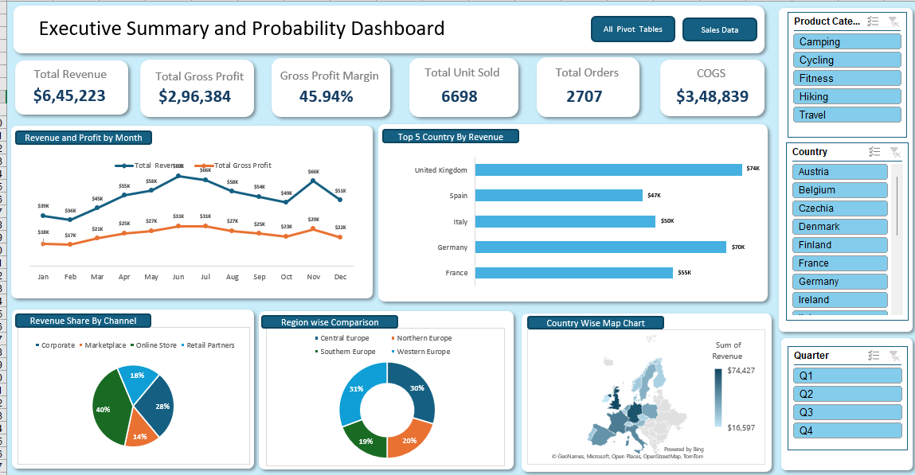
Executive Summary & Profitability Dashboard
Interactive Excel dashboard created from the analyzed data

Slide 6
Dashboard Highlights & Key Insights
The dashboard gives a quick view of overall performance and major business patterns
Total Revenue
Total Gross Profit
Gross Profit Margin
Total Units Sold
Total Orders
COGS
$645,223
$296,384
45.94%
6,698
2,707
$348,839
• Monthly revenue peaks around June and November at approximately $66K.
• Gross profit follows a similar monthly pattern, reaching about $31K in June and July.
• Online Store contributes the largest revenue share at 40%.
• Western Europe has the largest regional share at 31%, followed closely by Central Europe at 30%.
• The United Kingdom is the highest-revenue country among the five countries shown, at about $74K.
• Overall gross profit margin is 45.94%, indicating a strong share of revenue retained after COGS.

Slide 7
Conclusion
What this project demonstrates
• Converted raw business data into a clear executive dashboard.
• Used Excel to summarize, visualize and compare performance.
• Created an interactive report using Pivot Tables, Pivot Charts and slicers.
• Identified useful patterns in revenue, profit, channels, countries and regions.
• The dashboard can support faster and more informed business decisions.
• The project strengthened my practical Excel and data-analysis skills.
Thank You

