Slide 1
Cross-Language Topic Modeling
Gayatri Bandaru
Faiz Shaik Ahamed
Venkatesh Makkena

Slide 2





What is Topic Modeling?
Topic modeling is a machine learning technique used to discover the hidden thematic structure in a large collection of texts.
It's like sorting a pile of documents into groups without reading them; instead, the computer finds patterns of words that often appear together.
Algorithms, such as LDA (Latent Dirichlet Allocation), are used to detect these patterns and assign topics to documents.
Each topic is a collection of words that represents a theme, like "environment," "health," or "technology."
This helps us to summarize large datasets and find the most talked-about subjects without manual work.

Slide 3
Cross-language Topic Modeling
Cross-language topic modeling extends the idea of topic modeling across different languages.
It allows us to analyze and compare what topics are discussed in multiple languages, even if we don't speak those languages.
By using translation techniques and semantic understanding, the model can identify that "health" in English is related to "salud" in Spanish.
This is crucial for businesses and researchers who work with international data and need insights from documents in many languages.

Slide 4
Challenges in Cross-Language Topic Modeling
Understanding nuances: Words can have different meanings in different cultures, even if they're translated correctly.
Data scarcity: Some languages have fewer texts available for analysis, making it hard to teach the computer about them.
Aligning topics: It's challenging to ensure that topics match up across languages without direct translations.
Language complexity: Words in different languages can have multiple meanings or be used in various ways, complicating analysis.
Scalability: The model must handle new languages efficiently as it grows.

Slide 5

Our Approach to Overcoming Challenges
Multilingual Encoder: We use advanced algorithms that understand language context, making it possible to compare topics in different languages.
Data Augmentation: For languages with less data, we artificially create more examples to improve the model's understanding.
Semantic Mapping: By focusing on the meaning behind words, we can align topics more accurately, even without translations.
Polysemy and Homonym Handling: We have special rules to deal with words that sound the same or have multiple meanings, avoiding confusion.
Modular Design: Our system is built to easily add new languages, ensuring it stays useful as it expands globally.

Slide 6
Data
Multilingual Focus: The dataset used is open-source and centers around Swiss policy matters, emphasizing a multilingual approach.
German Training Set: It consists of 194 open-ended questions covering diverse topics like healthcare, welfare, and other sociopolitical issues. German, being a well-documented language, serves as the primary language for training.
French and Italian Test Corpus: This part is significantly larger, containing around 17,000 political survey responses in French and Italian. These responses are translations of similar questions found in the German training set, offering a cross-lingual perspective.
Diverse Topics: The dataset spans a range of subjects, providing a comprehensive view of public opinion on various policy matters.

Slide 7






Data Preprocessing
Cleaning: We cleaned the data by removing duplicates and irrelevant information, ensuring only useful text data was left.
Text Normalization: This step involved tokenization, converting all text to lowercase, and removing special characters and punctuations.
Handling Stopwords: We removed common words like 'the', 'is', etc., which don't contribute to topic understanding, in all three languages.
Language-Specific Preprocessing: For French and Italian texts, additional language-specific preprocessing steps were applied to account for linguistic nuances.
Vectorization for Semantic Analysis: We used TF-IDF (Term Frequency-Inverse Document Frequency) vectorization to transform the text data into a numerical format, highlighting the most significant words for topic modeling.
Ensuring Data Consistency: Throughout the preprocessing steps, we maintained consistency across languages to ensure the model could effectively learn and compare topics.

Slide 8
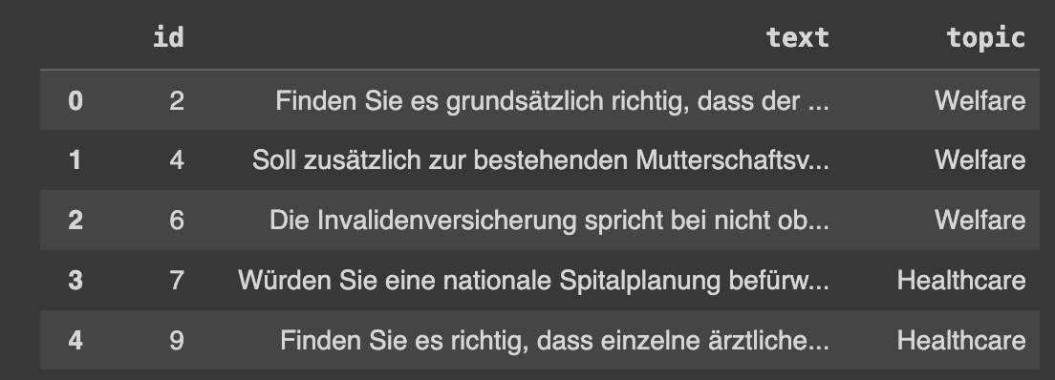
Sample Data

Slide 9
Model Selection
1
2
3
4
Model Chosen: We selected the Zero-Shot Topic Model (ZeroShotTM) for our project. This model is ideal for cross-language topic modeling due to its ability to handle multiple languages efficiently.
Multilingual Understanding: ZeroShotTM is designed to work with texts in multiple languages, making it perfect for our dataset which includes German, French, and Italian.
No Need for Parallel Data: It can predict topics in languages it wasn't trained on, eliminating the need for parallel corpora.
Semantic Consistency: This model uses semantic understanding rather than just word frequency, ensuring that topics are consistent across languages.

Slide 10

Model Working and Advantages
How Does It Work?:
Vector Space Mapping: It uses a multilingual sentence transformer to encode text into a shared semantic vector space, bridging the gap between different languages.
Clustering and Topic Discovery: The model clusters these vector representations to discover topics, effectively finding patterns that represent similar themes across different languages.
Evaluation: We use coherence scores to evaluate how meaningful the discovered topics are, ensuring they are relevant and interpretable.
Advantages:
Flexibility: Can be easily extended to include more languages.
Efficiency: Capable of handling large datasets without compromising on performance.
Innovative: Represents a cutting-edge approach in the field of NLP, particularly for multilingual topic analysis.

Slide 11

Training Process
The model was trained on the German dataset, after preparing the data using paraphrase-multilingual-mpnet-base-v2. This training involved the ZeroShotTM model tuned with specified parameters: the size of the bag-of-words vocabulary, the size of the contextual embeddings, the number of topics (n_components), and the number of training epochs.
The training process was iterative, allowing the model to refine its understanding of topics with each pass over the data.

Slide 12
Training and Optimization Techniques
Regularization:
Function: Applies constraints to the model to prevent overfitting, ensuring it generalizes well to new, unseen data.
Hyperparameter Tuning:
Function: Adjusts the model's parameters (like the number of topics, learning rate) to find the most effective settings for the task.
Method: Often involves a search process, like grid or random search, to explore different combinations of parameters.
Multilingual Embeddings:
Role: Utilizes embeddings trained on multiple languages to enable the model to understand and link concepts across different linguistic contexts.
Benefit: Critical for cross-language topic modeling, as it allows the discovery of consistent topics in various languages without direct translation.

Slide 13
Model Metrics Overview
Coherence Score:
Definition: Measures the degree of semantic similarity between high scoring words in the topic.
Purpose: Ensures topics are meaningful and words within a topic are related.
Technical Insight: Higher coherence means the topic is more interpretable to humans.
Topic Diversity:
Definition: Evaluates how distinct the topics are from each other.
Purpose: Prevents the model from producing repetitive or overlapping topics.
Technical Insight: A diverse set of topics indicates a broad coverage of the subject matter within the dataset.

Slide 14
Model Evaluation – Coherence and Diversity
Coherence Scores:
Range of Scores: The model produced coherence scores ranging from 0.141 to 0.992, with multiple measurements taken under different settings.
Highest Score: The peak coherence score obtained was 0.992, indicating a strong semantic consistency within topics.
Average Score: Among the notable scores, an average coherence score was approximately 0.199 to 0.322 for different runs, suggesting that topics are interpretable and well-defined.
Diversity Score:
Observed Score: The model achieved a diversity score of 0.622, reflecting a good variation between the topics it discovered.
Implication: This score demonstrates that the model is capable of generating a broad range of distinct and diverse topics, which is crucial for effective topic modeling across languages.

Slide 15
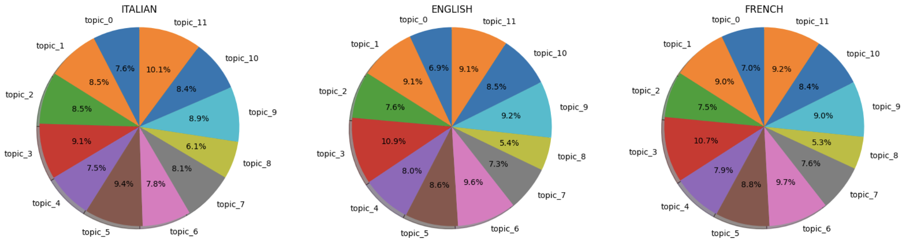
Results

Slide 16
Conclusion
Summarizing the Journey:
Our exploration into Zero-Shot Topic Modeling (ZSTM) has been a journey of innovation and discovery. We've successfully demonstrated the model's ability to transcend language barriers, identifying coherent topics in German, French, and Italian texts with no direct training on the latter two.
Key Findings:
Effective Cross-Lingual Modeling:
ZSTM has proven effective in cross-lingual topic discovery, showcasing an impressive ability to generalize from one language to others while maintaining topic coherence and relevance.
Semantic Consistency Across Languages:
The model has displayed a remarkable level of semantic consistency, capturing the essence of topics across different languages and presenting them in a unified, understandable format.
Model Versatility and Scalability:
Our experiments highlight the model's versatility and scalability

