Slide 1

STATISTICS

Slide 2

STATISTICS
Statistics is the branch of mathematics that involves collecting, analysing, interpreting and presenting the data. It provides tools and methods to understand and make sense of large amount of data and draw conclusion and make decision based on the data.
For Example,
Daily Life
Business

Slide 3
Why Statistics is Important?
Informed Decision Making
Data Interpretation
Problem Solving
Predictive Analysis
Quality Control
Research and Innovation
Resource Optimization
Risk Assessment
Social & Economic Understanding
Career Opportunities

Slide 4
Type of Statistics
Descriptive Statistics
Inferential Statistics
Descriptive Statistics -
Descriptive statistics is a methods of collect data, organize, analyse, interpreted and present the sample data.
Inferential Statistics -
It deals with making a conclusion or prediction about the population data using the sample data.

Slide 5
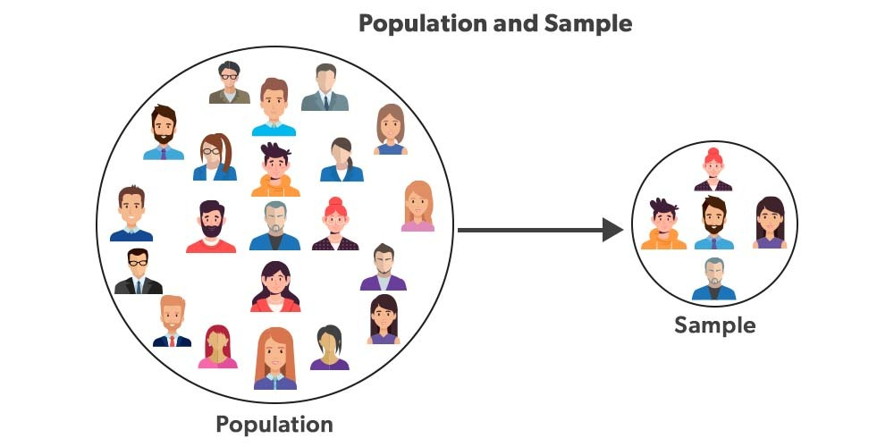
Population
A population is the entire group of individuals or the object.
Sample
A sample is a sub-group of population.
For example –
Population :- Entire fans of Cricket in the world.
Sample :- The fans available at stadium.

Slide 6
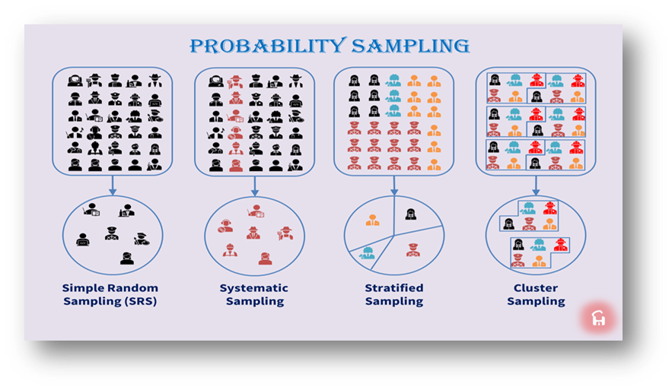
Sampling Techniques
Simple Random Sampling -
Every member has an equal chance.
Stratified Sampling -
A method of sampling that involves the division of a population into smaller sub-group known as strata.
Systematic Sampling -
It is a type of probability sampling that selects items of data at regular intervals from a population.
Cluster Sampling –
Dividing the population into clusters and randomly selecting entire clusters.

Slide 7
TYPE OF DATA
Qualitative/Categorial Data
Nominal Data
Ordinal Data
Quantitative/Numerical Data
Discrete Data
Continuous Data

Slide 8
Qualitative/Categorical Data
Qualitative data is used to describe qualities or characteristics of something. It provides answers in words instead of numbers.
Types:
Nominal Data - Nominal data is used for naming or labelling. There is no rank or order among categories. Nominal categories are simply different.
Example:
Gender, such as male or female. Eye colour, such as brown, blue, or green.
Type of fruit, such as apple, banana, and mango.
Ordinal Data - Ordinal data contains values that have a defined order. Ordinal data can be ordered low-to-high or high-to-low.
Example:
Education level, such as high school, bachelor’s, master’s.
Race positions, such as 1st, 2nd, and 3rd.

Slide 9
Quantitative/Numerical Data
Quantitative data involves numbers. It can be counted, measured, and calculated.
Types:
Discrete Data - Discrete data refers to whole numbers. These are values you can count one by one. They are not fractions or decimals.
Example:
Number of students in a classroom.
Number of cars in a parking lot.
Number of pages in a book.
Continuous Data - Continuous data can consist of any value in a given range. It can consist of fractions and decimal numbers. Continuous data is more likely to be measured than counted.
Example:
Height of a person.
Temperature.
Weight.

