Slide 1

HOSPITAL DATABASE MANAGEMENT
By GAYATRI BORATE
- Guided By Manisha Ma’am

Slide 2
About me
Background : BSC(Computer Science) from Savitribai Phule Pune University, Pune
Why you want to learn Data Science : Data Science offers continuous learning and growth. As new technologies and methods evolve, it encourages me to stay curious, adaptable, innovative and qualities that are essential for a successful career in today’s technology landscape.
Any work experience : Freshers
LinkedIn and GitHub profile URLs :
http://www.linkedin.com/in/gayatri-borate-853907367
https://github.com/gayatriborate16/Gayatri-Borate.git

Slide 3
Agenda
Objective of the Project
ER Diagram and schema explanation
Key analysis questions
SQL query results with screenshots or summaries
Final business insights and recommendations
Conclusion
Experience/Challenges working on SQL – Data Analysis Project.

Slide 4
Project Storyline
I chose the Hospital Database Management System project because healthcare is a domain where data accuracy and structure are extremely important. Hospitals deal with patients, doctors, treatments, medications, rooms, and schedules simultaneously, which makes it a perfect real-world example of complex relational data.
Through this project, I wanted to understand how large, interrelated datasets are designed and managed using SQL. It helped me practice normalization, primary and foreign key relationships, and complex joins while simulating real hospital workflows such as appointments, patient stays, prescriptions, and procedures.

Slide 5
Problem Statement
Problem Statement :
Hospitals manage large volumes of data related to patients, doctors, nurses, appointments, treatments, medications, room allocation, and medical procedures. When this information is maintained manually or in unstructured systems, it leads to data redundancy, inconsistency, difficulty in retrieval, and risk of errors that can directly affect patient care.
Objective :
My project solves the problem of managing complex and interconnected hospital data in a structured way. It reduces redundancy, improves data accuracy, and enables efficient retrieval of information such as patient history, doctor assignments, room availability, and treatment records using SQL.

Slide 6
Why Relational Database is needed ?
A relational database is required because hospital operations must strictly follow business rules, and these rules can be enforced directly at the database level.
In this project:
A procedure can only be performed by a physician who is trained and certified
An appointment cannot exist without a valid patient and physician
A room assignment must refer to an existing room and block
A prescription must reference a valid patient, physician, and medication
Relational databases enforce these rules using:
Primary keys
Foreign keys
Unique constraints
Referential integrity
This ensures that invalid or inconsistent medical data cannot be inserted, which is critical in healthcare systems.

Slide 7
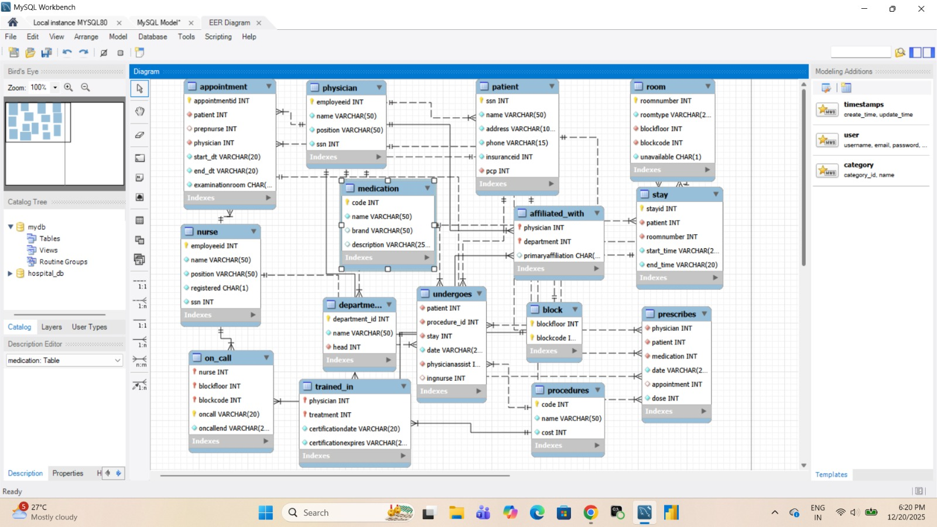
ER Diagram and Schema Explanation

Slide 8
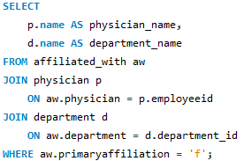

SQL Queries with Summaries Q. Write a query in SQL to obtain the name of the physicians with department who are yet to be affiliated
This query displays the names of the physicians who are not affiliated yet

Slide 9
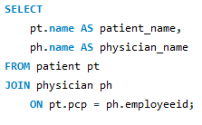
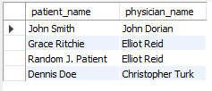
Q. Write a query in SQL to obtain the name of the patients with their physicians by whom they got their preliminary treatment
This Query shows the patients along with the doctors who provided their initial treatment

Slide 10
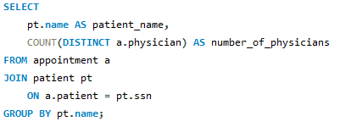
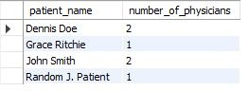
Q. Write a query in SQL to find the name of the patients and the number of physicians they have taken appointment
This query shows each patient and how many different physician they have taken appointment with.

Slide 11


Q. Write a query in SQL to count number of unique patients who got an appointment for examination room C
This query shows the count of unique patients who got an appointment in room c

Slide 12
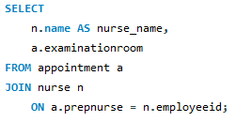
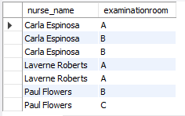
Q. Write a query in SQL to find the name of the nurses and the room scheduled, where they will assist the physicians.
It shows which nurses assisted physicians and the examination rooms where they were scheduled.

Slide 13
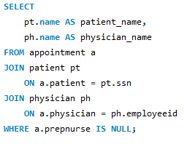

Q. Write a query in SQL to find the name of patients and their physicians who does not require any assistance of a nurse.
It shows the names of the patients and their physicians who does not require any assistance

Slide 14
Business Insights
Improves quality of patient care and prevents physician overload
Reduces repeated tests or treatments by keeping the complete view of patient history which improves the efficiency of treatment.
By analyzing staff scheduling we can prevent staff burnout
This project protects patient’s safety and hospital’s reputation
Helps forecast future demands and improve appointment scheduling.

Slide 15
Experience and challenges
Challenges :
Designing Complex Relationships Between Tables
Handling Date Fields Stored as Strings
Interpreting Ambiguous Business Requirements
Query Performance Consideration
Experience :
Real-World Database Design Experience
Data Accuracy & Compliance Awareness
Confidence Working With Large Schemas
Exposure to Compliance-Oriented Data

Slide 16
Conclusion
The Hospital Database Management System project demonstrates the effective use of a relational database to manage complex hospital operations.
It organizes data related to patients, physicians, nurses, appointments, treatments, medications, and room allocation in a structured manner.
By applying normalization and enforcing primary and foreign key constraints, the system ensures data integrity and consistency.
The project supports complex SQL queries for operational and analytical insights. It also highlights the importance of accurate data management in healthcare environments.
Overall, the project enhanced practical SQL skills and real-world database design understanding.

Slide 17

THANK YOU

