Slide 1
32-BIT RIPPLE CARRY ADDER
Verilog HDL Implementation in AMD Vivado
Half Adder → Full Adder → Generate-for → 32-bit Ripple Carry Adder
DIGITAL LOGIC DESIGN
VERILOG HDL
VIVADO
Project documentation • RTL design • Simulation • Schematic
32-Bit Ripple Carry Adder • Verilog HDL • Vivado | 1

Slide 2
1. Project Objective
What are we building?
Design hierarchy
• Add two 32-bit binary numbers.
• Use a Full Adder for each bit position.
• Connect carry-out of one stage to carry-in of the next stage.
• Generate all 32 Full Adder instances using a Verilog generate-for loop.
• Produce a 33-bit result to include the final carry.
Half Adder
↓
Full Adder
↓ × 32
32-bit Ripple Carry Adder
32-Bit Ripple Carry Adder • Verilog HDL • Vivado | 2

Slide 3
2. Half Adder
The basic building block for binary addition
Logic equations
Verilog implementation
SUM = A ⊕ B
CARRY = A · B
module halfadder(
input a, b,
output sum, car
);
assign sum = a ^ b;
assign car = a & b;
endmodule
Truth table
A
B
SUM
CARRY
0
0
0
0
0
1
1
0
XOR gives the Sum; AND gives the Carry.
1
0
1
0
1
1
0
1
32-Bit Ripple Carry Adder • Verilog HDL • Vivado | 3

Slide 4
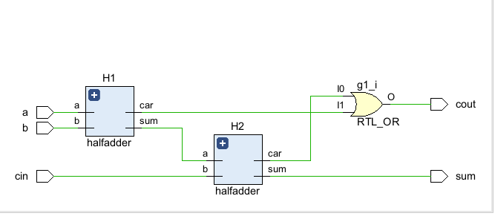
3. Full Adder
Adds A, B and an incoming carry
Construction
Two Half Adders + one OR gate
• H1 adds A and B → s1, c1
• H2 adds s1 and cin → sum, c2
• OR gate combines c1 and c2 → cout
sum = A ⊕ B ⊕ cin
cout = (A·B) + (cin·(A⊕B))
Vivado RTL schematic of the Full Adder
32-Bit Ripple Carry Adder • Verilog HDL • Vivado | 4

Slide 5
4. From Full Adder to 32-Bit Adder
Ripple-carry principle
FA0
→
FA1
→
FA2
→
FA3
→
… FA31
bit 0
bit 1
bit 2
bit 3
• Each Full Adder handles one bit position.
• Carry travels from the least-significant bit (LSB) toward the most-significant bit (MSB).
• This is called a ripple-carry structure because the carry propagates through the stages.
• For 32 bits: 32 Full Adders are required.
Signal widths
a → [31:0] = 32 bits
b → [31:0] = 32 bits
s → [32:0] = 33 bits
c → [32:0] = carry chain
32-Bit Ripple Carry Adder • Verilog HDL • Vivado | 5

Slide 6
5. Verilog Design of the 32-Bit Adder
module adder(
input [31:0] a,
input [31:0] b,
output [32:0] s
);
wire [32:0] c;
assign c[0] = 1'b0;
genvar i;
generate
for (i = 0; i < 32; i = i + 1) begin
fulladder FA(
a[i], b[i], c[i],
s[i], c[i+1]
);
end
endgenerate
assign s[32] = c[32];
endmodule
What each part does
• `wire [32:0] c` stores the carry chain.
• `c[0] = 0` sets the initial carry-in.
• `genvar i` creates a generate-loop index.
• The loop instantiates 32 Full Adders.
• `c[i]` is the carry-in and `c[i+1]` is the carry-out.
• `s[32] = c[32]` exposes the final carry.
32-Bit Ripple Carry Adder • Verilog HDL • Vivado | 6

Slide 7
6. Generate-for Loop
A key Verilog concept used to repeat hardware structures
Template
How the loop maps to hardware
genvar i;
generate
for (i = 0; i < 32; i = i + 1) begin
fulladder FA(
a[i], b[i], c[i],
s[i], c[i+1]
);
end
endgenerate
i = 0
→
FA0
i = 1
→
FA1
i = 2
→
FA2
i = 3
→
FA3
Vivado expands this into individual hardware instances.
⋮
i = 31 → FA31
32-Bit Ripple Carry Adder • Verilog HDL • Vivado | 7

Slide 8
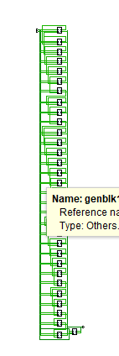
7. Vivado RTL Schematic
What the schematic shows
• Generated Full Adder instances appear as genblk blocks.
• There are 32 repeated stages for a 32-bit design.
• The carry chain connects one stage to the next.
• Vivado elaborates the generate-for loop into hardware structure.
Tip: the schematic layout may look vertical or compact; the important part is the connectivity.
32-Bit Ripple Carry Adder • Verilog HDL • Vivado | 8

Slide 9
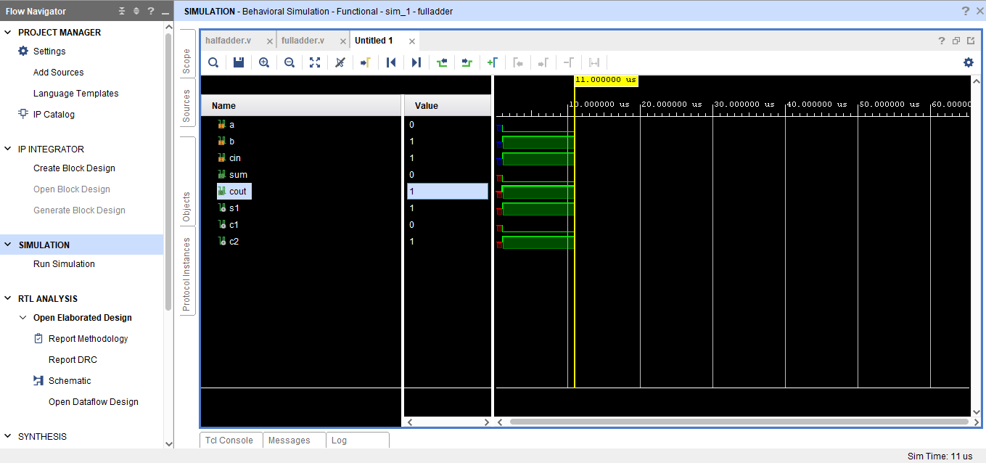
8. Full Adder Functional Simulation
Observed test
a = 0
b = 1
cin = 1
sum = 0
cout = 1
1 + 1 = 10₂
The waveform confirms that the Full Adder produces the correct sum and carry for this input combination.
32-Bit Ripple Carry Adder • Verilog HDL • Vivado | 9

Slide 10
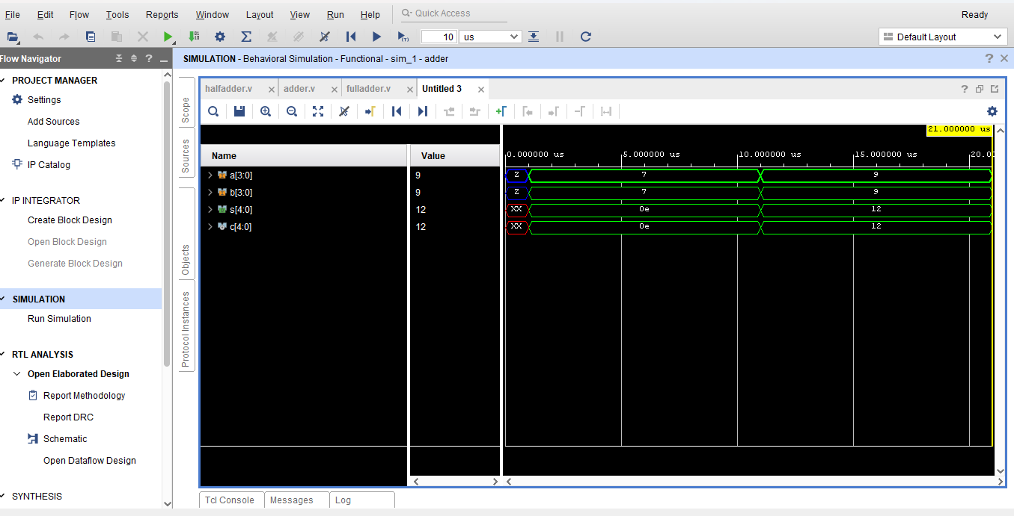
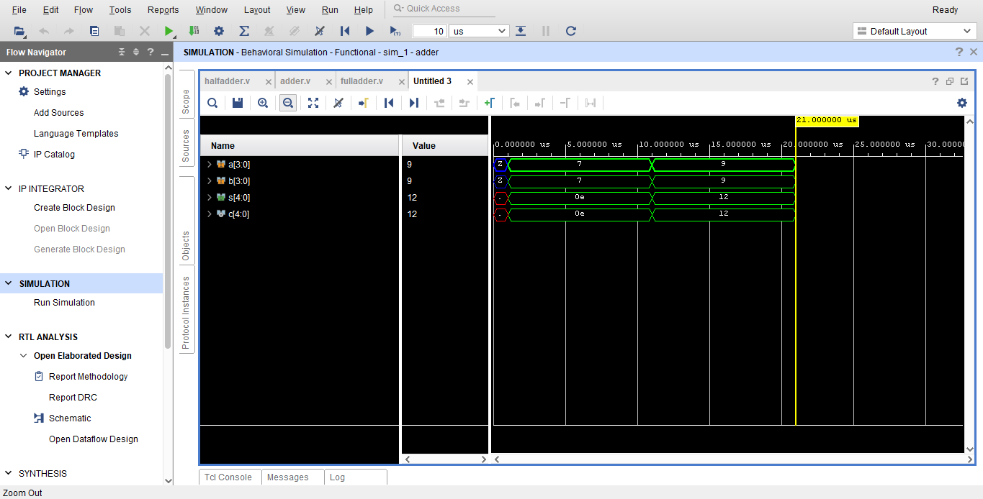
9. Adder Functional Simulation
Example: a = 9, b = 9
The waveform displays 0x12 = 18₁₀
32-Bit Ripple Carry Adder • Verilog HDL • Vivado | 10

Slide 11
10. Understanding the Simulation Result
Why does Vivado show 12?
Important observation
The Objects window is displaying the bus value in hexadecimal.
• The lower four bits represent the 4-bit sum.
• The extra MSB represents the carry.
• For a 32-bit implementation, the same idea extends to 32 stages and a 33-bit result.
• Simulation verifies functional behavior before hardware implementation.
Hexadecimal : 0x12
Decimal : 18
Binary : 10010₂
Therefore:
9 + 9 = 18 = 10010₂ = 0x12
Note: the screenshots show a 4-bit simulation example used to verify the same adder concept; the final architecture is extended to 32 bits.
32-Bit Ripple Carry Adder • Verilog HDL • Vivado | 11

Slide 12
11. Key Concepts & Viva Points
Concepts learned
Common viva questions
• Half Adder: XOR + AND
• Full Adder: two Half Adders + OR
• Ripple Carry: carry propagates between stages
• generate-for: creates repeated hardware instances
• genvar: generate-loop variable
• Bus notation: [31:0] means 32 bits
• 33-bit output stores the final carry
• Vivado: RTL elaboration, schematic and simulation
• Why do we need 33 output bits?
• Why is c[0] assigned 0?
• Why use generate-for instead of writing 32 instances manually?
• What is the difference between a Half Adder and Full Adder?
• What is ripple-carry propagation?
• What does genvar do?
• Why is the final carry connected to s[32]?
32-Bit Ripple Carry Adder • Verilog HDL • Vivado | 12

Slide 13
12. Conclusion
Final outcome
A hierarchical 32-bit Ripple Carry Adder was designed in Verilog HDL using reusable Half Adder and Full Adder modules. A generate-for loop was used to instantiate 32 Full Adders, and Vivado was used for RTL analysis and functional simulation.
HALF ADDER
FULL ADDER
GENERATE-FOR
32-BIT RCA
Thank You
32-Bit Ripple Carry Adder • Verilog HDL • Vivado | 13

