Slide 1

Resume Classification
Group 3
Mentors :- Karthik and Dhanya
Participants :-
1.Mr.Aniruddha Bharat Dhokate
2.Ms.Gayatri Gaonkar
3.Mr.Chinnam Rahul Sai Pawan Reddy
4.Ms.Ankita Bhagwan Gawali
5.Mr.Sagar Betadur
6.Mr.Ashish Vijay Vidhate

Slide 2
Business Objective
To develop an automated system that can accurately classify resumes based on different job roles or categories, such as software developer, HRM.
This system could be used by organizations to filter and screen large numbers of resumes quickly and efficiently, saving time and effort in the hiring process.
To develop an automated system that can accurately classify resumes based on different job roles or categories, such as software developer, HRM.
This system could be used by organizations to filter and screen large numbers of resumes quickly and efficiently, saving time and effort in the hiring process.

Slide 3
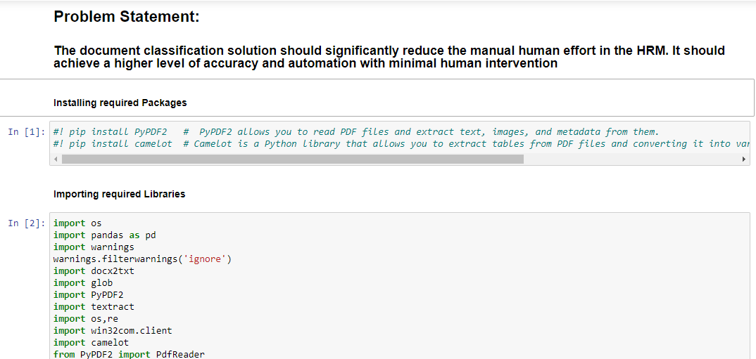
1.Data Extraction:-
1.Download all the files from the Google Drive to the local computer.
2.Use the necessary libraries for the Data Extraction Process.
To get the list of the docents present in the folder:-

Slide 4
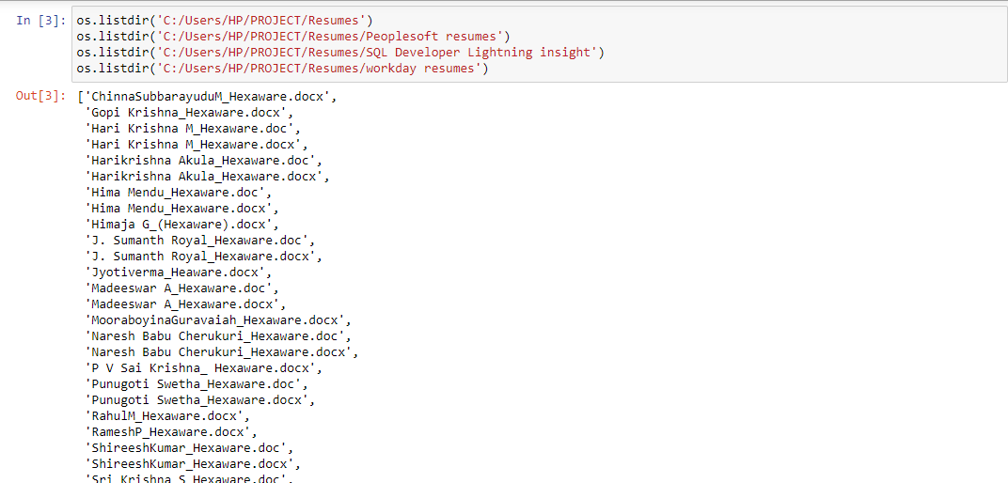
3.To get the list of the Documents present in the Folder use the following function :-

Slide 5
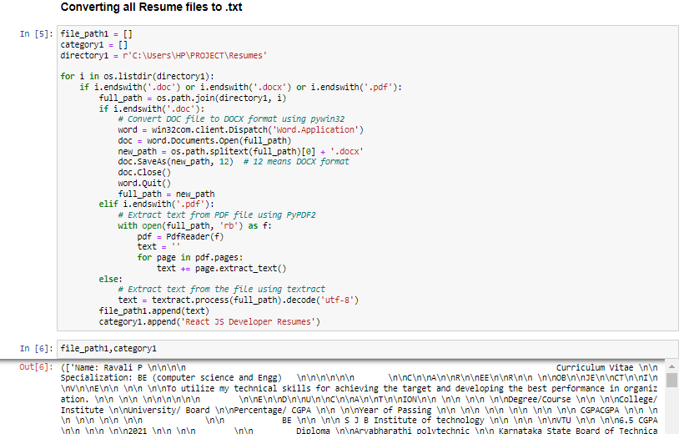
4.Extract data from the documents stored in the folder and append it the empty list.
(Follow the similar step for all the folders containing the documents providing the path for the various folders. )

Slide 6
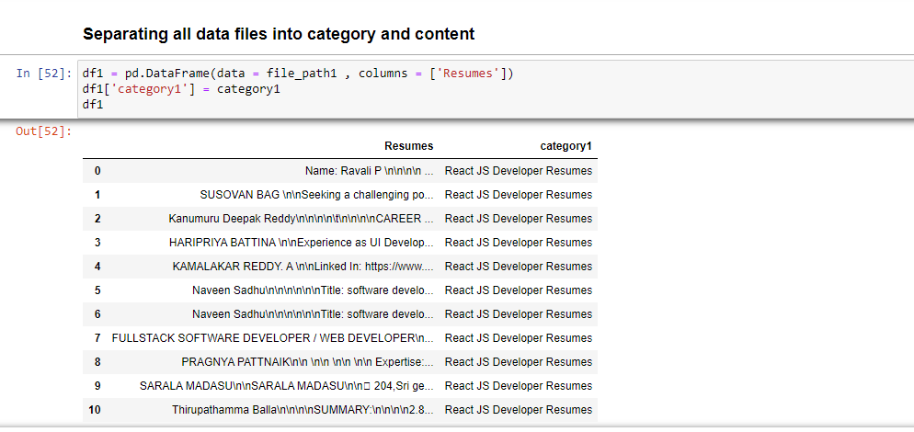
5.Create a DataFrame for the data that is extracted.
(Follow the same procedure for all the lists having data)

Slide 7
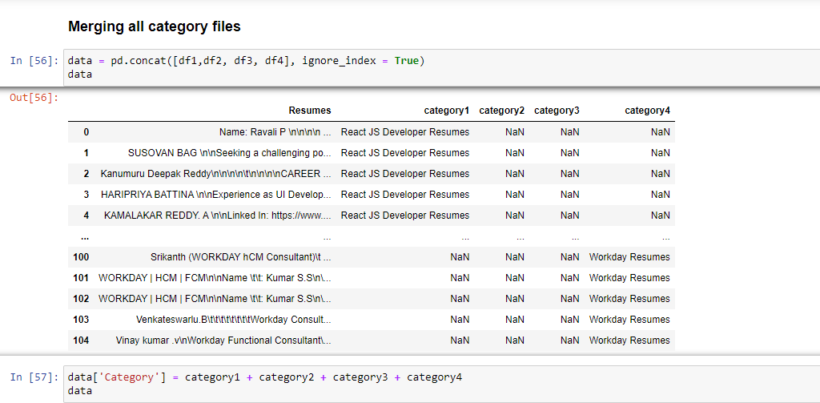
6.Concat/Join the so that the data extracted is combined in a single
data frame.

Slide 8
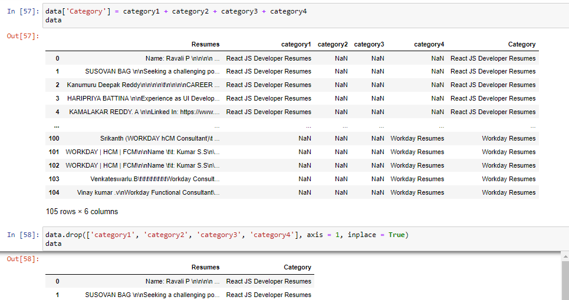
7.Create a column in the dataframe named category having all
the categories merged.
(keep the merged column and drop the other columns)
Model Building

Slide 9

8.Finally convert the dataframe to the csv file

Slide 10
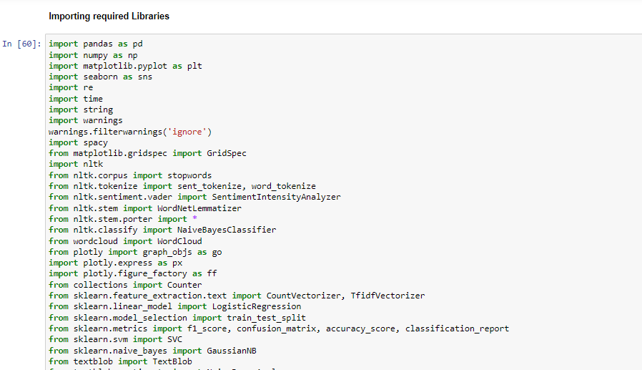
Exploratory Data Analysis (EDA) :
Importing Libraries

Slide 11
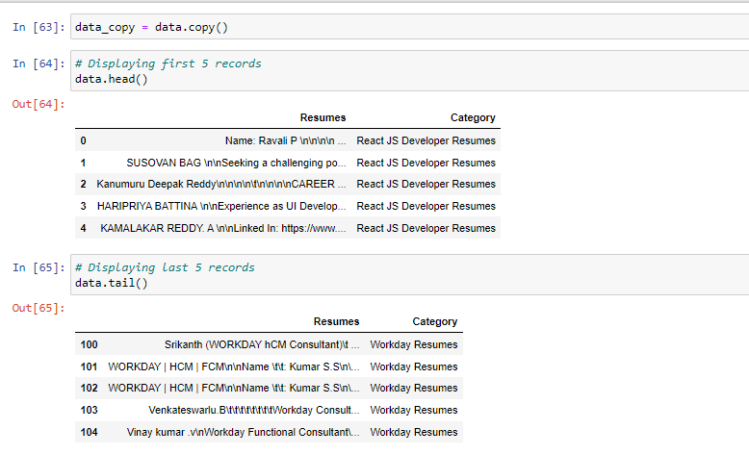
1.Performing initial steps of EDA i.e. head(), tail()

Slide 12
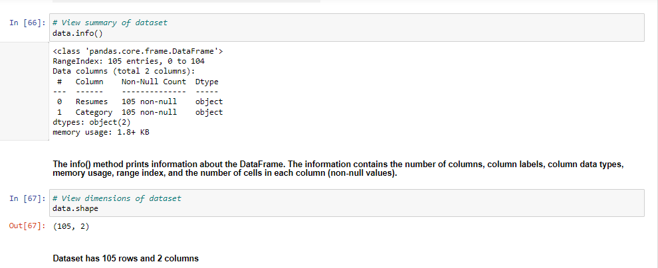
2. Info() , shape

Slide 13
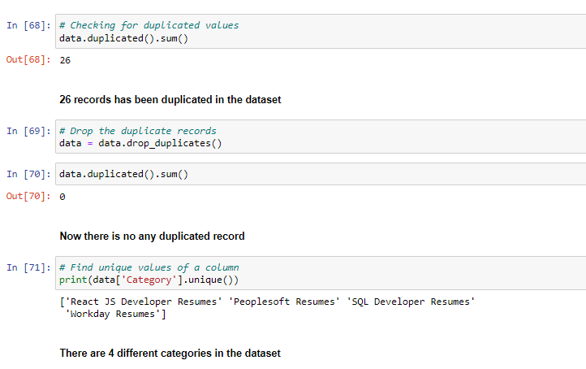
3.Finding duplicates and dropping the duplicated records

Slide 14
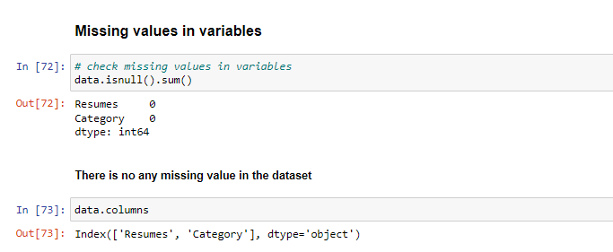
4. Checking missing values

Slide 15
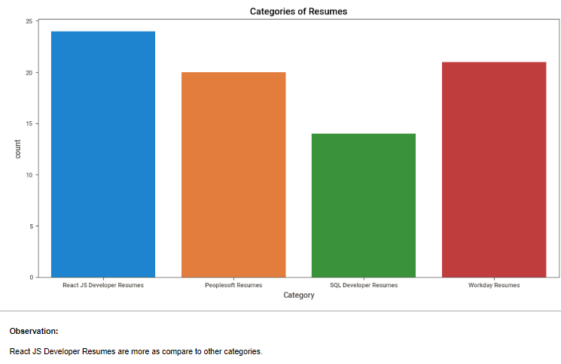
5. Bar Chart

Slide 16
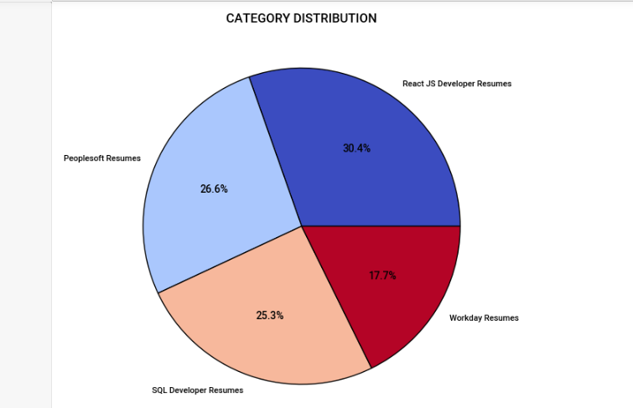
6. Pie Chart : Percentage wise Category Distribution

Slide 17
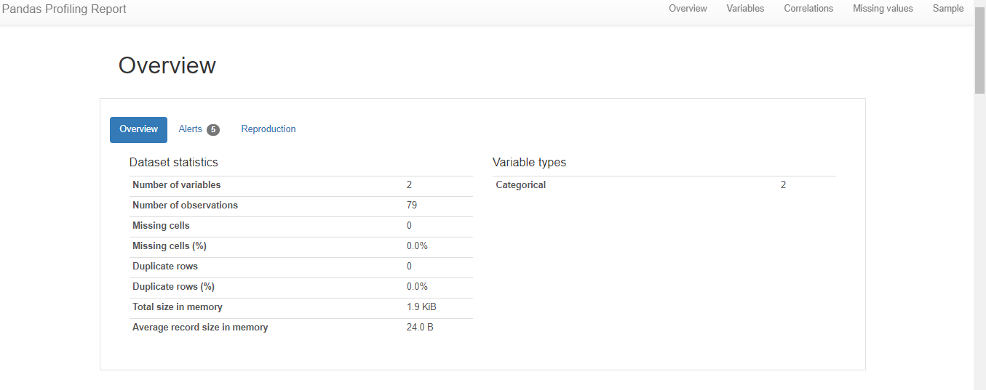
EDA using pandas_profiling & sweetviz libraries
1. pandas_profiling

Slide 18
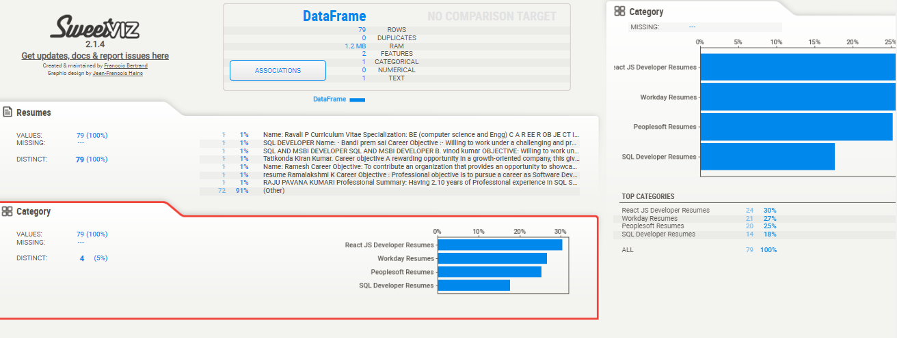
2. sweetviz

Slide 19
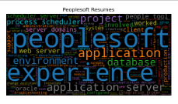
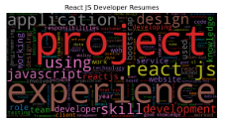
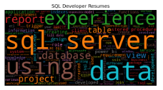
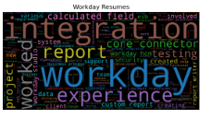
Category wise WordCloud :

Slide 20
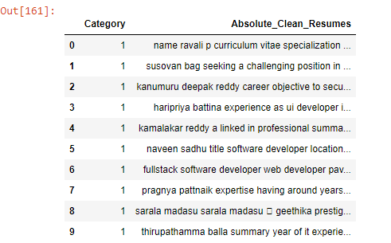
LABEL ENCODING
Since there are four
Categories it will
encode them into
PeopleSoft - 0
React JS - 1
SQL Developer- 2
Workday - 3

Slide 21
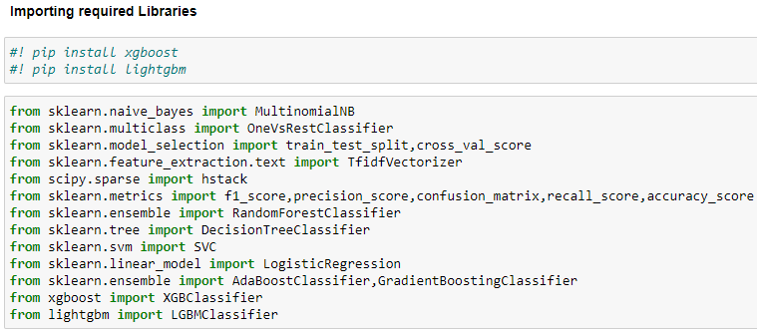
MODEL BUILDING
Importing required libraries:

Slide 22
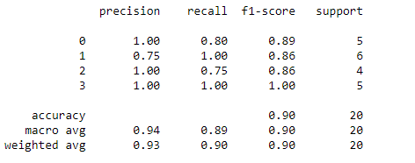
Logistic Regression

Slide 23
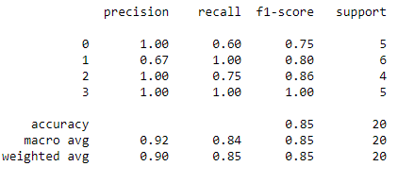
Support Vector Machine Classifier(SVC)

Slide 24
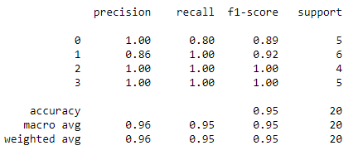
Random Forest Classifier

Slide 25
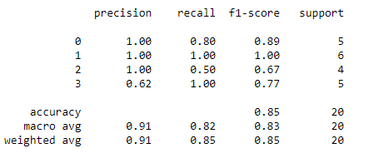
Naive-Bayes Classifier

Slide 26
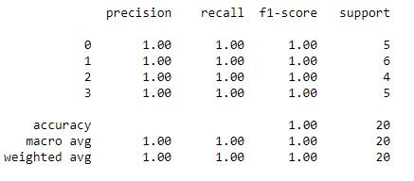
Decision Tree Classifier

Slide 27
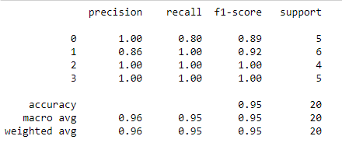
AdaBoost Classifier

Slide 28
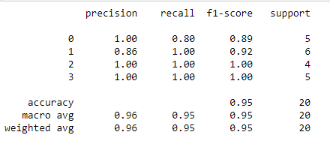
Gradient Boosting Classifier

Slide 29
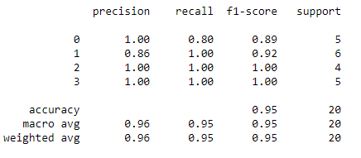
XGBoost Classifier

Slide 30
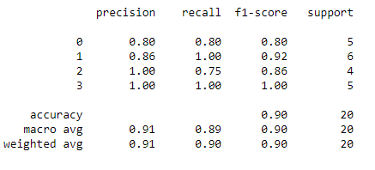
LGBM Classifier

Slide 31
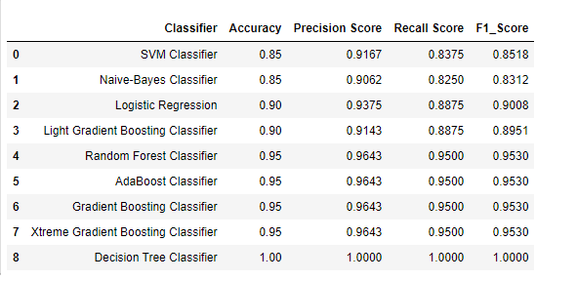
Tabulated Results

Slide 32
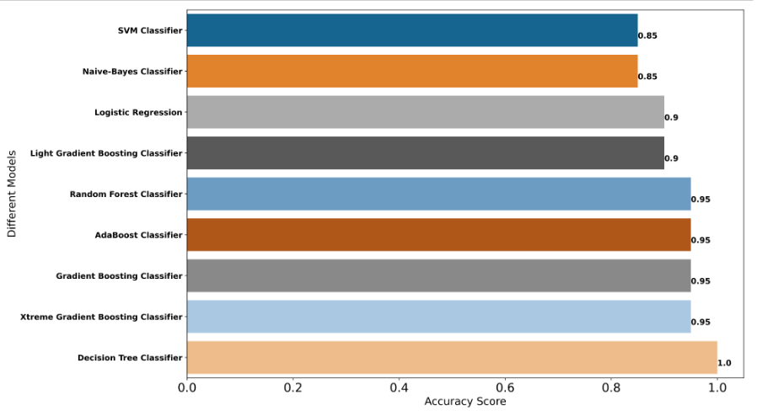
Bar Graph of Model Accuracy

Slide 33
Model Selection
Out of models performed we’re considering Support Vector Classifier for deployment.
It has Accuracy : 0.85
It has Precision Score : 0.91
It has Recall Score : 0.83
It has F1_Score : 0.85

Slide 34
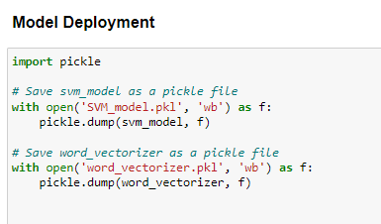
Model Deployment

Slide 35
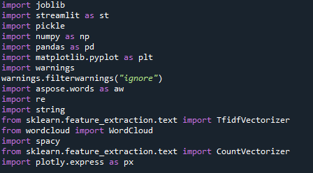
Importing Libraries for Deployment :

Slide 36
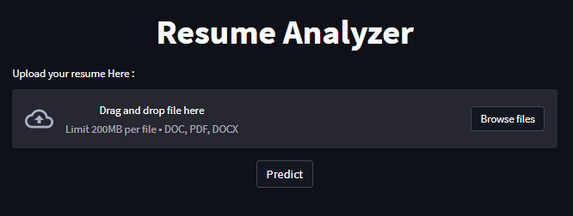
Before Uploading Resume :

Slide 37
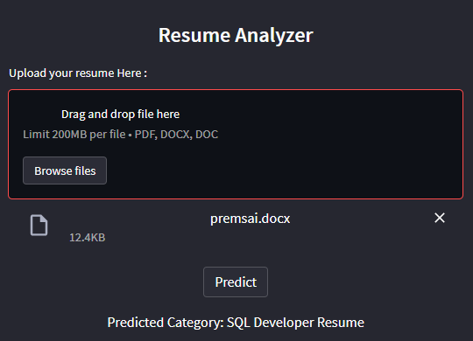
Predicting Resume Category :

Slide 38
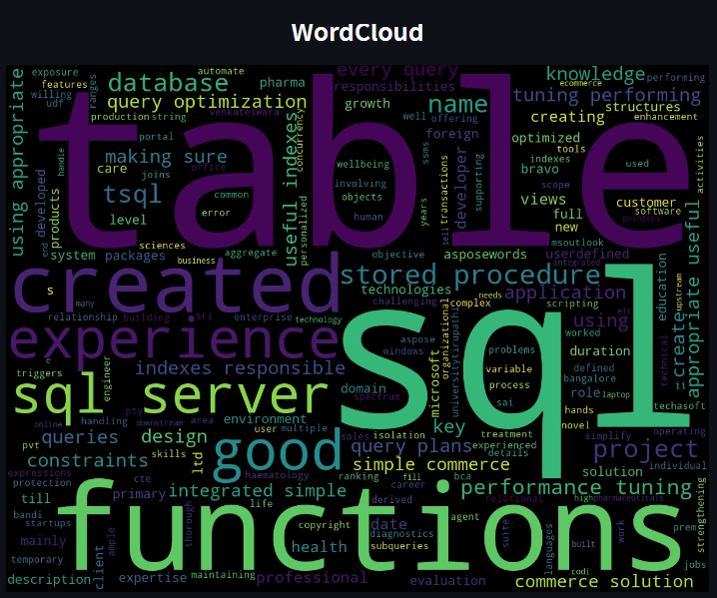
WordCloud for Uploaded Resume :

Slide 39
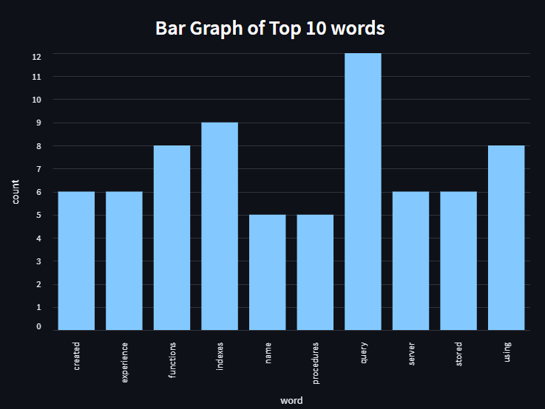
Bar Graph of Top 10 words :

Slide 40
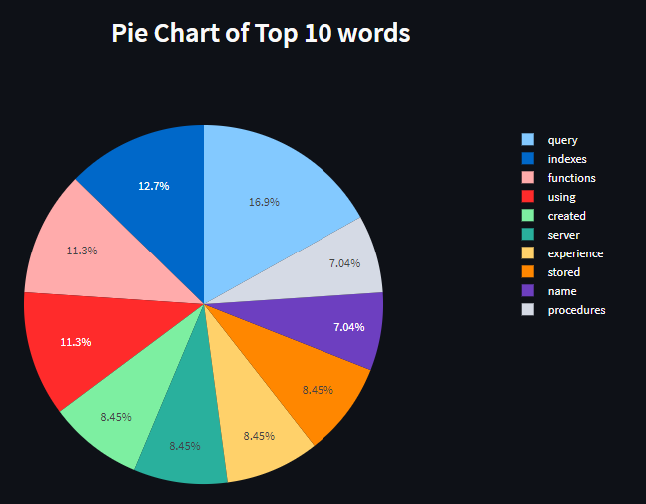
Pie Chart of Top 10 words :

Slide 41
Challenges Faced
We faced difficulties while extracting data from resumes, so we used ‘PyPDF2’ & ‘camelot’ libraries to overcome the problem.
We were facing difficulties while loading the pickle file, so we used the ‘joblib’ library.
We were facing issue while uploading the file, so we used the ‘st.file_uploader’ to resolve the issue.
We encountered an error while deploying the model, so we created a separate pickle file for the TF-IDF vectorizer.

Slide 42
Thank You !

