Slide 1
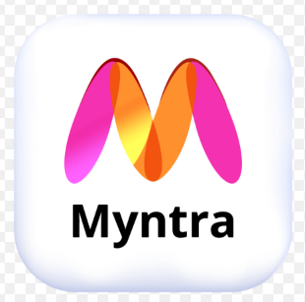
Project Title:
Myntra Fashion E-commerce Trends
Power BI Data Analytics Project
Interactive dashboard for sales, orders, customers, categories, brands and products
Presented by : Jadhav Gayatri
1 / 10

Slide 2
1. Project Overview
• Objective: analyze fashion e-commerce sales and order trends through an interactive Power BI dashboard.
• The dashboard combines business KPIs, category performance, gender-wise sales, brand performance and city-wise orders.
• Users can interact with Category, Brand, City and Order Date slicers to explore specific segments.
• The project helps convert raw e-commerce data into clear and actionable visual insights.
2 / 10

Slide 3
2. Data & Connectivity
Source Data
Excel / MySQL / CSV
Power Query
Clean & Transform
Data Model
Relationships + DAX
Report
Interactive Dashboard
• Typical fields used: Order_ID, Order_Date, Category, Brand, Product_Name, Gender, City, Quantity and Revenue.
• Power Query can be used for data cleaning, changing data types, removing blanks and standardizing categories.
• DAX measures can calculate Total Sales, Total Orders, Total Customers and Average Order Value.
3 / 10

Slide 4
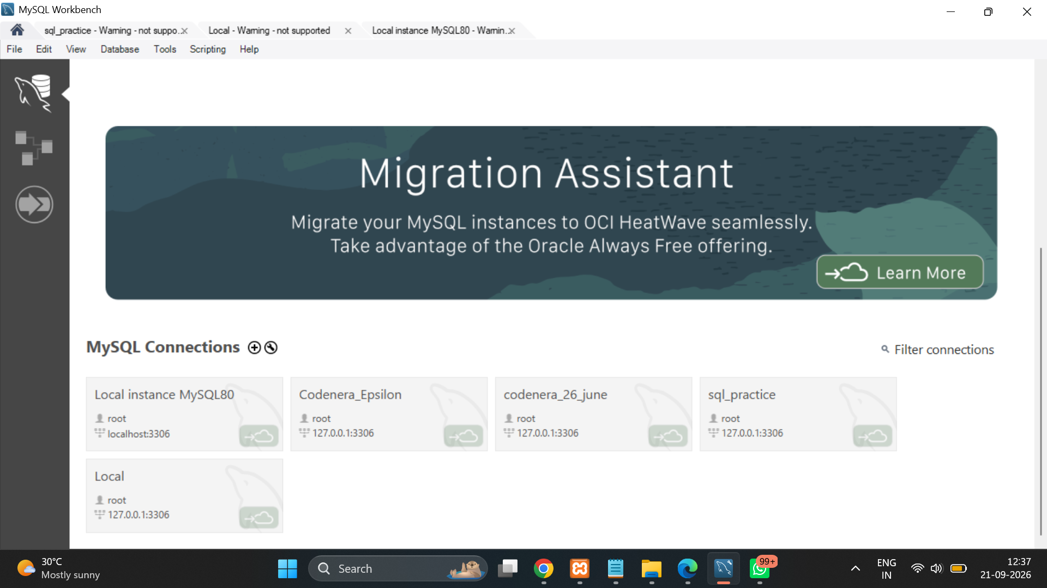
4 / 10

Slide 5
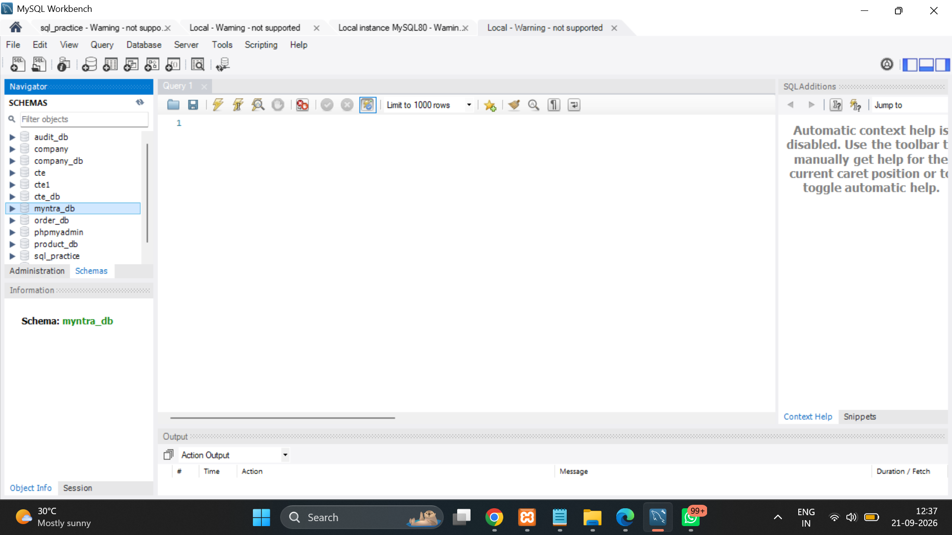
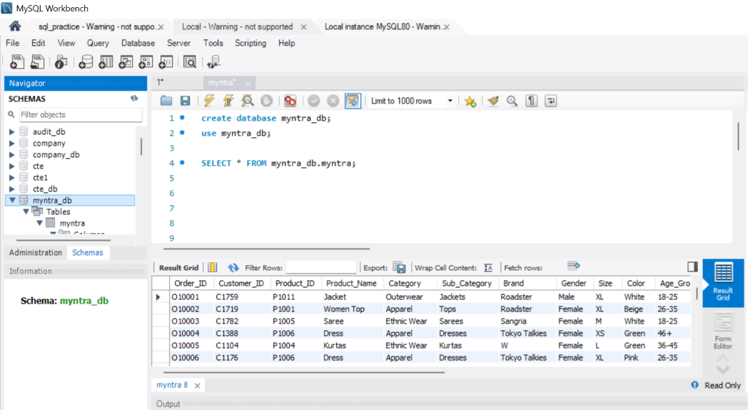
5/ 10

Slide 6
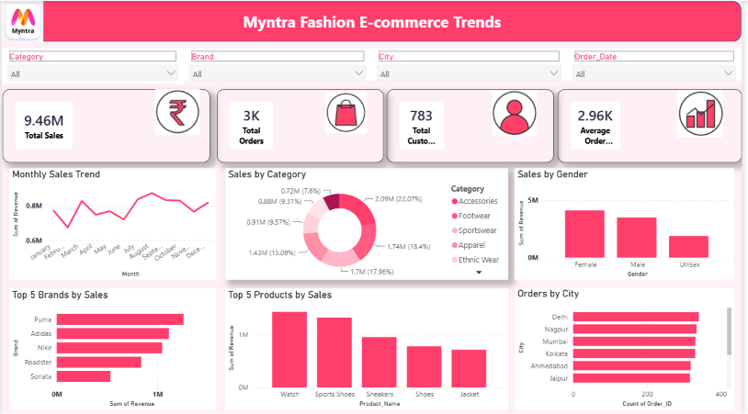
3. Final Dashboard
6 / 10

Slide 7
4. Dashboard Components
KPI Cards
Total Sales • Total Orders • Total Customers • Average Order Value
Trend Analysis
Monthly Sales Trend shows how revenue changes over time.
Category Analysis
Sales by Category identifies contribution of fashion categories.
Gender Analysis
Female, Male and Unisex sales are compared visually.
Brand & Product
Top 5 Brands and Top 5 Products highlight leading performers.
Geographical View
Orders by City compares order volume across locations.
7 / 10

Slide 8
5. Interactivity & Design
• Slicers: Category, Brand, City and Order Date allow users to filter the complete report.
• Charts are linked through Power BI interactions, so selecting a category or brand updates related visuals.
• The maroon/pink theme gives the dashboard a fashion-focused and consistent visual identity.
• KPI cards provide quick business-level information, while charts provide detailed analysis.
• A clean layout with aligned visuals improves readability and makes the dashboard presentation-ready.
8 / 10

Slide 9
6. Key Insights & Conclusion
• The dashboard provides a single view of major e-commerce sales and order metrics.
• Monthly sales trends help identify high- and low-performing periods.
• Top brands and products can be compared to understand where revenue is concentrated.
• Category and gender analysis supports customer-segment understanding.
• City-wise order analysis highlights geographic demand patterns.
• Conclusion: Power BI makes the fashion e-commerce data easier to explore, compare and present for business analysis.
9 / 10

Slide 10
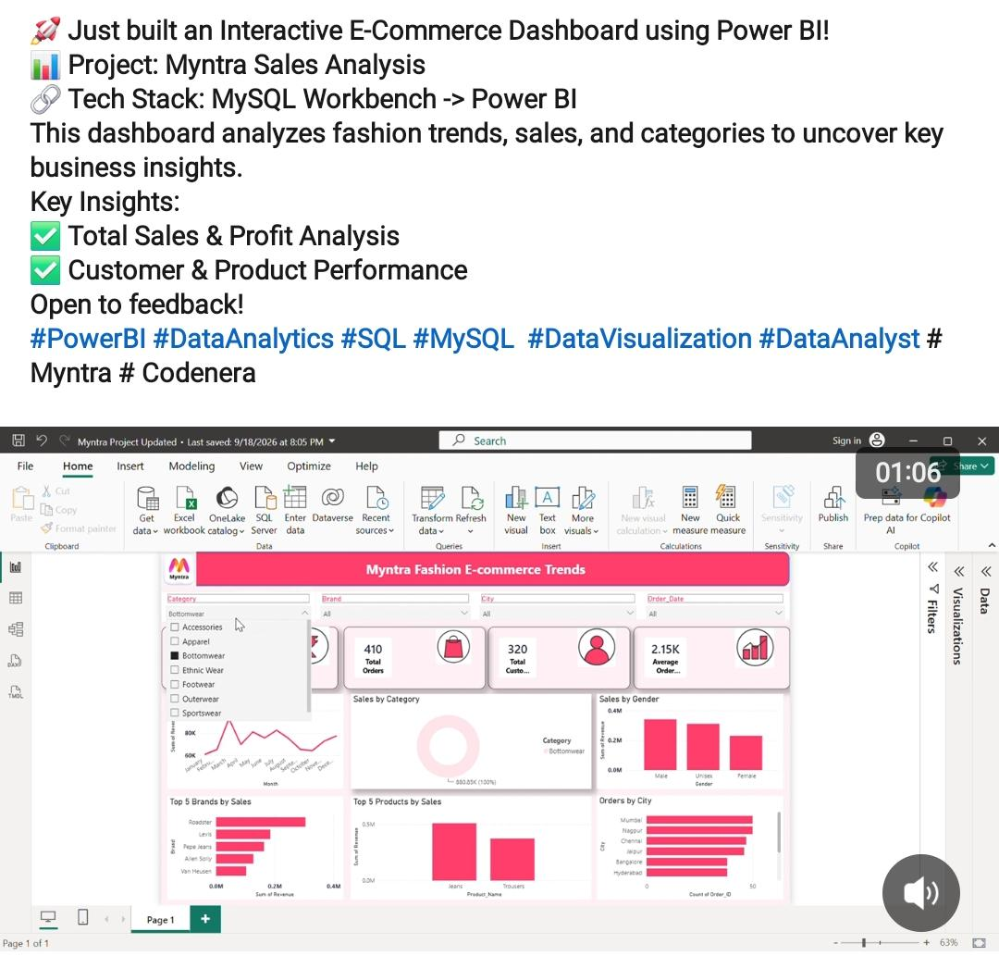
7. Project Showcase On Linkdin
Shared the Myntra Dashboard project on linkdin to build
professional presence and
receive engagement and
improved visibility.
Thank You
10 / 10

