Slide 1



She ARISE 2.0 B-24 PDEA
A Mini project on
ATM System
By – Group No: 4
Priyanka Khuspe
Gayatri Hampe
Gayatri Khot
Sana Patel
Bhavika Holkar

Slide 2
Responsibilities
Presentation Flow: Gayatri Khot
Coding: Priyanka Khuspe, Sana Patel
Diagrams: Gayatri Khot, Gayatri Hampe
Database: Gayatri Hampe, Bhavika Holkar
Documentation: Gayatri Khot, Bhavika Holkar

Slide 3
Introduction
Objectives
Tools Used
Components
Functionalities
Data Flow Diagram
Flow Chart
Class Diagram
Entity Relationship Diagram
Conclusion
Agenda

Slide 4
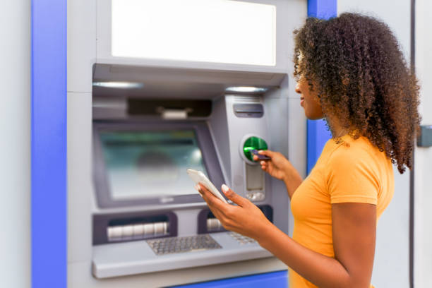
Introducing ATM System
In this project we we’ll explore the foundational aspects of Java backend development focusing on Hibernate as a key technology.
The project will display efficient mapping of the Java objects to database, simplifying data manipulation.

Slide 5
Objectives
Providing convenient access to banking services
Development of User-Friendly Interface
Reliable Transaction Processing
Multifunctionality
Security Measures Implementation
Customer Satisfaction

Slide 6
Tools used
Software Requirements
Hardware Requirements
Java Programming Language
Hibernate Framework
MySQL RDBMS
Maven Repository
Windows OS
16 GB RAM
Back to Agenda Page

Slide 7
Components
Entities involved in Project:
Bank
Customer
Address
Account
Transaction
Card

Slide 8
Functionalities
By making use of the ORM framework , the project provides the following functionalities
Cash withdrawal
Cash Deposit
Change Pin
View Balance
Mini Statement

Slide 9
Data Flow Diagram: Level 0
ATM
System
Customer
Procced transaction
Account
Request transaction
Display result
Make transaction

Slide 10
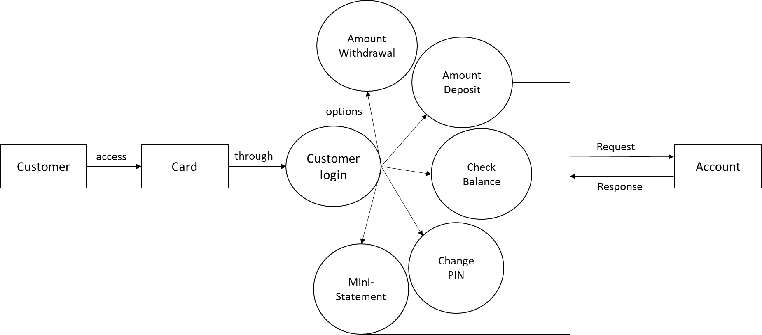
Data Flow Diagram: Level 1

Slide 11
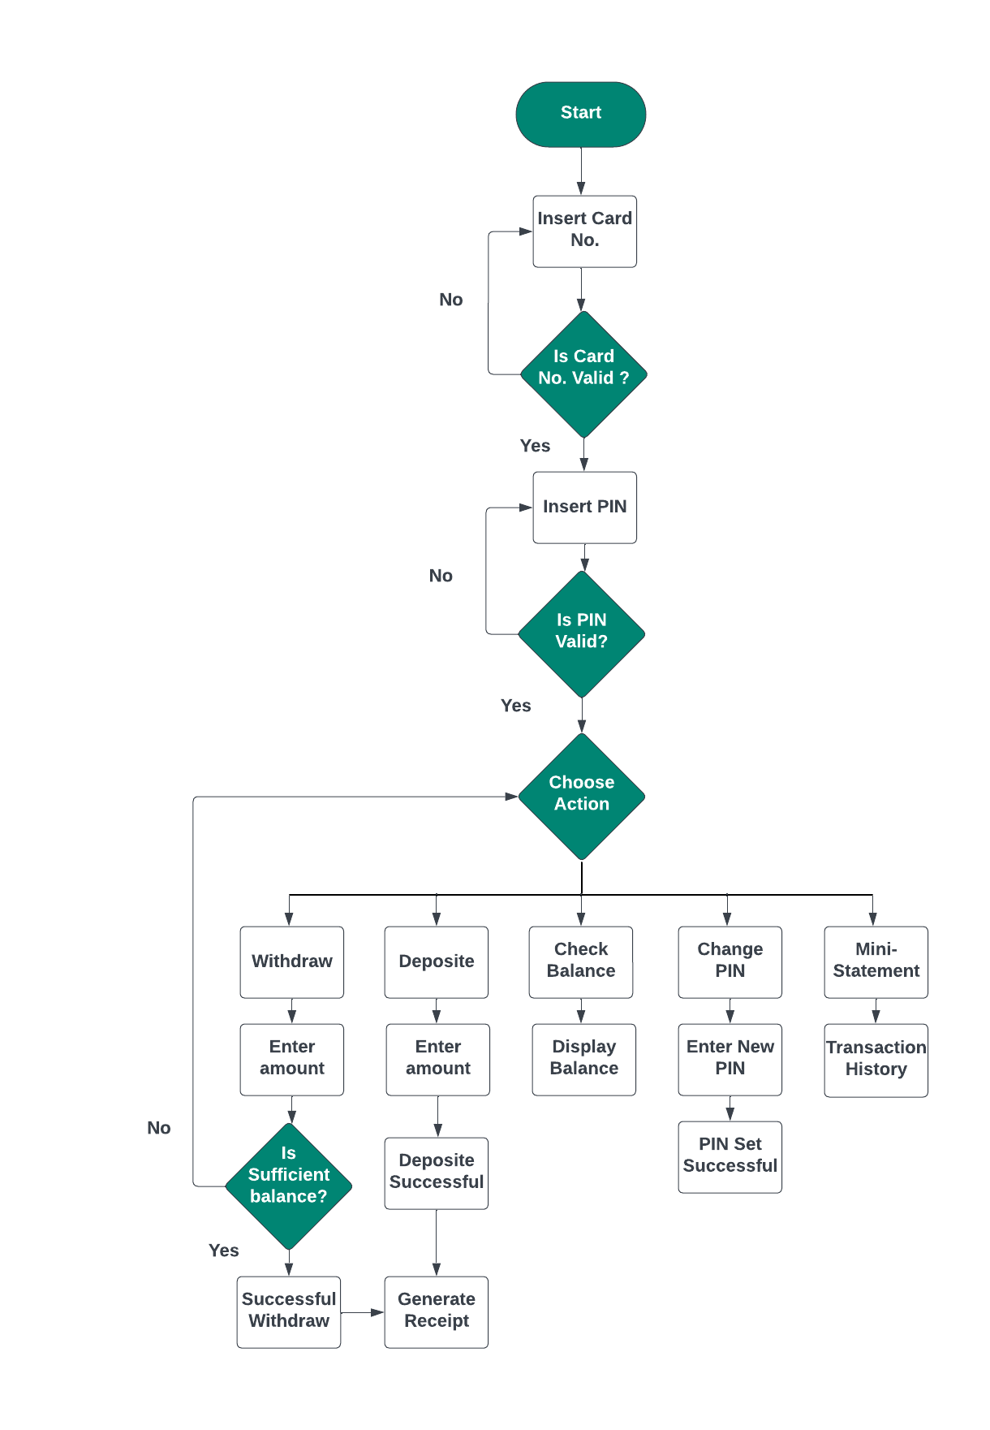
Flow Chart

Slide 12
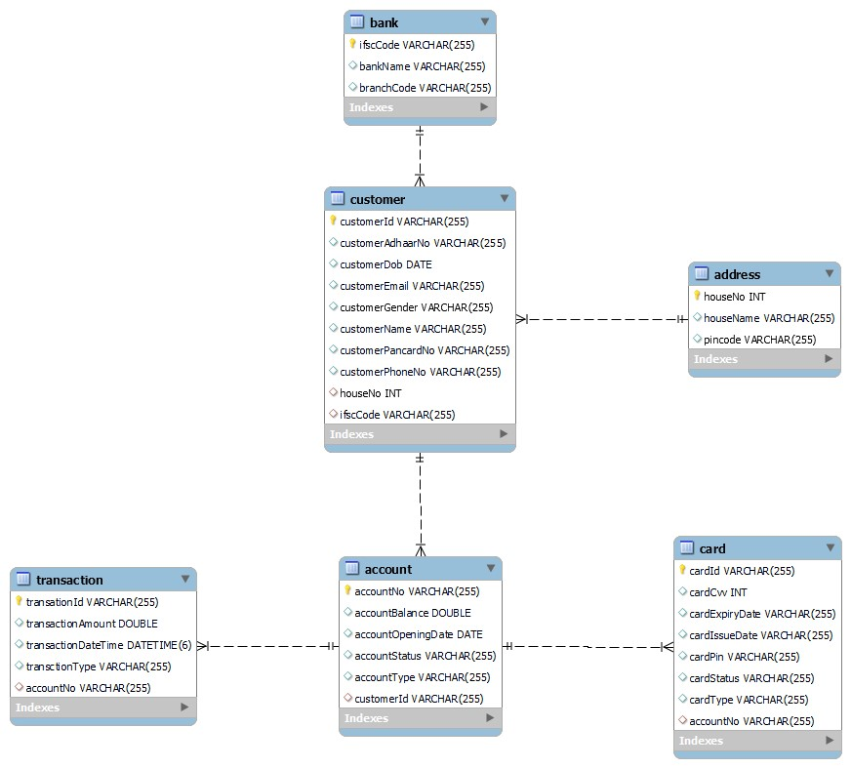
Class Diagram:

Slide 13
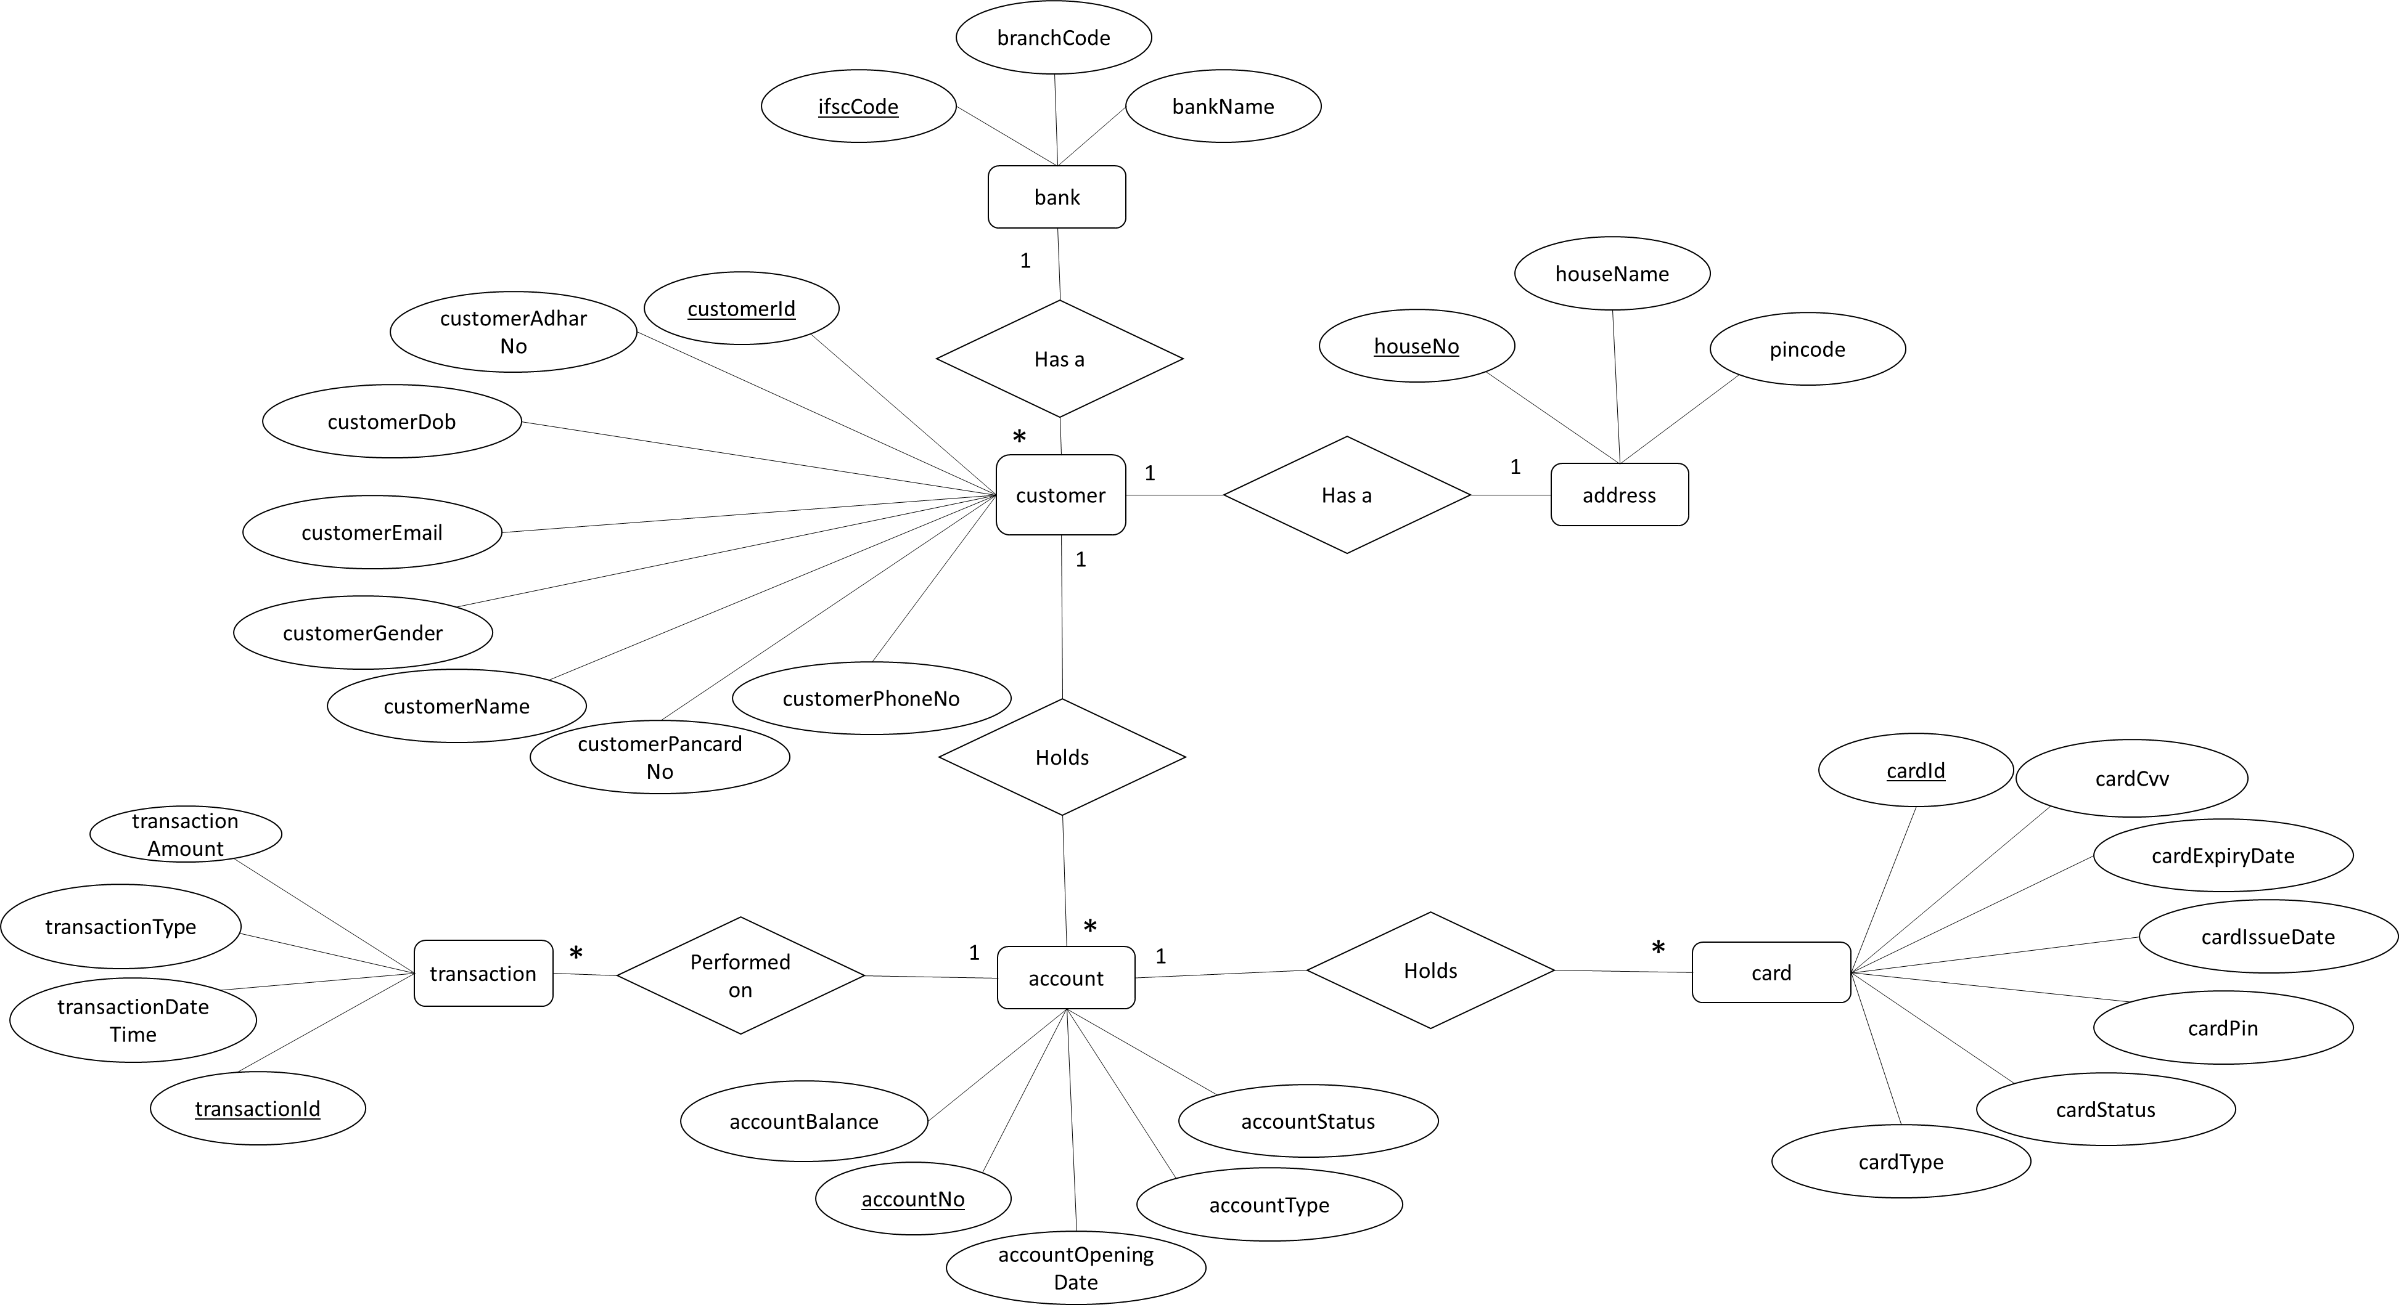
Entity Relationship Diagram

Slide 14
Conclusion
Implementing an ATM management system using Hibernate with JPA indeed provides several benefits, primarily focused on efficient database management and simplified data access.
Hibernate is an object-relational mapping (ORM) framework for Java that simplifies the interaction between Java applications and relational databases, such as MySQL.

Slide 15
Thanks

