Slide 1
PyKV
A Scalable, Persistent, and Distributed Key-Value Store
PyKV, a high-performance, fault-tolerant, and distributed
in-memory Key-Value Store developed entirely in Python.
Presented By:
Gayatri Kolapati
Stage | Process | Components
1. Ingress | Client initiates $\text{SET}/\text{DELETE}$ request. | CLI Client / HTTP API
2. Validation | Request undergoes $\text{Pydantic}$ schema check. | FastAPI, Pydantic
3. Core Execution | In-memory store updates data; LRU order is adjusted. | Core Data Store, LRU Cache
4. Durability | Operation is written to the Append-Only Log on disk. | Persistence Module
5. Redundancy | Log entry is asynchronously shipped to the Replica Server. | Replication Module
6. Egress | Success confirmation is returned to the Client. | FastAPI
Conclusion
(Slide 7: Summary and Q&A)
PyKV successfully integrates core distributed systems concepts into a Python framework, demonstrating:
High Performance via asynchronous design.
Memory Efficiency via LRU caching.
Durability via Write-Ahead Logging.
High Availability via Replication.
We have built a resilient, scalable key-value solution. Thank you. We are now ready for your questions.

Slide 2
Module 1: Core System Architecture
Objective: Establish the high-speed, non-blocking foundation.In-Memory Storage: The core data structure is a native dictionary, ensuring O(1) average time complexity for all fundamental operations: GET , SET and DELETE.
Asynchronous API Exposure: We utilize FastAPI to expose these operations. This framework, combined with Python's async,await paradigm, ensures the server handles high concurrency using a non-blocking architecture, maximizing Request Per Second throughput.
Key Functions:
get(key): Data retrieval from the in-memory store.
set(key, value): Insertion or update of a key-value pair.
delete(key): Removal of a key-value pair.

Slide 3
Module 2: Performance and Integrity
Least Recently Used (LRU) Caching
Purpose: To manage finite memory resources and maintain high cache hit rates by implementing an effective eviction policy.
Implementation: The LRU mechanism is built using a hybrid structure: a Hash Map (Python Dictionary) for O(1) key access, integrated with a Doubly Linked List for O(1) maintenance of usage order.
Eviction Principle: When capacity is exceeded, the item at the tail of the linked list (Least Recently Used) is instantaneously evicted.

Slide 4
Pydantic Data Validation
Integrity Enforcement: All incoming API requests are subjected to validation using Pydantic.
Benefit: This ensures data typing, structure, and constraints are met before the request reaches the core logic, enhancing system reliability and preventing injection of malformed data.

Slide 5
Module 3: Durability and Crash Recovery
(Persistence and Recovery)
Goal: Achieve data durability and fault-tolerance, making the system crash-safe.
Mechanism: Write-Ahead Logging (WAL): All mutating operations SET andDELETE are recorded to an append-only log file on persistent storage before the client receives confirmation.
System Recovery: Upon system restart, the Recovery module reads the entire append-only log file sequentially to fully rebuild the in-memory data store to its last committed state.

Slide 6
Optimization: Log Compaction
Challenge:
The log file size grows rapidly due to multiple updates to the same key.
Compaction Process: A background process scans the log, discards superseded records (e.g., old versions of updated keys or deleted keys), and creates a new, condensed log file. [Image comparing an uncompacted append-only log file with redundant operations to a compacted log file with only the final, relevant operations]
Benefit: Dramatically reduces persistent storage requirements and accelerates recovery time.

Slide 7
Module 4: Distribution and Client Interface
(Replication and Interface)
Master-Replica Replication
High Availability (HA): We implemented an asynchronous log-shipping mechanism to achieve redundancy.
Process: The primary Master Server ships its append-only log entries to a designated Replica (Backup) Server.
Outcome: Ensures high availability and failover capability in the event of a Master node failure.

Slide 8
Client Interface and Benchmarking
CLI Client: A dedicated Command Line Interface (CLI) was developed using the Python requests library to provide a user-friendly way to interact with the PyKV HTTP API.
Performance Verification: Rigorous benchmarking was conducted to measure system performance under load, focusing on:
Throughput (RPS)
Latency (particularly for write operations involving disk I/O)
Validation of system scalability.

Slide 9
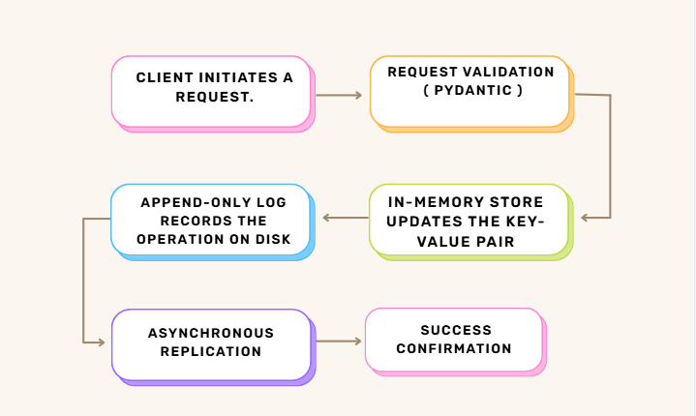
PyKV: Integrated Workflow

Slide 10
THANK YOU

