Slide 1
CUSTOMER SENTIMENT ANALYZER
CAPSTONE PROJECT
Presented By:
Mamidipalli Dharani Gayatri
Aditya College of Engineering
Computer Science and Engineering

Slide 2
OUTLINE
Problem Statement (Should not include solution)
Proposed System/Solution
System Development Approach (Technology Used)
Algorithm & Deployment
Result
Conclusion
Future Scope
References

Slide 3
Problem Statement
Example: With the rapid growth of online platforms for sharing opinions and reviews, restaurants often rely on customer feedback. Sentiment analysis helps improve their services and attract new customers by analyzing the sentiments expressed in these reviews. Developing a sentiment analysis model to classify restaurant reviews as positive or negative can provide valuable insights into customer satisfaction.

Slide 4
Proposed Solution
The proposed system aims to address the challenge of predicting the sentiment of restaurant reviews to classify them as either positive or negative. This classification helps restaurant owners understand customer satisfaction based on online feedback. The solution will consist of the following components:
Data Collection:
Gather historical data on restaurant reviews, including review text, review date, rating, and other relevant factors.
Utilize real-time data sources, such as social media comments and live customer feedback, to enhance prediction accuracy.
Data Preprocessing:
Clean and preprocess the collected data to handle missing values, outliers, and inconsistencies.
Feature engineering to extract relevant features from the data that might impact sentiment analysis, such as review length, presence of specific keywords, etc.
Machine Learning Algorithm:
Implement a machine learning algorithm, such as a text classification model (e.g., SVM, or LSTM), to classify reviews as positive or negative based on historical patterns.
Consider incorporating other factors like review length, sentiment polarity scores, and reviewer history to improve prediction accuracy.
Deployment:
Develop a user-friendly interface or application that provides real-time predictions for sentiment classification of new reviews.
Deploy the solution on a scalable and reliable platform, considering factors like server infrastructure, response time, and user accessibility.
Evaluation:
Assess the model's performance using appropriate metrics such as accuracy, precision, recall, and F1-score, or other relevant metrics.
Fine-tune the model based on feedback and continuous monitoring of prediction accuracy.
Result:
Implement a sentiment analysis system for restaurant owners, offering actionable insights from customer reviews and enabling continuous model improvement.

Slide 5
System Approach
The "System Approach" section outlines the overall strategy and methodology for developing and implementing the restaurant review system. Here's a suggested structure for this section:
System requirements
Windows 11.
Anaconda.
Google Collab.
Jupiter Notebook.
Library required to build the model
Pandas.
Matplotlib.
Seaborn.
WordCloud.
Collections.
NLTK.
BeautifulSoup.
Scikit-learn (sklearn).

Slide 6
Algorithm & Deployment
In the Algorithm section, describe the machine learning algorithm chosen for classifying the reviews. Here's an example structure for this section:
Algorithm Selection:
The chosen algorithm for sentiment analysis of customer reviews is the Multinomial Naive Bayes classifier. This model is selected due to its effectiveness in text classification tasks, making it suitable for predicting sentiment (positive or negative) based on textual data.
Data Input:
The algorithm takes pre-processed textual reviews as input. These reviews undergo preprocessing steps such as lowercasing, punctuation removal, HTML tag removal, contraction expansion, and lemmatization to extract meaningful sentiment-related information.
Training Process:
During training, the algorithm uses TF-IDF (Term Frequency-Inverse Document Frequency) vectorization to convert textual data into numerical vectors. The dataset is split into training and testing sets (80-20 split) to evaluate model performance on unseen data. The Multinomial Naive Bayes model is trained on the TF-IDF transformed training data.
Prediction Process:
For predicting sentiment from new reviews, the pre-trained model is used. New reviews undergo the same preprocessing steps and are vectorized using the pre-fit TF-IDF vectorizer. The model then predicts whether the sentiment of the review is positive or negative based on its vectorized representation.

Slide 7
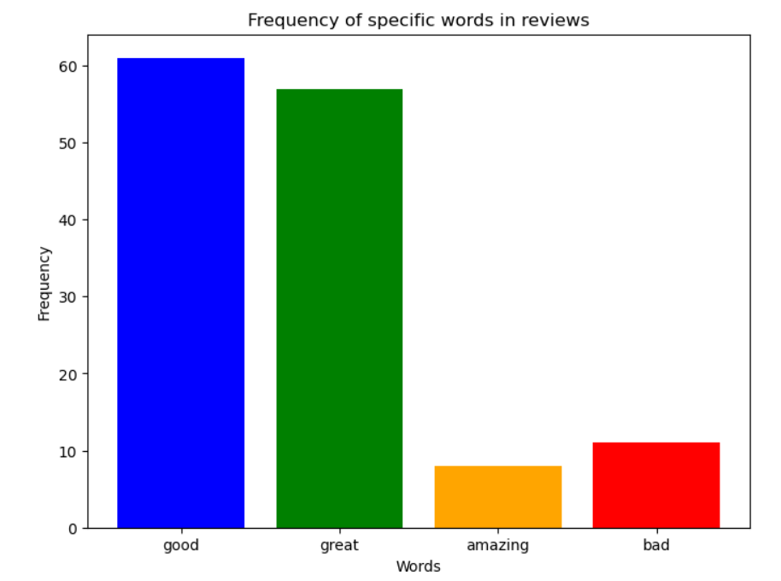
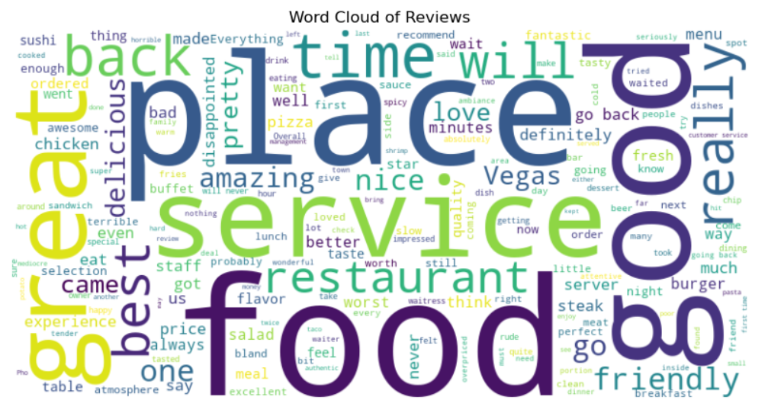
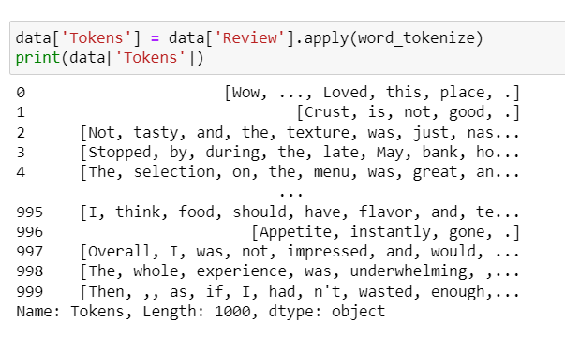
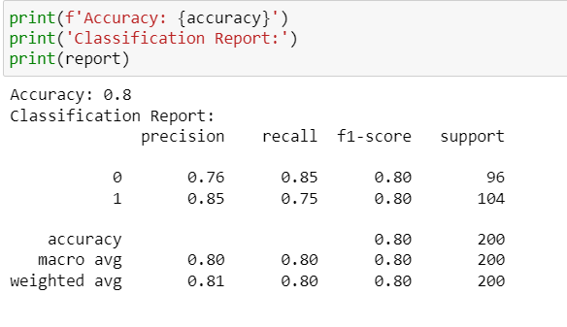
Result

Slide 8
Conclusion
In summary, sentiment analysis transforms text data into actionable insights by categorizing sentiments as positive or negative. Utilizing the Multinomial Naive Bayes classifier on cleaned and standardized reviews enables accurate prediction of customer sentiments. This automated approach equips businesses with valuable feedback to enhance customer experiences and refine strategic decisions, ultimately fostering improved service delivery and customer satisfaction levels.

Slide 9
Future scope
The future of sentiment analysis looks bright with advancements in natural language processing and machine learning. Technologies like deep learning and transformer models such as BERT are set to improve accuracy by understanding context and nuances in text. This will broaden sentiment analysis applications beyond customer reviews to include social media, healthcare feedback, and market trends. Enhanced computational capabilities will enable real-time insights, empowering businesses to refine strategies, boost customer satisfaction, and manage brand reputation more effectively.

Slide 10
References
Academic Papers:
Pang, B., & Lee, L. (2008). "Opinion Mining and Sentiment Analysis."
Medhat, W., Hassan, A., & Korashy, H. (2014). "Sentiment Analysis Algorithms and Applications: A Survey."
Research Articles:
Feldman, R. (2013). "Techniques and Applications for Sentiment Analysis."
Liu, B. (2012). "Sentiment Analysis and Opinion Mining.".
Best Practices in Data Preprocessing and Model Evaluation:
Aggarwal, C. C., & Zhai, C. (2012). "Mining Text Data."
Sebastiani, F. (2002). "Machine Learning in Automated Text Categorization."

Slide 11
THANK YOU

