Slide 1

Department of Computer Science and Engineering
ADITYA COLLEGE OF ENGINEERING
(Affiliated to JNTUK, Kakinada & Approved by AICTE, New Delhi and accredited by NAAC and NBA)
Surampalem, ADB road, East Godavari District, AP-533437

Slide 2
TEAM MEMBERS:
NAME ROLL NO
M.DHARANI GAYATRI(TEAM LEADER) 21MH1A05A9
N.MOUNIKA 21MH1A05B4
D.NAGA PHANINDRA DINESH 21MH1A0583
A.YUVARAJU 21MH1A05D9

Slide 3

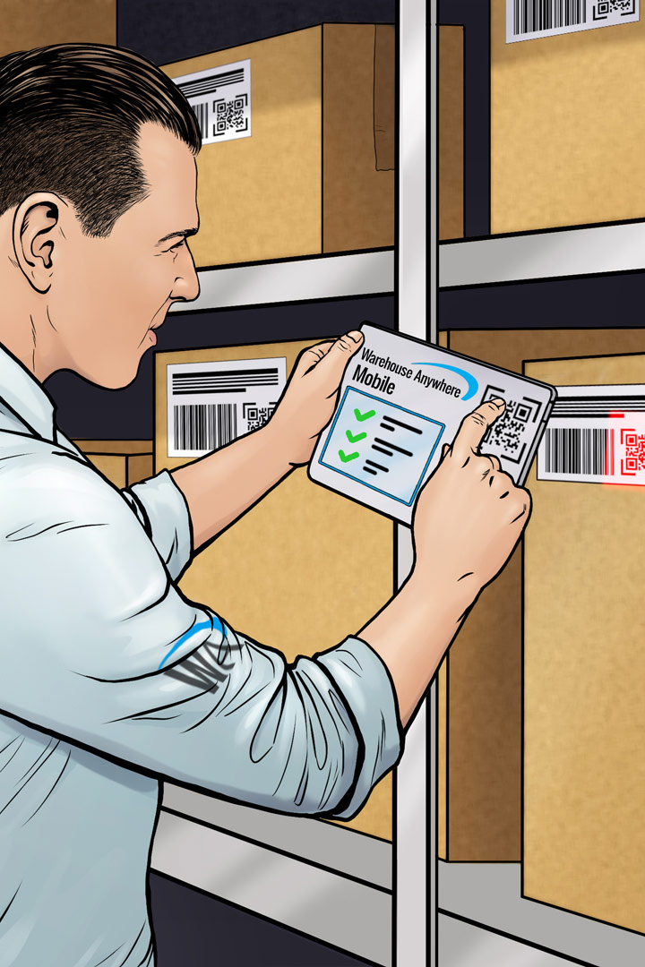
TIt
TITLE:
Inventory Management System
An overview of the Java project for managing inventory in electrical stores. To demonstrate the benefits and functionalities of the system.

Slide 4
Abstract
The Inventory management system is a GUI-based Java application for managing a product inventory using JDBC database connectivity. It is designed to help businesses efficiently manage their product inventory. This system provides a set of essential features and allows the users to view, add and update product details stored in MYSQL database. And it maintains a list of products with details including product ID, name, quantity and cost. It provides a user-friendly interface for interacting with the inventory and ensures data integrity.

Slide 5
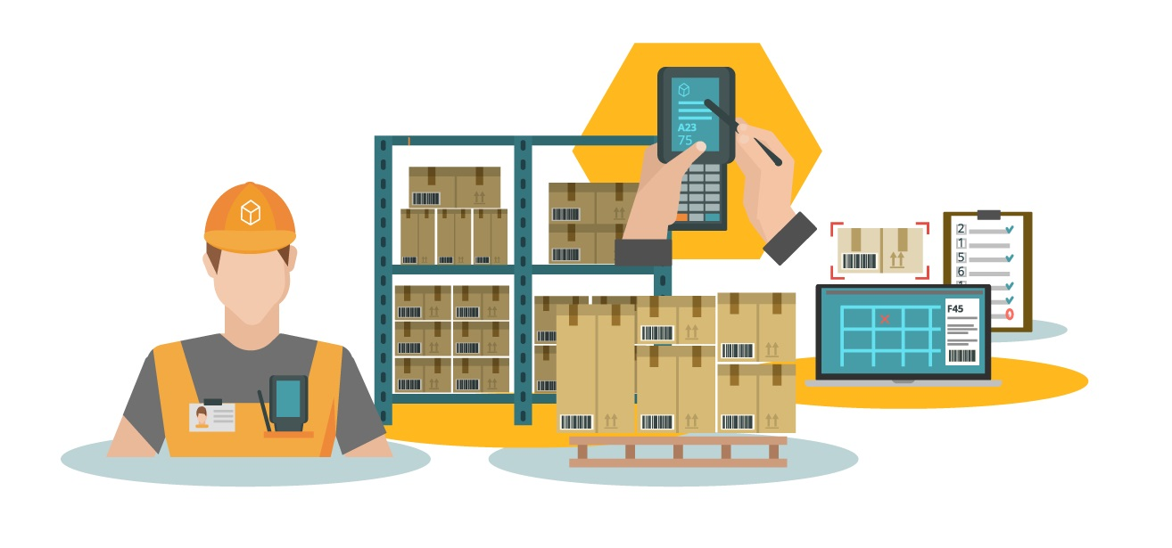
Introduction to Inventory Management System
We discovered the importance of Inventory management systems in electrical stores and how they streamline processes and optimize productivity. The Inventory management system offers a graphical user interface (GUI) to manage a product inventory using JDBC database connectivity. It allows users to perform various inventory management tasks, including listing all products, adding new products and viewing product details.

Slide 6
Project Requirements
Functionality
User Interface
Identify the essential features and functionalities required for an effective inventory management system.
Create an intuitive and user-friendly interface to ensure a seamless experience for store employees.
Data Management
Reporting
Develop a robust data management system to track inventory, purchases, and sales accurately.
Implement a reporting module to generate insights and analytics for informed decision-making.

Slide 7

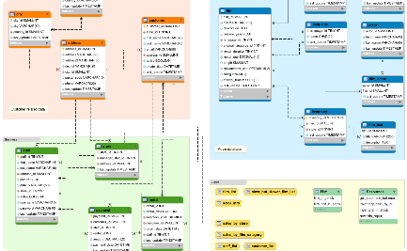
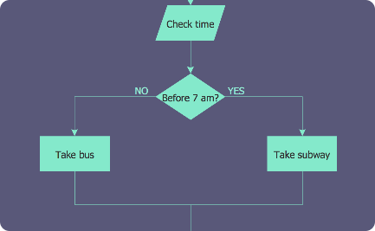
Design and Architecture
Object-Oriented Design
Relational Database
Flowchart and Diagrams
Utilize object-oriented principles to create a modular and extensible architecture for the inventory management system.
Design a robust and scalable database schema to store and retrieve inventory data efficiently.
Create visual representations to illustrate the flow of data and system processes.

Slide 8
IMPLEMENTATION: Technologies used
GUI Interface: The GUI (Graphical User Interface) in the provided java code for the Inventory Management System is built using Java’s Swing framework. Swing is a set of components and libraries that allow developers to create interactive and visually appealing graphical interfaces in Java applications. It is used to create the graphical user interface for the Java application to manage product inventory.
Various Swing components like JFrame , JPanel , JLabel , Jtextfield , JTextArea , JScrollPane, and JButton atre used to create the user interface for the Inventory Management System. These components are used to design the various input fields,buttons and textareas that enable user to interact with the system.
Java AWT: Java AWT(Abstract Window Toolkit) is another GUI library used for creating graphical components and handling events.
The Java ActionListener is notified against ActionEvent whenever you click on the button. The ActionListener interface is found in java.awt.event.package. It has only one method:actionPerformed().
Image Handling: The code uses Java’s Image Handling capabilities to display images on the GUI, such as icons and background images.
JDBC (Java Database Connectivity): JDBC is used for database connectivity in java applications. In this code , it is used to connect to a MYSQL database to store and retrieve data related to Inventory Management System.
MYSQL is a relational database management system, and it is used to store data related to product inventory,such as product quality , cost and other related information.

Slide 9
Software Requirements: Java Development Kit(JDK): You need to have a Java Development Kit(JDK) installed on your system. The code appears to be written in Java, so you’ll need the JDK to compile and run Java programs. You can download the JDK from the official Oracle website or use an open-source JDK distribution like OpenJDK. MySQL Database: The code assumes that you have a MySQL database setup to store inventory data. You need to have MySQL installed and running on your system, and you should have a database named “project”(as mentioned in the code). Make sure you have the necessary credentials(username and password) to connect to the MySQL database. JDBC Driver: You need the MySQL JDBC driver to connect to the MySQL database. The code relies on the JDBC driver to establish a connection and execute SQL queries. You should include the MySQL JDBC driver JAR file in your project’s class path. IDE or Text Editor: To work with the code, you can use an Integrated Development Environment(IDE) like Eclipse, IntelliJ IDEA, or Netbeans, or you can use a simple text editor to write and compile the Java code.
Specifications:

Slide 10
Hardware Requirements:
Computer or Device: You’ll need a computer or a compatible device with sufficient processing power to run the Java program and the MySQL database. The hardware requirements depend on the complexity of your database and the number of products in your inventory.
Memory(RAM): The memory requirements depend on the size of the database and the number of concurrent users. In general, more memory can improve the performance of the database operations.
Storage Space: you’ll need storage space for the MySQL database, including the data files and log files. The space required depends on the amount of data stored in the database.
Network Connection: If my SQL database is running on a remote server, you’ll need a network connection to access the database. Ensure that your network connection is reliable.
Input and Output Devices: You’ll need input devices such as a keyboard, mouse and output devices such as monitor or screen to interact with the program through the GUI.
Operating System: The code cab run on the different operating systems including windows, macOS and various Linux distributions as long as you have the required software components (Java, MySQL) installed for your specific OS.

Slide 11
Code Overview:
Main Class: Inventory Management GUI
->The core of the application is the Inventory Management GUI class, which extends JFrame.
->It manages the GUI, database connection and inventory operations.
Graphical User Interface(GUI):
->The GUI uses Java Swing components for user interaction.
->Buttons and text fields allow users to perform inventory – related tasks.
->A scrollable text area displays product details.
Database Connection:
->The application connects to a MySQL database using JDBC.
->Database connection details , such as the URL, username and password are defined in the code.
Event Handling:
->Event listeners respond to user actions, with each button associated with specific operations.
->Users can list products , add products, update quantities, update costs, view product details and delete products.
Inventory Operations:
Supported inventory operations include:
->Listing all products
->Adding a product
->Viewing product details
->Updating quantity
->Updating cost
->Deleting a product.
Security considerations:
->The code emphasizes the importance of database security.
->It encourages the use of parameterized queries or prepared statements to prevent SQL injection.
Code Structure:
->The code follows a standard Java application structure using classes like Jframe, Jbutton and JTextArea to create GUI components.
Limitations and Future Improvements:
->The code may have limitations such as the absence of user authentication.
->Future enhancements could include user accounts, transaction history and reporting features.

Slide 12
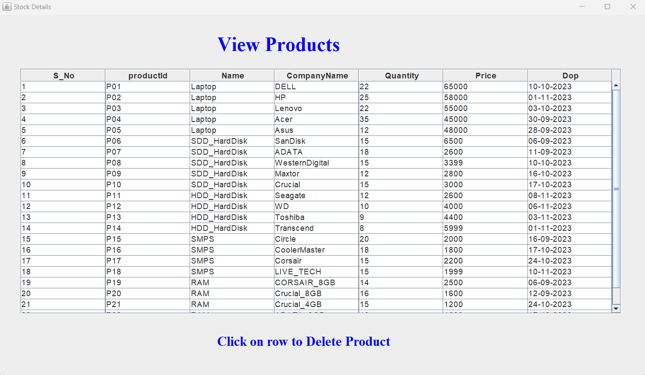
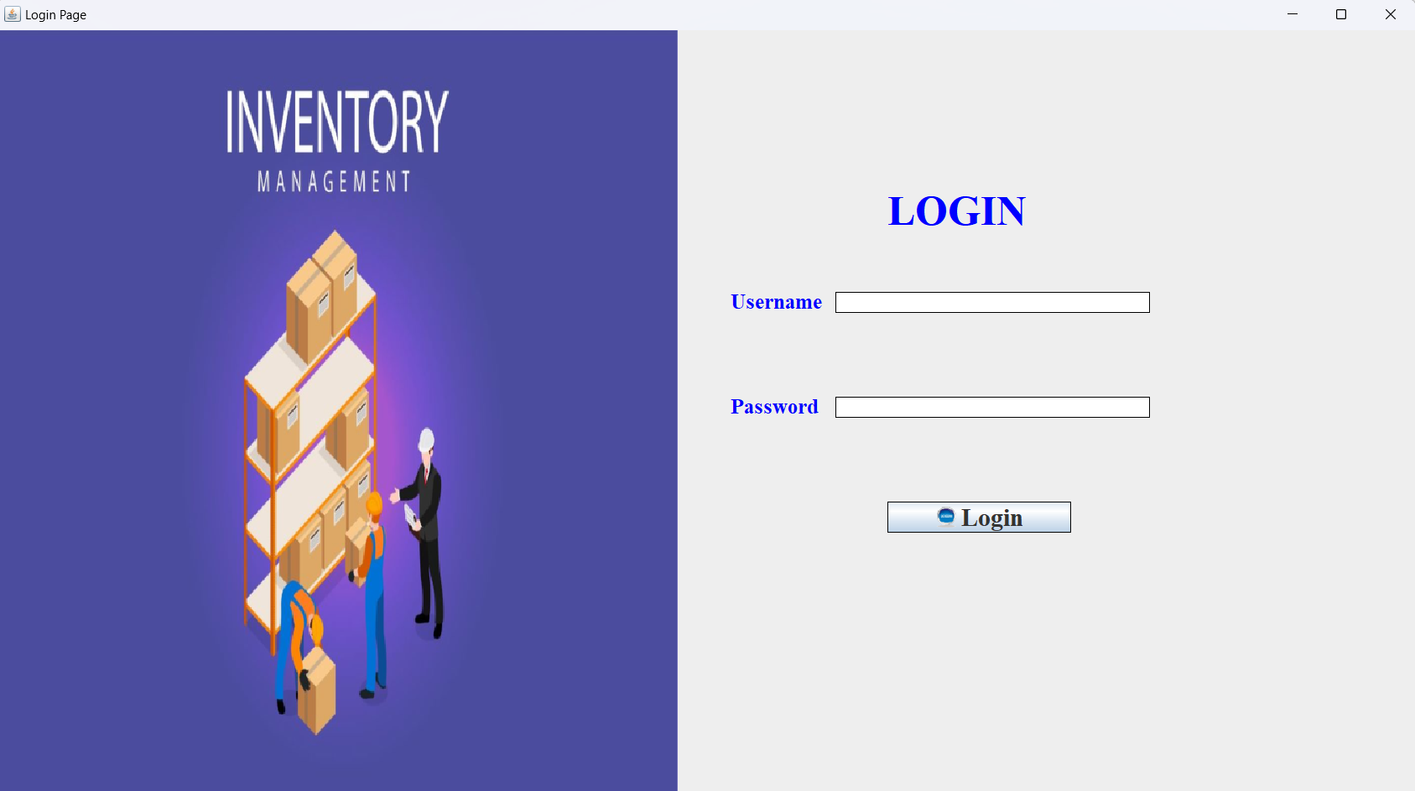
Output:

Slide 13
Conclusion:
The development of our Inventory Management System driven by Java and JDBC has been enlightening and fulfilling journey. Throughout this project, we’ve acquired valuable insights into software development, database management and effective project coordination. We’ve successfully incorporated essential features, including product listing, addition, updates and deletion, providing a comprehensive solution for inventory management. The user-friendly GUI design has garnered positive user feedback.
While we encountered challenges, particularly in terms of security and error handling, our collaborative spirit and problem-solving approach led to effective resolutions.
Looking ahead, we are committed to refining the system by implementing future enhancements and performance optimizations. We will ensure seamless system deployment and maintenance, while also gathering user feedback to enhance the overall user experience. The Inventory Management System stands as a testament to our dedication to improving inventory control and operational efficiency for business.

Slide 14
THANK YOU!

