Slide 1
DATA ANALYTICS PROJECT REPORT
Student Placement Analytics
A data-driven analysis of placement outcomes across 100,000 students
SQL • Python (Pandas, Seaborn) • Power BI
August 2026 | Prepared by [Your Name]

Slide 2
OVERVIEW
What We'll Cover
01
Problem Statement
04
Critical Data Issue
Why this analysis, and what it needed to answer
A target-leakage bug found and corrected
02
Data & Methodology
05
Recommendations
SQL, Python, and Power BI pipeline
Six evidence-based actions
03
Key Findings
06
Conclusion
What actually drives placement — and what doesn't
What this means for placement strategy
Student Placement Analytics
2

Slide 3
01 — PROBLEM STATEMENT
Where Should Limited Placement Resources Go?
Placement cells operate with limited coaching time, mock-interview slots, and skill-building budget. Deciding where to focus that capacity requires knowing which student attributes actually move placement outcomes — rather than relying on assumption.
This analysis answers four questions
1
What is the overall placement rate, and how does it vary by branch, tier, and gender?
2
Which factors show a real relationship with placement — and which commonly-assumed ones don't?
3
What does a genuinely strong candidate profile look like?
2
Is this data suitable for a future prediction model, and under what conditions?
Student Placement Analytics
3

Slide 4
02 — DATA & METHODOLOGY
Dataset at a Glance
100,000
26
0
54.46%
Student records
Raw features
Missing values
Overall placement rate
One row per student across demographics, academics, practical experience, assessed skills, lifestyle habits, and placement outcome. The raw file arrived with zero missing values and zero duplicate rows — verified, not assumed.
Class balance: 54,459 Placed (54.46%) vs. 45,541 Not Placed (45.54%) — close to even, well-suited to standard classification metrics.
Student Placement Analytics
2

Slide 5
02 — DATA & METHODOLOGY
A Five-Stage Analytics Pipeline
1
→
2
→
3
→
4
→
5
Data Quality Audit
Data Cleaning
SQL Analysis
EDA & Visualization
BI Dashboard
Python — nulls, duplicates, dtypes, distributions
Python — standardize, dedupe, derive placement_flag
MySQL — 44 business-question queries
Python / Seaborn — 6 charts, saved programmatically
Power BI — 2-page dashboard
QA identified the Power BI page-count documentation mismatch and an EDA compatibility issue; both are documented or corrected in the final package.
Student Placement Analytics
5

Slide 6
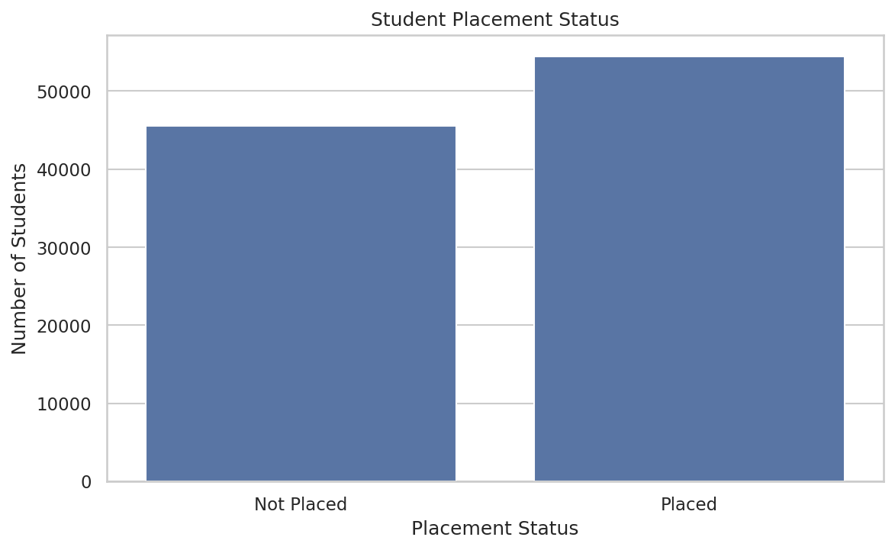
03 — KEY FINDINGS
Placement Outcomes, Overall
54.46%
45.54%
Placed
Not Placed
54,459 students were placed and 45,541 were not — a close-to-balanced split that supports standard classification metrics like accuracy for any future model built on this data.
Figure 1. Placement status distribution, Python / Seaborn (n = 100,000).
Student Placement Analytics
6

Slide 7
03 — KEY FINDINGS
What Doesn't Move the Needle
CGPA
Attendance
Branch
College Tier
Gender
53.3% → 55.8%
84.66% vs 84.82%
54.08% – 55.17%
54.28% – 54.72%
54.38% vs 54.51%
across CGPA bands (r = 0.012)
placed vs. not placed — flat
1.09-point spread, 6 branches
0.44-point spread, 3 tiers
0.13-point spread
These are the five variables most commonly assumed to drive placement — none show a meaningful gap in this dataset. Treating any of them as a primary lever would misallocate coaching effort.
Student Placement Analytics
7

Slide 8
03 — KEY FINDINGS
What Actually Drives Placement
Ranked, non-leaked correlations with placement_flag (Pearson r). No single legitimate feature exceeds |r| = 0.08 — effects are real but individually modest.
Student Placement Analytics
8

Slide 9
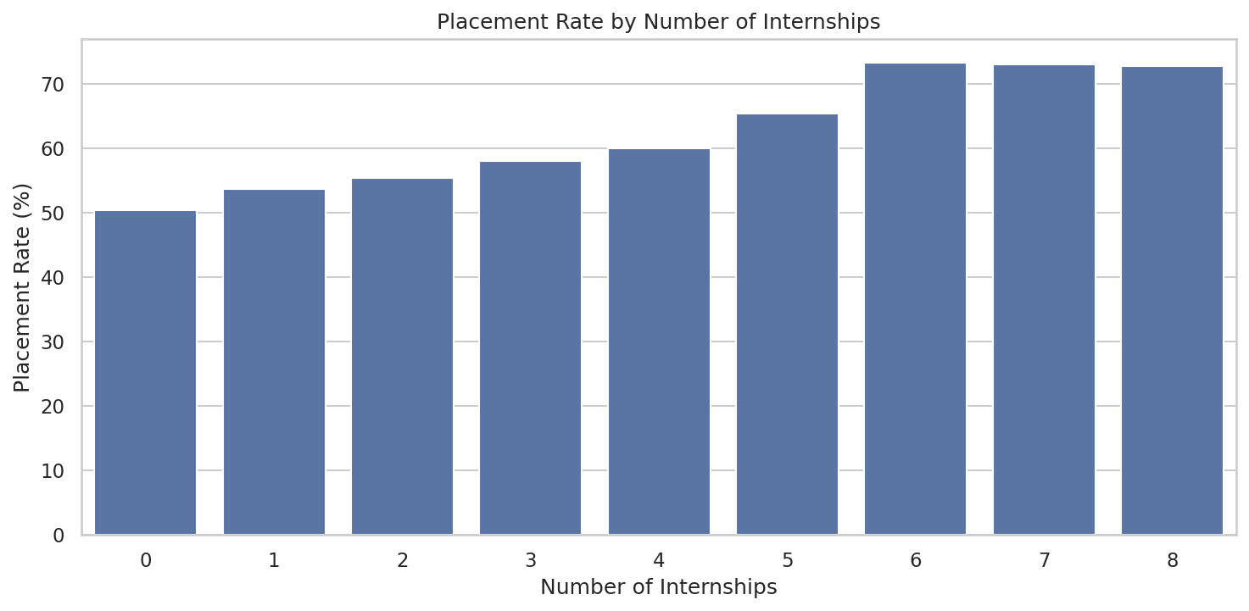
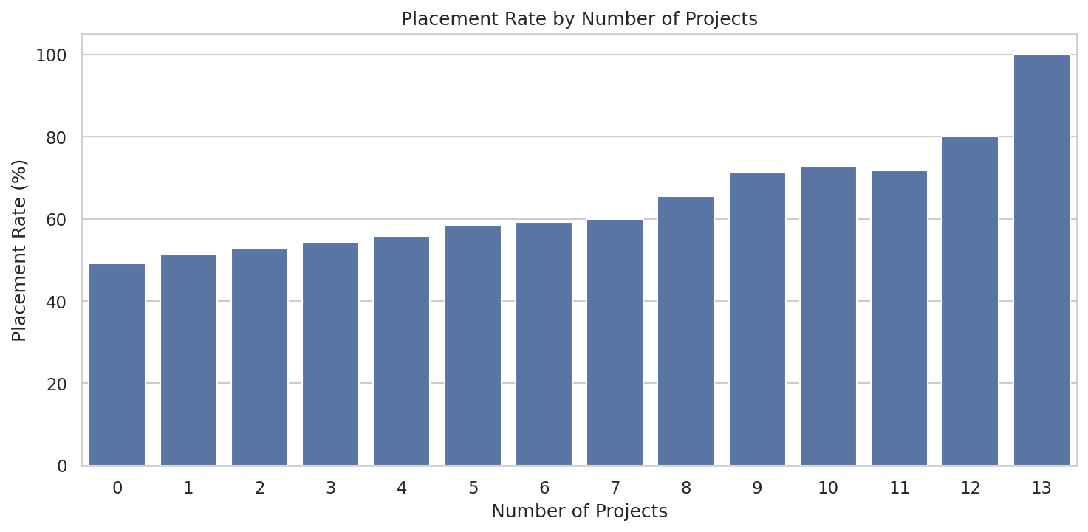
03 — KEY FINDINGS
Internships & Projects: The Clearest Levers
Figure 4. Placement rate by internships.
Figure 5. Placement rate by projects.
Any internship vs. none: +5.3 points (55.6% vs. 50.3%). 0–2 projects vs. 9+: 51.8% → 71.8% — the largest step-up of any non-leaked factor.
Student Placement Analytics
9

Slide 10
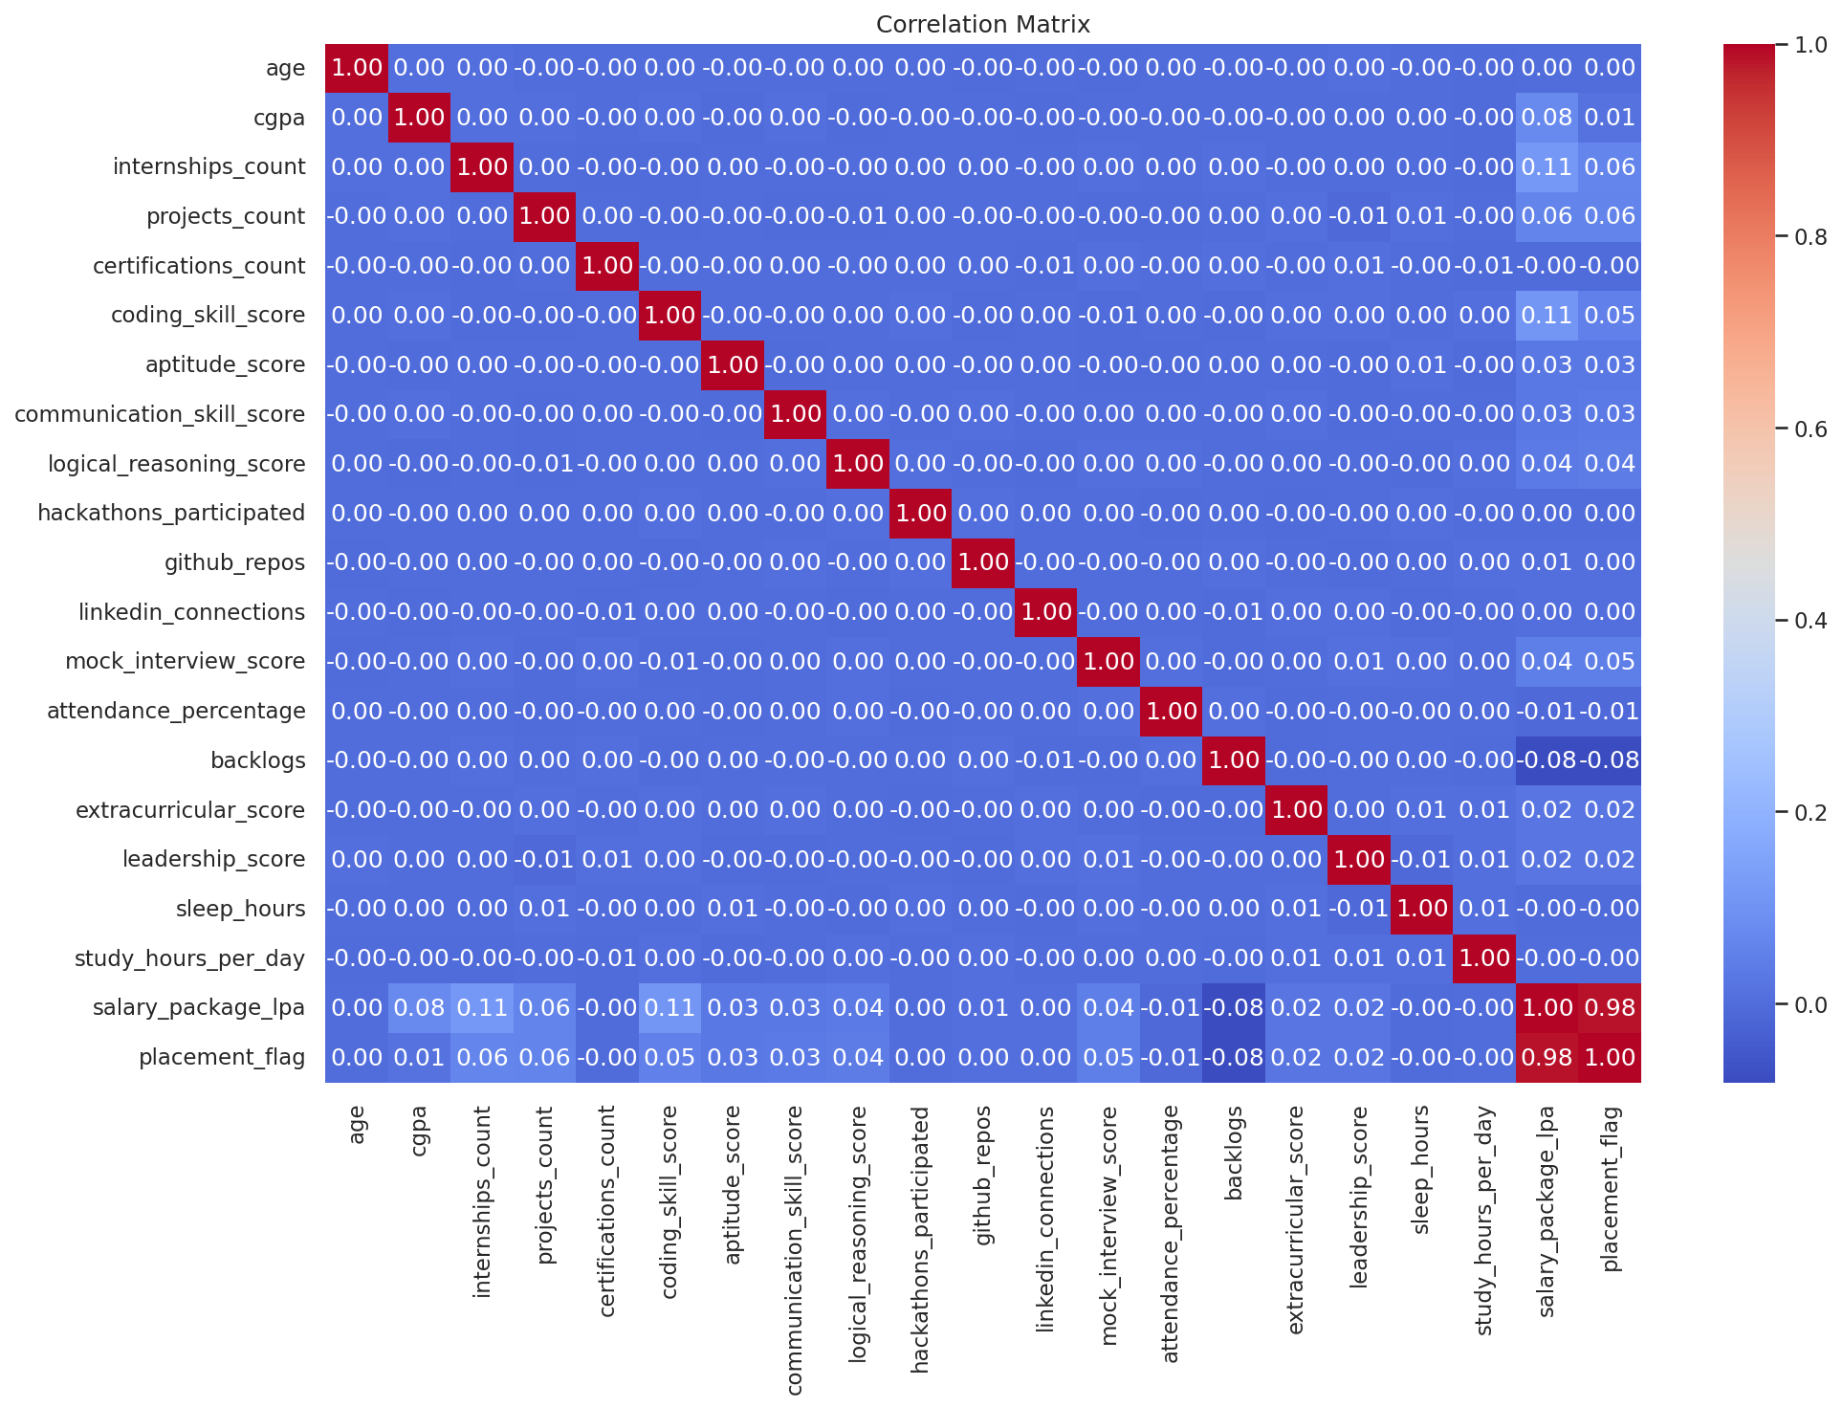
03 — KEY FINDINGS
The Full Picture: Correlation Matrix
Figure 6. Full correlation matrix, all numeric fields, Python / Seaborn (student_id excluded).
Student Placement Analytics
10

Slide 11
04
The proof, row by row
CRITICAL
DATA FINDING
Placement Status | Students | Salary = 0 | Salary > 0
Not Placed | 45,541 | 45,541 (100%) | 0 (0%)
Placed | 54,459 | 0 (0%) | 54,459 (100%)
Target Leakage
Salary is 0 for every single non-placed student and strictly positive for every single placed student. It is a deterministic proxy for the outcome — only knowable after placement happens — not an independent feature.
salary_package_lpa correlates r = 0.98 with placement_flag — implausibly high for a genuine predictor.
Why this matters for modeling
A model trained with salary_package_lpa as an input will appear to predict placement near-perfectly — but it's reading the answer off a column that only exists because placement already happened. It must be excluded from any predictive model's feature set. It remains valid as a downstream outcome metric (e.g., salary analysis for students already placed).
Found in EDA (Python) · Proven in SQL query 44
Student Placement Analytics
11

Slide 12
03 — KEY FINDINGS
Readiness Is Cumulative, Not Single-Factor
The strongest defined profile lifts placement rate by +5.7 points over baseline. The broader pattern is cumulative: technical, academic and experience signals are more useful together than as a single magic lever.
Student Placement Analytics
12

Slide 13
05 — RECOMMENDATIONS
Six Evidence-Based Actions (1 of 2)
1
Track backlogs, not CGPA, as the early-warning signal
Backlogs is the strongest real driver (r = -0.082): 57.2% (0 backlogs) down to under 35% (4+). CGPA shows almost no relationship (r = 0.012).
2
Expand internship access for the zero-internship group
Any internship vs. none is a 5.3-point placement gap (55.6% vs. 50.3%) — prioritize the ~22% of students with none.
3
Make project-based learning core, not optional
Project count shows the largest step-up of any non-leaked factor: 51.8% (0-2 projects) to 71.8% (9+ projects).
Student Placement Analytics
13

Slide 14
05 — RECOMMENDATIONS
Six Evidence-Based Actions (2 of 2)
2
Run mock interviews repeatedly, not once
Mock-interview score shows an approximately 8-point placement-rate spread between the lowest and highest practical bands. It is a useful, coachable signal, although not one of the top Pearson correlations.
5
Build technical and communication skills in parallel
Placed students score modestly higher on coding (70.5 vs 69.0), aptitude, and communication — small gaps that compound together.
6
Prepare holistically — no single factor is a magic lever
The strongest lift in the dataset (+5.7 pts) comes from combining strong technical, academic, and experiential factors together.
Student Placement Analytics
14

Slide 15
LIMITATIONS
Read the Findings With These Caveats
Dataset characteristics (uniformly weak correlations, unusually precise decimal scores) suggest synthetic/generated data — treat findings as a methodology demonstration, not a real-world claim.
No predictive model has been trained yet. Scope covers EDA, SQL analysis, and BI dashboarding only.
Given max |r| ≈ 0.08 on legitimate features, an honest classifier would likely land only modestly above the 54.5% majority-class baseline — that should be the expected, reported result.
No automated tests accompany the Python scripts — reasonable at this scope, but stated rather than implied otherwise.
Student Placement Analytics
15

Slide 16
06 — CONCLUSION
Evidence Over Assumption
CGPA, attendance, branch, and gender show little to no relationship with placement — while backlogs, internships, projects, and mock-interview readiness show real, actionable effects that compound when addressed together. A target-leakage issue and a documentation mismatch were identified during QA. The final package documents the limitations clearly so the dashboard can be presented accurately.
44
6
22
2
SQL queries
EDA visualizations
DAX measures
Dashboard pages
Thank you — Questions & discussion welcome

