Slide 1
MINOR PROJECT PRESENTATION ON Feature extraction using NLP
PRESENTED BY:
Rishi illuri
Chaitanya rangu
B siva rama krishna
Akhil poreddy

Slide 2
CONTENTS
INTRODUCTION
TOOLS USED
DATA SET FORMAT
METHODOLOGY
ARCHIITECTURE
HAC
MOS
BAR REPRESENTATION
RESULT ANALYSIS
CONCLUSION

Slide 3
INTRODUCTION
The project aims to make use of the highly unstructured text reviews about any product, extract the potential features about the product, assign scores to them and then classify the reviews as either positive or negative.
The features of the product play a crucial role in the decision making process of the potential customer. It is these features that distinguish one product from other similar products from different brands. Most of the companies focus on a specific feature as their selling point.

Slide 4
TOOLS USED
ANACONDA
NUMPY
NLTK
TEXTBLOB
PYTHON 3.7.0
Intel Core i5-7200u CPU @2.50GHz 2.70GHz
8.00GB RAM
64bit operating system, x64-based processor

Slide 5
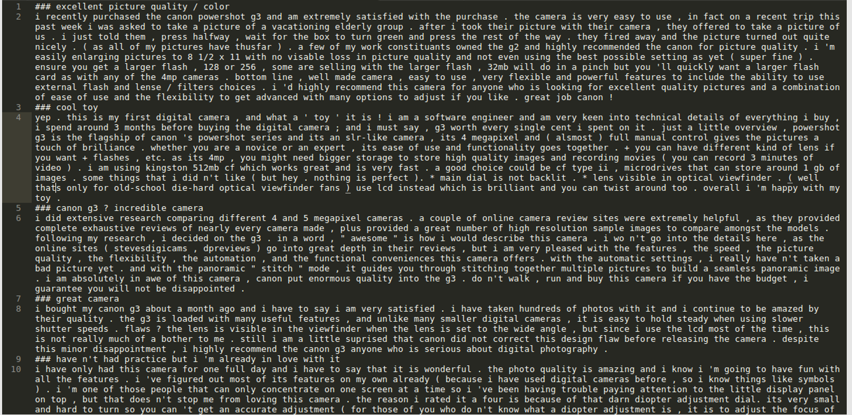
DATA SET FORMAT
The following dataset was taken from amazon.com reviews

Slide 6
METHODOLOGY

Slide 7
procedure
Basically, two algorithms are used sequentially for our purpose:
The 1st algorithm ("HAC algorithm") identifies and extracts the potential features from the reviews of the product.
The 2nd algorithm ("MOS algorithm") takes these potential features as input, assigns scores to them and finally helps in classifying every review as either positive or negative.

Slide 8
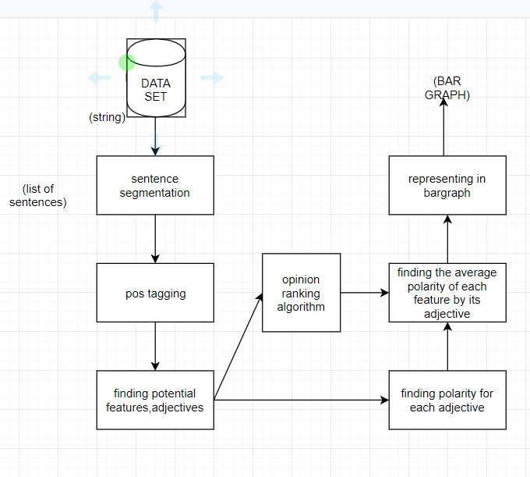
ARCHITECTURE

Slide 9
ASSUMPTION OF THE HAC ALGORITHM
The HAC algorithm extracts the good potential features only when the reviews in the dataset follows the assumption that:
Users comment on the features they care about using adjectives.
The more often a noun is in the vicinity of an adjective, the more likely it is to be a representative feature of the item reviewed.
Example:
If the review is
"This camera has very good image quality", then the adjective 'good' is more likely to describe the noun "image quality" than the noun "camera".

Slide 10
High Adjective Count Algorithm (HAC)
Instead of using frequency of keywords, the algorithm starts identifying adjectives and nouns in every review.
For every review, if each adjective is associated with a noun to which it is closest, this adjective is more likely to describe the noun.
If an adjective is found to be describing a noun, then the noun_score is incremented by 1. After processing all the reviews, we will have a score associated with each noun, which we call them as opinion scores.
So nouns with high score have more adjectives to describe them. Then we can have a threshold and nouns having score more than threshold are considered as potentialfeatures.
The adjectives are even extracted from this step

Slide 11
Max Opinion Score Algorithm
The MOS algorithm takes 3 arguments as inputs:
● The first argument is the list of adjectives which are used to express opinions (obtained from the 1st algorithm). These adjectives are given scores between [-4, +4] in such a way that a high score indicates a stronger opinion than lower score.
● Example:
• The adjective 'excellent' gets a higher positive opinion score than the adjective 'good'.

Slide 12
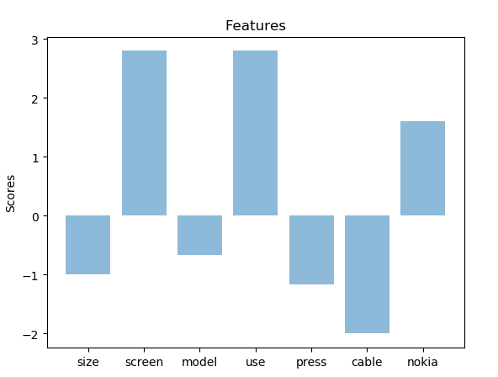
BAR GRAPH REPRESENTATION
The output from the MOS was represented in the bar graph representation

Slide 13
RESULT ANALYSIS

Slide 14
AT LAST THE SCORE WAS REPRESENTED IN BAR GRAPHS
The final result displayed was about the feature and its score.it was displayed in the range of -4 to 4. The normal of feature score was as below diagram
And the bar-graph was the final pictorial representation of the total score which can be negative also.

Slide 15
CONCLUSION
In this work, we have presented a method to extract product features from customer product reviews..
The objective is to provide a feature based opinion of a large number of customer reviews of a particular product..
The problem, analysis of customer product reviews, will become increasingly important as more people are buying and expressing their opinions on the Web.
Analyzing the opinions of reviews is not only useful to common shoppers, but also crucial to product manufacturers.

Slide 16
THANK YOU

